Slide 1
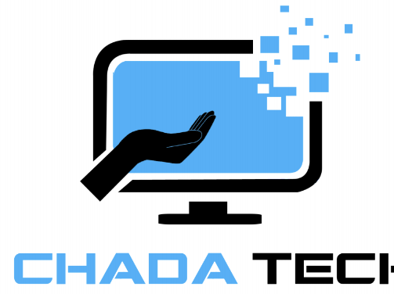
Agile Software Development
By Jermaine Wiggins

Slide 2
Contents
What is Agile
Agile Roles
SDLC
The Waterfall method
Agile vs Waterfall

Slide 3

What is the Agile Scrum Method?
The agile method is a specific framework that helps a team deliver products through incremental progress.
Strong focus on collaboration, flexibility and improvement.
Provides a structured but flexible framework for teams to collaborate and deliver work in incremental stages (sprints)
Key Roles
Product owner
Scrum master
Developer and tester

Slide 4
Agile Roles
Product Owner : Ensure product delivers max value
Defines and communicates product end goals
Prioritizes product backlog based on customer needs
Works closely with team to clarify requirements to ensure product aligns with customer expectations
Key decision maker and in way represents the stakeholders
Scrum Master : Helps team stay on track and removes obstacles
Ensures the Agile framework is followed
Facilitate scrum events ( daily standups, sprint planning, reviews and retrospective)
Help foster a collaborative environment, remove distractions and blockers
Coach team on the Agile principles
Developer and Tester : Build the product incrementally
Plan and estimate task during sprints
Build and deliver working increments of the product after each sprint
Test and ensure each increment meets requirements

Slide 5
Software Development Life Cycle
Planning : Define product vision and goals
Agile: Establish clear direction of the the project, what’s being built and why it matters
Design : Creates detailed design of the product
Agile: Helps avoid potential costly changes, and design only what’s necessary
Develop : Coding and building the product
Agile: Built and refined in increments (sprints, encourages collaboration for quick and innovative problem solving
Test : Continuous testing during the development phase
Agile: Early testing to catch errors as they occur or as soon as possible
Release : At the end of a sprint the team releases an increment product to stakeholders, eventually to public
Agile: Regular releases allow for constant feedback, ensure the product aligns with customer needs
Maintenance : Ongoing support to enhance the product through user feedback
Agile: Continuously adapt product to meeting user needs to ensure long term quality

Slide 6
The Waterfall method A more linear approach to the SDLC, each phase is completed before moving to the next
Planning : Once initial requires gathered, thus step would have to be revisited causing delays
Design : Once requirements are finalized, could require significant effort to to change
Development : Begins after Design phase, if new features are to be added late in this phase this could lead to major delays because may have to be entirely rewritten.
Testing : Happens after development phase, any errors found must return to previous stages to correct, possibly delaying project
Release : After testing complete product is released to public, stakeholders won’t see until this phase
Maintenance: Stakeholder feedback collected in this phase, very likely that product doesn’t meet customer expectations, resulting in possible additional testing and development cycles to meet expectations

Slide 7
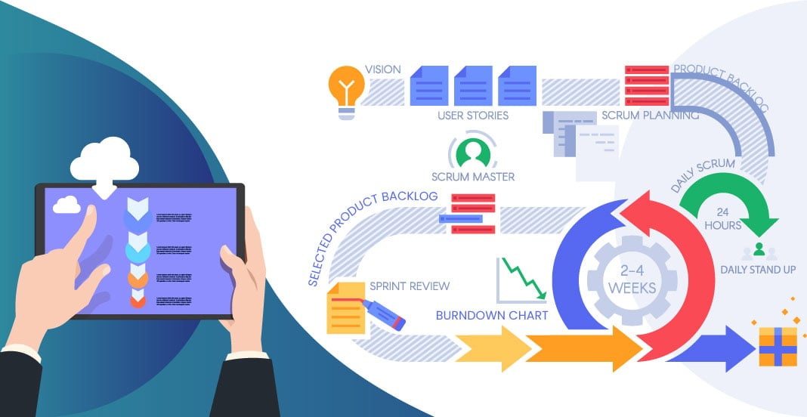
Agile vs Waterfall
When Agile is beneficial
Requirements are evolving or unknown
Complex projects
Able to deliver working increments faster
Collaboration with stakeholders required
Flexibility to adapt to change faster
When Waterfall is beneficial
Requirements are clear and fixed
Fixed scope and budget
Little to no stakeholder feedback
Notes:
To implement the waterfall method on the SNHU travel project would have been more difficult because there was a few last minute changes that needed to be implemented that was done effortlessly with the agile approach. If the waterfall method was used we would have to do a significant amount of recoding depending on how far we were into the project at the time.

Slide 8
Works cited
Cobb, C. G. (2015b). The Project Manager’s Guide to Mastering Agile: Principles and practices for an adaptive approach. John Wiley & Sons.
Kneafsey, S. (2023, March 31). Agile principles - effective communication. Scrum.org. https://www.scrum.org/resources/blog/agile-principles-effective-communication
Atlassian. (n.d.-a). How to be an awesome agile developer. https://www.atlassian.com/agile/software-development/developer
Mehta, N. (n.d.). Agile Development Team: Role of Development Team in agile. Techtic Solutions. https://www.techtic.com/blog/agile-development-team/

