Slide 1

DriverPass System Analysis
[Jermaine Wiggins]
Notes:
For this presentation we will paint a clear picture of what DriverPass can do and how it will meet your specific needs. Special consideration went into every step from our first interview up until now (this presentation).

Slide 2

System Requirements
Functional Requirements
The system shall allow admin to modify/block users
The system shall validate users at login
Non-Functional Requirements
System updated when DMV is
Web based accessible on PC and mobile
Notes:
DriverPass is a web-based application that helps people prepare for their state driving exam. It can be accessed from home on a PC or on the go using a mobile device, providing flexibility and convenience for users. To ensure that all the information is accurate and up to date, DriverPass is linked to the DMV, so any changes to driving rules or policies will automatically be reflected in the training materials.
Since DriverPass stores sensitive information like driver’s licenses and addresses, security is a top priority. Users must log in with a valid account to access the system, and if someone tries to access an account without permission, the system will block them to protect user data. However, if a user is locked out by mistake, they can easily regain access through the account owner. This ensures that DriverPass remains secure, reliable, and always aligned with current driving regulations to help users succeed on their exam.

Slide 3
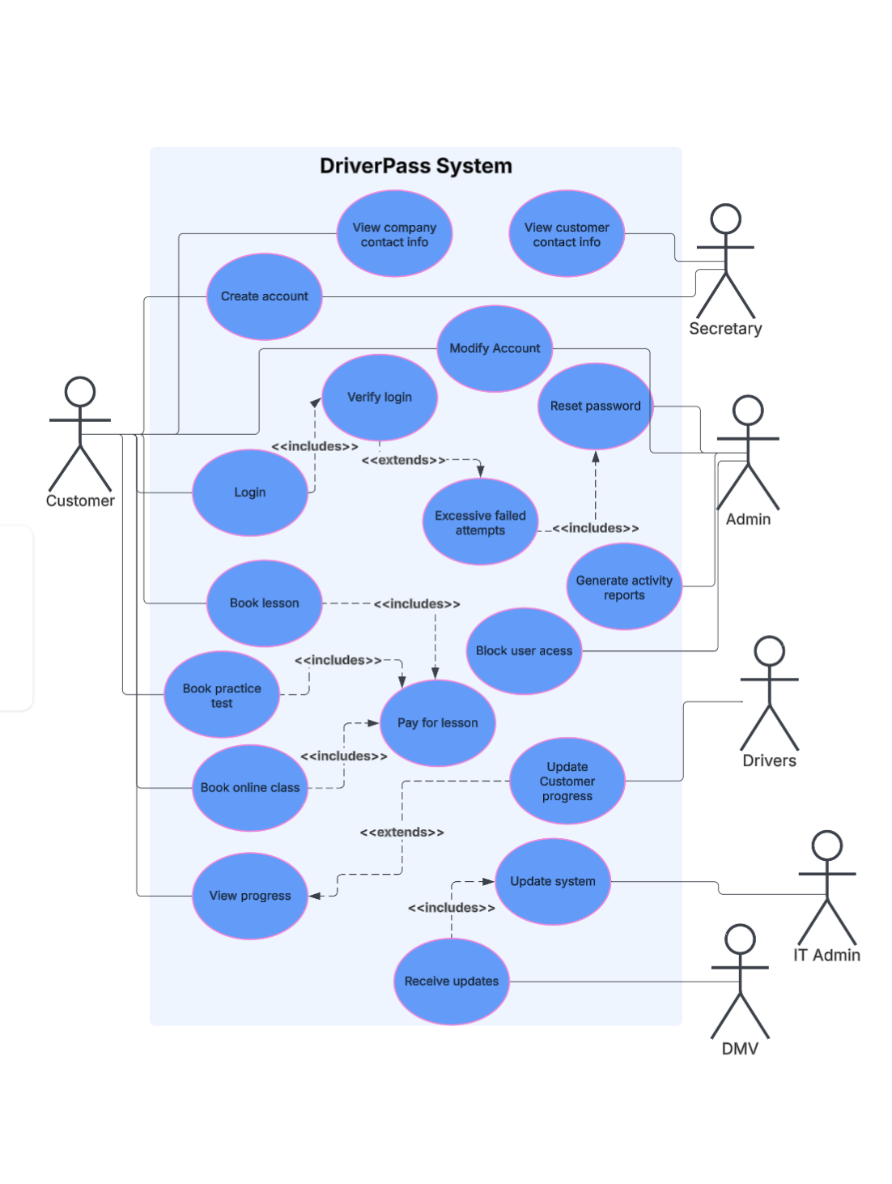
Use Case Diagram
Notes:
Now we will explain the ins and outs of DriverPass in more detail. As a customer, you can sign up for an account on your own, or if you prefer, you can call, and our secretary can create one for you. If you ever forget your password, you can reset it through your email or have the owner reset it for you. Additionally, to keep your account secure, if someone tries to break in, the admin can monitor activity in real-time or generate a log of all activity to detect any suspicious behavior.
Once your account is created, you can log in and browse all available packages. You have the option to book in-person driving lessons, sign up for an online class, or take online practice tests. After choosing a package, you can purchase it and start your training, track your progress, and view feedback from your instructor (driver).
To ensure that all the information is always accurate, DriverPass is synced with the DMV and receives regular updates from our IT officer. These updates run in the background during non-peak hours, so the system is never down and always available when you need it.

Slide 4
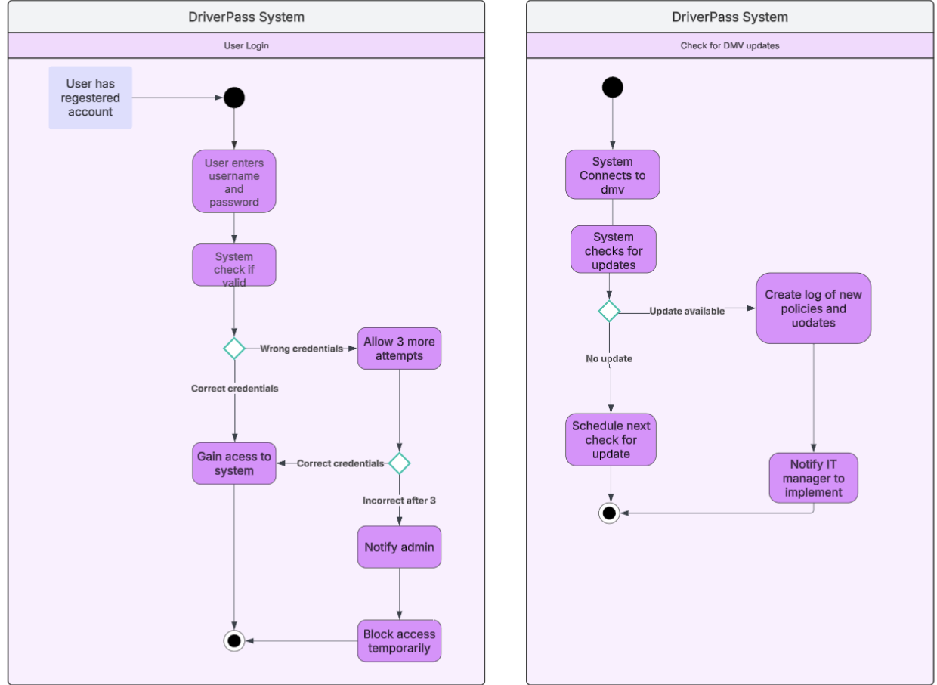
Activity Diagram
Notes:
Now let’s explain how user verification works. The only requirement is that the user has an account, which is pretty straightforward. First, you will navigate to the login page and enter your user ID and password.
If the credentials are correct, great—you now have access to DriverPass. However, if the login attempt is unsuccessful, don’t worry! You’ll have three more chances to enter the correct password because mistakes happen.
If you exceed three failed attempts, your account will be temporarily locked, and the owner will be notified immediately. Once the owner reviews the issue, they can reset your account and restore your access. This process ensures security while allowing a smooth way to regain access if needed.

Slide 5
Security
Unique user name/password login
Retrieve and store data with encryption
SSL/TLS to secure communication between client and server
Automatically locks out (brute force attempts)
Reset password through admin or email verification
Notes:
Security is a big factor when creating DriverPass because this application requires sensitive information from our users such as home address and license/permit information
Each user has a unique username and password to ensure only authorized individuals can access their accounts. To keep your data safe, all stored information is encrypted, making it unreadable to anyone who shouldn’t have access.
When you log in, your connection to the system is secure and private, so no one can steal your information while it’s being sent. To prevent hackers from forcing their way into an account, the system will automatically lock access if too many incorrect password attempts are made. If you ever forget your password, you can reset it easily through email verification or by contacting the owner for help.

Slide 6
System Limitations
Can disable packages but not add; future release
Speed of application will depend on available internet connection.
DriverPass only has 10 cars so booking an appointment is limited.
The types of vehicles available might not have variety to meet a range of customer needs.
Notes:
While we have created an application that meets your expectations, there are some limitations to consider. The good news is that some of these can be addressed in future updates.
Currently, the owner can enable or disable packages, but they cannot add new ones unless a programmer updates the web app. While all the requested packages have been implemented, any future additions will require a developer’s help.
Speed was also a key focus when designing DriverPass, but the customer’s internet connection will affect how fast the application runs.
Additionally, with only ten cars available, there may not always be a vehicle that matches everyone’s preference. While this isn’t a major issue now, as the business grows, it could lead to scheduling conflicts and lower customer satisfaction. Expanding the fleet in the future can help address this challenge

