Slide 1
Reversible Solid Oxide Cells
as a Mars Power Solution
Joshua Williams
EGEE 420 - Hydrogen & Fuel Cells
Dr. Yourey | March 14, 2026

Slide 2
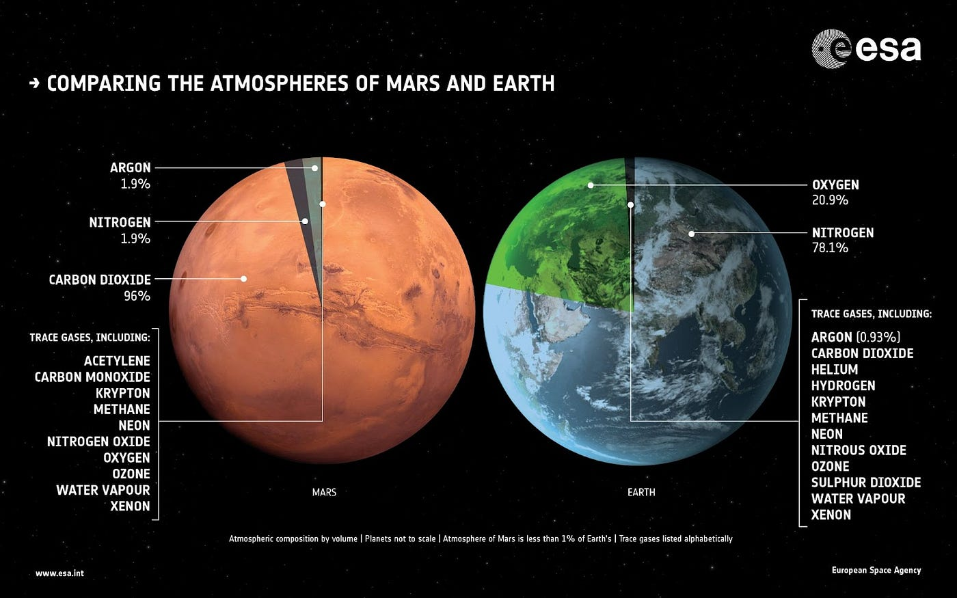
The Mars Challenge
95%
<1%
-60°C
Atmosphere
Surface Pressure
Avg Temperature
Carbon Dioxide
of Earth's
Extreme cold
Dust storms last weeks to months - solar generation drops up to 99%
NASA's Opportunity rover lost contact after the 2018 global dust storm
Every kg launched from Earth requires 12-13 kg placed in low Earth orbit
A crewed base of 4-6 needs 21-25 kW of continuous power
Insert image:
Mars surface /
atmosphere diagram
(Fig. 1)

Slide 3
Why Standard Fuel Cells Fail on Mars
PEM Fuel Cell - Problems
Batteries - The Math Fails
Requires pure hydrogen - scarce on Mars
Operates at ~80°C - too low for CO₂ processing
CO contamination rapidly degrades performance
Cannot use Martian atmosphere as a fuel source
Hundreds of metric tons needed for a month-long storm
Launching 1 kg to Mars = 12-13 kg to LEO first
Battery mass at that scale is mission-prohibitive
A systems-level solution using local resources is required

Slide 4
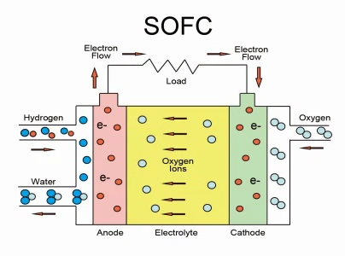
What is a Reversible Solid Oxide Fuel Cell?
600-900°C
YSZ
TWO MODES - ONE DEVICE
Fuel Cell Mode: fuel in - electricity out
Electrolysis Mode: power in - fuel + O₂ out
Operating
Temperature
Ceramic
Electrolyte
Runs on CO₂ and CO - perfect for the Martian atmosphere
No expensive platinum catalysts needed at high temperature
Can produce methane, oxygen, and water from a single device
Waste heat at 800°C offsets habitat heating - 81% total efficiency
Insert image:
SOFC diagram /
cross-section

Slide 5
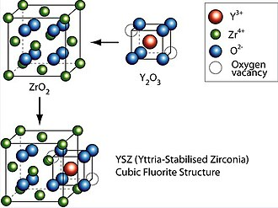
RSOFC Operating Principle
Electrolysis Mode (Day / Surplus)
Fuel Cell Mode (Night / Storm)
CO₂ fed in split at cathode into O²⁻ + CO
O²⁻ ions migrate through YSZ electrolyte
O₂ released at anode - stored for life support/propellant
Stored CO or CH₄ fed to anode
CO + O²⁻ → CO₂ + 2e⁻ (electricity released)
CH₄ + 4O²⁻ → CO₂ + 2H₂O + 8e⁻
YSZ Electrolyte: Yttria-stabilized zirconia heated to 600-900°C opens its crystal structure, creating oxygen vacancies that allow O²⁻ ions to migrate - enabling both power generation and fuel production.

Slide 6
The Reversibility Advantage
Same ceramic electrolyte, electrodes, and temperature - two completely different jobs
Eliminates the need to launch separate electrolyzer AND fuel cell systems
DOE testing: 11,900+ hours, 6,000+ mode switches equivalent to 15+ years of daily operation
Cycles 10.5 hrs electrolysis / 12.5 hrs fuel cell per day mirrors a solar-integrated Mars schedule
11,900+
Hours DOE tested
6,000+
Mode-switch cycles
Key insight: One device replaces two. On a mission where every kilogram to Mars costs 12-13 kg in LEO

Slide 7
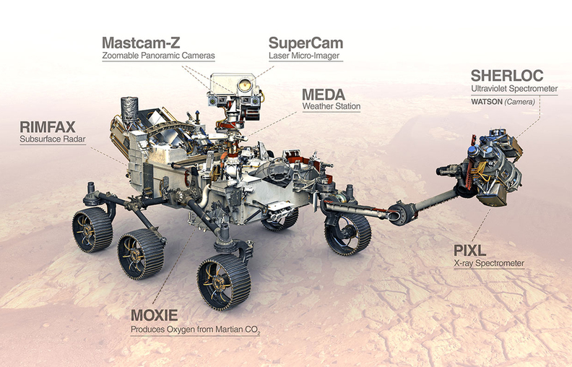
MOXIE: Proof of Concept on Mars
122g
16
98%
2×
Total oxygen produced
Successful runs
Oxygen purity
NASA's original target
How MOXIE worked:
Collected Martian air through HEPA filter → compressed → heated to 800°C → fed into SOXE assembly
CO₂ split at nickel-ceramic cathode into O²⁻ ions + CO
O²⁻ ions conducted through ScSZ electrolyte recombined as pure O₂ at the anode
Operated April 2021 - September 2023 aboard Perseverance

Slide 8
From MOXIE to "Big Atmospheric MOXIE" (BAM)
MOXIE (Prototype)
BAM (Scale-Up Goal)
~12 g O₂ per hour (peak)
Toaster-sized device
Degraded due to thermal cycling (rover power limits)
Proof of concept not a continuous operation
3 kg O₂ per hour 250× more than MOXIE
9,000+ kg system consuming ~27 kW
Continuous operation eliminates thermal cycling damage
31 tons O₂ needed for Mars Ascent Module propellant
Without ISRU: Bringing 31 tons of O₂ from Earth, launching 500 tons to LEO. BAM makes that unnecessary.

Slide 9
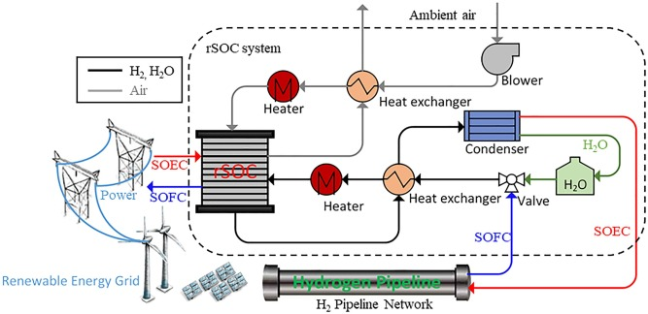
The Sabatier Reaction: Closing the Loop
CO₂ + 4H₂ → CH₄ + 2H₂O (at ~300°C with nickel catalyst)
Exothermic reaction - the heat produced can warm the Sabatier reactor inputs
Water produced can be electrolyzed back into H₂ + O₂ - partial closed loop
Hydrogen sourced from Martian water ice at the poles and mid-latitudes
Outputs CH₄ + O₂ - the exact methalox propellants SpaceX Raptor engines use
Goal: Land Starship empty. Manufacture propellant on Mars. Launch home without bringing fuel from Earth.

Slide 10
Power Management & System Efficiency
Solar Arrays
Kilopower Fission Reactor
Primary source on clear days
Drops up to 99% during dust storms
Uranium core weather-independent
NASA tested up to 10 kW
Crew of 6 needs only 0.2 kg O₂/hr to breathe a fraction of BAM's 3 kg/hr output
Surplus O₂ and CH₄ flow directly into propellant tanks
800°C waste heat captured heats habitat + preheats Sabatier inputs
81%
Total system efficiency
(with waste heat recovery)
Standalone SOFC electrical efficiency: 39-54% - With waste heat recovery: 81% - Every extra % matters when every watt must be generated locally.

Slide 11
Engineering Challenges
Thermal Insulation
Martian Dust
Keeping ceramics at 800°C in a -60°C environment requires advanced insulation systems
Fine, electrostatically charged dust requires filter systems that operate for years maintenance-free
Chromium Poisoning
Low Atmospheric Pressure
Chromium evaporation from metallic interconnects poisons cathode performance gradually over time
~600 Pa requires significant gas compression accounted for ~40% of MOXIE's power draw
80,000+ Hour Lifespan
Seal and Gas Leakage
Interconnects must survive full mission duration not yet demonstrated at mission scale
At 800°C, seals between ceramic and metal components are prone to failure, risking efficiency loss and dangerous fuel-air mixing

Slide 12
Conclusion
MOXIE proved it works: 16 runs, 122g O₂, 98% purity, 2× NASA's goal
Future development: 80,000+ hr ceramics, better interconnects, full fission integration
Environmental impact: Every kg produced on Mars = one less kg launched from Earth
No harmful byproducts: consumes CO₂, outputs exactly what humans need to survive
The RSOFC turns Mars' atmosphere from a threat into a supply chain.

Slide 13
Questions

Slide 14
References
1. Hoffman et al. (2022). Mars Oxygen ISRU Experiment (MOXIE). Science Advances, 8(35).
2. Hoffman et al. (2023). 18 months of MOXIE operations on Mars. Acta Astronautica, 210.
3. NASA Jet Propulsion Laboratory. (2023). NASA's oxygen-generating experiment MOXIE completes Mars mission.
4. Petri, R. (2012). Advanced materials for RSOFC dual-mode operation. DOE / Versa Power Systems.
5. Han et al. (2007). Fabrication and properties of a YSZ electrolyte for SOFCs. J. Power Sources, 165(2).
6. Sabbaghi et al. (2025). Economic viability of SOFC-integrated energy system with CO₂ capture. Int. J. Hydrogen Energy, 144.
7. Guan et al. (2006). High-performance flexible reversible SOFC. DOE Final Technical Report.
8. Reddy, M. J. (2023). Metallic materials for SOFCs. Doctoral thesis, Chalmers University.
9. NASA. (2023). Kilopower. NASA Space Technology Mission Directorate.

