Slide 1
Preprocessed Data
 | Eline | Jon | Hsin
Number of Runs | 8 | 15 | 15
Epochs Removed (timing errors) | 127 | 13 | 13
Mean Impedance values | N/A | 30, 38 | 60

Slide 2
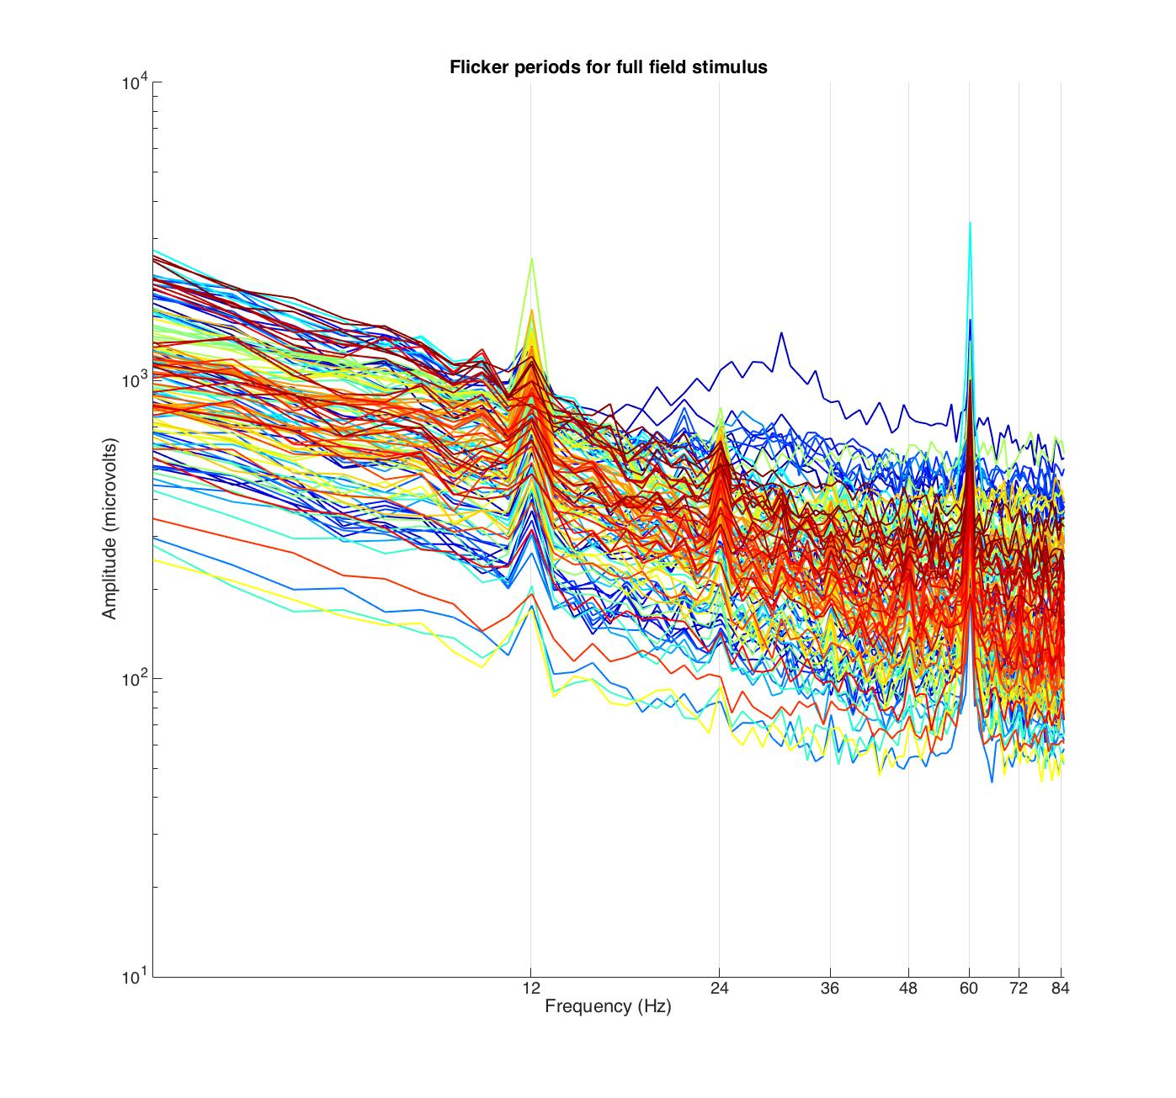
Subj-001 full field Spectra

Slide 3
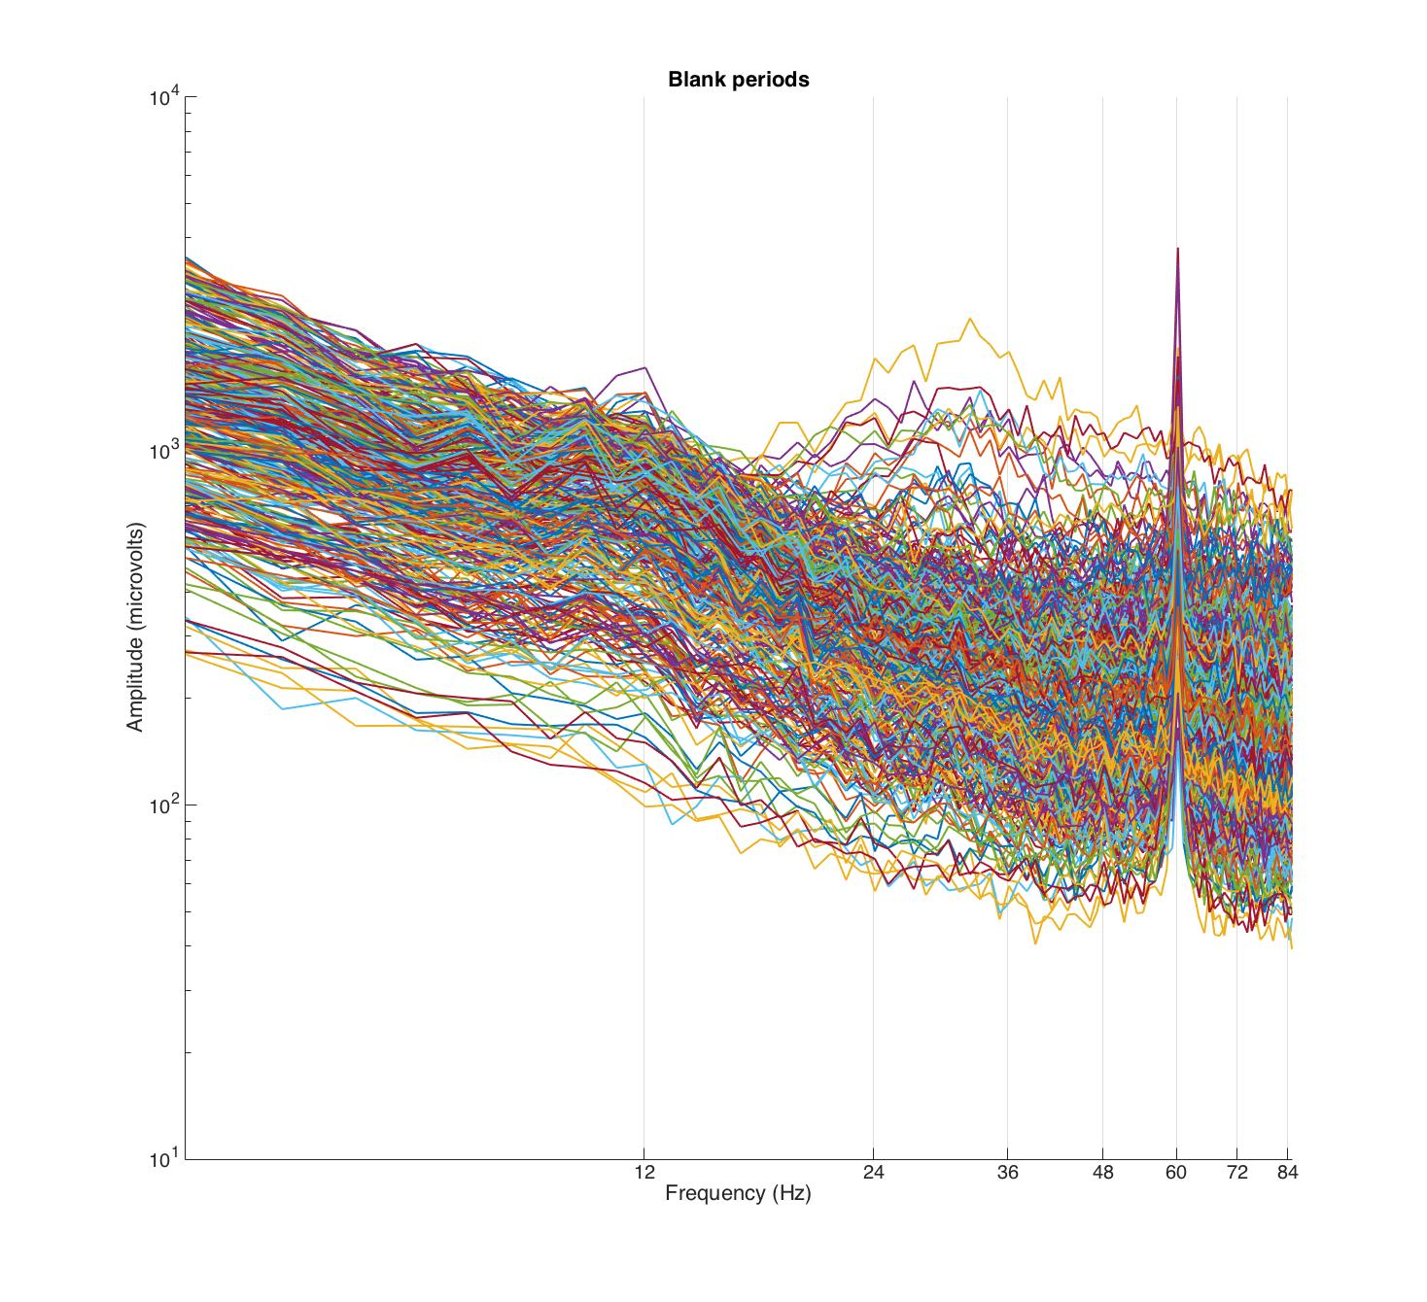
Subj-001 Blank spectra

Slide 4
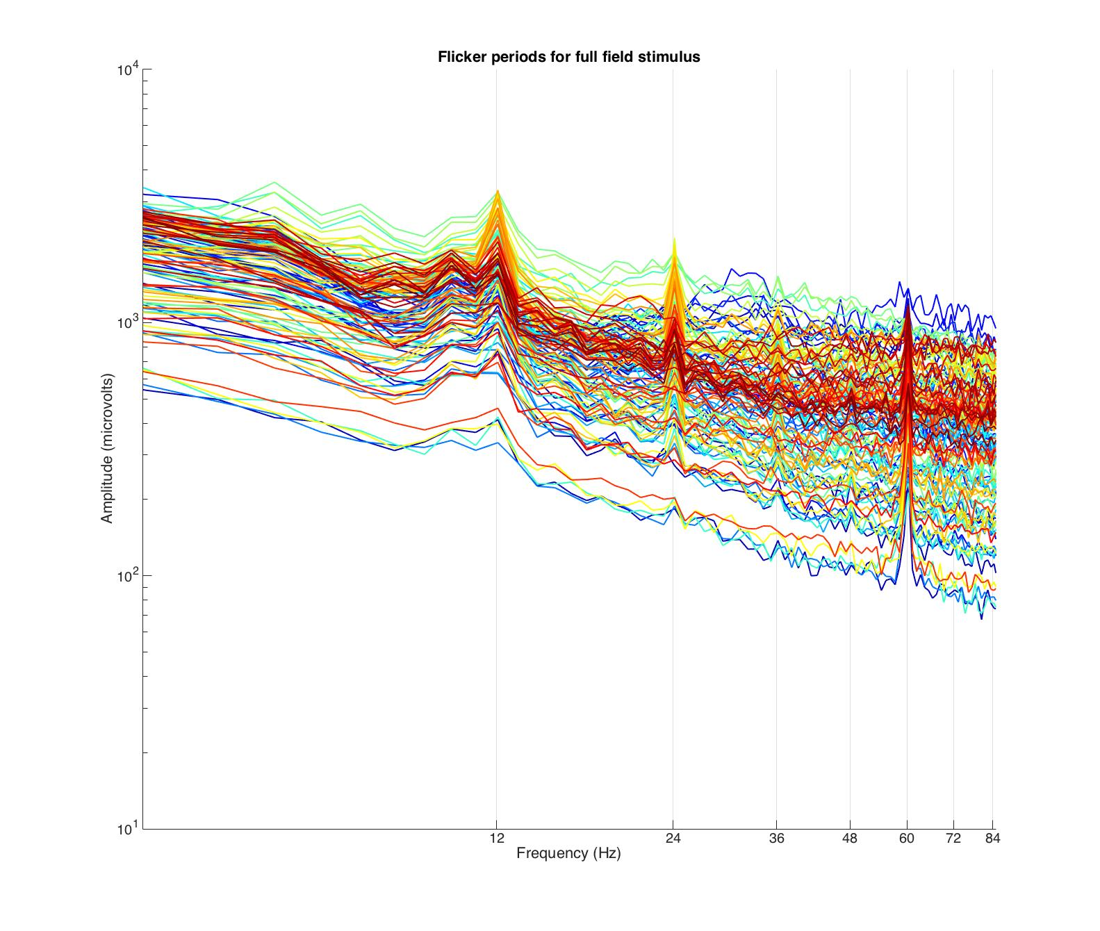
Subj-004 full field Spectra

Slide 5
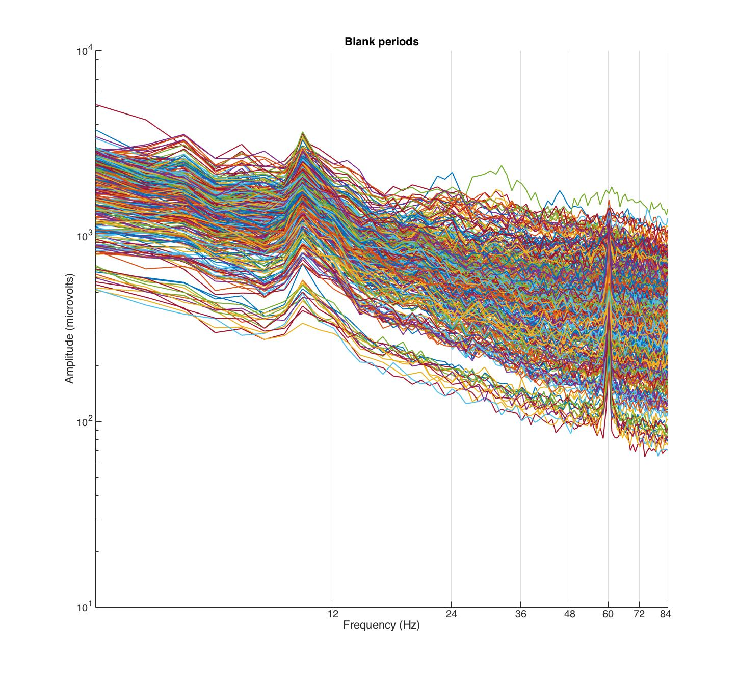
Subj-004 blank spectra

Slide 6
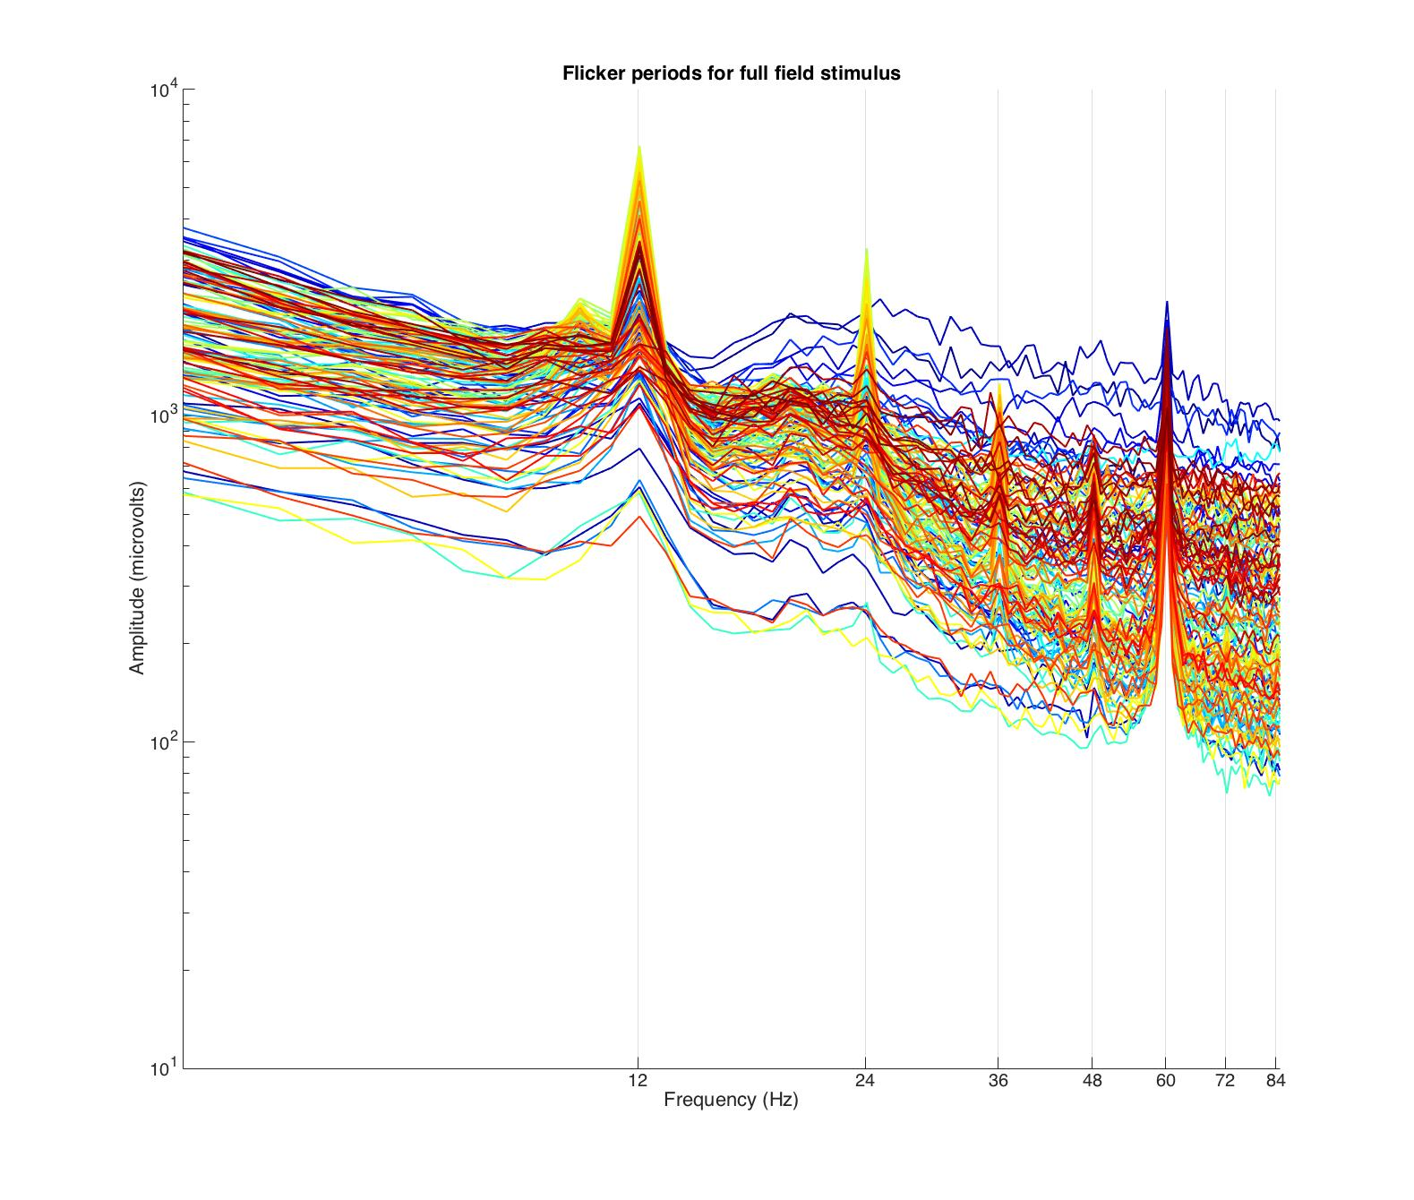
Subj-019 Full field spectra

Slide 7
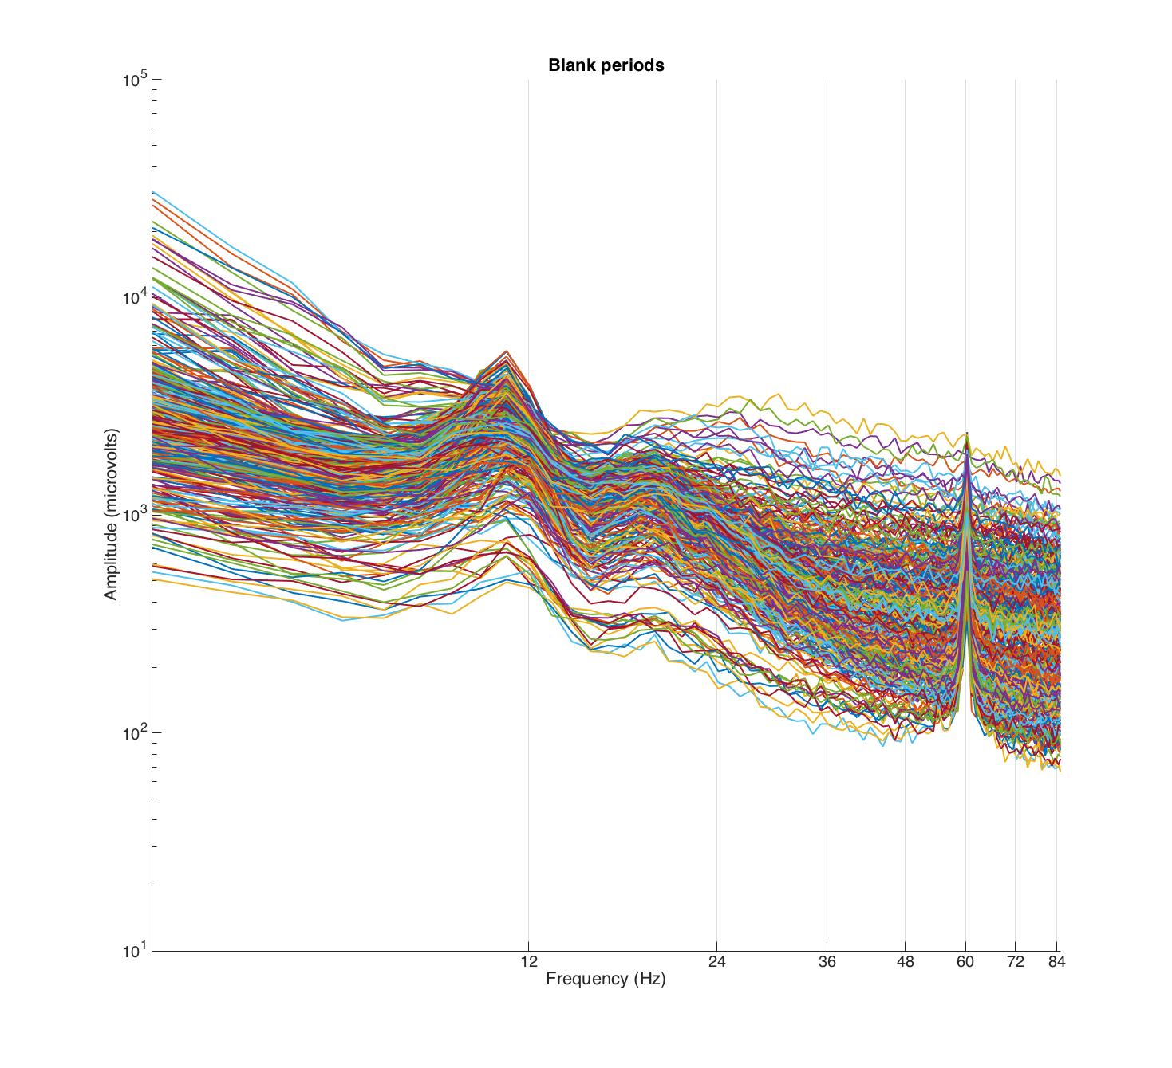
Subj-019 Blank Spectra

Slide 8
Denoising Parameters/Results
PCs were chosen with optimal r2 value (i.e. pcchoose = 1.05)
Number of PCs to try: 10
60 channels selected for noise pool based upon r2 values
 | Subj-001 | Subj-004 | Subj-019
Num of PCs for broadband | 3 | 0 | 0
Num of PCs for Stim-Locked | 6 | 10 | 10

Slide 9
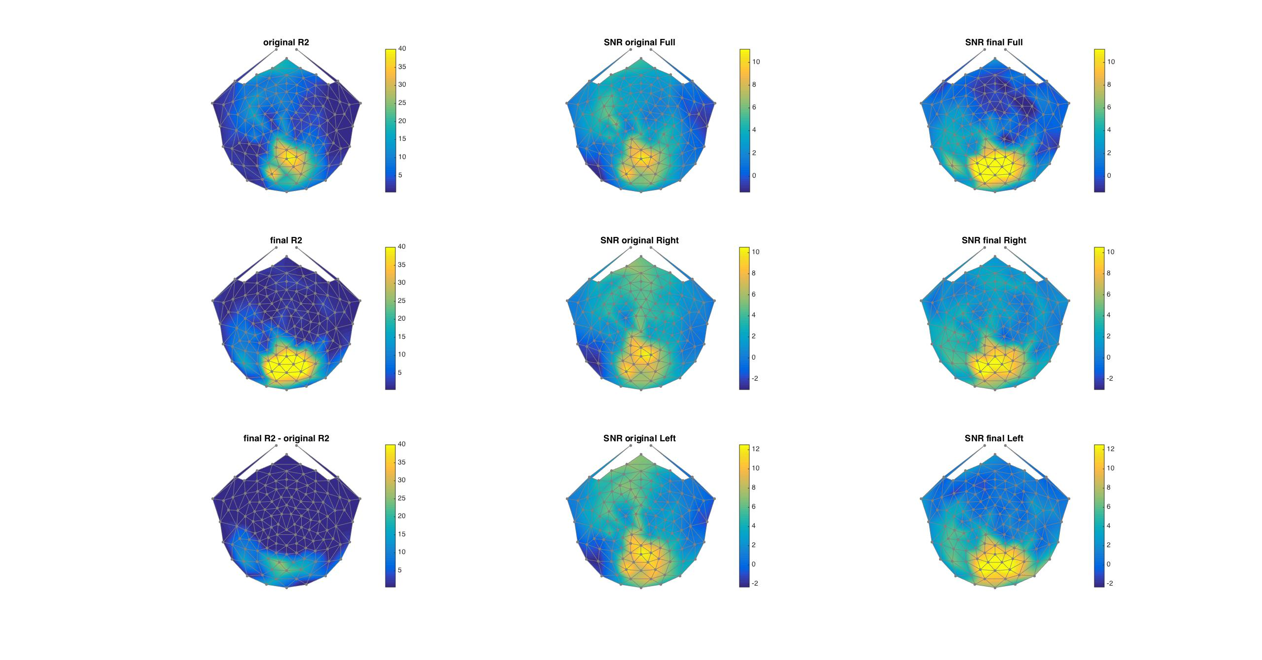
Subj-001 Stimulus Locked

Slide 10
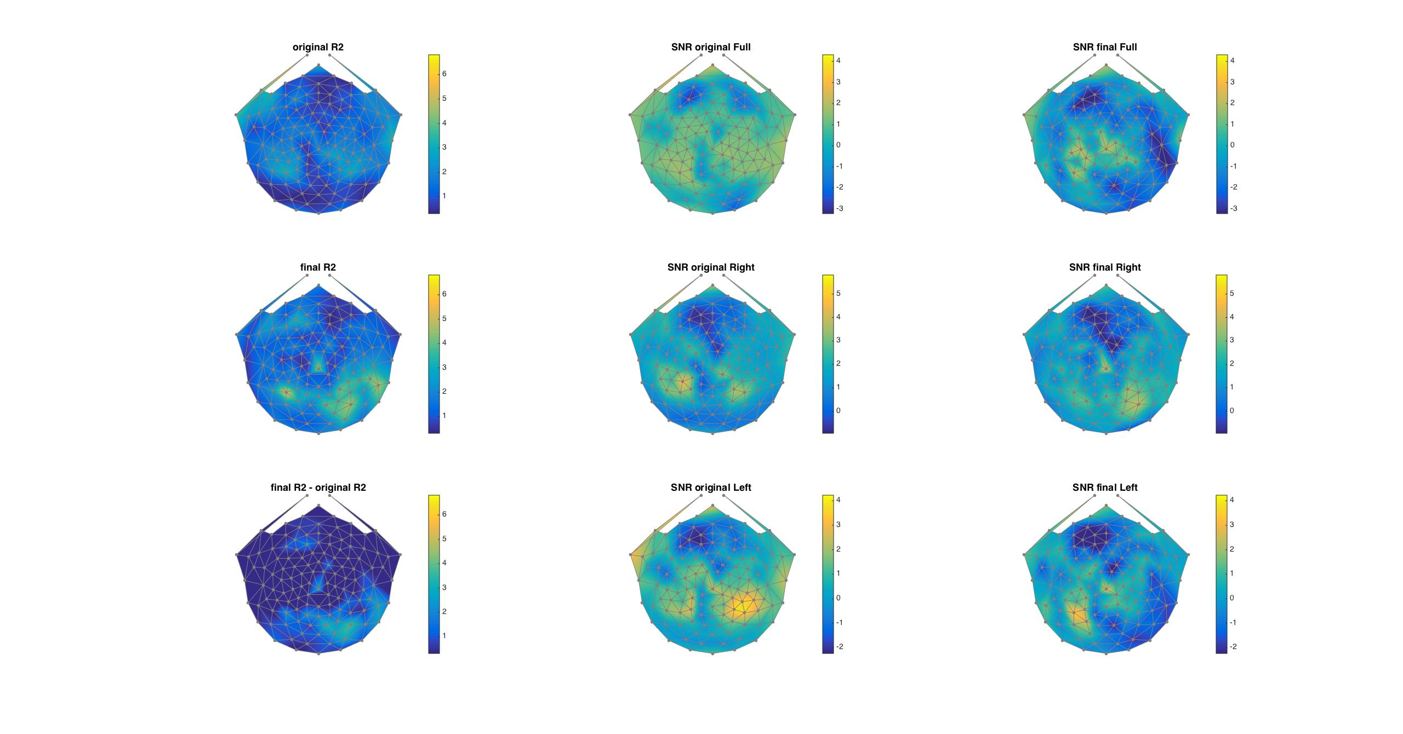
Subj-001 Broadband

Slide 11
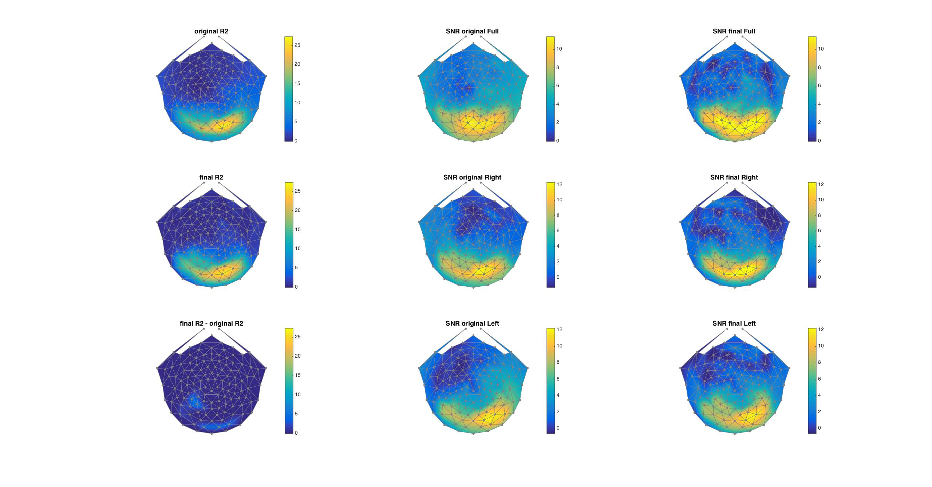
Subj-004 Stimulus Locked

Slide 12
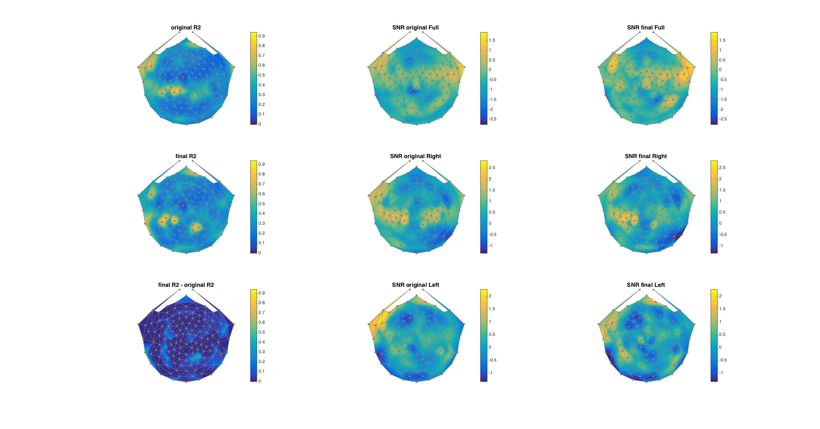
Subj-004 Broadband

Slide 13
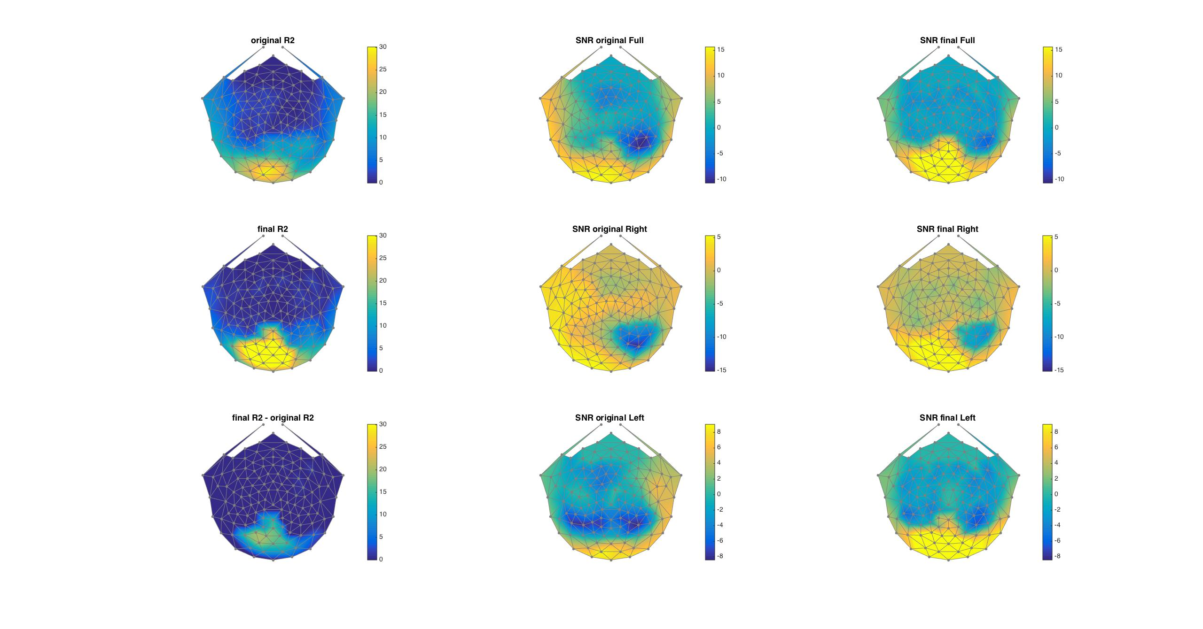
Subj-019 Stimulus Locked

Slide 14
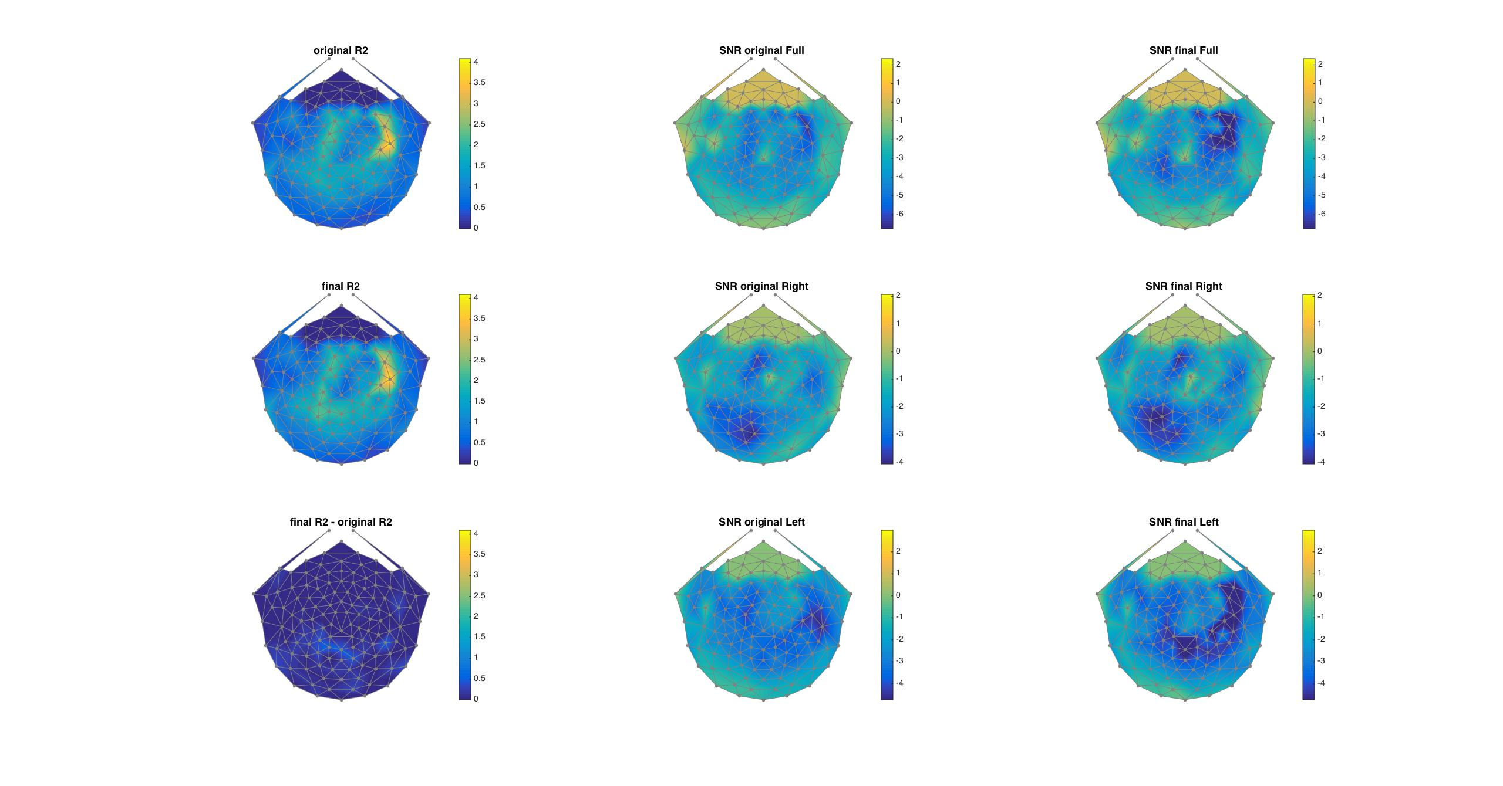
Subj-019 Broadband

Slide 15
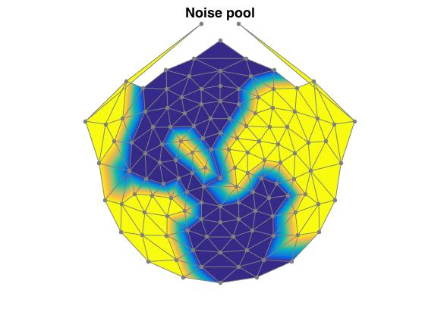
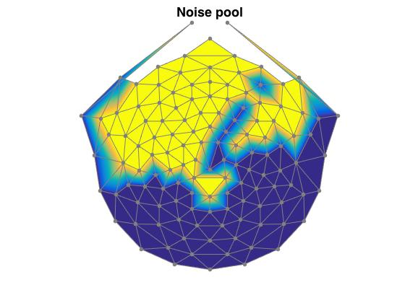
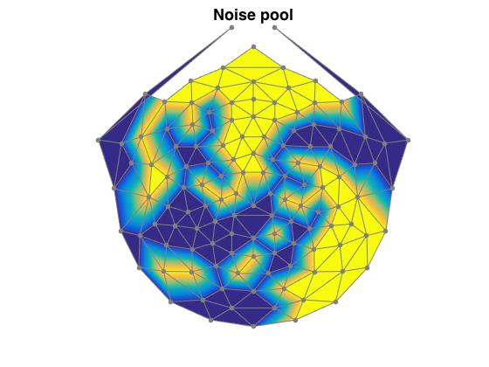
Noise Pools
Sub-001
Subj-004
Subj-019

Slide 16
Some Observations
Stimulus Locked
SNR and r2 values increase over occipital scalp from original to final models
Broadband
SNR values over occipital scalp show no increase from original to final models
However, r2 values in Subj-001 and Subj-004 provide distant hope of a broadband visual response.

Slide 17
Some Questions
Why are two of the three noise pools not frontally focused?
Are there ways in which we can make our data less noisy before the denoising algorithm (brainstorm)?
Should we consider using extra regressors?

