Slide 1
CS 612 : Concepts & Structures of Internet Computing
Jennifer Woodbury
7/10/2017
Assignment #5:
RESTful Web Service Implementation & Docker

Slide 2
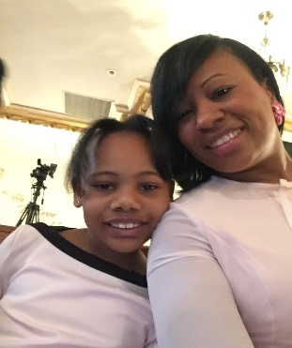

OBJECTIVE:
Last weekend my daughter (Jenna) suggested having a Family Game Night. She loves to play Monopoly with certain players (the players that let her win….LOL). These special key players are: Jennifer (Mommy), Jenna, Shirley(Ma-Ma), Lucille (Aunt Lu).
In conjunction with Assignment #5 I created a JSON file of key players, occupations, ages, and favorite game pieces. (Filename: players.json)
Designed a RESTful Web Service using FLASK & Python (app.py) in a Docker Container (Dockerfile.txt & docker-compose.yml)
Docker image flask-CS612-apps.
Using Python, JSON, Flask & Docker……and PRESTO!! A RESTful Web Service was Created. Welcome to Jenna’s Family Game Night!!

Slide 3
Localhost 5000:
/ - returns “Welcome to the Family Game Night Player’s Page”
/players – returns the entire JSON file with all of the players
/players/<id> - returns player data based on <id>
(id’s range from 0 – 4)

