Slide 1
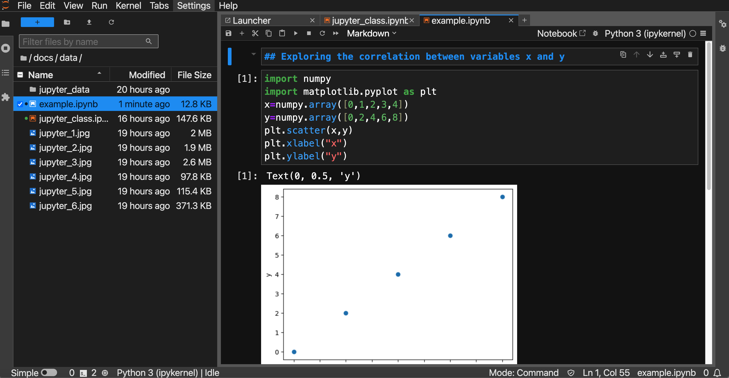
Save
Run
Formatted text
Insert new cell
Code cell
Outout

