Slide 1
Department of Mechanical and Aerospace Engineering
EML 4930 – wall following
PID control

Slide 2
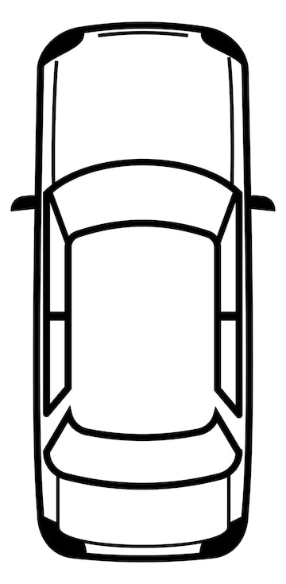
Objective
Travel in the hallway, maintaining a distance of 1 meter from the right-side wall.
Get d₁ and (x₁,y₁) for lidar beam along –y_{sensor}
Get d₂ and (x₂,y₂) for lidar beam at angle θ from the first beam
Calculate d₃
y_{sensor}
x_{sensor}
d₂
θ
d₁
d₃
(x₁, y₁)
(x₂, y₂)

Slide 3
Objective
Travel in the hallway, maintaining a distance of 1 meter from the right-side wall.
let v be a unit direction vector pointing from P₁ to P₂
d_{wall} = d₁ cos φ
y_{sensor}
x_{sensor}
d₂
d_{wall}
θ
d₁
φ
φ
(x₁, y₁)
(x₂, y₂)

Slide 4
Objective
Travel in the hallway, maintaining a distance of 1 meter from the right-side wall.
error = d_{wall} – 1 (units of meters)
if error > 0, turn right
if error < 0, turn left
y_{sensor}
x_{sensor}
d_{wall}

Slide 5
PID control
e = = d_{wall} – 1 (units of meters)
let u represent the control input (steering angle)
the control effort at time t depends on the current error, the current rate of change of the error and the summation of all past errors
in a discreet time implementation
subtract the prior control effort from the current control effort
y_{sensor}
x_{sensor}
d_{wall}

Slide 6
PID control
e = = d_{wall} – 1 (units of meters)
u must be bounded between -45 and +45 degrees
y_{sensor}
x_{sensor}
d_{wall}

Slide 7
PID tuning
synthesize the gains
start with K_{d} = K_{i} = 0
increase K_{p} until there is considerable overshoot and or instability
back off K_{p}
add K_{d} to reduce overshoot
add K_{i} to reduce steady state error

Slide 8


