Slide 1
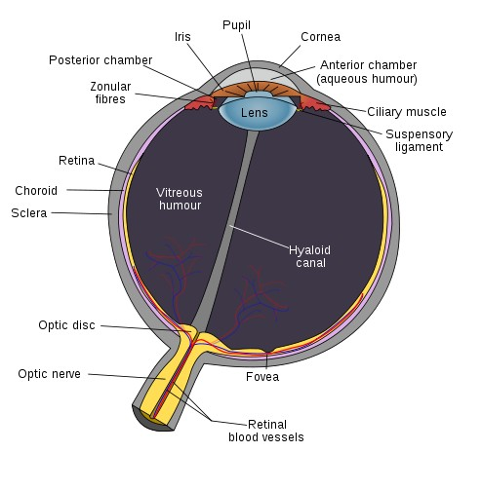
Human Eye
Some interesting facts
Rod cells:
requires only low light
b/w vision
blur, all over retina EXCEPT fovea
Cone cells:
requires bright light,
Color vision: three kinds of cone sensitive to roughly RGB wave lengths
acute, sharp image, located at the fovea
Dynamic range and adaptation
Useful fact
Lens is like a low pass filter!!
Image credit: Wikipedia: fovea
Image credit: Wikipedia (Fovea)

Slide 2
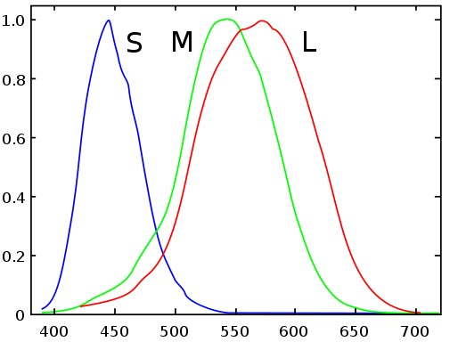
Color?
Colorimetry
Measurement description of color
Remember our eye?
3 types of Cone cells: S M L
Each responsive to different visible wavelength!
Color representation:
based on three components!
Color perception is SUBJECTIVE!
CIE Standardization effort (self reading)
Image credit: Wikipedia: cone cells

Slide 3
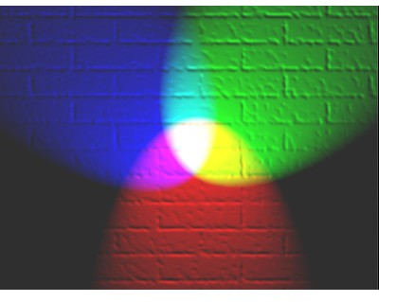
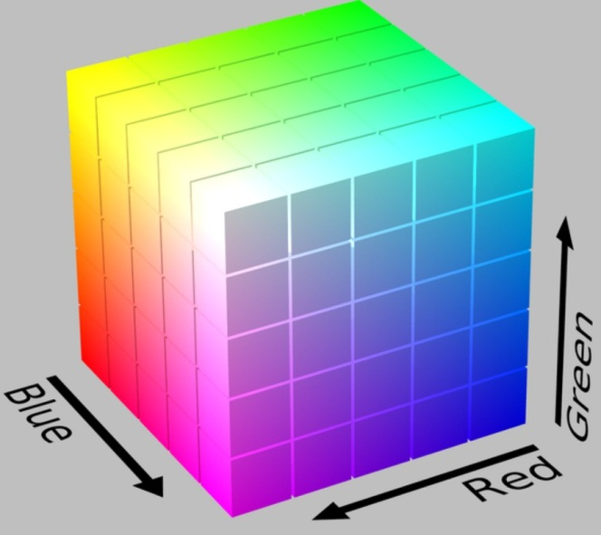
RGB: Additive Color
(R, G, B): 0 – off, 1 – full on
Components are added
E.g., Our eyes, CRT, LCD, Projector
RGB – most often used
range between 0 to 1
RGB: a Color Cube
B (1,0,0)
G (0,1,0)
Image credit: Wikipedia: Additive Color
R (1,0,0)

Slide 4
Additive Color
Easier for human to
separate color from “intensity”
HSV Hue, Saturation, Value
HSL (Luminosity, Lightness)
HSB (Blackness?)
Demo: http://demos.telerik.com/aspnet-ajax/colorpicker/examples/default/defaultcs.aspx
RGB to HSV Demo: https://math.hws.edu/graphicsbook/demos/c2/rgb-hsv.html

Slide 5
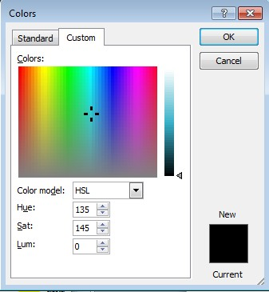
Additive Color: Example
Microsoft Office Color Picker
Hue: Which color. Range: 0 to 360, degrees around the cone circumference (MS normalized this to 0 to 255)
Luminosity: the “intensity” or brightness.
Range: 0 to 100, height of the cone (MS normalized this to 0 to 255)
Saturation: how colorful. Range: 0 to 100, distance from the center of the cone (MS normalized this to 0 to 255)

Slide 6
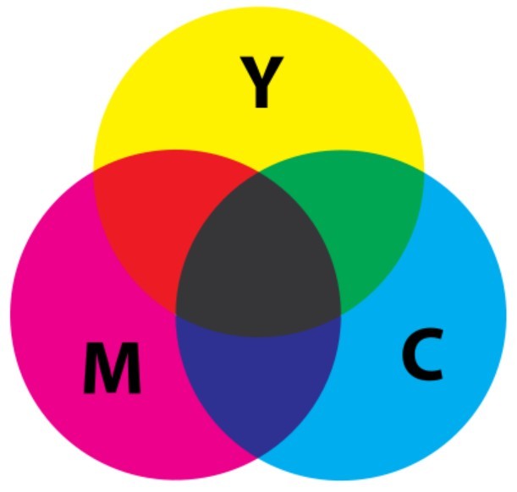
Subtractive Color
The expensive printer cartridges
CMY – filtering white color
Each acts as a filter of (1,1,1)
E.g., Black on White Paper: (1,1,1)
Through Y filter => (1,1,0)
Through M filter =>(1,0,0)
Through C filter => (0,0,0)
The filter (ink pigment) leaks
Black is not very black
That’s why the separate black cartridge
Yellow (1, 1, 0)
Image credit: Wikipedia: Subtractive Color
Cyan (0, 1, 1)
Magenta (1, 0, 1)

Slide 7
Example
If I want to show red color: (1, 0, 0) on White
Use Yellow: (1, 1, 0) → white filters to yellow
Use Magenta: (1, 0, 1) → yellow filters to red
DO NOT use Cyan: (0, 1, 1)
If I want to show blue color (0, 0, 1) on white
DO NOT use yellow:
Use Magenta: (1, 0, 1) → white filters to magenta
Use Cyan: (0, 1, 1) → magenta filters to blue

Slide 8
Linear Blending of Color
We have experienced with this:
Out = w * C1 + (1-w) * C2
Out1 = (1-w) * C1 + w * C2
We have experienced with C and C1 being
simple float values (shape blending), or
Colors: color blending
Now creating the illusion of transparency
Alpha blending

Slide 9
Lerp: Linear Interpolation

