Slide 1
Ambient Light
T/F:
Changing the ambient light position will affect the illumination computation
Ambient light has no position!
Ambient light source color must be a number between 0 to 1
NO! Not based on physics, so can even be negative!

Slide 2
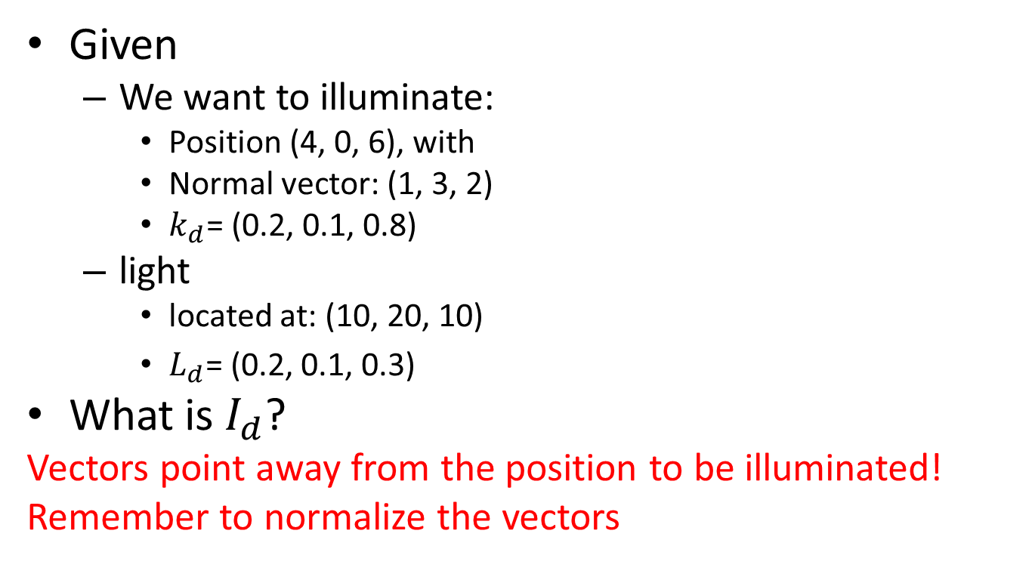
Diffuse Reflection
Given
We want to illuminate:
Position (4, 0, 6), with
Normal vector: (1, 3, 2)
$k_{d}$= (0.2, 0.1, 0.8)
light
located at: (10, 20, 10)
$L_{d}\text{= (0.}\text{2}\text{, 0.}\text{1}\text{, 0.}\text{3}\text{)}$
What is $I_{d}$?
Vectors point away from the position to be illuminated!
Remember to normalize the vectors

Slide 3
Specular Reflection
The three elements that must participate are:
The object, to provide what vector(s)?
N (normal for reflecting L)
The light, to provide what vector(s)?
L and R: Light and reflection of light
The eye (camera), to provide what vector(s)?
V (from eye to the point to be illuminated)
Of these vectors, which is the most expensive to compute?
Typically R (reflection of L), that’s why the H vector
What are the effects of increasing n?
Highlight area shrink,
Everything else the same, the entire image appears darker (add up all the RGB shaded values, the results will be smaller)

Slide 4
Phong model
The 3D feature of Phong illuminated object is main a result of which component?
Mostly Diffuse (use N), Specular is typically much more regional, cannot help show the 3D feature.
T/F:
Specularity models reflection of objects. FALSE!
Shadow is properly modeled by the Phong model we have learned. FALSE
The RGB components of colors must be within the range of 0 to 1 FALSE

