Slide 1
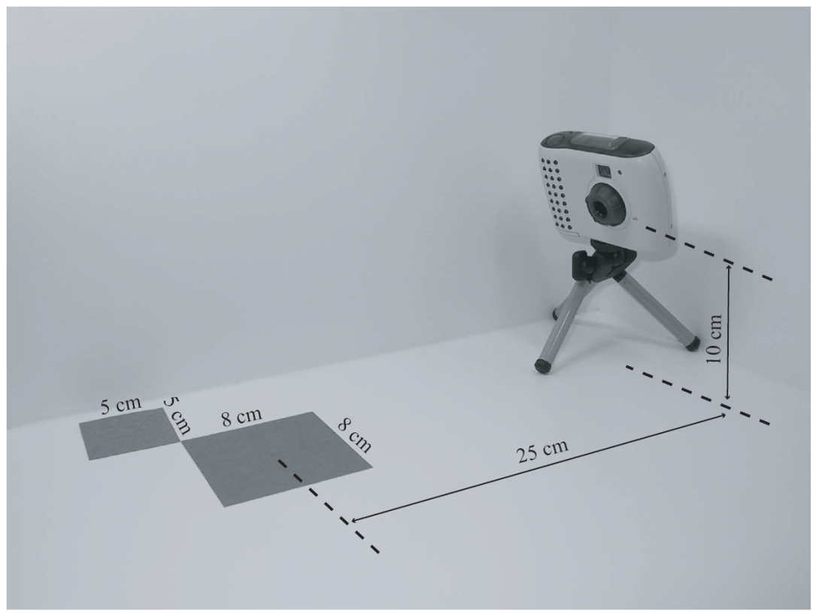
Illumination Model
How to compute color to represent a scene
As in taking a photo in real life:
Camera
Lighting
Object
Geometry
Material
Illumination model:
Combine all to produce a color
Light source
Camera
material property
Object geometry (shape, size, location)

Slide 2


Ambient Light
Simplest model: when all lights are off!
Still sees color!
Why?
How to model?
is the “ambient” light
is the object’s “ambient” material property!
A “Vector” equation: RGB
Blend, flat, no 3D features

Slide 3
Diffuse Reflection
Intensity of paper in relation with light source
In coming energy: is scattered uniformly in all directions according to the “facing” of the paper
Normal Vector of the paper

Slide 4
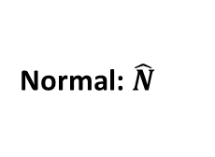
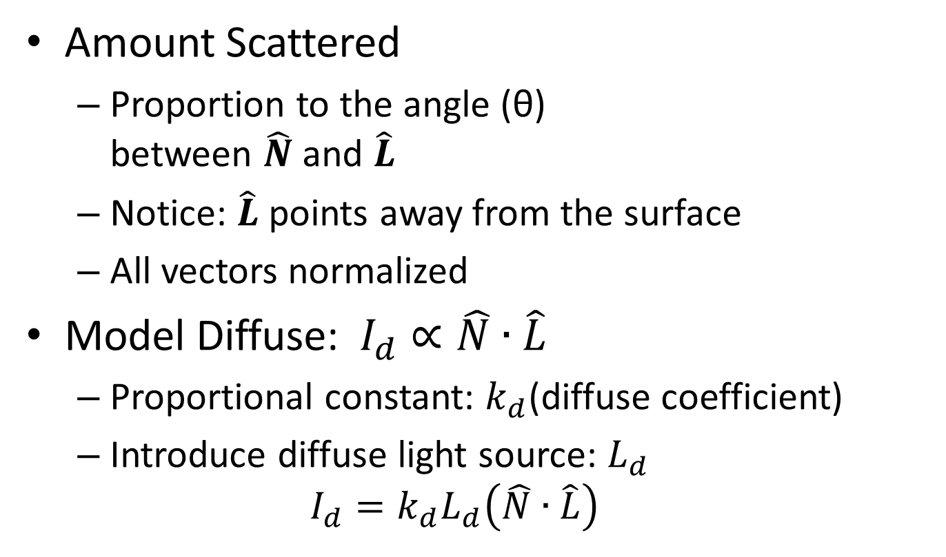
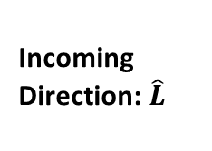
Model Diffuse Reflection
Normal: $\hat{N}$
θ
Incoming Direction: $\hat{L}$
Amount Scattered
Proportion to the angle (θ) between $\hat{N}$ and $\hat{L}$
Notice: $\hat{L}$points away from the surface
All vectors normalized
Model Diffuse:$I_{d}∝\hat{N}∙\hat{L}$
Proportional constant: $k_{d}$(diffuse coefficient)
Introduce diffuse light source: $L_{d}$
$$I_{d}=k_{d}L_{d}\left(\hat{N}∙\hat{L}\right)$$

Slide 5
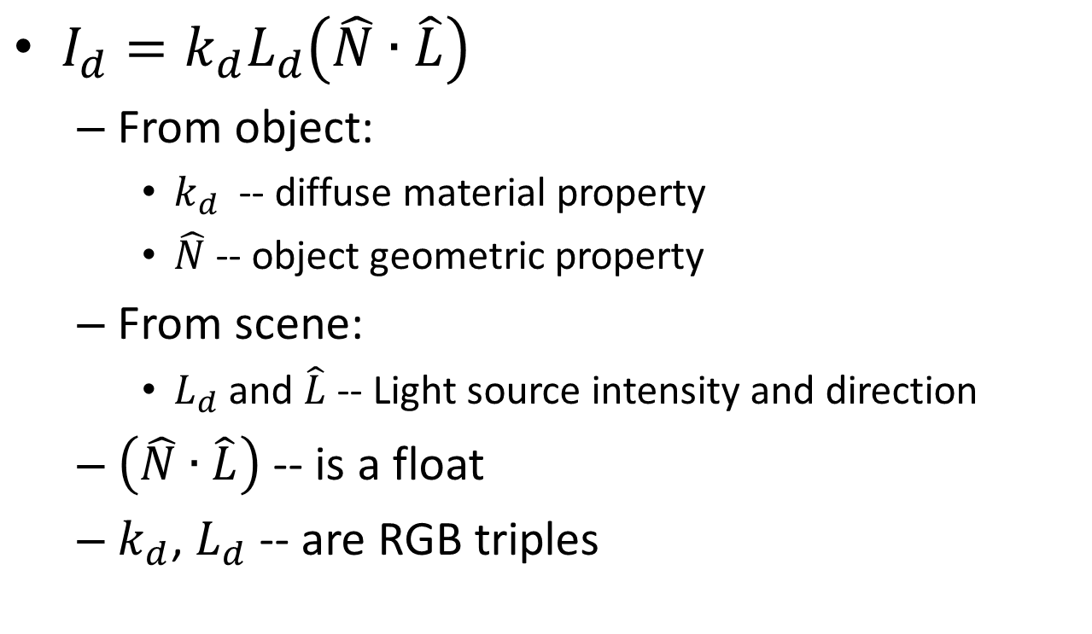
Diffuse Lighting
Normal: $\hat{N}$
θ
Incoming Direction: $\hat{L}$
$I_{d}=k_{d}L_{d}\left(\hat{N}∙\hat{L}\right)$
From object:
$k_{d}$ -- diffuse material property
$\hat{N}$-- object geometric property
From scene:
$L_{d}$ and $\hat{L}$-- Light source intensity and direction
$\left(\hat{N}∙\hat{L}\right)$ -- is a float
$k_{d}$, $L_{d}$ -- are RGB triples

Slide 6
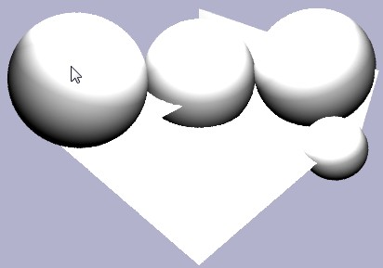
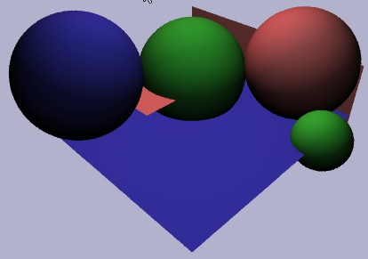
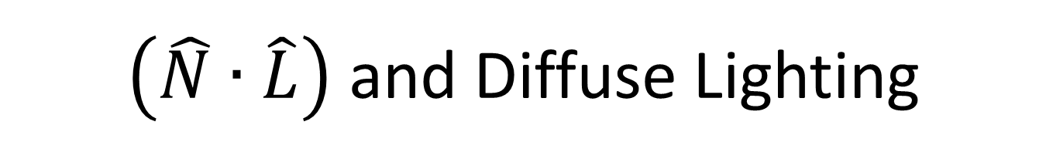


$\left(\hat{N}∙\hat{L}\right)$ and Diffuse Lighting
$$I=\left(\hat{N}∙\hat{L}\right)$$
$$I_{d}=k_{d}L_{d}\left(\hat{N}∙\hat{L}\right)$$

Slide 7
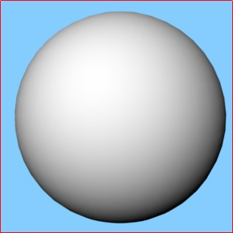
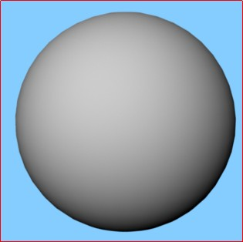
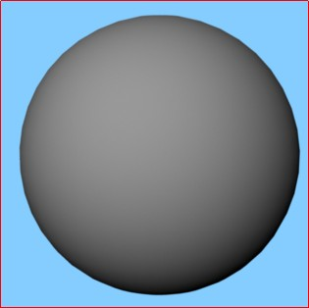
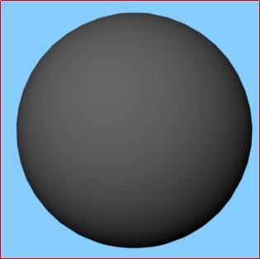
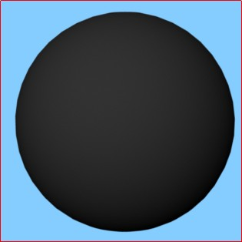
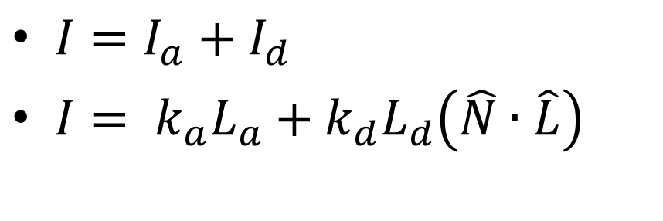
Combine: Ambient and Diffuse
$I=I_{a}+I_{d}$
$I= k_{a}L_{a}+k_{d}L_{d}\left(\hat{N}∙\hat{L}\right)$
kd(1,1,1)
kd(0.8)
kd(0.6)
kd(0.4)
kd(0.2)

Slide 8
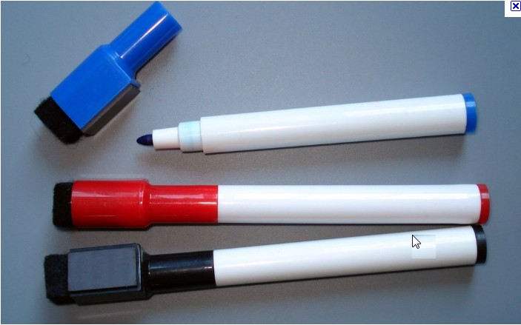
Look at my White Board Marker!
What are these? “shinning” white stuff?
Image credit: Some random site selling random stuff
Reflection of Light Sources!!
Visible: scattered energy is a function of how far from mirror reflection direction
In coming energy: is scattered mainly in the mirror reflection direction

Slide 9

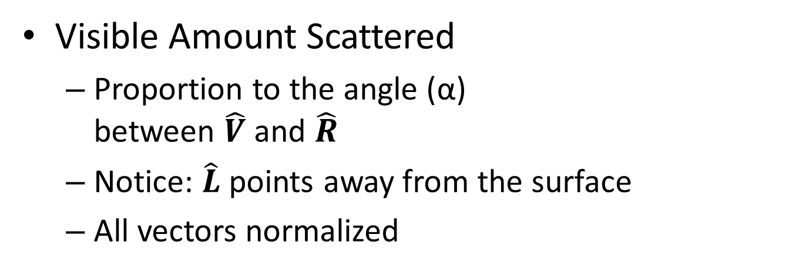
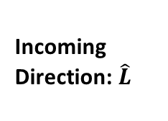
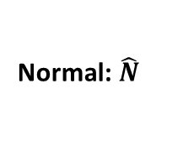
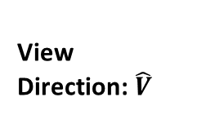
Model Specular Reflection
View Direction: $\hat{V}$
Normal: $\hat{N}$
Incoming Direction: $\hat{L}$
α
Reflection Direction of Light: $\hat{R}$
θ
Visible Amount Scattered
Proportion to the angle (α) between $\hat{V}$ and $\hat{R}$
Notice: $\hat{L}$points away from the surface
All vectors normalized

Slide 10






Specular Reflection
$I_{s}∝\hat{V}∙\hat{R}$
Proportional constant: $k_{s}$(specular coefficient)
Specular light source: $L_{s}$
$I_{s}=k_{s}L_{s}\left(\hat{V}∙\hat{R}\right)$
From object:
$k_{s}$ -- specular material property
$\hat{N}$-- object geometric property
From scene:
$L_{s}$ and $\hat{L}$-- Light source intensity and direction
$\hat{V}$-- is defined by camera
$\left(\hat{V}∙\hat{R}\right)$ -- is a float
$k_{s}$, $L_{s}$-- are RGB triples
$$\hat{V}$$
$$\hat{N}$$
$$\hat{L}$$
α
$$\hat{R}$$
θ
But, where does $\hat{R}$ come from??

Slide 11
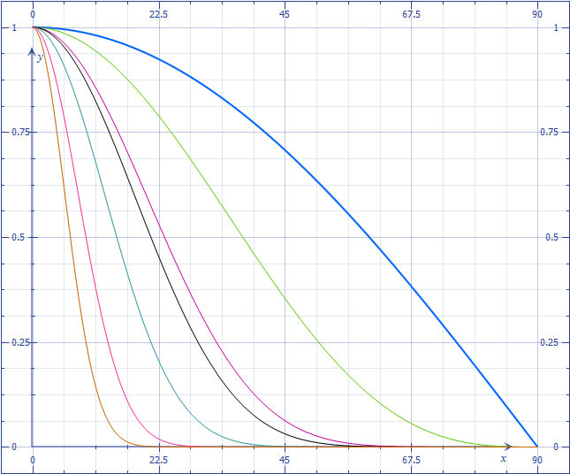





Inadequacy of $\hat{V}∙\hat{R}$
$I_{s}=k_{s}L_{s}\left(\hat{V}∙\hat{R}\right)$
Introduce: n – shininess
$I_{s}=k_{s}L_{s}{\left(\hat{V}∙\hat{R}\right)}^{n}$
$$\hat{V}$$
$$\hat{N}$$
α
$$\hat{L}$$
$$\hat{V}∙\hat{R}$$
Drops off too slowly
$$\hat{R}$$
θ
Need to control drop off rate
α
90$°$

Slide 12
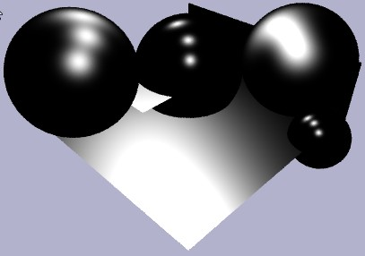
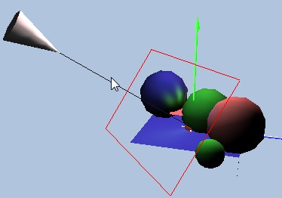
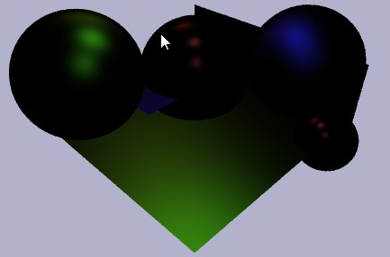


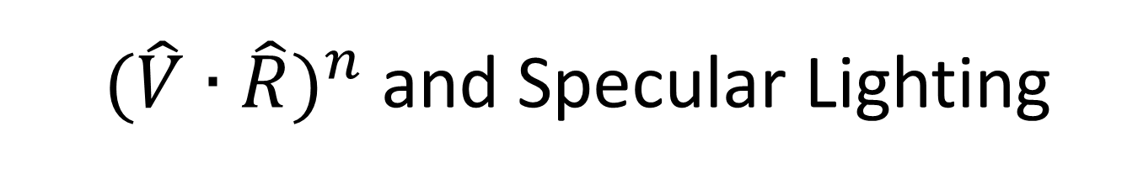
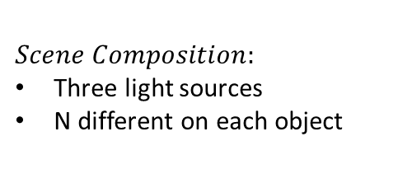




${ (\hat{V}∙\hat{R})}^{n}$ and Specular Lighting
$n=5$0
$$n=1$$
$n=1$0
$$n=10$$
$$I={\left(\hat{V}∙\hat{R}\right)}^{n}$$
$$Scene Composition:$$
Three light sources
N different on each object
$$I_{s}=k_{s}L_{s}{\left(\hat{V}∙\hat{R}\right)}^{n}$$

Slide 13
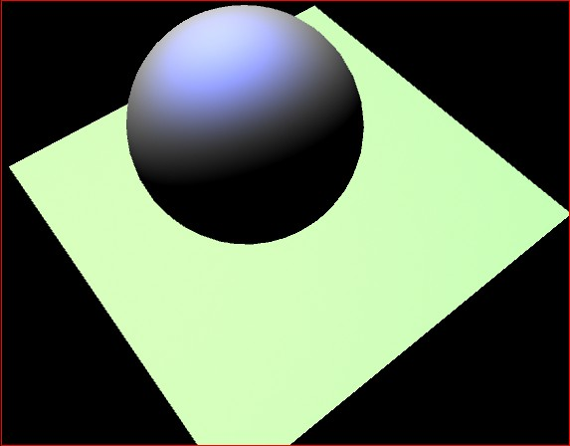
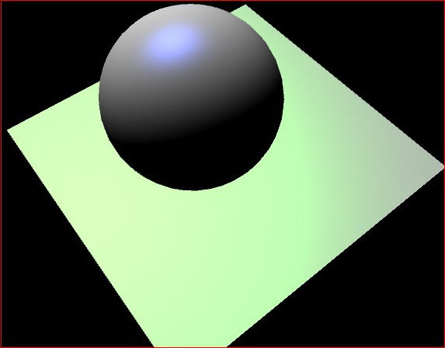
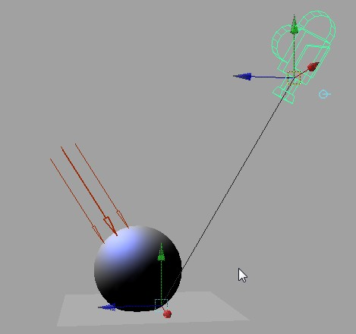

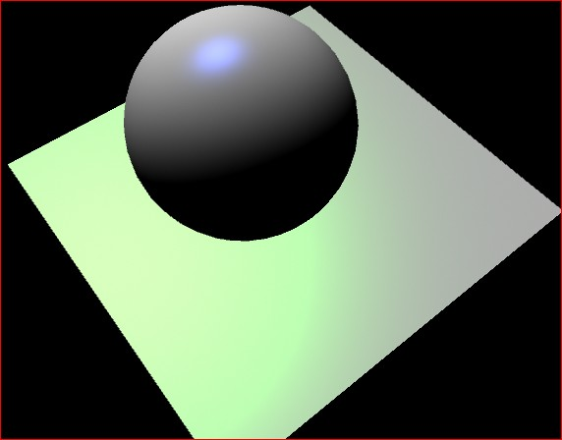
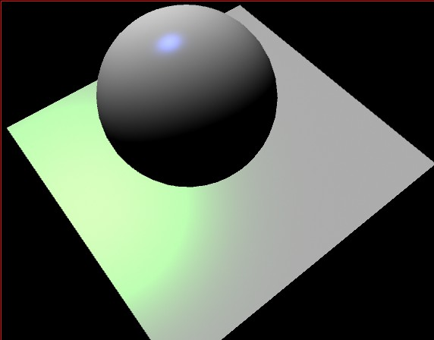


Combine all:
$$I=I_{a}+I_{d}+I_{s}$$
$$I=k_{a}L_{a}+k_{d}L_{d}\left(\hat{N}∙\hat{L}\right)+k_{s}L_{s}{\left(\hat{V}∙\hat{R}\right)}^{n}$$
n=2
n=10
Scene Composition
n=20
n=50

Slide 14





The Reflection Halfway Vector
$\hat{R}=2\left(\hat{N}∙\hat{L}\right)\hat{N}−\hat{L}$
Must compute for each pixel
Very expensive!!
Introduce halfway vector ($\hat{H}$)
$\hat{H}=\left(\frac{\hat{V}+\hat{L}}{2}\right)$
$I_{s}=k_{s}L_{s}{\left(\hat{N}∙\hat{H}\right)}^{n}$
$$\hat{V}$$
$$\hat{N}$$
$$\hat{L}$$
α
$$\hat{R}$$
θ
$$\hat{H}$$
$$\hat{N}$$
$$\hat{L}$$
$$\hat{V}$$

Slide 15




The Phong Illumination Model
$I=k_{a}L_{a}+k_{d}L_{d}\left(\hat{N}∙\hat{L}\right)+k_{s}L_{s}{\left(\hat{V}∙\hat{R}\right)}^{n}$
All graphics hardware implements (maybe small variation of this mode)
E.g., the H vector
$$\hat{N}$$
$$\hat{L}$$
$$\hat{R}$$

Slide 16
Evaluating the Phong Model
Question:
How to improve the model?
Non-physically based
Based on “observation”
E.g., specularity: as n increase the area under the curve decreases
Large n => less energy in the scene!
E.g., “Ambient” term
Color bleeding

Slide 17
Describe/simulate physics
Radiance: Light energy in a direction
Think river: flow of energy over cross section area
Irradiance: Radiance received from fixed incoming area
BRDF: (material properties)
Bi-directional Reflectance Distribution Function
How energy reflect across surfaces
Angular and Spectrum dependencies
Challenges:
Difficult to model correctly
Computationally costly
What is the ultimate goal?
looks good vs. looks real

Slide 18
Recently: physics only if ..
As long as it looks good, who cares?
Games, Movies, etc.
Physics: Looks real
But: does it look “good”?

Slide 19
Lighting/Illumination vs Shading
Lighting and Illumination
Probably means the same thing
scene lit/illiuminated by light sources
Shading: usually mean Gouraud Shading
Color interpolation from vertices vs Flat Shading
Should have nothing to do with lights
D3D example (General Cylinder Example)
Maya example (Shading -> Flat shading)

Slide 20
Review questions …

Slide 21
Ambient Light
T/F:
Changing the ambient light position will affect the illumination computation
Ambient light source color must be a number between 0 to 1

Slide 22
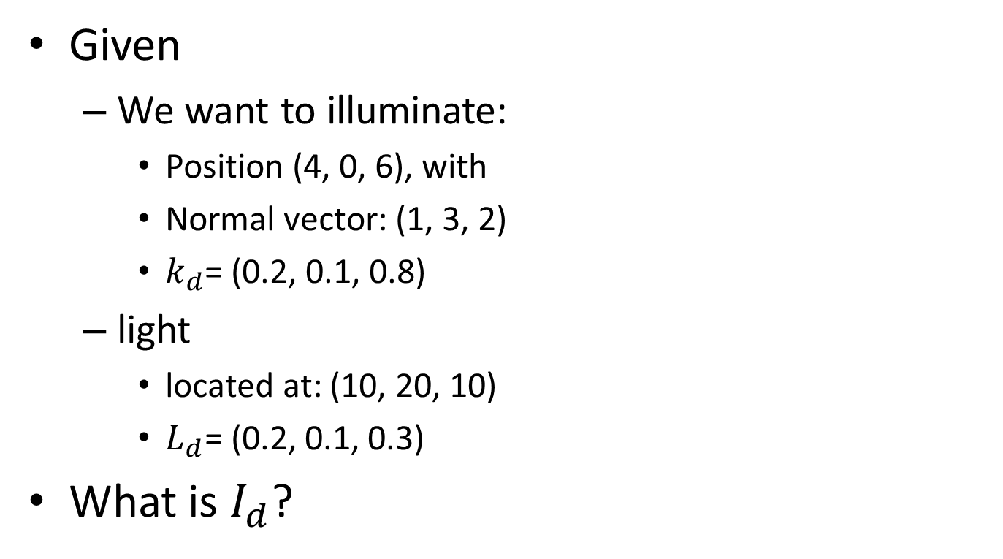
Diffuse Reflection
Given
We want to illuminate:
Position (4, 0, 6), with
Normal vector: (1, 3, 2)
$k_{d}$= (0.2, 0.1, 0.8)
light
located at: (10, 20, 10)
$L_{d}\text{= (0.}\text{2}\text{, 0.}\text{1}\text{, 0.}\text{3}\text{)}$
What is $I_{d}$?

Slide 23
Specular Reflection
The three elements that must participate are:
The object, to provide what vector(s)?
The light, to provide what vector(s)?
The eye (camera), to provide what vector(s)?
Of these vectors, which is the most expensive to compute?
What are the effects of increasing n?

Slide 24
Phong model
The 3D feature of Phong illuminated object is mainly a result of which component?
T/F:
Specularity models reflection of objects.
Shadow is properly modeled by the Phong model we have learned.
The RGB components of colors must be within the range of 0 to 1

