Slide 1
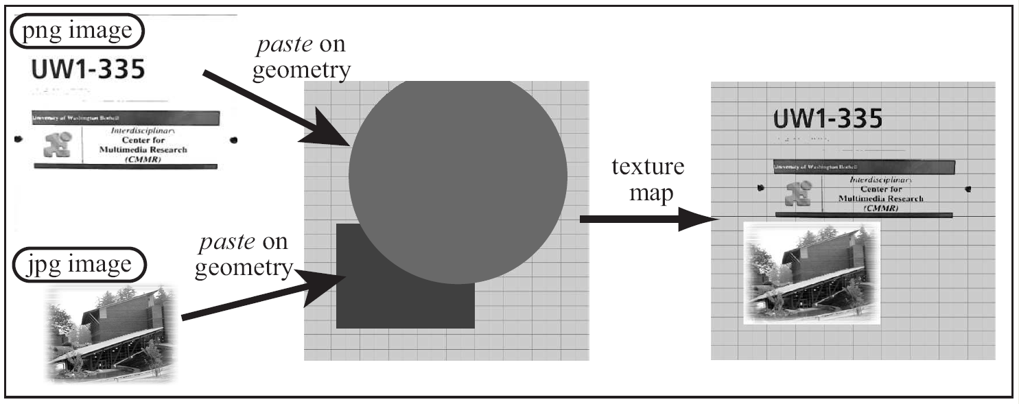
File Texture Mapping
Pasting images on primitives

Slide 2
File Texture and Mapping
File Texture: an image file
A 2D array of color stored in a file
Texel: each color element in the file
Any image or digital photograph
Images are stored in formatted files:
E.g.: gif, jpg, tiff, png.
Mapping: “pasting on”
Paste the image (file texture) on a given primitive

Slide 3
Texture Coordinates
Mapping: matching of coordinates
A coordinate system on image file
(st) - coordinate
A coordinate system on primitive
(uv) - coordinate
Mapping:
Match the two coordinate systems!

Slide 4
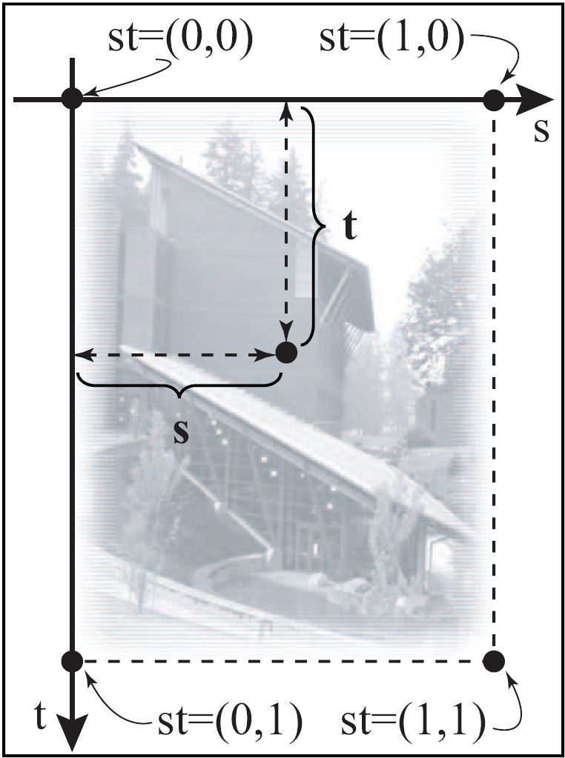
Implicit st – Coordinate System
implicitly defined on all file textures
Origin: upper-left corner
s-Axis: Right-wards
t-axis: down-wards
Range: 0.0 to 1.0
Coverage: always the entire image!

Slide 5
Explicit uv – Coordinate System
uv are
Defined on the Primitives
Defined by, us, the programmers!
Each vertex of a primitive:
A Position: (x, y, z)
A Color: (r, g, b)
NOW: Texture Coordinate (u, v)

Slide 6
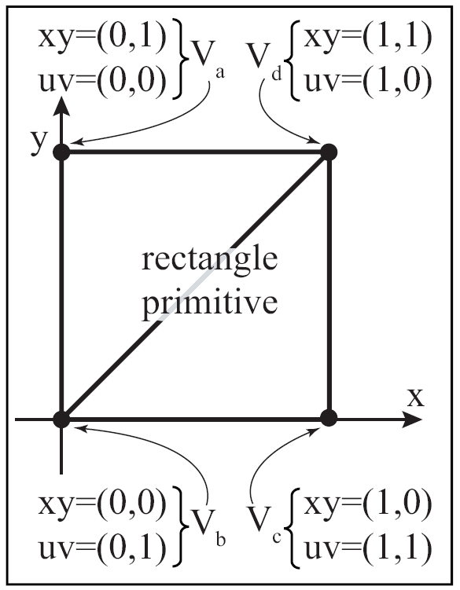
Example of defining uv: rectangle

Slide 7
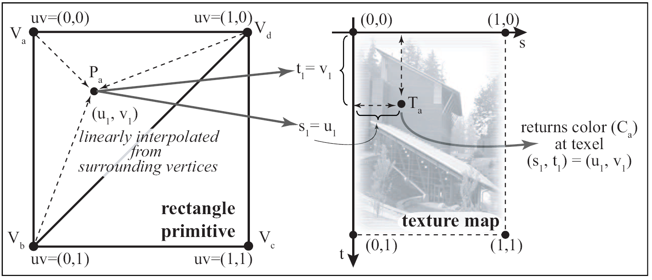
Mapping: Texel lookup
Texel color (C_{a}) used as color of primitive

Slide 8
Programming File Texture
We must define uv-coordinate on primitives
Select/Load an image file into the graphics API
Define how texel will be used
Enable texture mapping before drawing the primitive

Slide 9
Now finally (M4 EX1)
Look at our vertex shader
What is the: uv
What does: TRANSFORM_TEX() do?
UnityCG.cginc
C:\Program Files\Unity\Hub\Editor\2021.3.10f1\Editor\Data\CGIncludes
#define TRANSFORM_TEX(tex,name) (tex.xy * name##_ST.xy + name##_ST.zw)
Editor->Material: XY (Tiling) and ZW (Offset)

Slide 10
Texture Mapping
pixel locations
One scaneline
Distance between the samples:
Image pixel vs Display pixel

Slide 11

Image (AdobeStock_110585524_low.jpg)
Resolution: 1440x960

Slide 12
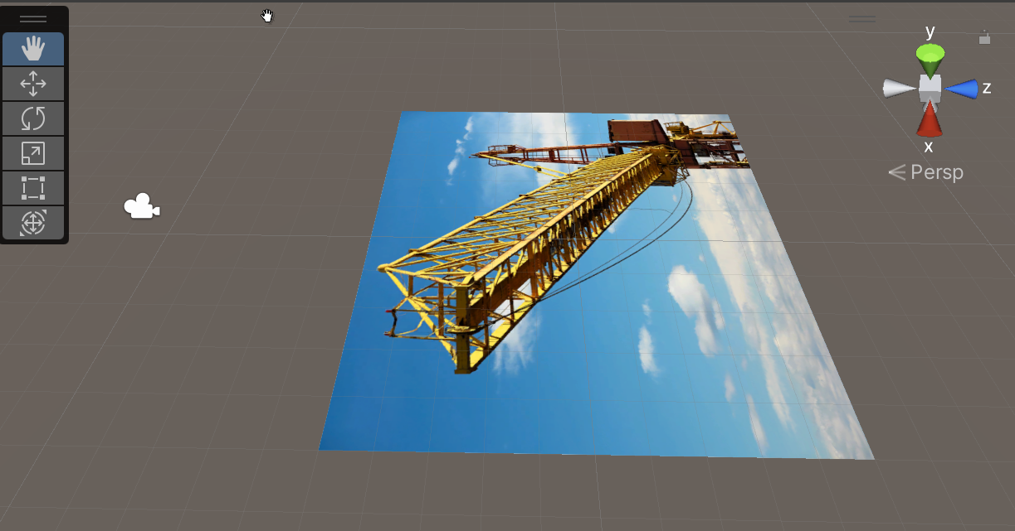
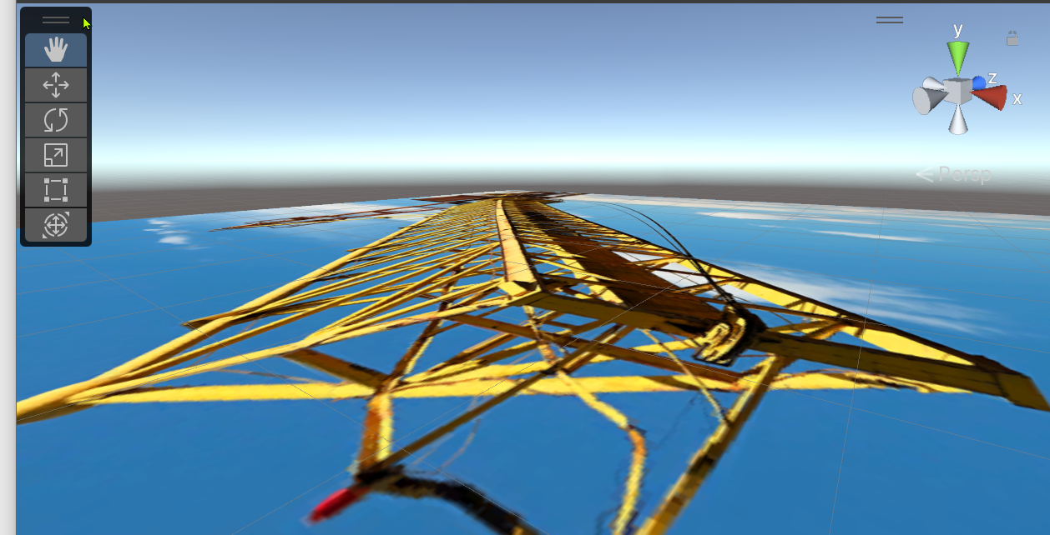
Issue: When viewed in 3D

Slide 13

Issue: When viewed in 3D
Pixels on image: e.g., 400 pixels
➔ Need to “combine” (or filter) pixels
Pixels on image: e.g., 100 pixels
➔Need to “magnify pixels
Pixels on screen, e.g., 200 pixels

Slide 14

Texture filtering: Magnify
One pixel on image
Average!
One pixel on display

Slide 15
Texture filtering: Minimize
One pixel on image
What to do?
One pixel on display

Slide 16
Mipmap: Hierarchy of images
Pre-shrink the images
N x M -> N/2 x M/2 -> N/4 x M/4 …
During rendering, choose
The appropriate Mipmap level
One pixel on display: choose from Level-2 and/or 3 and filter (average)

Slide 17
Check out M4 EX2
Select the image in the EX2 folder
Make sure remember to click “apply”
Need to send request to the GPU!
Insufficient sampling
Texture swimming!

