Slide 1
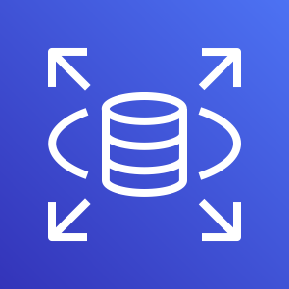





AWS Cloud
Amazon RDS
AWS Lambda
Amazon API Gateway
Amazon Simple Storage Service
User

Slide 2
AWS Cloud
User
Amazon Simple Storage Service
AWS Lambda
Amazon RDS

