Slide 1
Bodyfat Dataset Analysis
By Yan Chu, Boliang Ma, Jiancheng Xu (Group 5)
Department of Statistics
UW-Madison

Slide 2
Outline
Raw Data and Data Visualization
Modeling and Analysis
Diagnostics and Conclusion

Slide 3
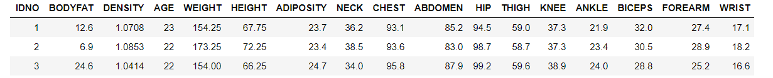
Raw Data and Data Visualization

Slide 4
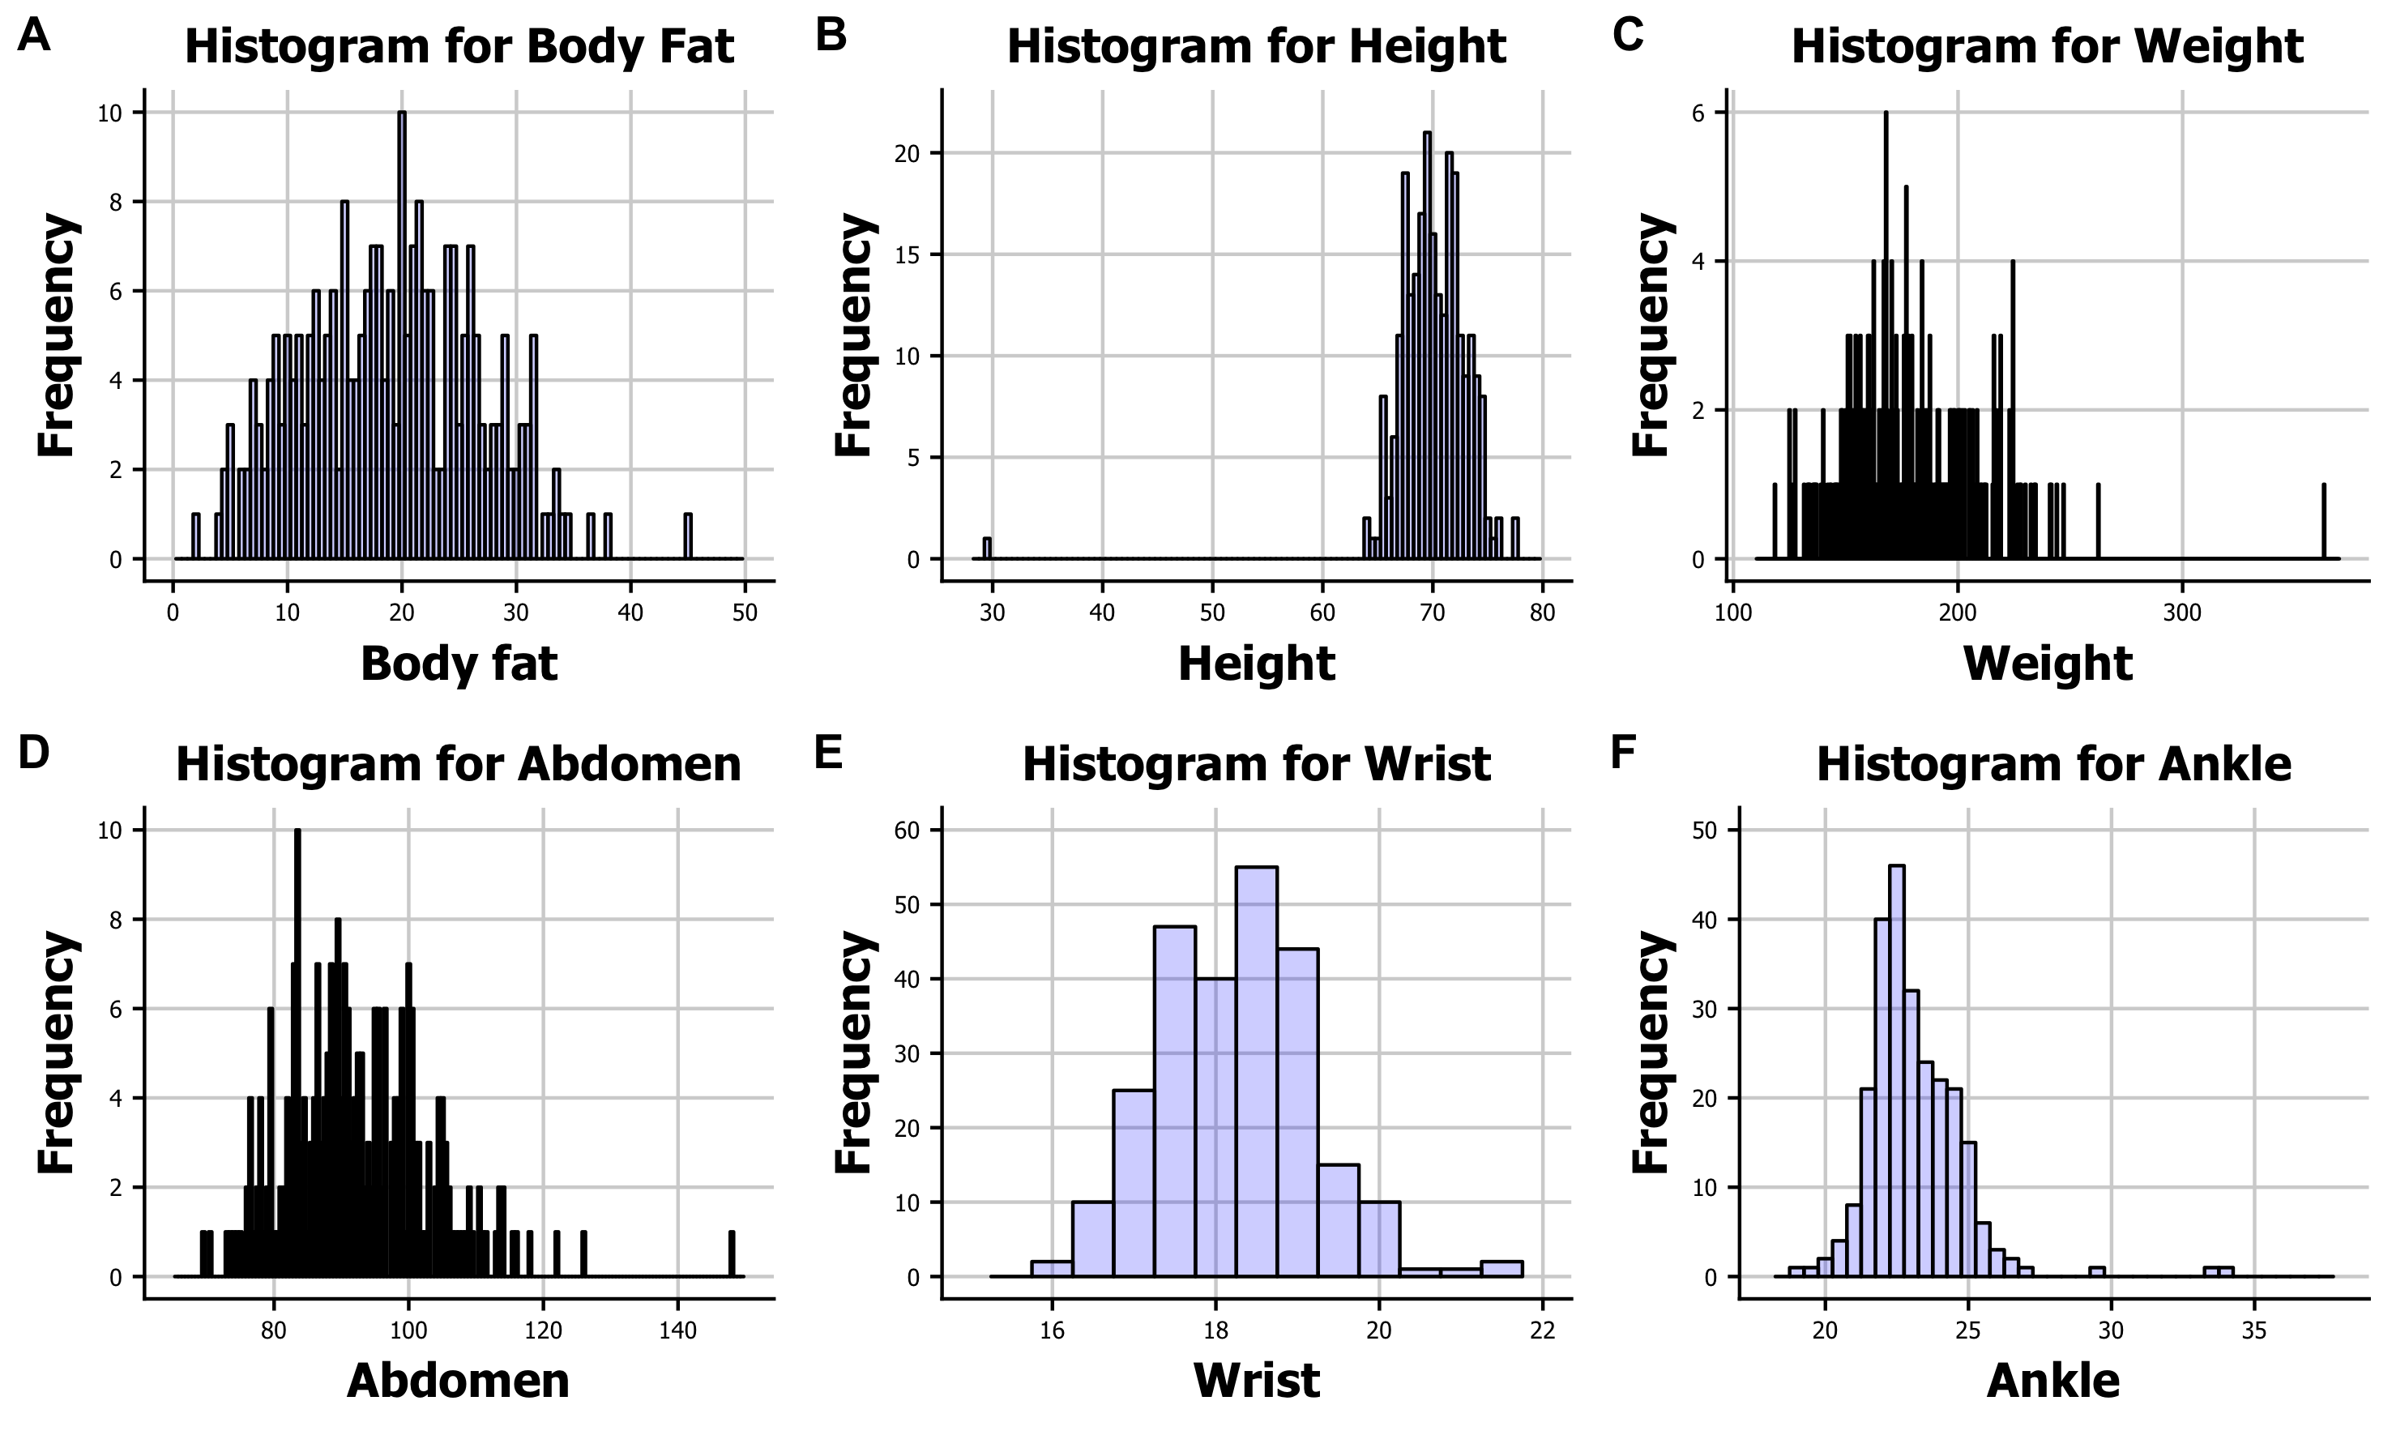
Raw Data and Data Visualization

Slide 5
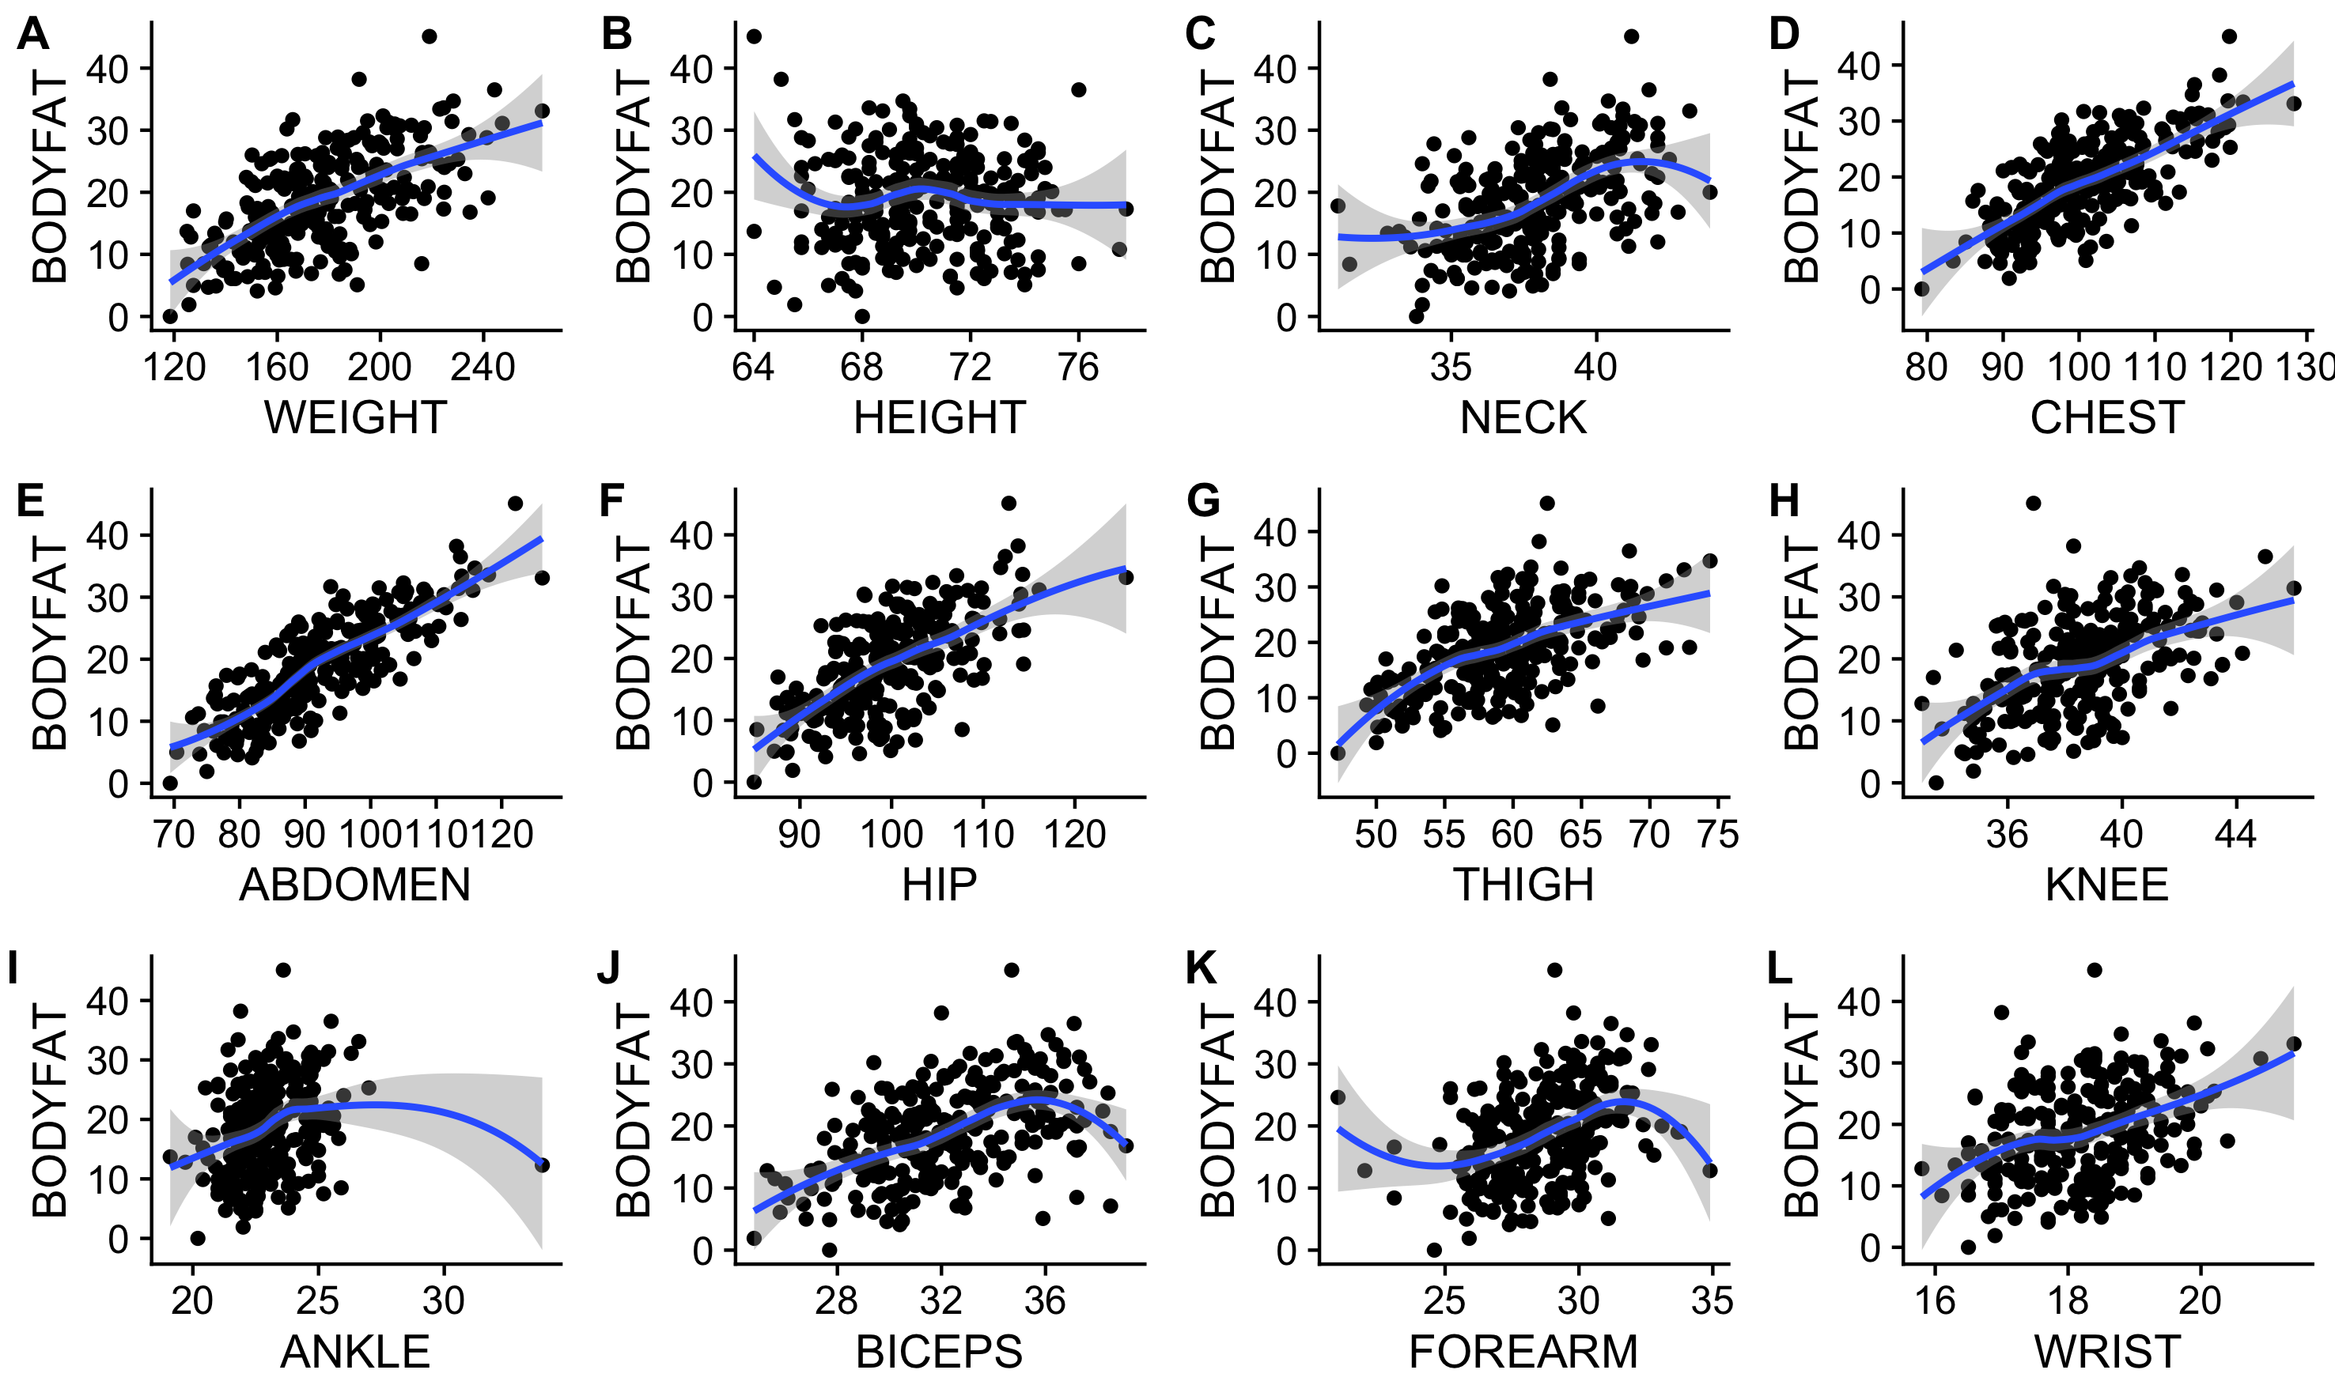
Raw Data and Data Visualization

Slide 6
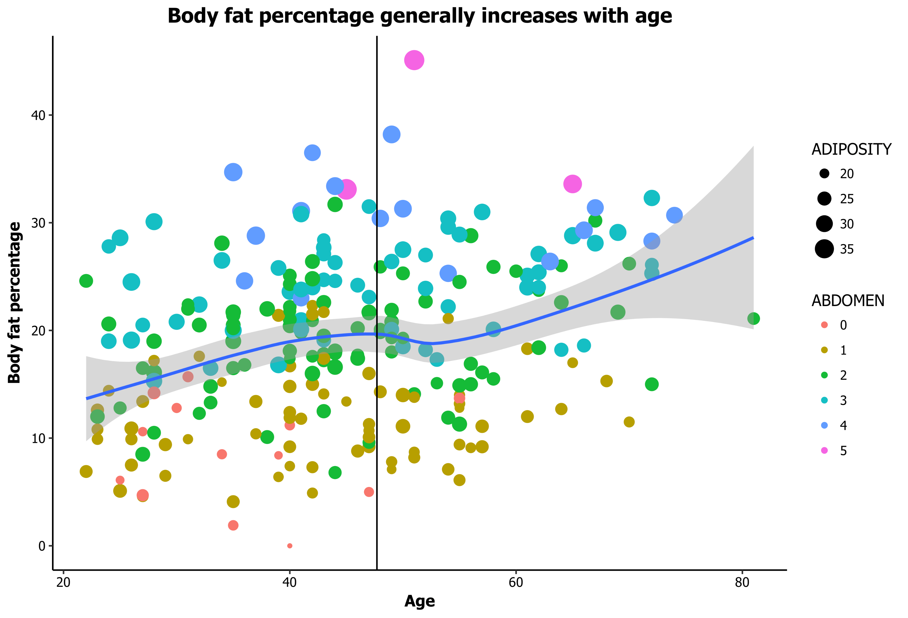
Raw Data and Data Visualization
Notes:
This plot shows relation between age and bodyfat

Slide 7
Modeling and Analysis
Full data model - use all data
Two age level separate model - divided by age

Slide 8
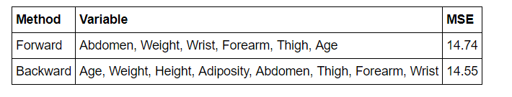
Modeling and Analysis
Full model is obtained use forward selection.
Forward model is simpler and only losing a little accuracy
Further deleting three variables, keep WEIGHT, ABDOMEN and WRIST.

Slide 9
Modeling and Analysis
Separated model
Under age 45, multicollinearity is a heavy issue.
Delete variable ADIPOSITY
Finally find ABDOMEN, WEIGHT, WRIST, BICEPS and ANKLE.

Slide 10
Modeling and Analysis
Separated model
Beyond 45
Forward and backward give the same solution: ABDOMEN and WEIGHT. Simple and accurate.

Slide 11

Modeling and Analysis
Compared Mean square error of the full data model and separated two age level model

Slide 12
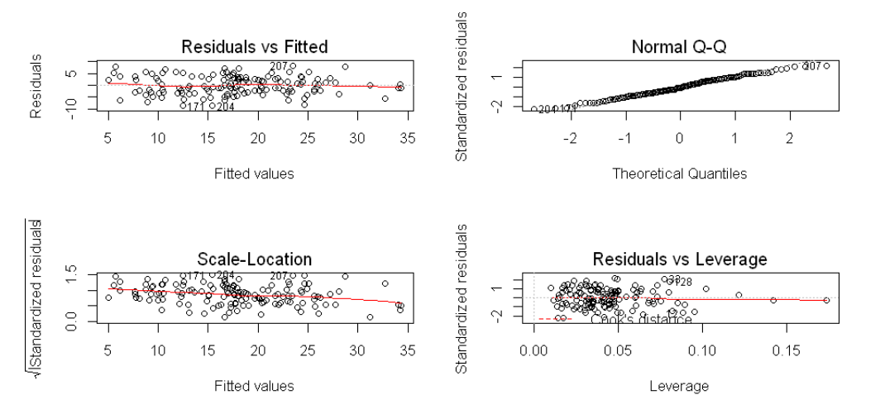
Model Diagnostics
Under 45

Slide 13
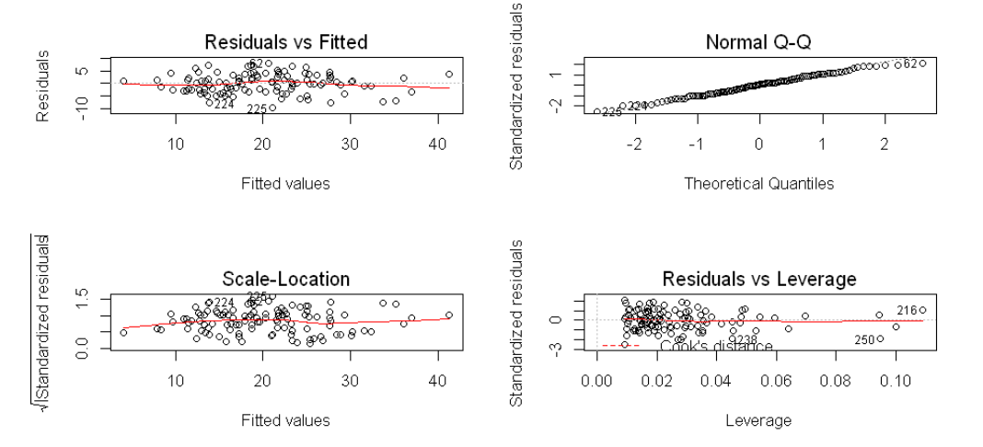
Model Diagnostics
Beyond 45

Slide 14

Conclusion
Possible rule of thumb:
Under 45
Beyond 45

Slide 15
Strength and Weakness
All assumptions are well satisfied.
No advanced techniques for dealing with multicollinearity is employed since we just delete the most correlated variables.
Due to data constraints, our model is unable to predict bodyfat percentage for children or even more older people.
We can only predict male's bodyfat.

Slide 16
Simple Example
For a 47 years old man, he has a abdomen circumference 90cm and weight 200 lbs. His bodyfat can be estimated as 90 minus 200 multiplied by 0.1 and then minus 46, which is 24%.

Slide 17
Future work
PCA, LASSO, and PLS for multicollinearity
GMC by Prof. Zhengjun Zhang for variable selection
For large dataset, generate a relatively small sample to start variable selection
…

Slide 18
Thank you!

