Slide 1
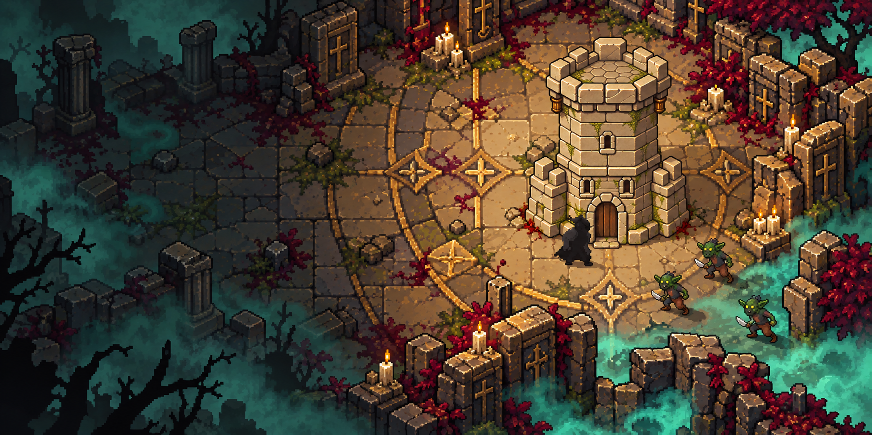




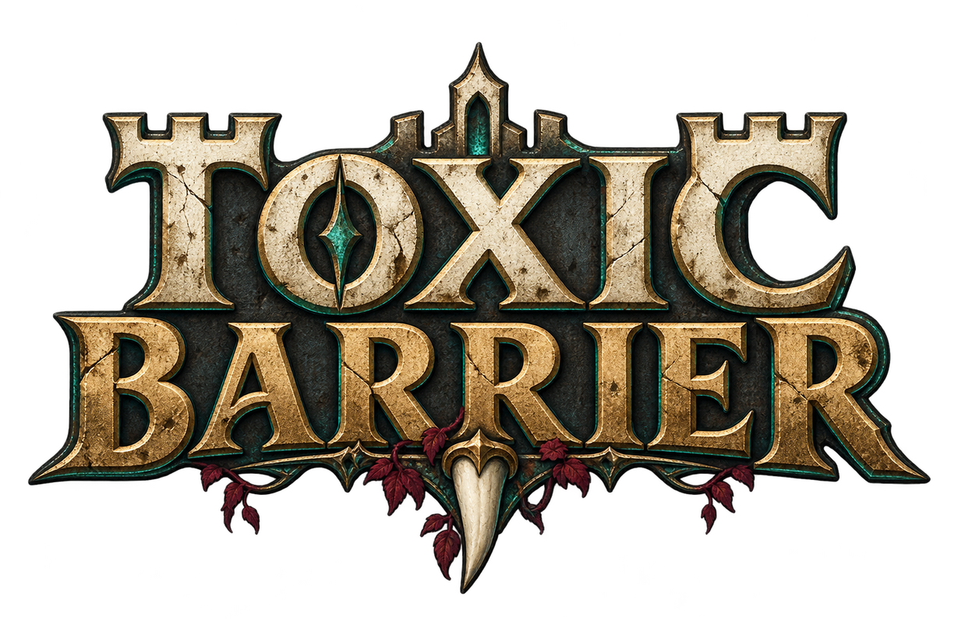
TOXIC
BARRIER
2D SURVIVAL & TOWER DEFENSE
Toxic fog erupted beneath a medieval kingdom.
The dead rose. Its cities fell.
One tower still holds back the poison.
You are its last defender.
github.com/JXia0/ToxicBarrier
Picture Generated by AI

Slide 2

How to play & game flow
TOXICBARRIER / PERSONAL PROJECT
The player gathers and maneuvers. The allied tower attacks automatically.
Gather & upgrade
Collect four resource types and invest them in the tower.
Lure & survive
Bring enemies into tower range. Break pursuit with cover.
Expand & defend
Upgrade to unlock regions and bring back repair supplies.
KEYBOARD CONTROLS
VICTORY
WASD / Arrows
E
Esc
Tower level 3. All regions and remaining enemies cleared.
Move
Upgrade / collect supplies
Pause

Slide 3
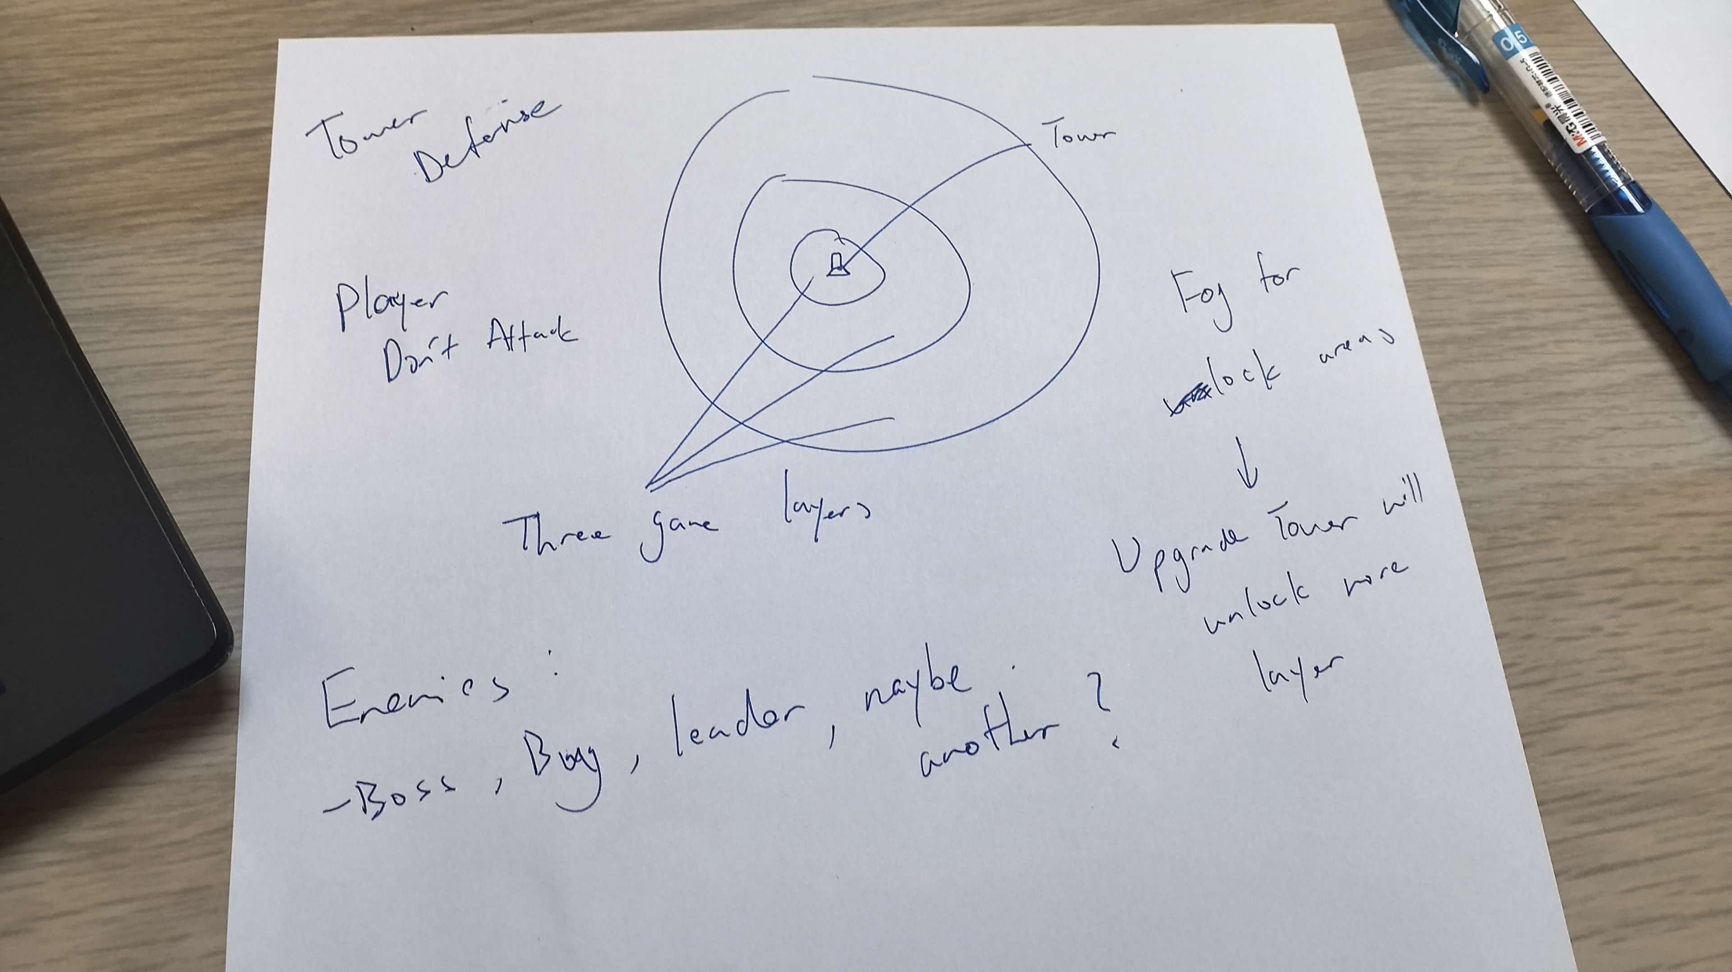
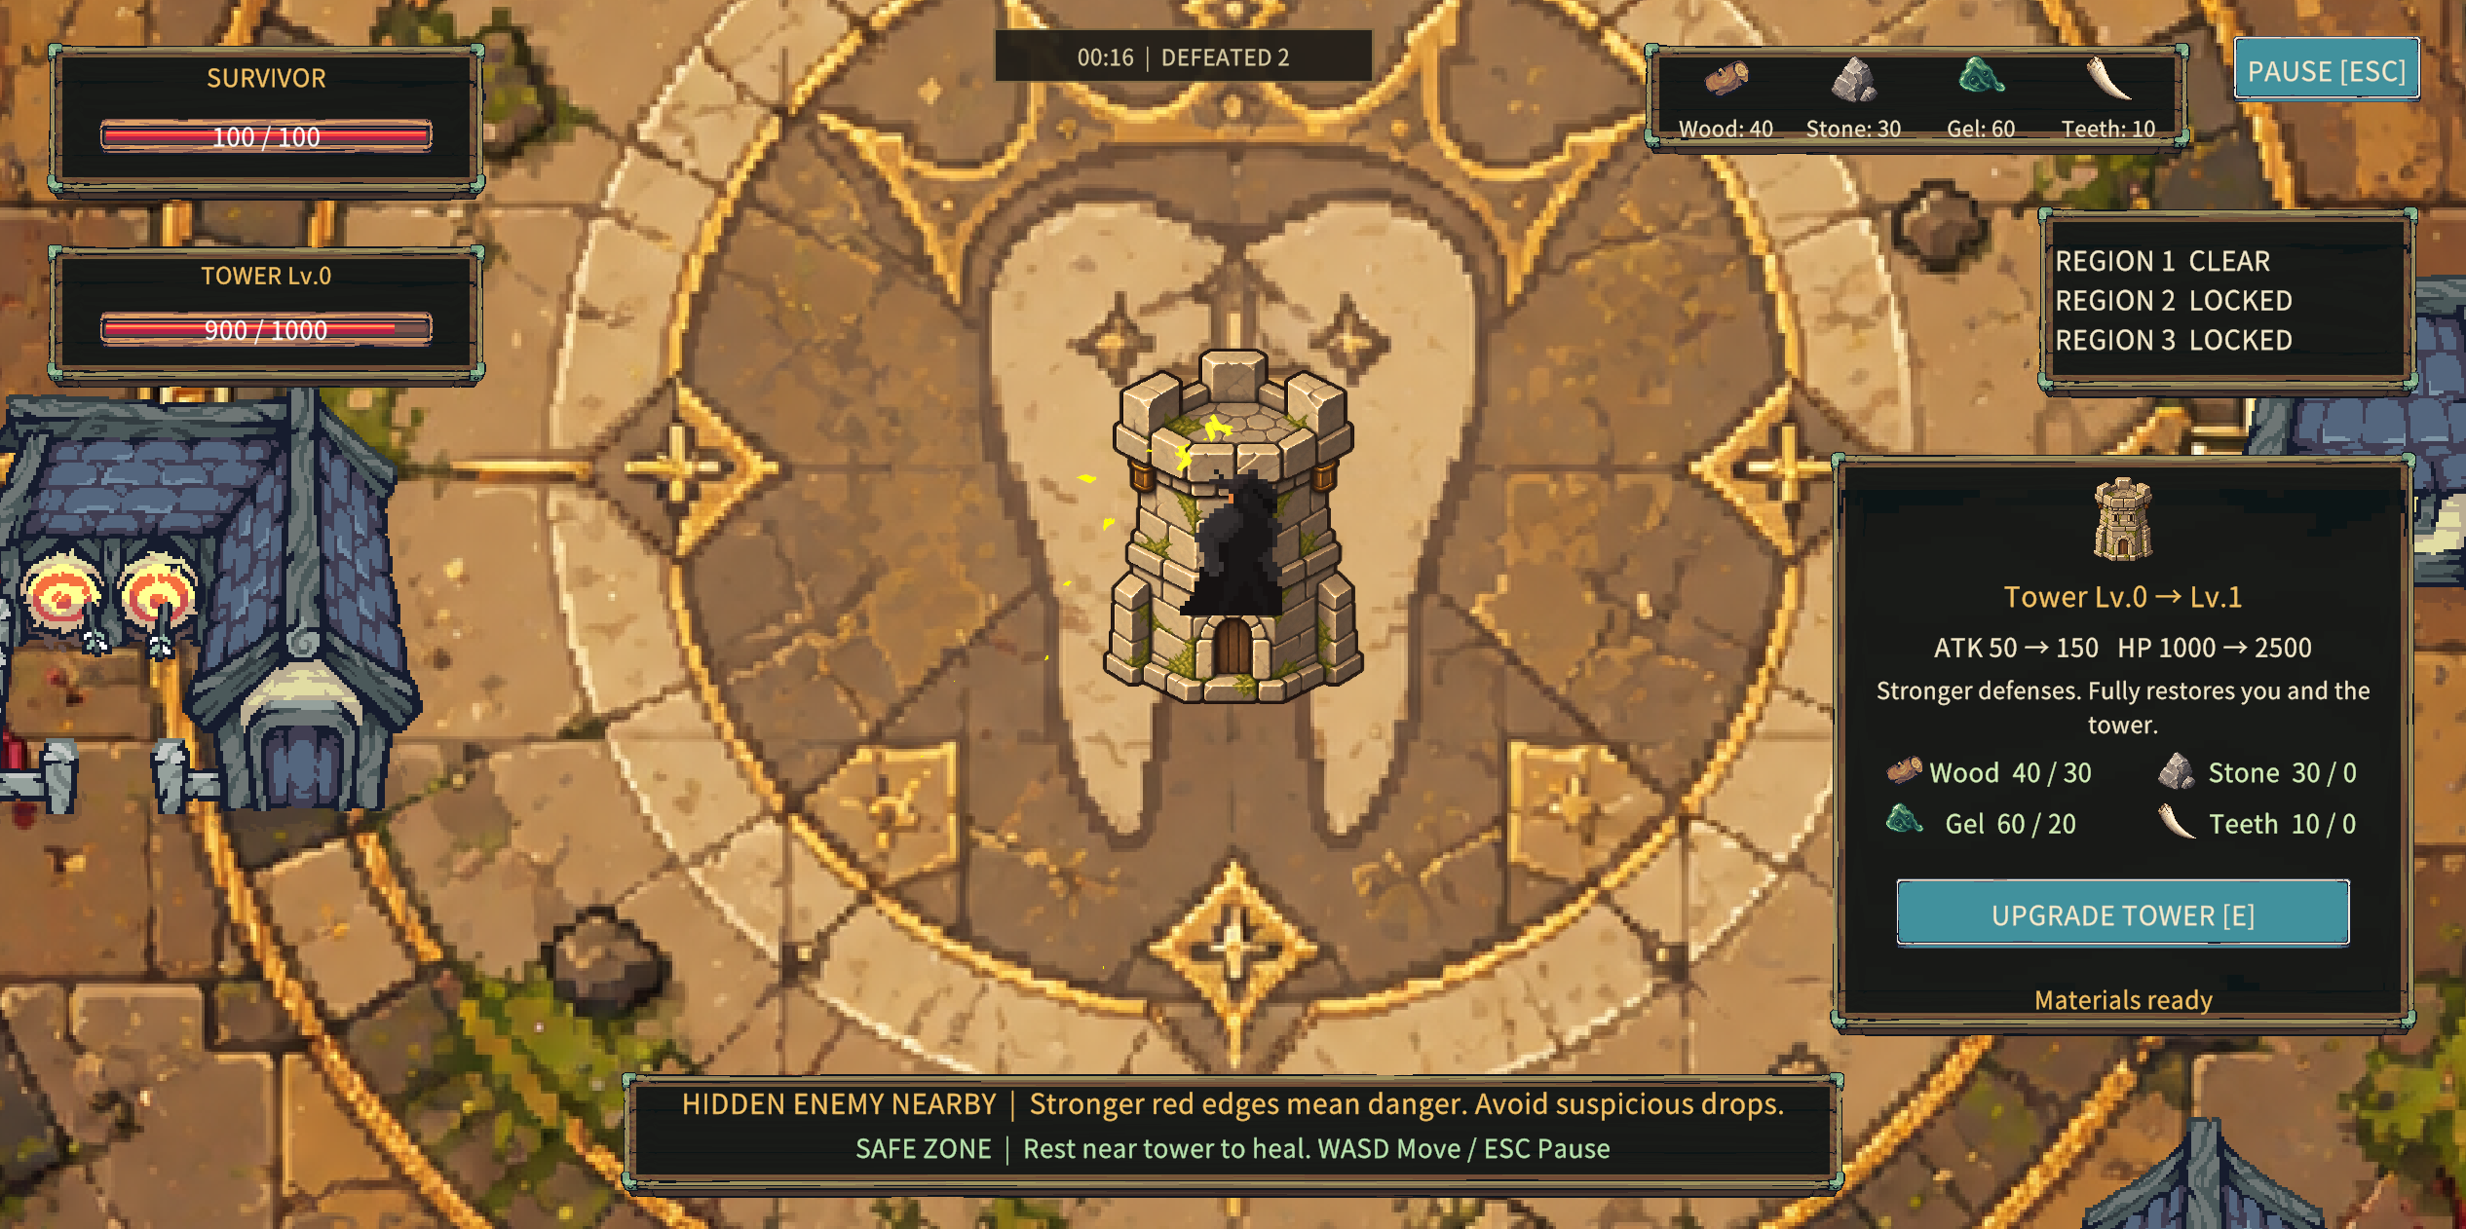
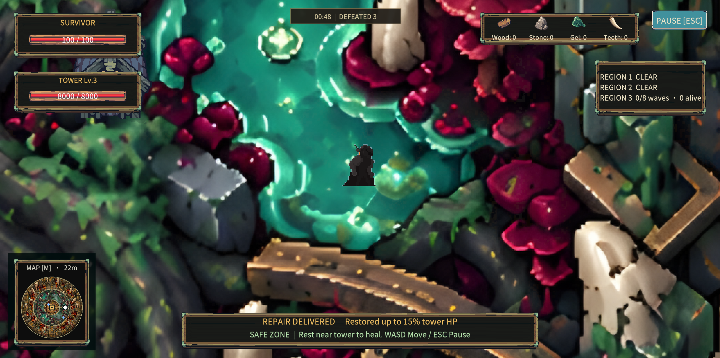
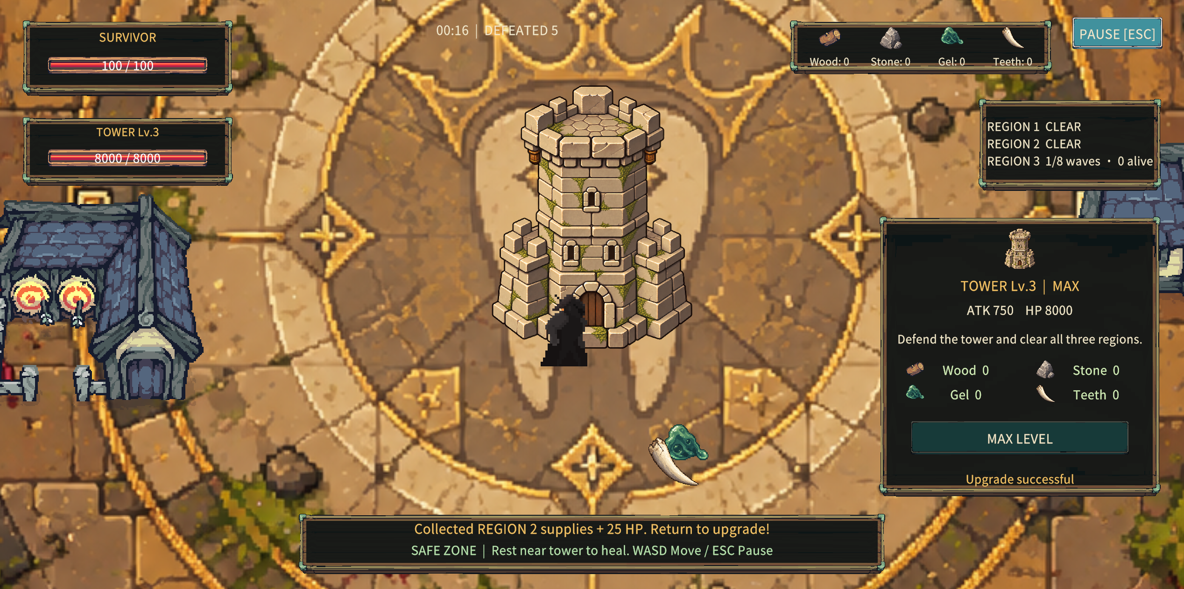
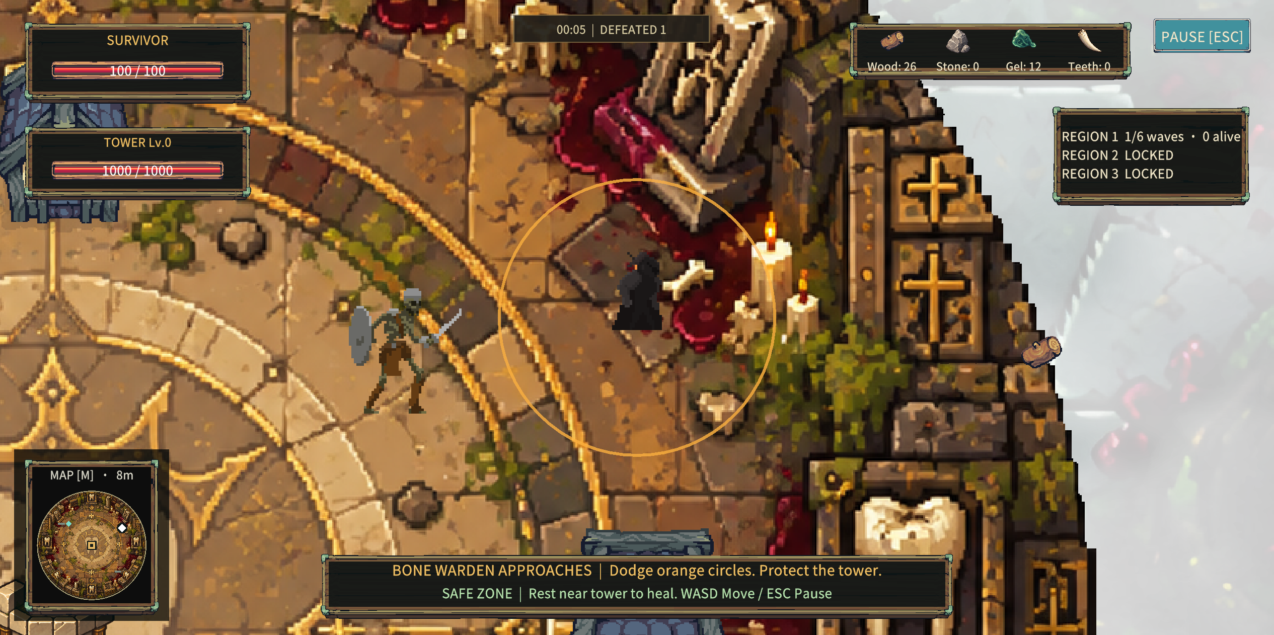
Level design & progression
TOXICBARRIER / PERSONAL PROJECT
Three concentric regions keep the tower central while exploration becomes more demanding.
01 LEARN THE LOOP
02 LEAVE THE REFUGE
03 SURVIVE THE SIEGE
LEVEL DESIGN
MY ORIGINAL SKETCH
Gather resources near the tower, then spend them on upgrades. Early waves teach movement and safe returns.
Tower level 2 opens the next ring. Travel beyond safety for supplies, using buildings to break pursuit.
A fully upgraded tower anchors the final defense. Keep it standing while clearing the remaining waves.
1 Refuge
2 Outer ring
3 Final siege
Fog limits access
until tower upgrades.
REGION 1 / SAFE RETURNS
REGION 2 / RISK AND REWARD
REGION 3 / FINAL DEFENSE
Gather
resources
Upgrade
the tower
Unlock
next ring

Slide 4
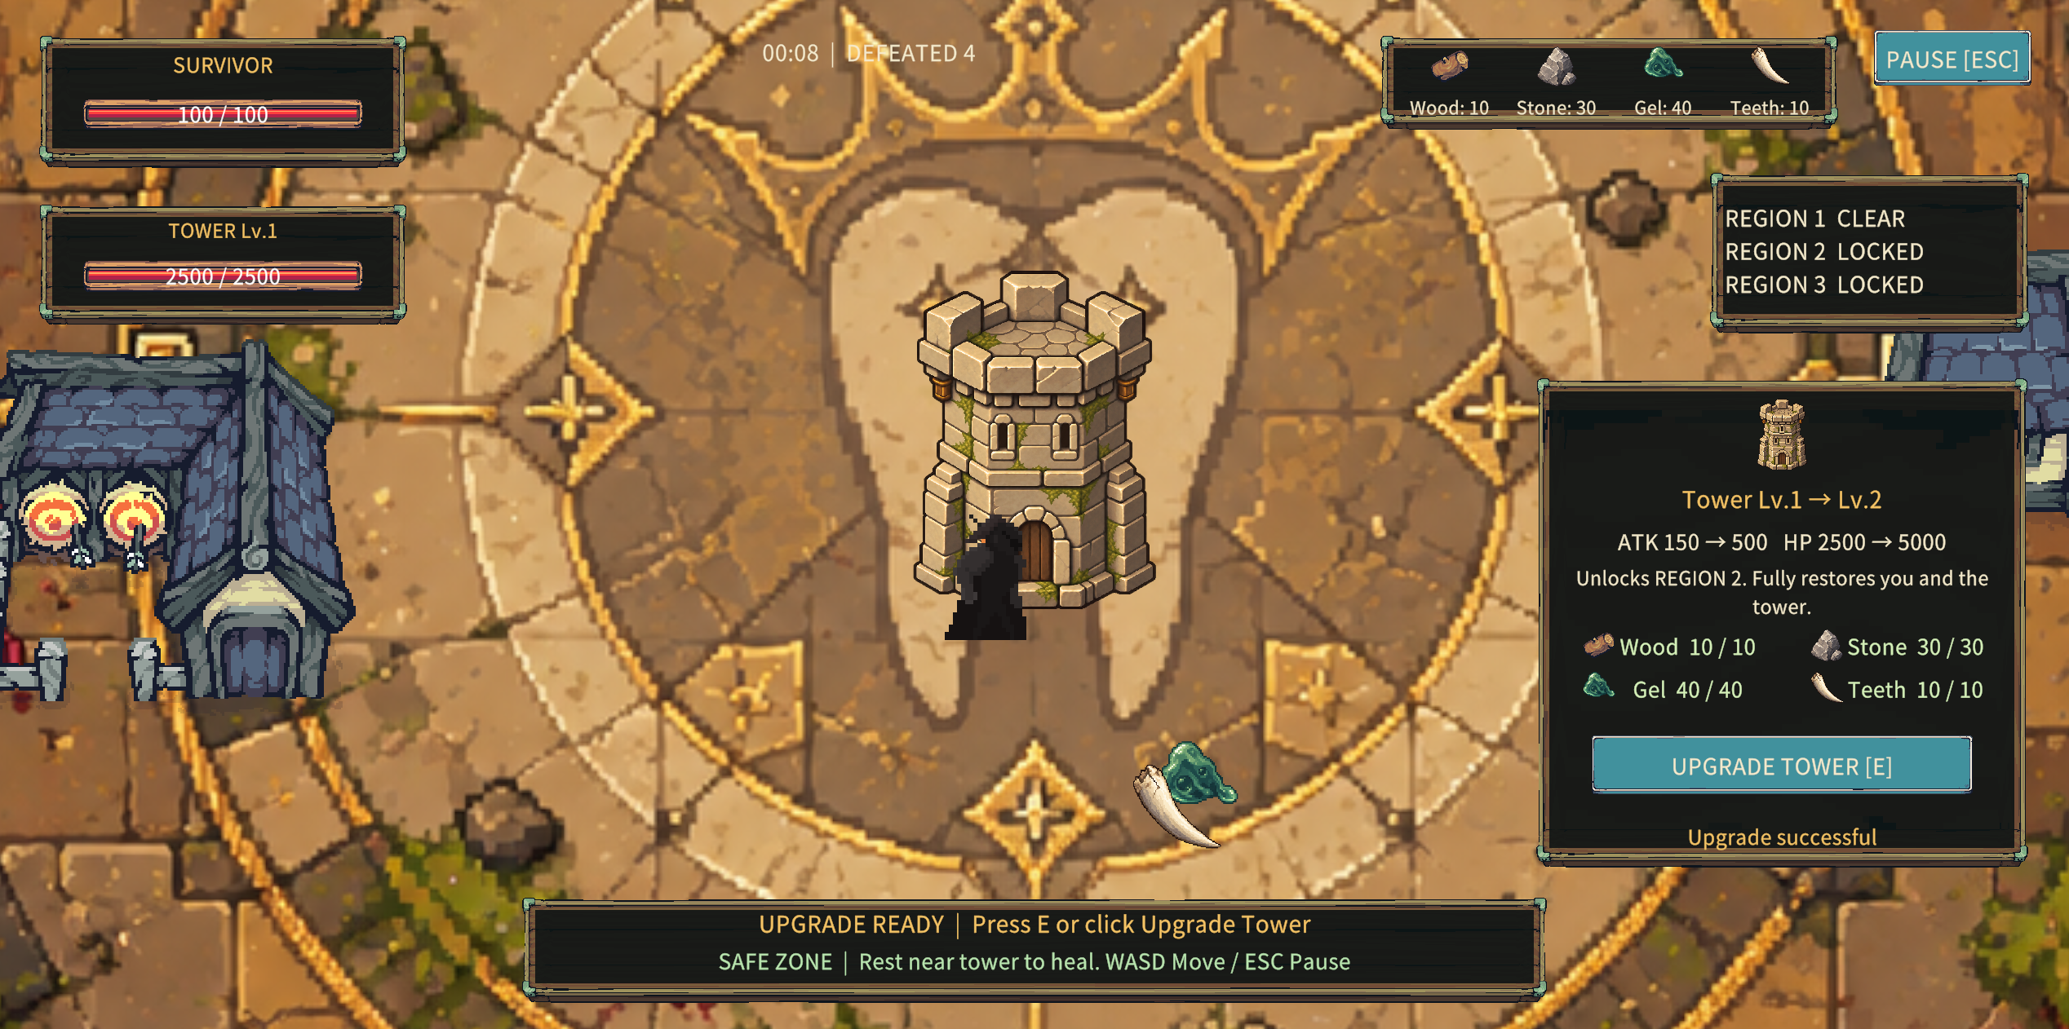
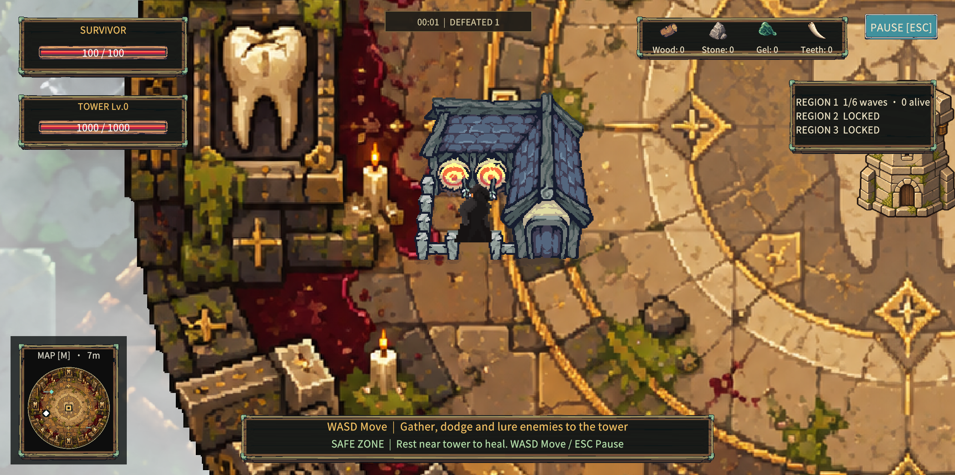
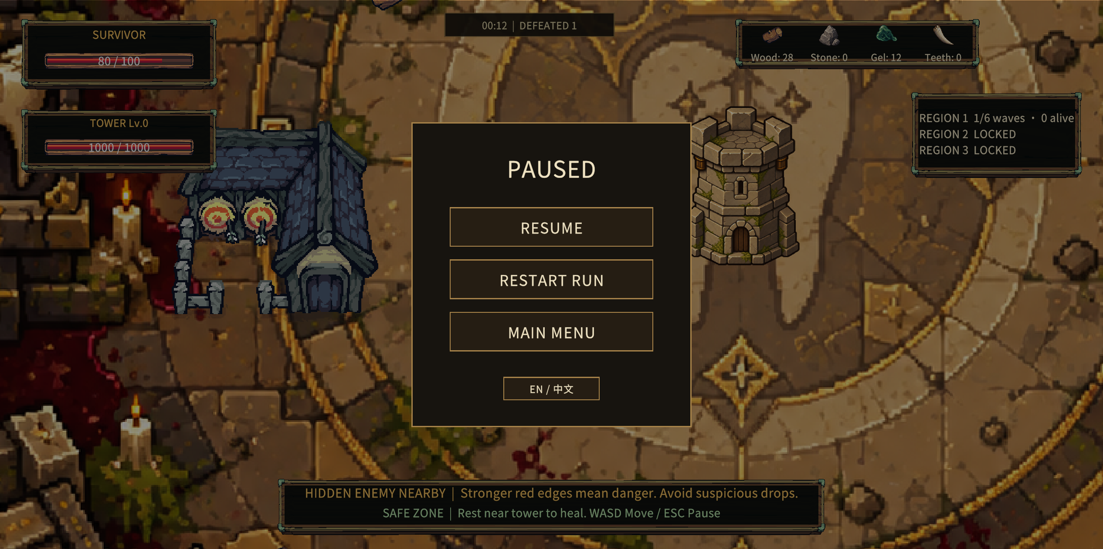
Code implementation
TOXICBARRIER / PERSONAL PROJECT
01 TOWER PROGRESSION
02 EXPLORATION
03 GAME FLOW
Resources strengthen the tower and unlock new regions.
Buildings create detours. Supplies reward leaving safety.
A shared game state controls starting, pausing and restarting.
Tower.cs
MapController.cs
ExplorationSupply.cs
TowerNavigationFootprint.cs
GameFlowManager.cs
GameFlowUI.cs

Slide 5
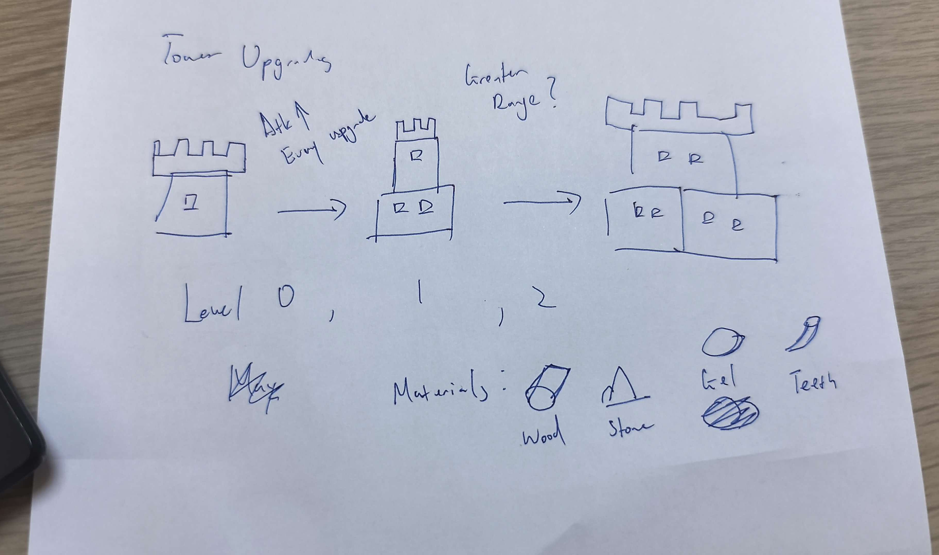
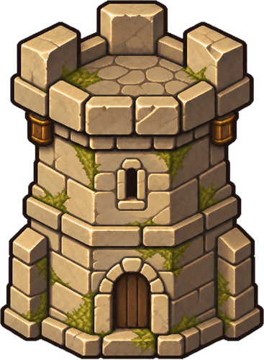
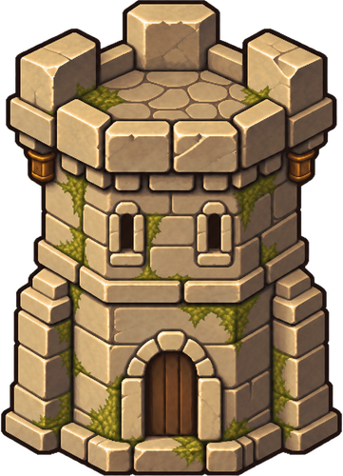

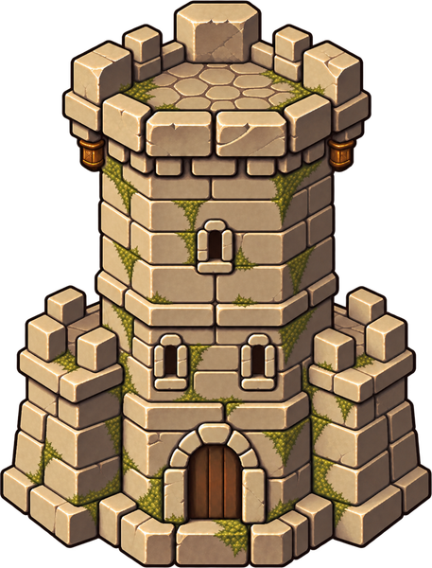
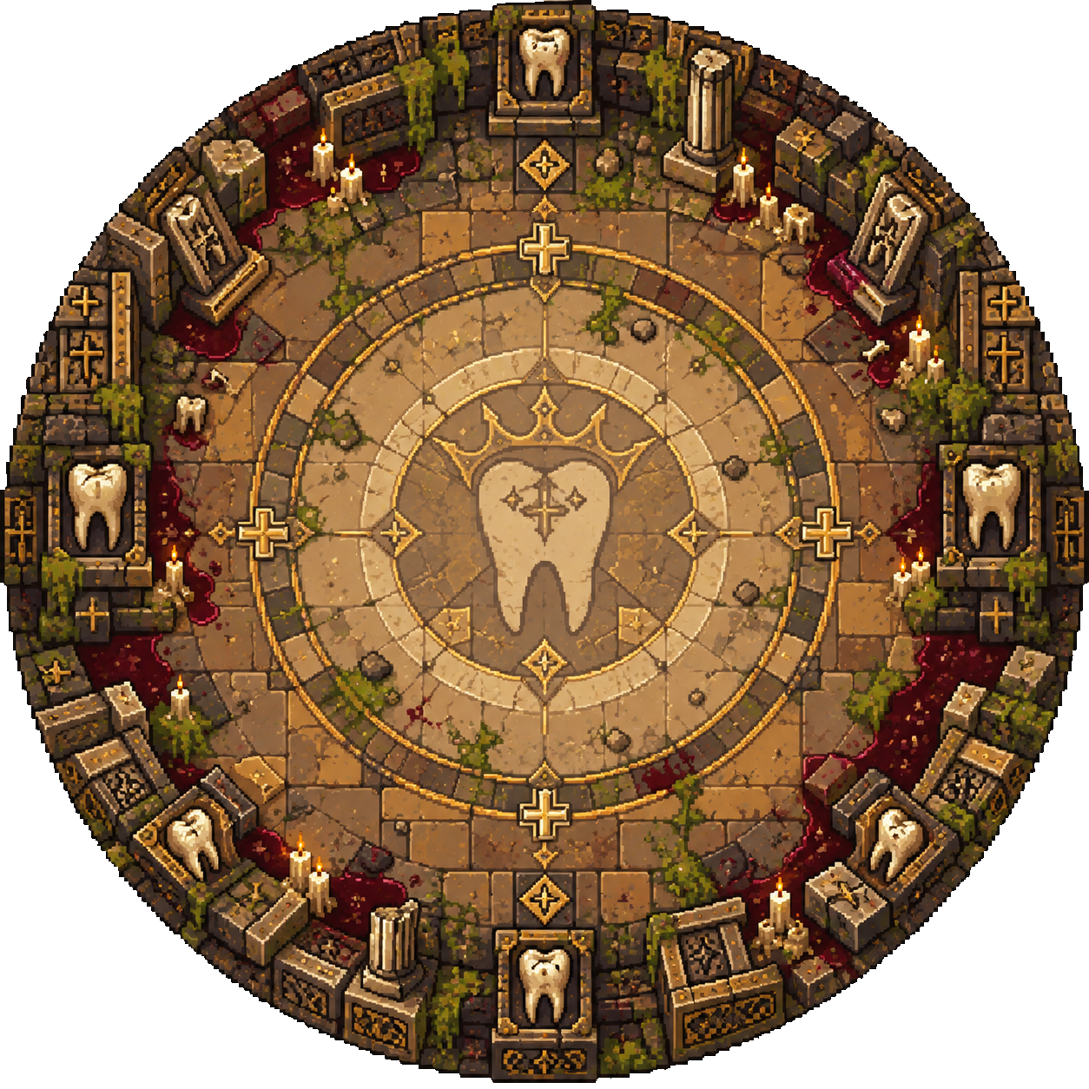
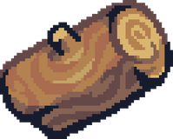
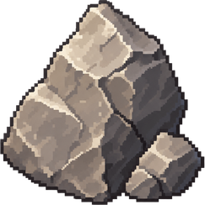


Visual Development Process
TOXICBARRIER / PERSONAL PROJECT
I direct the artwork through prompts, sketches and references, then select and refine AI-generated results.
01 PROMPT & SKETCH
02 REFERENCE & GENERATE
03 REVIEW & INTEGRATE
STYLE REFERENCES
PREVIOUSLY APPROVED ART
I use earlier approved assets to guide the palette, lighting and material style.
LV.0
LV.1
LV.2
LV.3
EARLY TOWER AND RESOURCE CONCEPT
ORIGINAL PROMPT
My sketch explores the tower silhouette as it grows, alongside wood, stone, gel and teeth.
I compare each result with the existing game, reject mismatched styles and prepare the chosen sprites for Unity.
Solo project. Game design, development and art direction.

Slide 6
FEEDBACK AND PLAYTEST
TOXICBARRIER / PERSONAL PROJECT
PLAYER PLAYTEST
PLAYER FEEDBACK
PLAYTEST PHOTOGRAPH 01
PLAYER COMMENT / OBSERVATION
PLAYTEST PHOTOGRAPH 02
PLAYER COMMENT / OBSERVATION

Slide 7
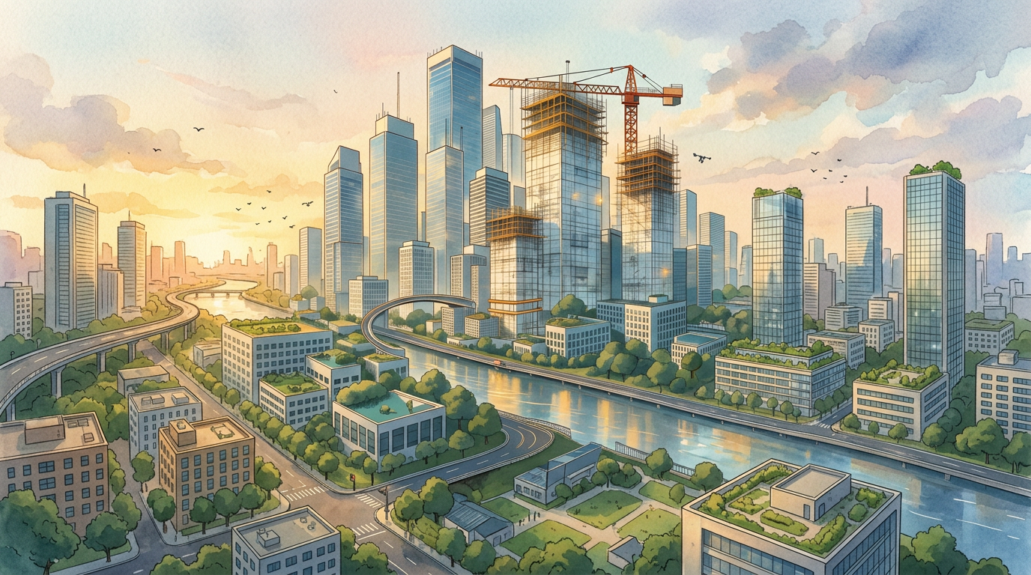
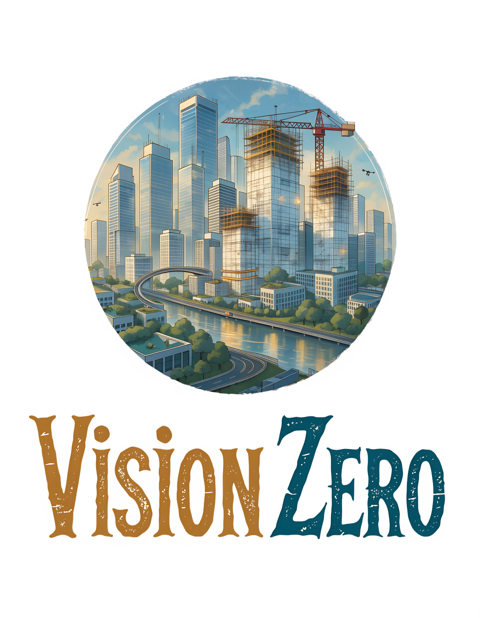

BOARD GAME DESIGN
Planning a safer city
A competitive board game where players assign city employees and draft safety dice to complete transport projects while managing funding and emergencies.
The Safe City Project
PERSONAL PORTFOLIO
2–4 players
5 rounds
Competitive city planning
A city shaped by every planning decision
MY ROLE
TEAM
DEVELOPMENT
Game design & iteration
Solo project
Feb. 2026 - Present

Slide 8
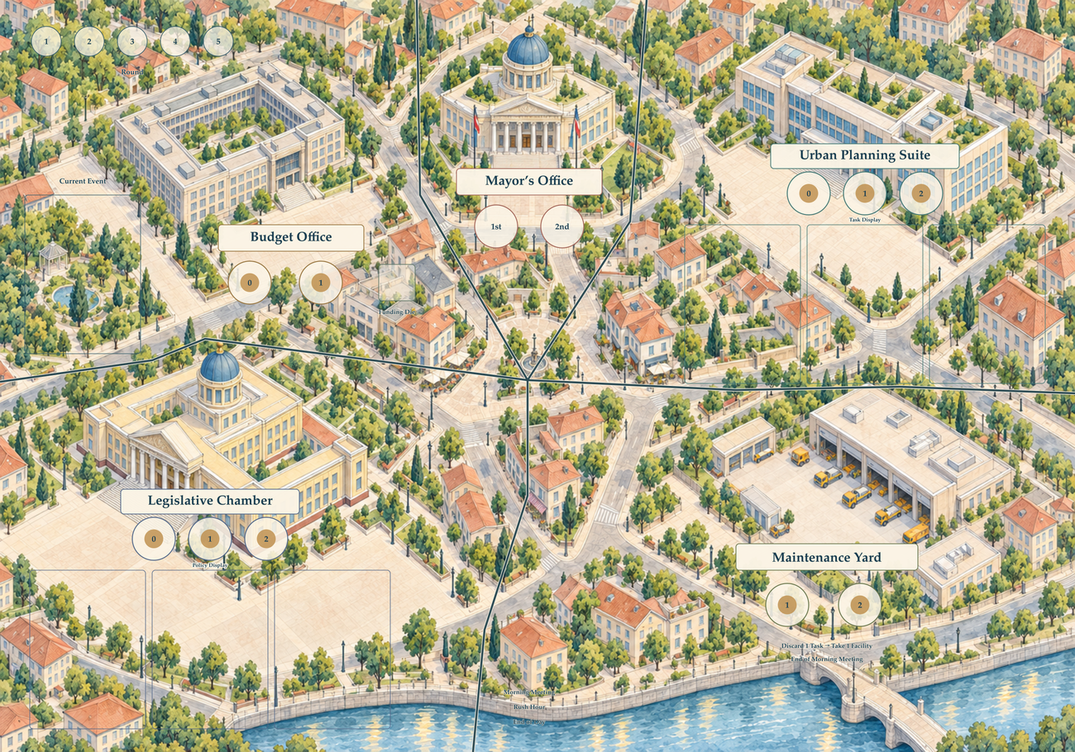
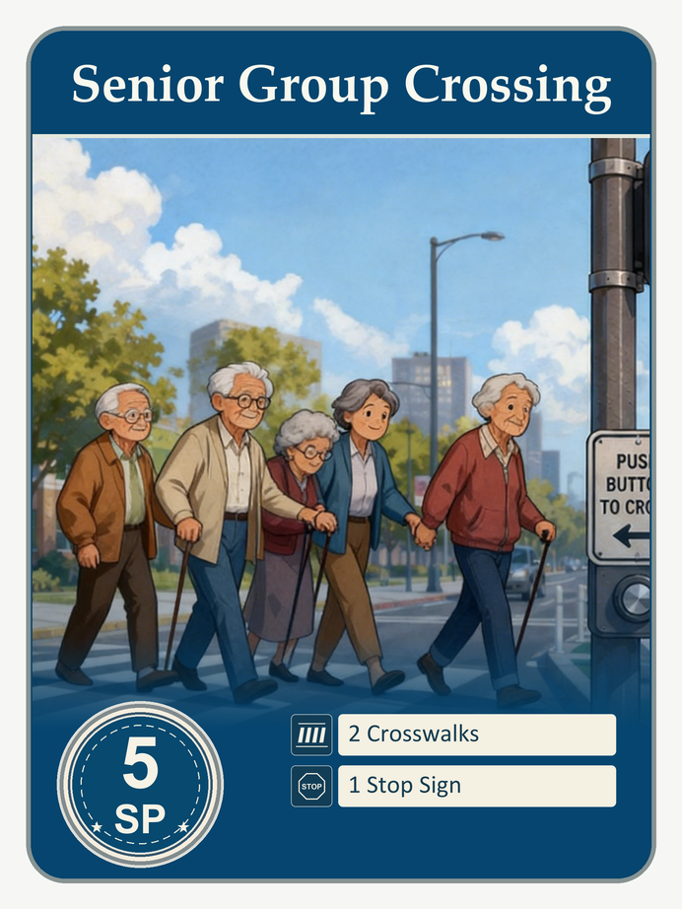
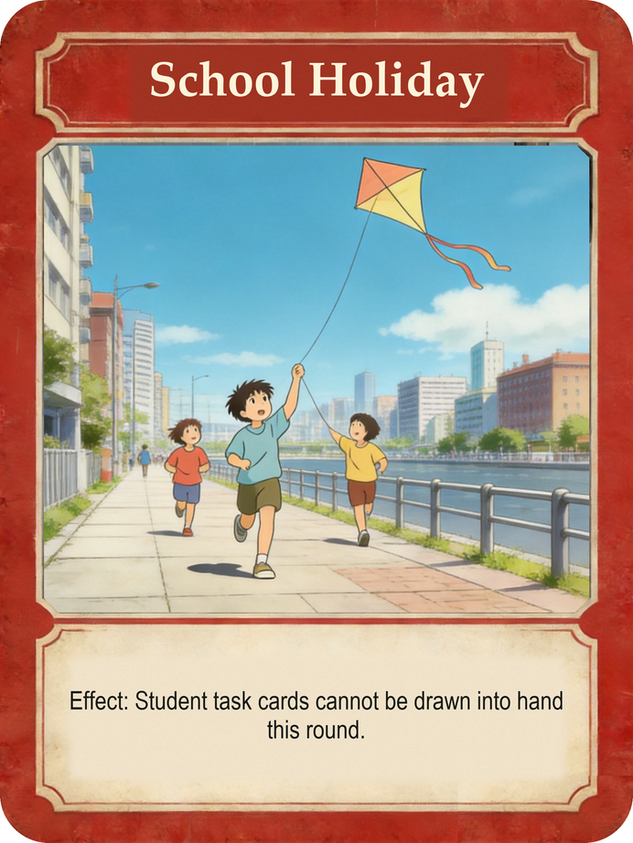
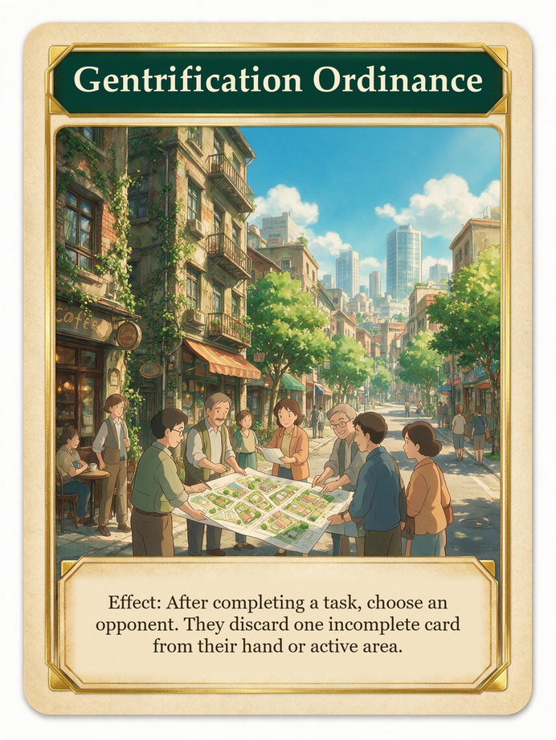
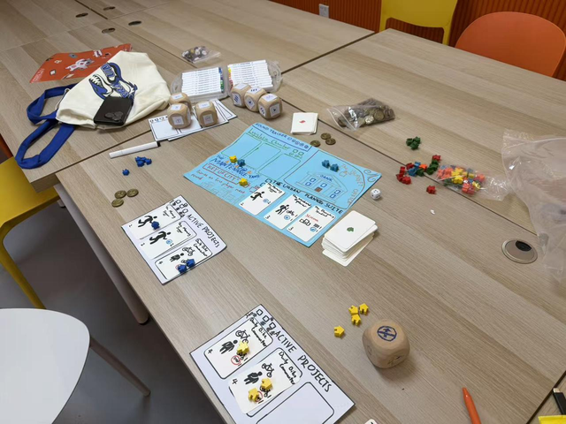
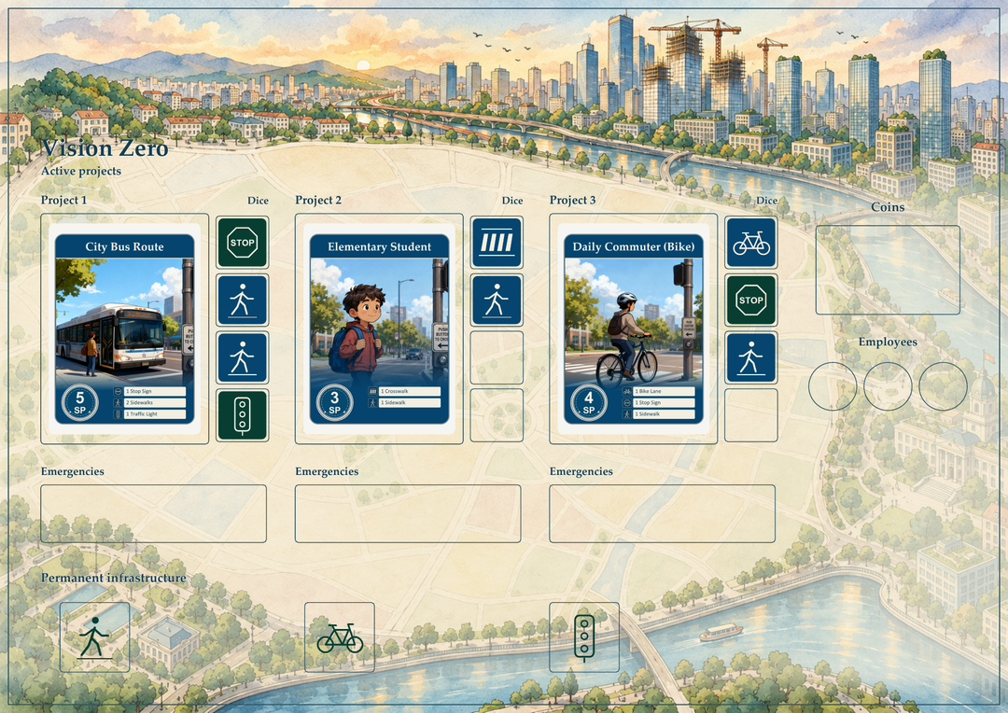
VISION ZERO / PERSONAL PORTFOLIO
Game components & setup
THE TABLE
40 CARDS
16 CARDS
24 CARDS
Planning tasks
Traffic events
Government cards
9 traveler designs
Projects that earn Safety Points
8 event designs
One city-wide effect each round
8 policy designs
Ongoing abilities and interaction
Main board artwork in progress
SHARED SUPPLY
5 Pedestrian dice + 5 Vehicle dice + 6 Emergency dice
12 employee pawns, Coins and infrastructure tokens
First Player marker and Round marker
Early paper prototype
Player Board

Slide 9
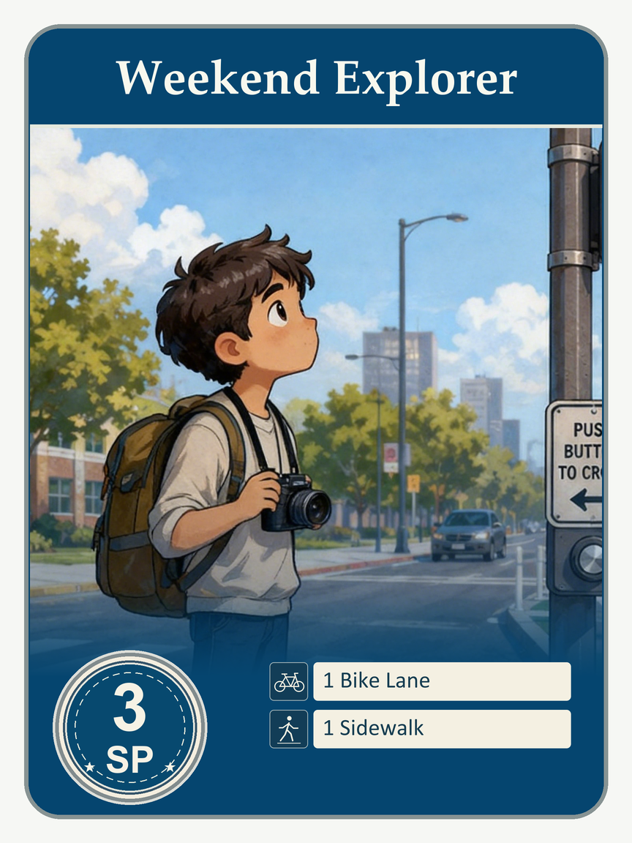
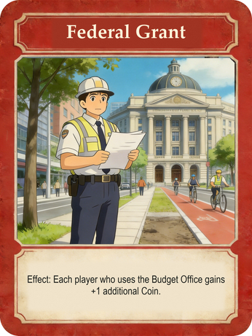

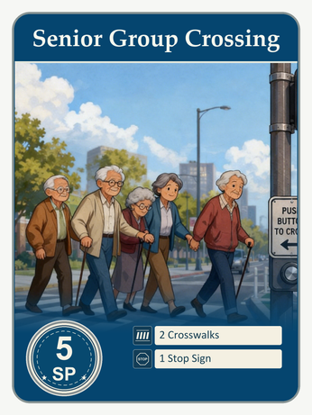
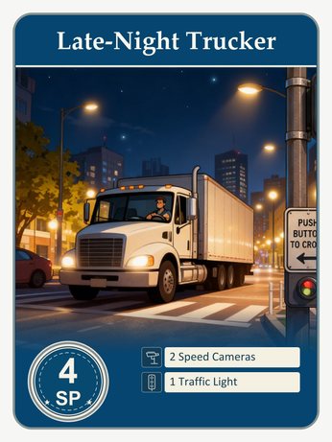

VISION ZERO / PERSONAL PORTFOLIO
How to play & how to win
STARTING RESOURCES / PER PLAYER
3
2
3
employees
Coins
task cards
01
02
03
Morning Meeting
Rush Hour
End of Day
SP
2
Event
3 employees
Roll & draft
Match
Score
Coins
Tasks
Activate projects
Place & resolve employees
Draft one eligible die
Place it on a project
Resolve hazards
Score & replenish
TASK EXAMPLE
Elementary Student
1 Crosswalk + 1 Sidewalk
Complete the project to earn 3 SP.
REPEAT FOR 5 ROUNDS
Unfinished tasks keep their safety dice.
WINNING CONDITION
Most Safety Points after Round 5 wins.
Task SP + policy bonuses + 1 SP per 3 Coins − unresolved emergency penalties

Slide 10

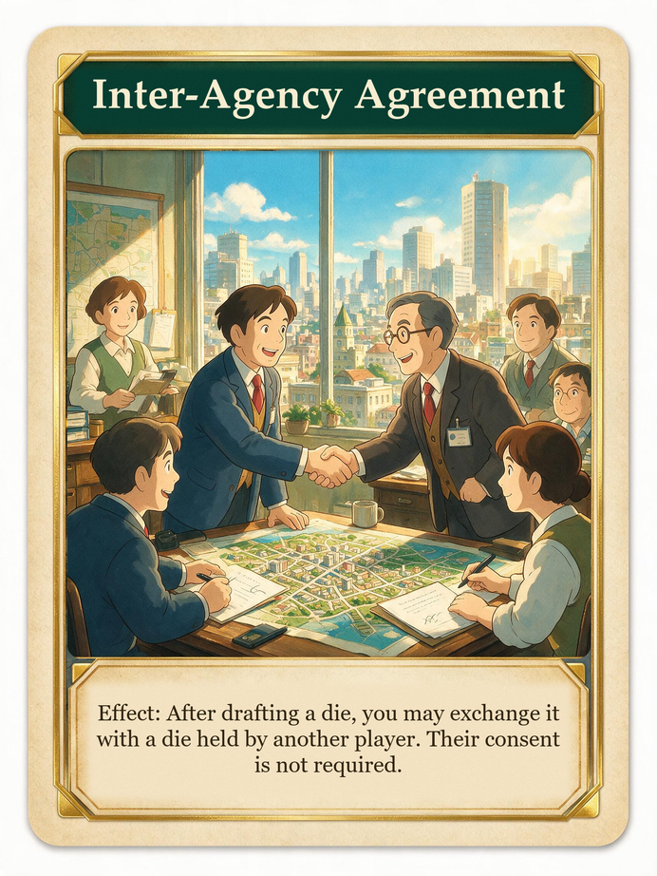
VISION ZERO / PERSONAL PORTFOLIO
Core mechanics & player strategies
01 WORKER PLACEMENT
02 DICE DRAFTING
03 GOVERNMENT POLICIES
Competition for action spaces
Shared dice, lasting commitments
Direct player interaction
Place 3 employees in departments, one pawn per action space.
Draft matching dice. Unfinished tasks keep them between rounds.
Policies alter resources or placement, including opponents’ pawns.
PLAYER STRATEGY
PLAYER STRATEGY
PLAYER STRATEGY
Secure scarce actions early. Balance immediate funding against reusable infrastructure.
Choose tasks with overlapping requirements. Keep Coins available to adjust a die or mitigate danger.
Time policy effects around contested actions and avoid relying on a single department.

Slide 11
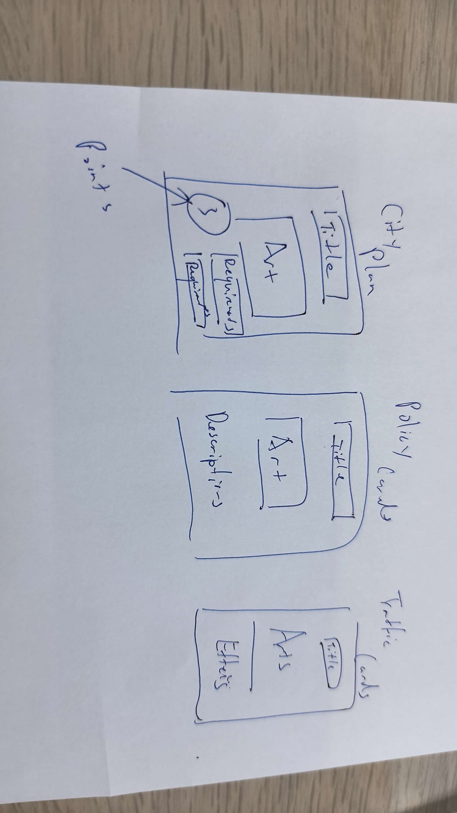
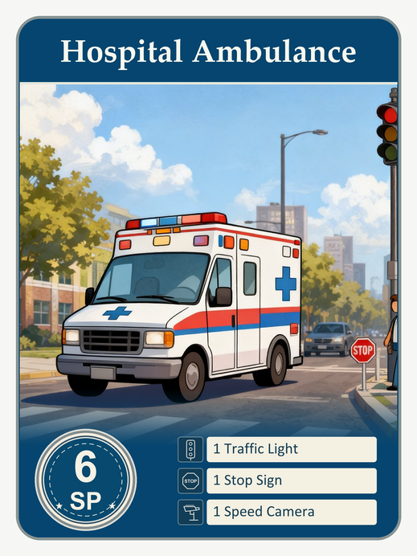
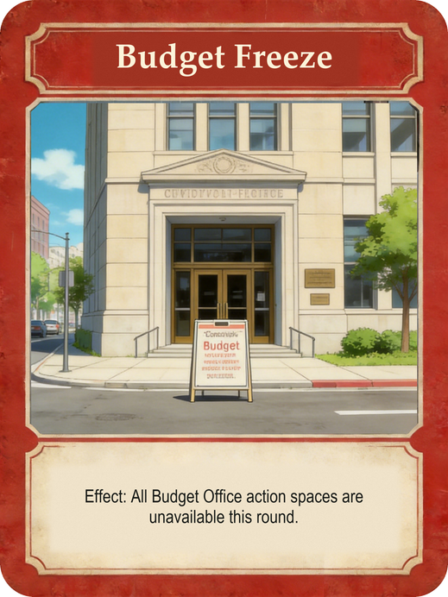
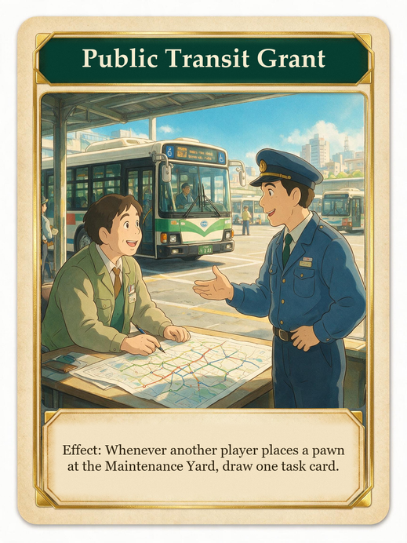
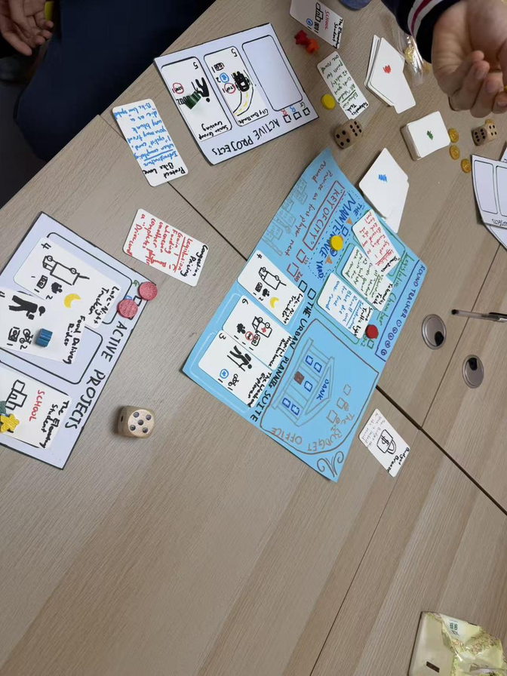
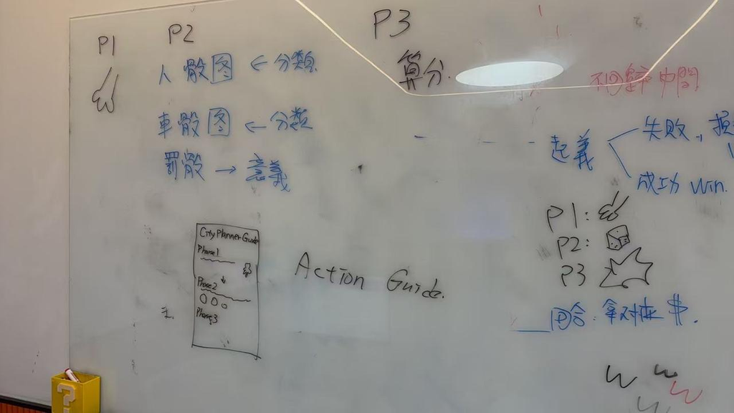
VISION ZERO / PERSONAL PORTFOLIO
Visual design & development
AI-ASSISTED ARTWORK
MY CARD SKETCH
Planning task
Traffic event
Government policy
AI-generated illustrations, selected to match a consistent card style.
01 SKETCH
I plan the card layout and reading order.
02 GENERATE
I use prompts and references to generate illustrations.
03 SELECT
I choose artwork that matches the approved card style.
Early phase and action-guide sketches
Early prototype playtest

Slide 12
VISION ZERO / PERSONAL PORTFOLIO
06 / 06
Final outcome & player testing
FINAL OUTCOME
PLAYER TESTING
PLAYTEST PHOTOGRAPH 01
FINAL GAME / TABLETOP PHOTOGRAPH
PLAYTEST PHOTOGRAPH 02
OUTCOME
PLAYER FEEDBACK & NEXT STEPS

Slide 13
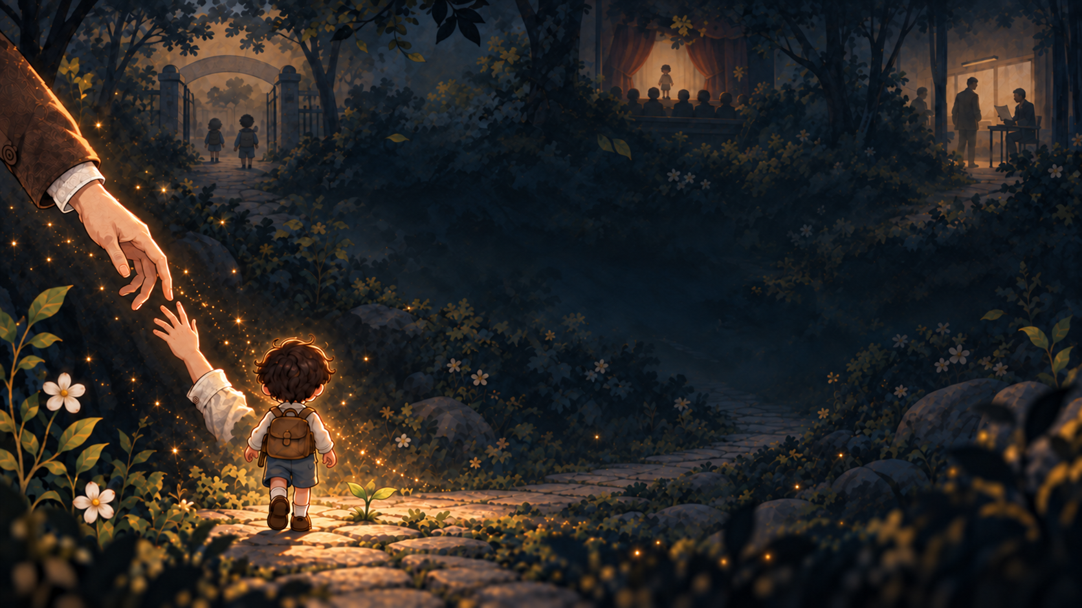

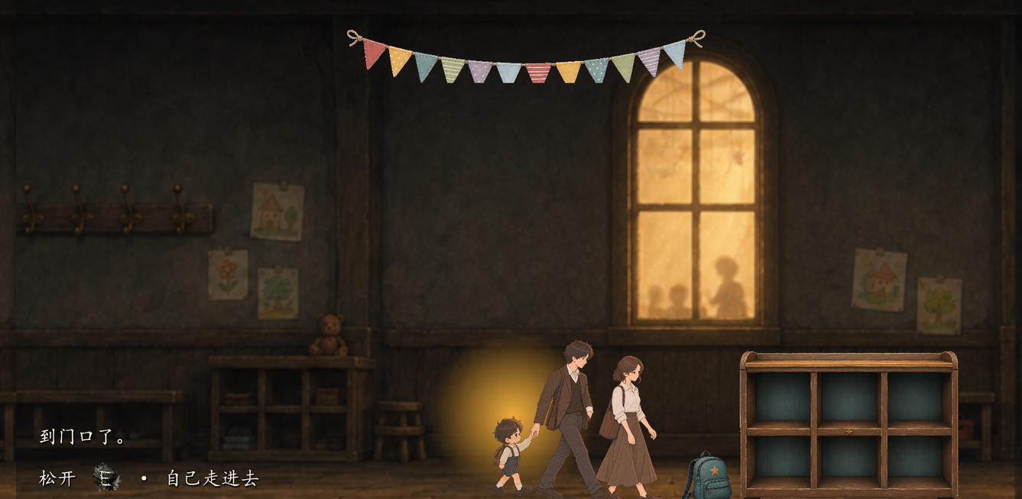
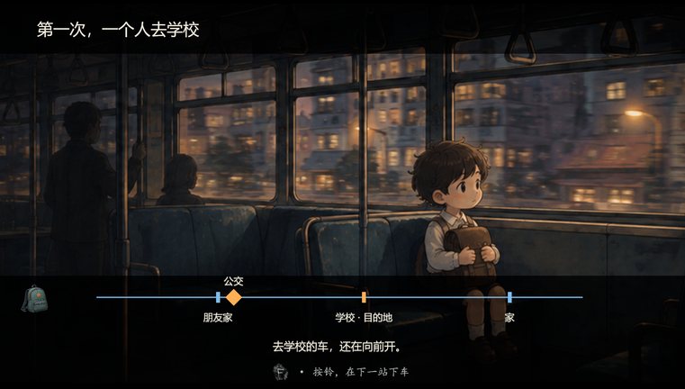
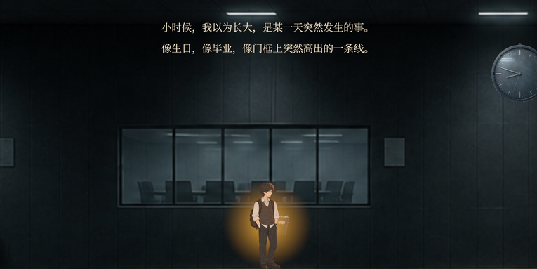
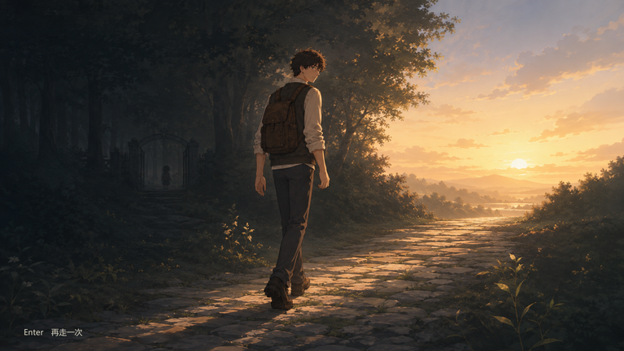
LETTING
GGJ 2026
THEME: GROW
globalgamejam.org/games/2026/letting-go-0
GO
Letting Go is a 2D side-scrolling narrative game where pressing and releasing a button lets you hold hands, steady your breathing, and support others through life’s defining firsts, growing from a child who needs their parents’ hand into an adult who must let someone else take their first step alone.
A story of growing up
and learning to let go.
MY ROLE
Game Designer
& Programmer
Core interaction design
Unity gameplay systems
Chapter flow and playtest iteration
TEAM COLLABORATION
Four-person team
Teammates: visual art,
music and sound
Holding a hand before taking the first step alone
Unity / C# Windows
First journey alone
Facing a new chapter
Learning to let go

