Slide 1

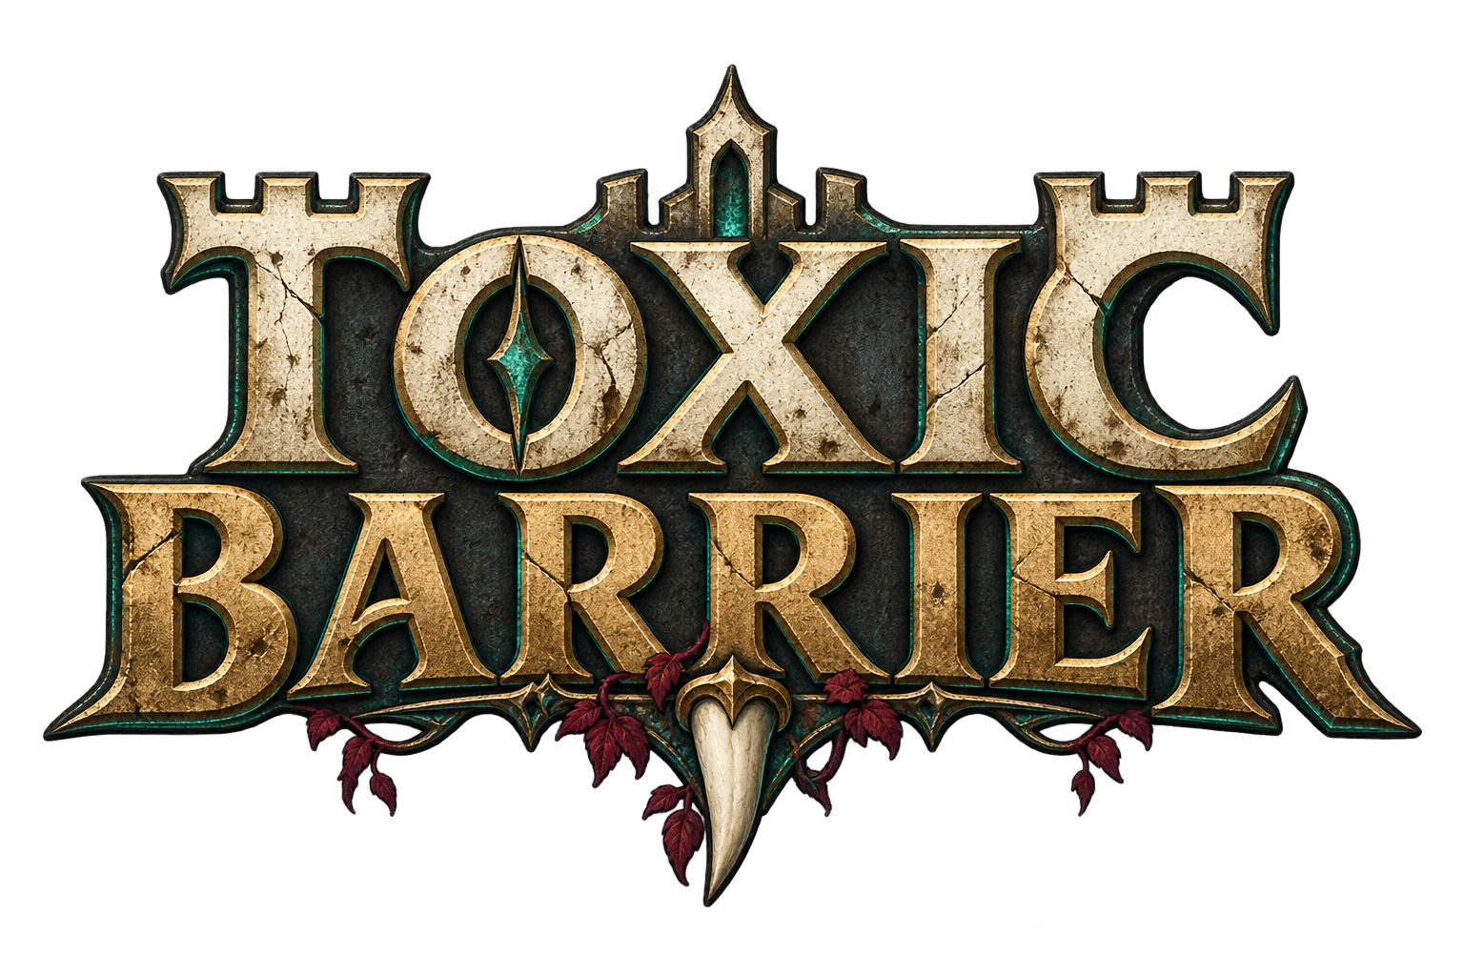




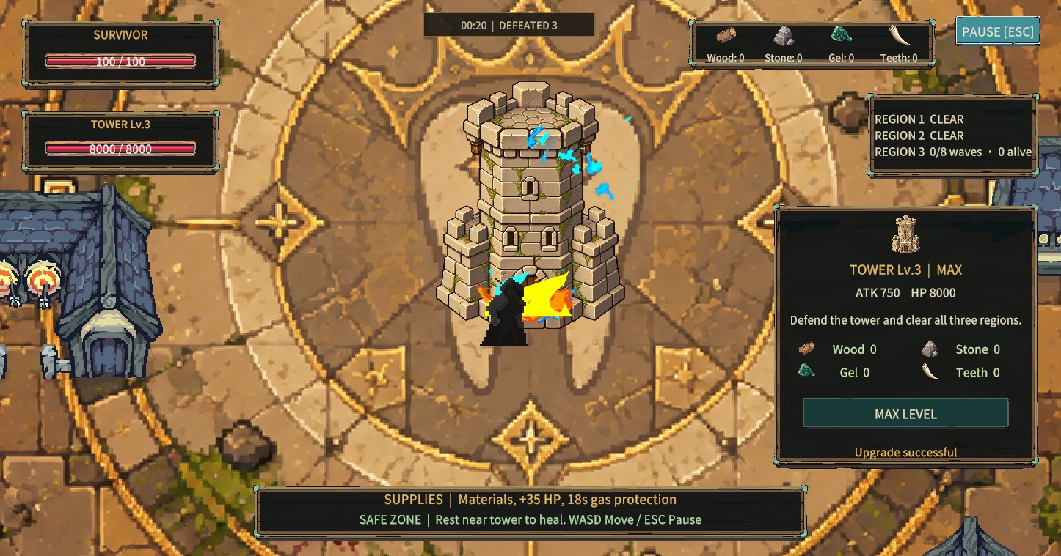
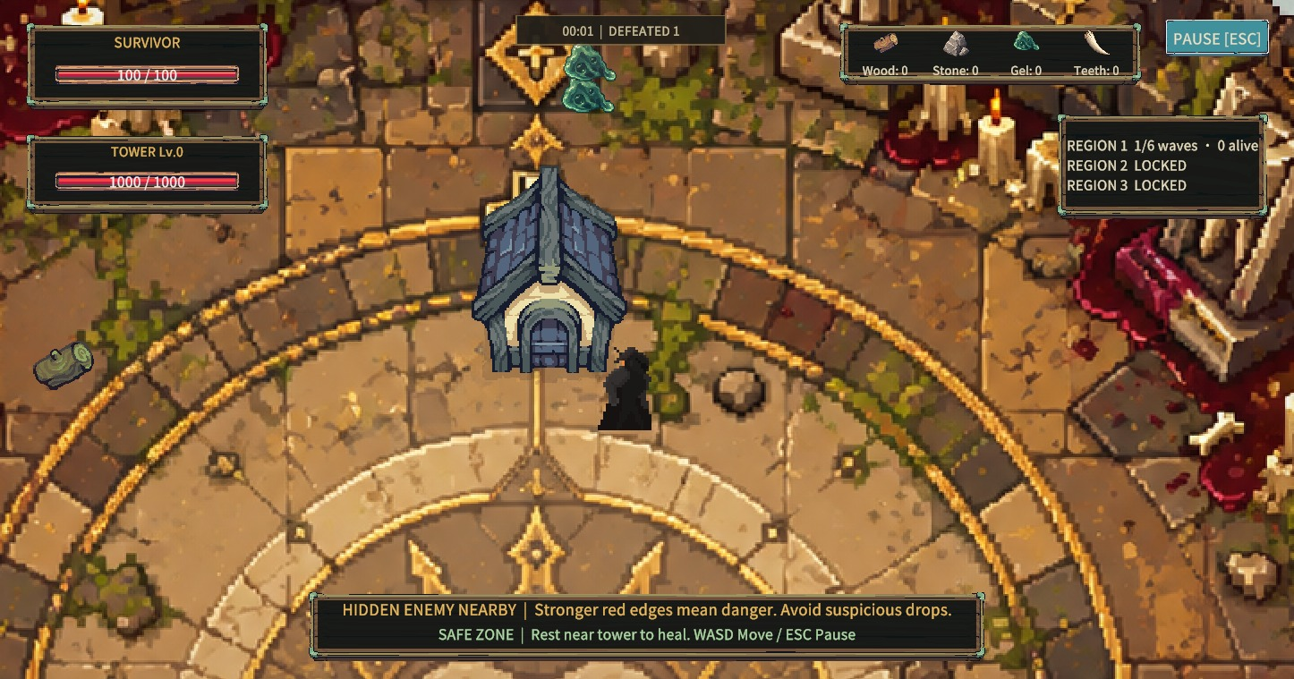
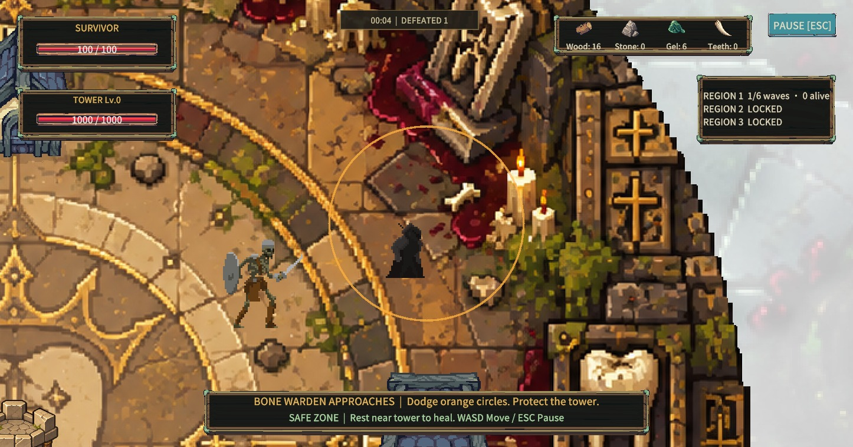
ToxicBarrier
SOLO PROJECT
github.com/JXia0/ToxicBarrier
ToxicBarrier is a 2D survival and tower-defense game where a lone defender gathers resources, upgrades an allied tower and uses the environment to survive waves across three expanding regions.
MY ROLE
Game Design
& Development
A lone defender.
A tower worth protecting.
Gameplay systems
Level design and balancing
Art integration and UI
DEVELOPMENT
Dec 2025 – Present
Independent project
Explore beyond safety. Return before the tower falls.
PERSONAL PORTFOLIO
Unity / C# / GitHub
Windows PC
Tower progression
Buildings create cover
A readable boss threat
Notes:
ToxicBarrier is my solo game project. The player and tower fight on the same side. The player supplies resources and controls enemy positioning, while the tower provides automatic fire. My work covers game design and development, level iteration and integrating the game’s presentation. Development began in December 2025.
Sources: User confirmed solo project and game development responsibility. Git initial commit 9111d0f dated 2025-12-27 agrees with Unity project creation time. Reference: Letting-Go-Personal-Portfolio.pptx slide 1, original layout and master reused. Screenshots: .utmp/ui-checks/02-game-hud.png, 07-fx-level-3.png, 11-building-route.png, 12-boss-telegraph.png; staged feature checks, not player research. Tool icons: https://github.com/devicons/devicon (MIT). New title logo is a portfolio design proposal, not an existing game asset.

Slide 2
TOXICBARRIER / PERSONAL PORTFOLIO
02 / 06
How to play & game flow
The player gathers and maneuvers. The allied tower attacks automatically.
01
02
03
Gather & upgrade
Lure & survive
Expand & defend
Collect wood, stone, gel and teeth. Spend materials near the tower to improve its level.
Lead enemies into tower range. Use buildings to block sight and make room to escape.
Unlock the outer regions as the tower grows. Bring limited repair supplies back from region three.
PLAY LOOP
VICTORY
Explore
Collect
Upgrade
Defend
Tower level 3 + every wave and remaining enemy cleared.
KEYBOARD CONTROLS
WASD / Arrow keys
E
Esc
Move
Upgrade near the tower / collect supplies
Pause or resume
Notes:
The core loop links resource collection to survival. Each trip away from the tower supports the next upgrade, but leaves defense less controlled. Progress through three regions ends only when the tower reaches level three and all waves and enemies are cleared. Player or tower death ends the run. E is contextual: upgrades require proximity and enough resources. Ordinary exploration supplies can be collected manually with E. Repair cargo loads by proximity.
Sources: Assets/Scripts/Loot/Enemies/Tower.cs; Assets/Scripts/Core/PlayerController2D.cs; Assets/Scripts/Map/ExplorationSupply.cs; Assets/Scripts/Player/TowerRepairCargo.cs; Assets/Documentation/FlowReview.md.

Slide 3
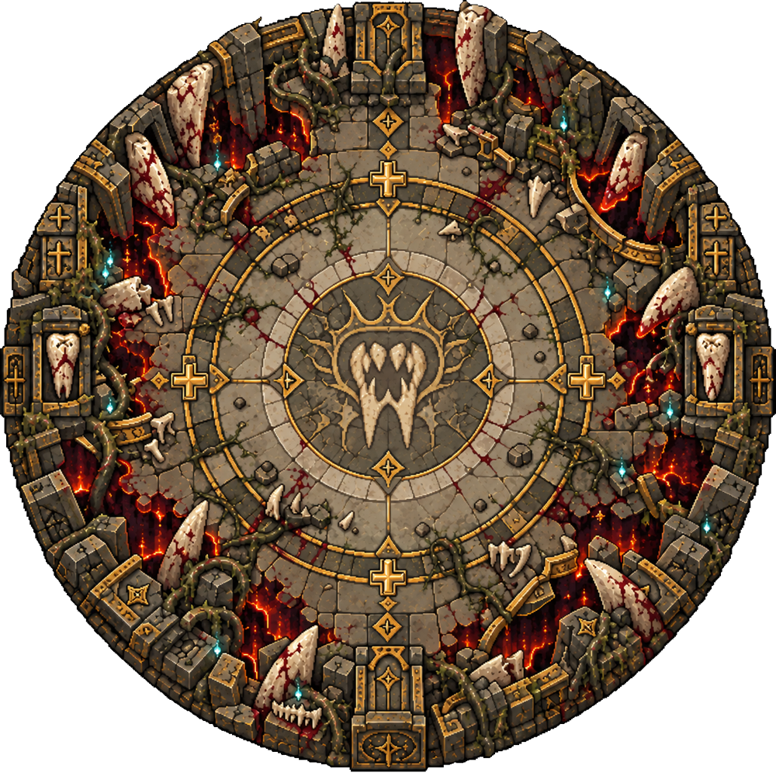
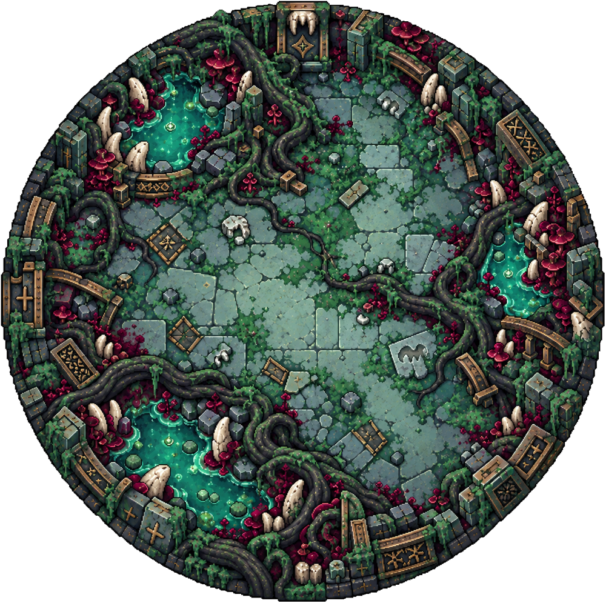
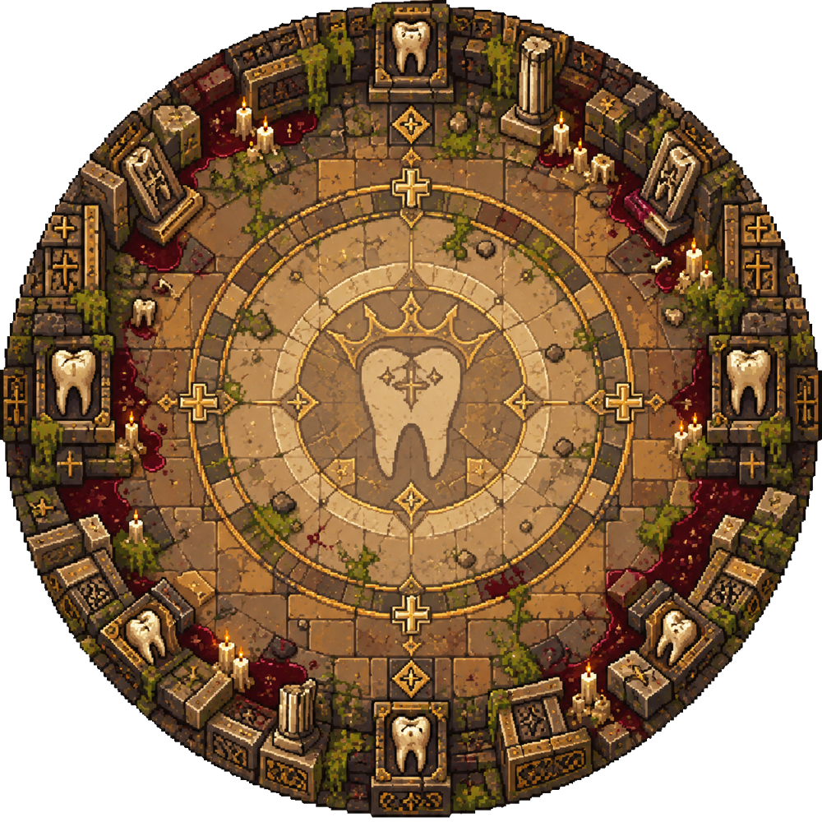
TOXICBARRIER / PERSONAL PORTFOLIO
03 / 06
Level design: three connected regions
Concentric progression keeps the tower central while exploration becomes more demanding.
01 CENTRAL REFUGE
6 building obstacles. Learn gathering and tower defense close to the safe area.
02 EXPANDING ROUTES
10 building obstacles. Staggered clusters leave exits on both sides and routes between regions.
03 OUTER SIEGE
14 building obstacles. Three one-use repair supplies reward a risky return trip to the tower.
IMPLEMENTATION
Ground-footprint colliders define the same obstacles used by navigation. The layout check covers 36 routes between the tower and the regions.
Authored region radii: 12.5 / 30 / 50 units
Notes:
This is the game’s current three-layer circular map, assembled from the actual imported sprites at their authored radius ratios. The inner region establishes the loop. Outer areas increase exposure and reward movement away from the tower. Thirty building obstacles form staggered pairs rather than sealing routes. Ground-level colliders and matching navigation obstacles make the visible cover usable. These buildings are separate scene objects and are not included in the terrain-only overview shown here.
Sources: Assets/Sprites/Sprites_map_1.png, Sprites_map_2.png, Sprites_map_3.png; output/Review/2026-09-20/ExpandedRoutes.md and expanded-navigation.txt. Assets/Editor/WorldLayoutPolishTool.cs.

Slide 4
TOXICBARRIER / PERSONAL PORTFOLIO
04 / 06
Code implementation: enemy pursuit
A visible player becomes the target. Breaking sight creates a short escape window.
SOURCE EXCERPT
PLAYER CONSEQUENCE
if (playerInRange != null)
{
_target = playerInRange;
_lastSeenPosition = playerInRange.position;
_lastSeenAt = Time.time;
return;
}
var playerHealth = MapController.Instance != null ? MapController.Instance.PlayerHealth : null;
if (playerHealth != null && playerHealth.CurrentHp > 0 && Time.time - _lastSeenAt < 1.6f)
{
_target = null;
_searchingLastSeen = true;
return;
}
Cover changes
the chase
The enemy remembers a fixed last-seen position for 1.6 seconds, then returns to attacking the tower.
VERIFICATION
Checked loss of sight, pause behavior, timeout and reacquiring the player.
EnemyAttackBehavior.cs / UpdateTarget()
A nearby target must also pass a line-of-sight check.
Notes:
The left-hand excerpt is copied directly from the project source. When the player is visible, the enemy stores their position and the current time. If sight is lost, the enemy temporarily clears the live target and searches the stored point. After 1.6 seconds, the rest of the method chooses the nearest living tower again. GetPlayerInAgroRange also requires line of sight. The movement branch handles the stored point rather than tracking the hidden player through walls.
Sources: Assets/Scripts/Loot/Enemies/EnemyAttackBehavior.cs, UpdateTarget and GetPlayerInAgroRange. output/Review/2026-09-20/route-gameplay-regression.txt. Code copied from current working tree; not a claim of hand-authorship of every line.

Slide 5
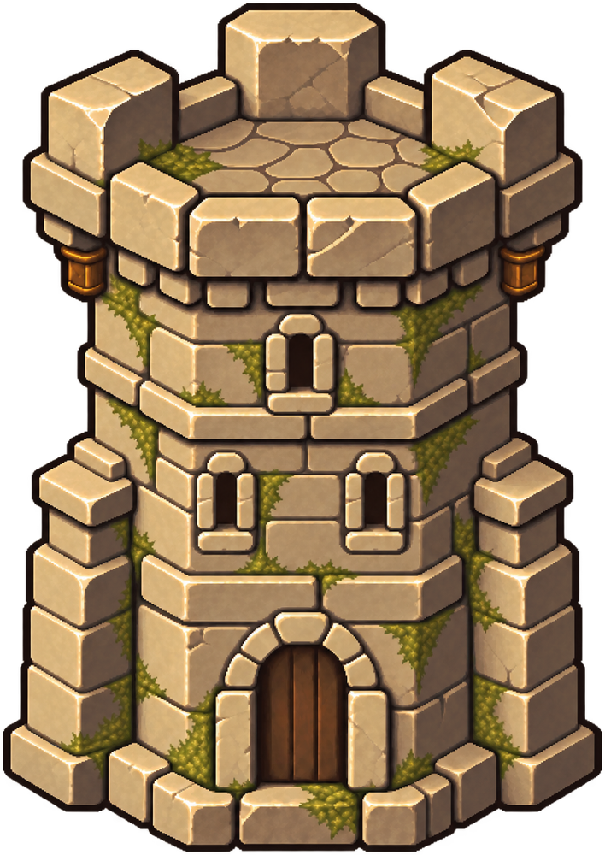
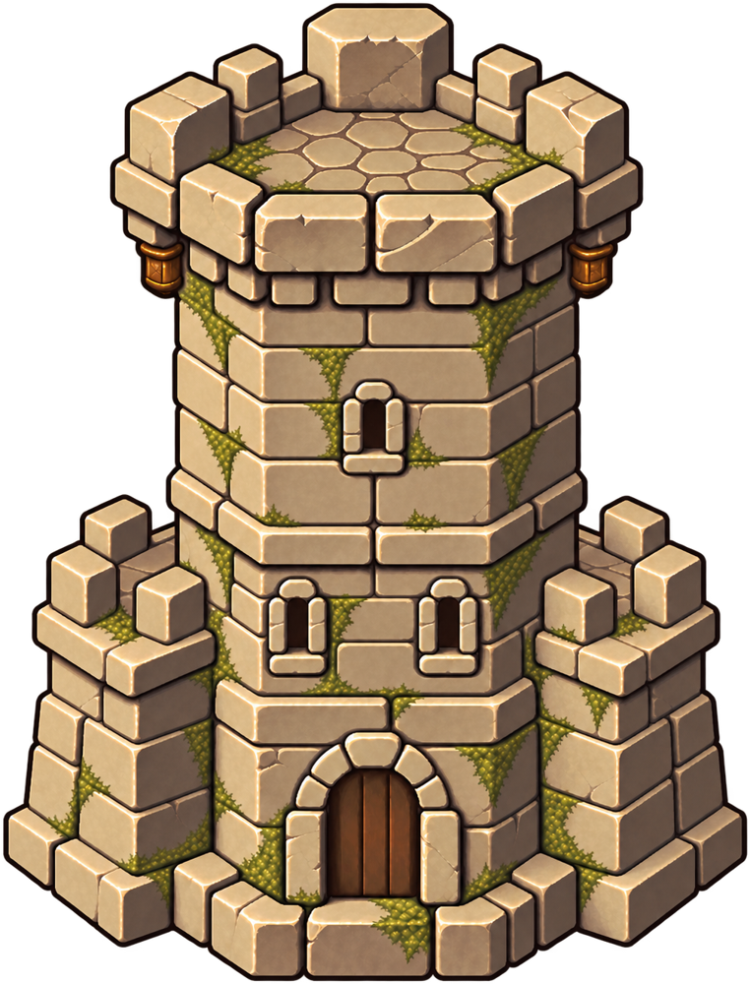
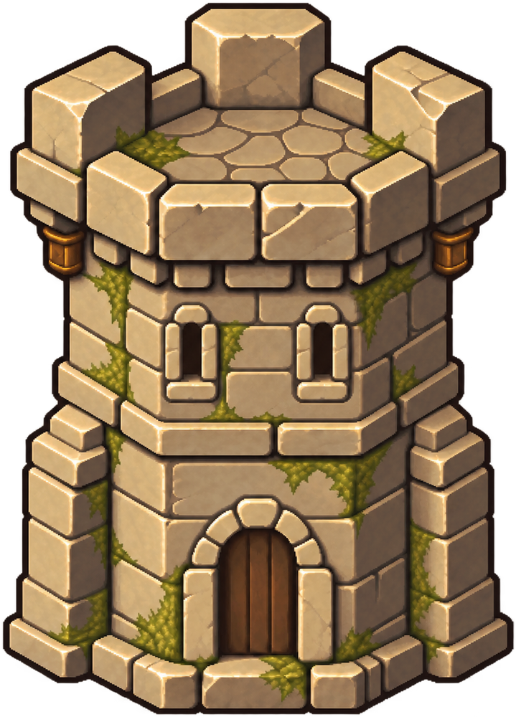
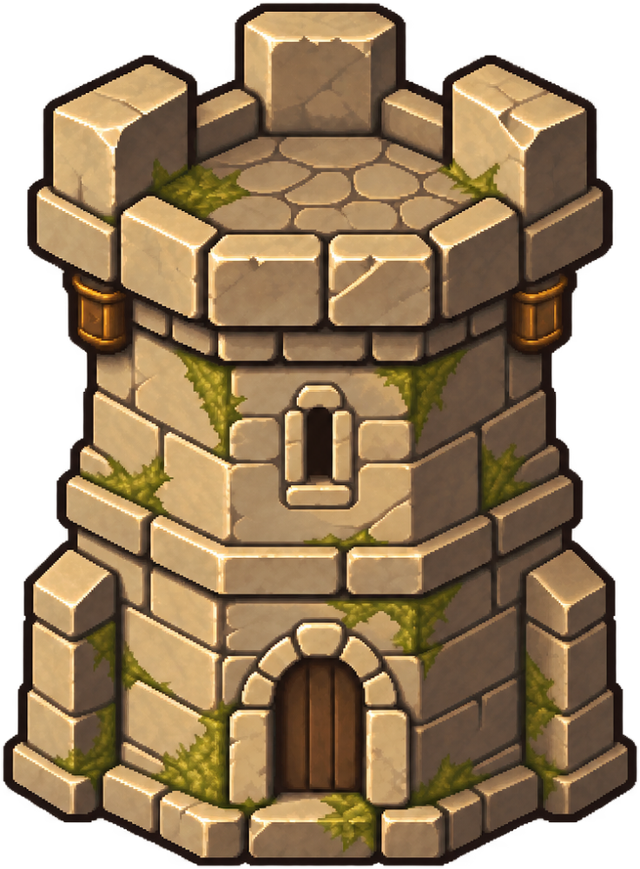
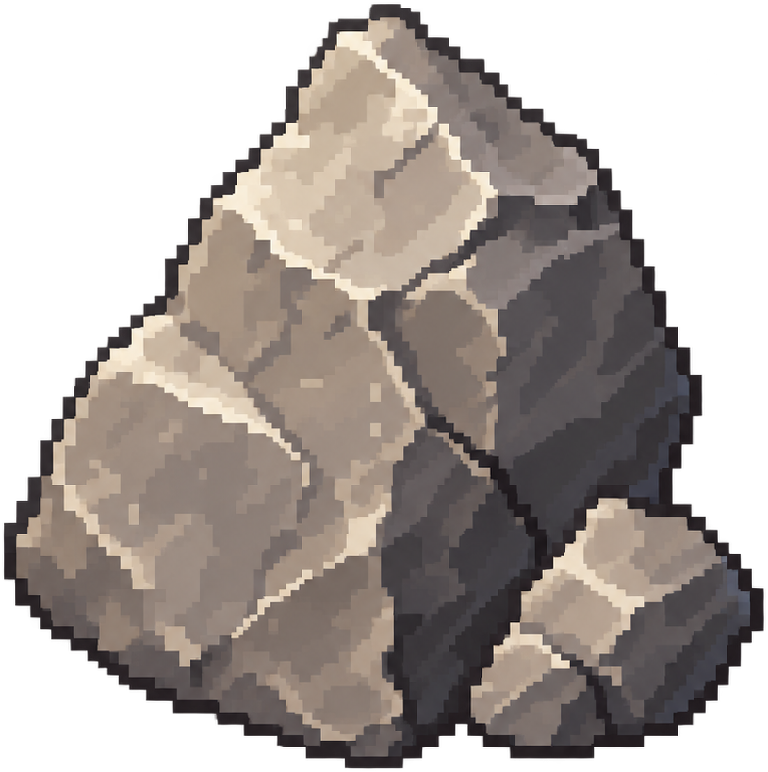
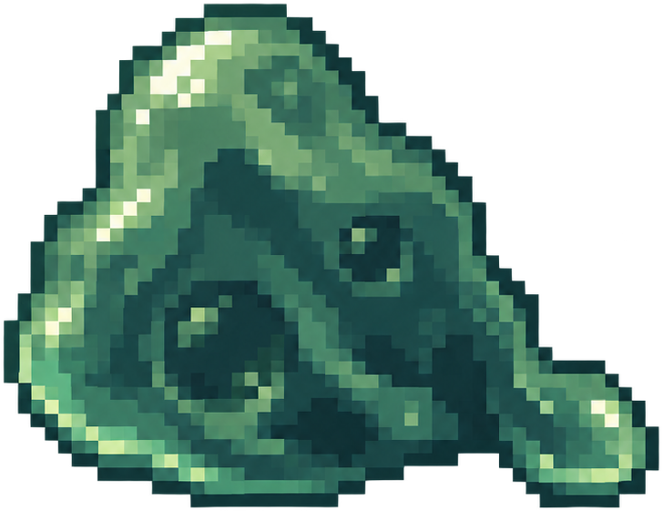

TOXICBARRIER / PERSONAL PORTFOLIO
05 / 06
Art integration & development process
The environment, pickups and tower progression share a weathered stone-and-metal palette.
TOWER PROGRESSION
DEVELOPMENT PROCESS
01 Prototype
Movement, resources, tower upgrades and authored enemy waves.
02 Integrate
Import transparent sprites. Align tower pivots and keep pixel filtering consistent.
LEVEL 0
LEVEL 1
LEVEL 2
LEVEL 3
03 Refine
RESOURCE READABILITY
Tune navigation, warning effects, bilingual UI and the full game loop.
Stone
Gel
Teeth
Notes:
This page shows the sprites currently used by the project, including the level-zero tower and all three upgrades. The work presented here is art direction and integration: coherent materials, readable silhouettes, real alpha, point filtering and consistent base pivots. Resource types remain distinct at pickup size. The production process moves from the core loop to visual integration and then to navigation, interface and balance refinement. Existing character and building asset packs are part of the project’s visual asset integration; this page does not claim all source art was hand-drawn.
Sources: Assets/Sprites/Sprites_tower0.png, Sprites_tower.png, Sprites_tower2.png, Sprites_tower3.png, Sprites_stone.png, Sprites_gel.png, Sprites_teeth.png. output/ArtIntegration/README.md; output/ArtDirection/ArtOnlyBrief.md; output/Review/2026-09-20/ExpandedRoutes.md.

Slide 6
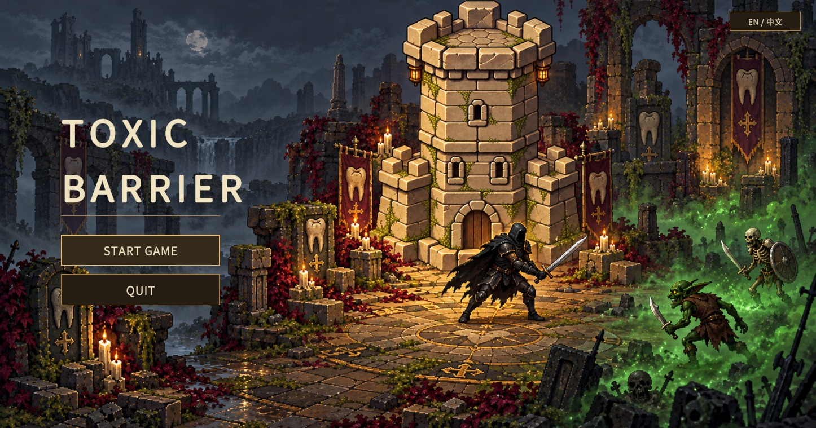
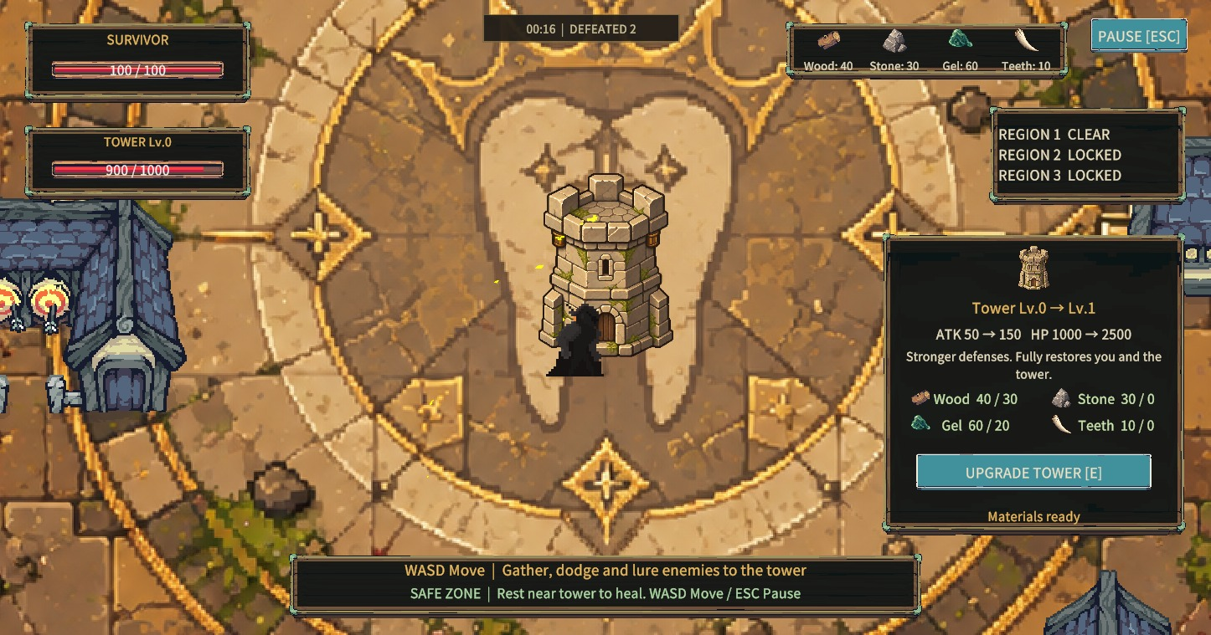
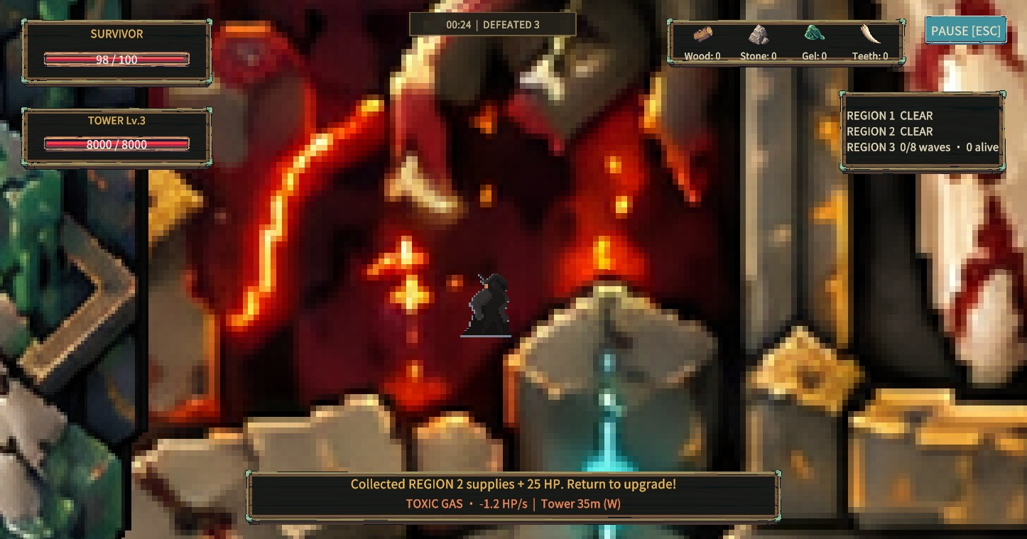
TOXICBARRIER / PERSONAL PORTFOLIO
06 / 06
Final experience & project presentation
A complete playable loop, with English and Chinese interface settings.
Main menu
Upgrade feedback
Outer-region exploration
PROMOTIONAL VIDEO / 1–2 MIN
PLAYER PLAYTEST
Video slot
THE ROOKIES
Project page pending
Notes:
The gallery shows the actual menu, upgrade feedback and exploration interface. The space under Player Playtest is intentionally empty for future player photos, observations and feedback. The promotional-video area is reserved for a recording and contains no video yet. The Rookies page has not been created. A shorter one-minute video can still be inserted if a timed presentation is needed later.
Sources: .utmp/ui-checks/01-main-menu.png, 04-upgrade.png and 13-outer-readability.png. User explicitly requested leaving playtesting blank and confirmed The Rookies is not set up. The sixth slide is a portfolio completion layout, not evidence that video or playtests exist.

