Slide 1





2D SURVIVAL & TOWER DEFENSE
Toxic fog erupted beneath a medieval kingdom.
The dead rose. Its cities fell.
One tower still holds back the poison.
You are its last defender.
github.com/JXia0/ToxicBarrier
Notes:
BACKSTORY
The first warning was the silence.
One autumn night, a poisonous fog erupted from beneath the streets of a medieval kingdom. It poured through cellar doors and rose from the wells. By dawn, the roads had vanished beneath it, and the bells of the surrounding villages had fallen silent.
Those who escaped spoke of creatures moving through the abandoned settlements. Goblins occupied the ruined streets. Beyond the city walls, soldiers buried centuries earlier clawed their way out of the earth. No one knew what had broken beneath the kingdom, or why the fog had brought the dead back with it.
At the heart of the city, an ancient watchtower still burned. Its warding flame held back the poison and struck the creatures that approached. The remaining survivors found shelter within its walls, but the tower had stood neglected for generations. Its stonework was failing, and its light weakened with every assault.
You are the last defender willing to leave its protection.
Wrapped in a dark cloak, you venture into the ruins to recover materials and restore the tower. Each journey gives it a better chance of surviving the next wave. Each moment away gives the creatures another chance to reach it.
Beyond the courtyard lie the poisoned streets and the outer burial grounds, where something is gathering the dead.
The tower cannot stand without you. You cannot survive without its light.
GAME CONCEPT
ToxicBarrier is a 2D survival and tower-defense game. A lone defender gathers resources to strengthen an allied tower and protect it from waves of enemies.
Sources: Cover composition follows the user-supplied Candle Castle image. Original 1920×1080 reference canvas and theme preserved. Promotional image: output/Promo/2026-09-19/ToxicBarrier_Background_1920x1080.png, horizontally reflected only in the slide layout to place the tower and defender on the right. Not a gameplay screenshot. Tool icons: https://github.com/devicons/devicon (MIT).

Slide 2

TOXICBARRIER / PERSONAL PORTFOLIO
02 / 06
How to play & game flow
The player gathers and maneuvers. The allied tower attacks automatically.
Gather & upgrade
Collect four resource types and invest them in the tower.
Lure & survive
Bring enemies into tower range. Break pursuit with cover.
Expand & defend
Upgrade to unlock regions and bring back repair supplies.
KEYBOARD CONTROLS
VICTORY
WASD / Arrows
E
Esc
Tower level 3. All regions and remaining enemies cleared.
Move
Upgrade / collect supplies
Pause
Notes:
The core loop links resource collection to survival. Each trip away from the tower supports the next upgrade, but leaves defense less controlled. Progress through three regions ends only when the tower reaches level three and all waves and enemies are cleared. Player or tower death ends the run. E is contextual: upgrades require proximity and enough resources. Ordinary exploration supplies can be collected manually with E. Repair cargo loads by proximity.
Sources: Assets/Scripts/Loot/Enemies/Tower.cs; Assets/Scripts/Core/PlayerController2D.cs; Assets/Scripts/Map/ExplorationSupply.cs; Assets/Scripts/Player/TowerRepairCargo.cs; Assets/Documentation/FlowReview.md.

Slide 3
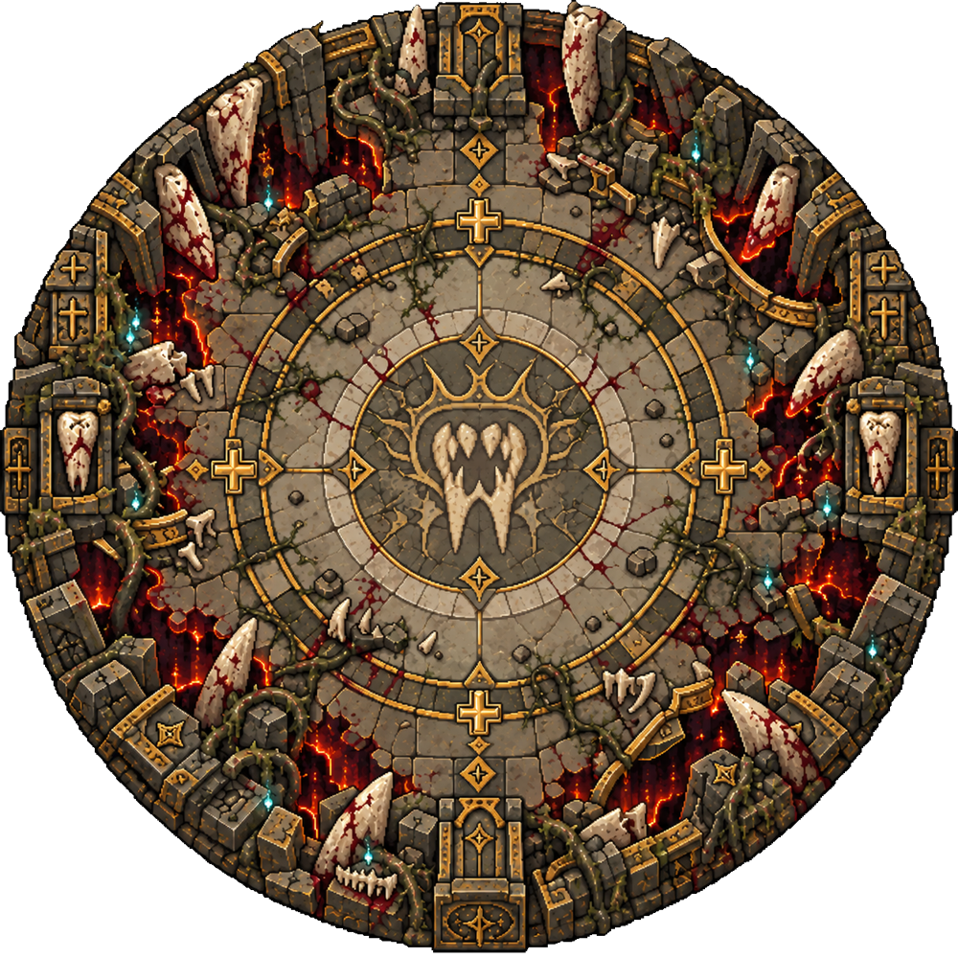
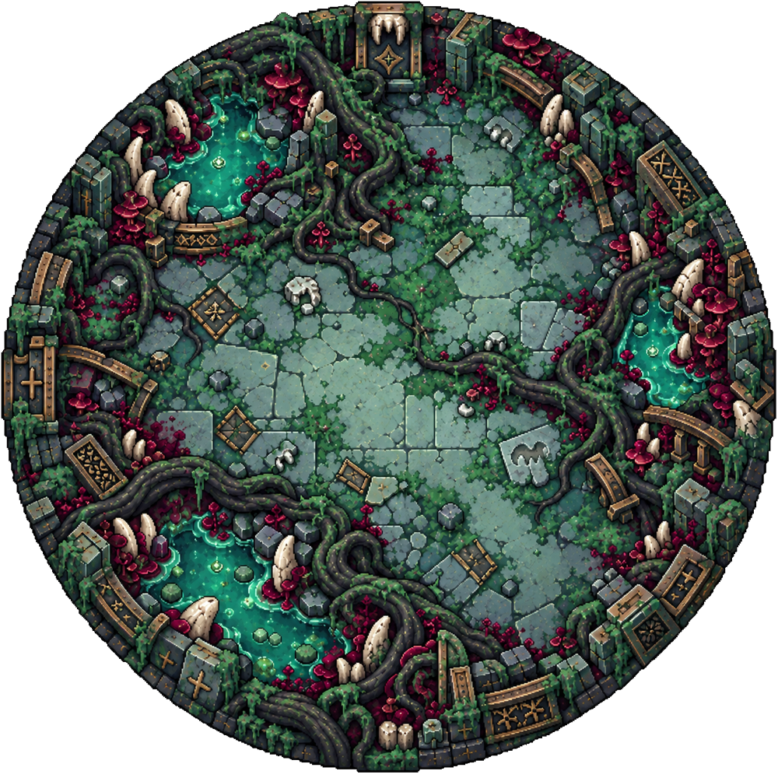
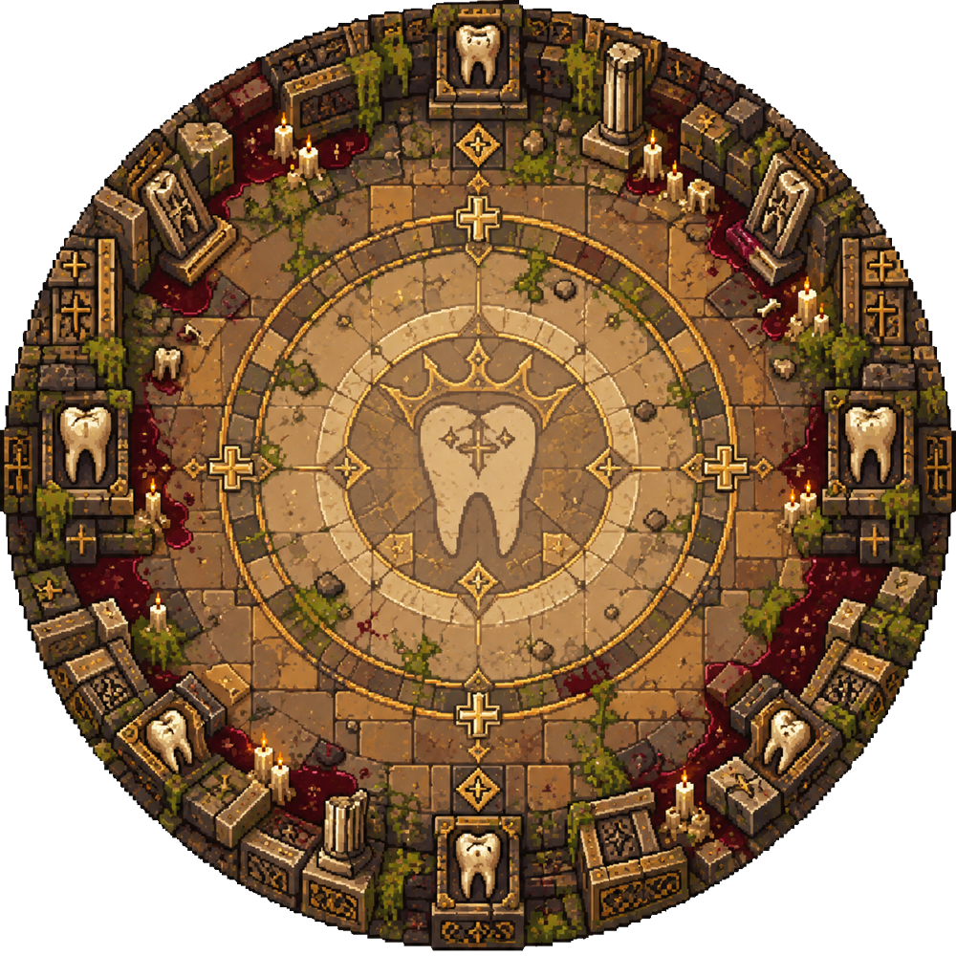
TOXICBARRIER / PERSONAL PORTFOLIO
03 / 06
Level design & progression
Three concentric regions keep the tower central while exploration becomes more demanding.
01 LEARN THE LOOP
Gather near the tower and build your first upgrades. Six buildings introduce cover and alternate routes.
02 LEAVE THE REFUGE
Tower level 2 opens the middle region. Ten buildings create routes around pursuing enemies.
03 SURVIVE THE SIEGE
Tower level 3 opens the final region. Fourteen buildings and three repair supplies support the last defense.
PLAY FLOW
Upgrade to open the next region. Clear its waves, collect supplies and return to the tower. Defeat the final enemies to win.
Authored region radii: 12.5 / 30 / 50 units
Notes:
This is the game’s current three-layer circular map, assembled from the actual imported sprites at their authored radius ratios. The inner region establishes the loop. Outer areas increase exposure and reward movement away from the tower. Thirty building obstacles form staggered pairs rather than sealing routes. Ground-level colliders and matching navigation obstacles make the visible cover usable. These buildings are separate scene objects and are not included in the terrain-only overview shown here.
Sources: Assets/Sprites/Sprites_map_1.png, Sprites_map_2.png, Sprites_map_3.png; output/Review/2026-09-20/ExpandedRoutes.md and expanded-navigation.txt. Assets/Editor/WorldLayoutPolishTool.cs.

Slide 4
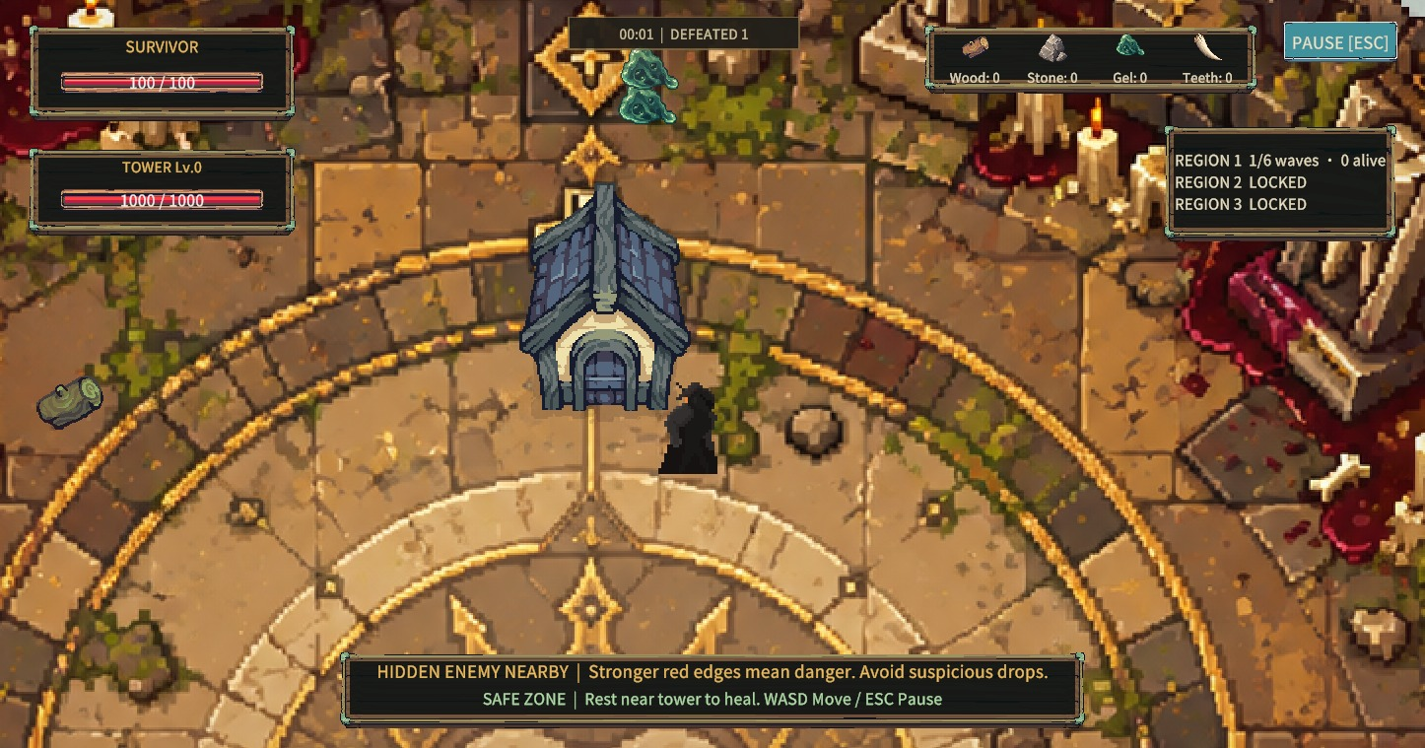
TOXICBARRIER / PERSONAL PORTFOLIO
04 / 06
Code implementation: enemy pursuit
A visible player becomes the target. Breaking sight creates a short escape window.
SOURCE EXCERPT
PLAYER CONSEQUENCE
if (playerInRange != null)
{
_target = playerInRange;
_lastSeenPosition = playerInRange.position;
_lastSeenAt = Time.time;
return;
}
var playerHealth = MapController.Instance != null
? MapController.Instance.PlayerHealth : null;
if (playerHealth != null && playerHealth.CurrentHp > 0
&& Time.time - _lastSeenAt < 1.6f)
{
_target = null;
_searchingLastSeen = true;
return;
}
Cover changes the chase
After losing sight, enemies search the last-seen position for 1.6 seconds before returning to the tower.
EnemyAttackBehavior.cs / UpdateTarget()
Verified: sight loss, pause, timeout and reacquisition.
Buildings block sight and create escape routes.
Notes:
The left-hand excerpt is copied directly from the project source. When the player is visible, the enemy stores their position and the current time. If sight is lost, the enemy temporarily clears the live target and searches the stored point. After 1.6 seconds, the rest of the method chooses the nearest living tower again. GetPlayerInAgroRange also requires line of sight. The movement branch handles the stored point rather than tracking the hidden player through walls.
Sources: Assets/Scripts/Loot/Enemies/EnemyAttackBehavior.cs, UpdateTarget and GetPlayerInAgroRange. output/Review/2026-09-20/route-gameplay-regression.txt. Source excerpt preserves logic, with line breaks adjusted for readability.

Slide 5
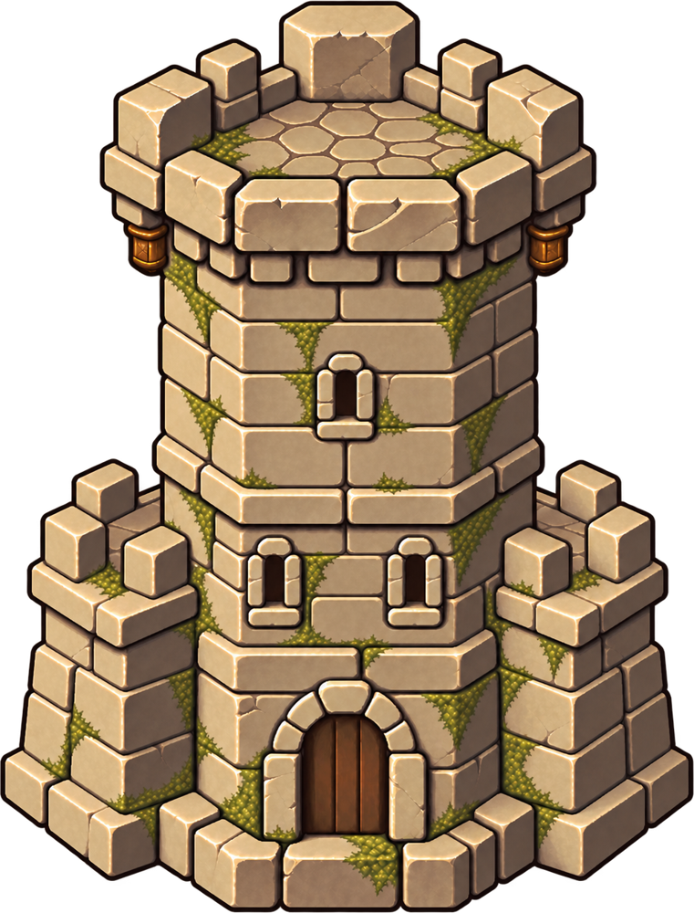

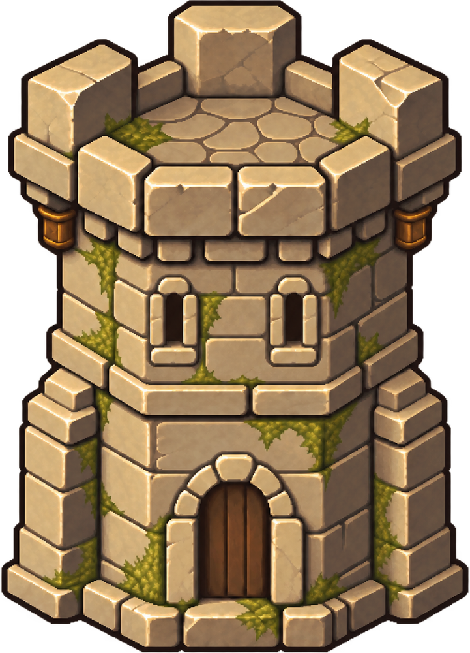
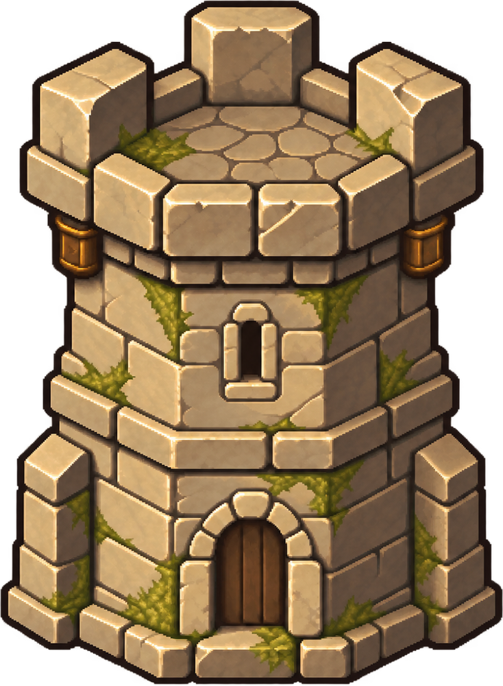

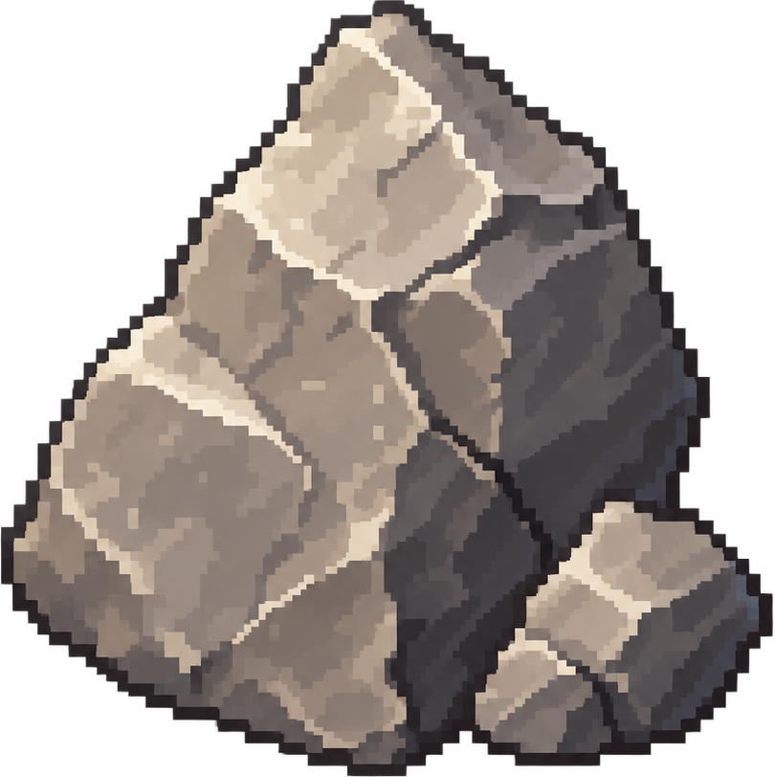

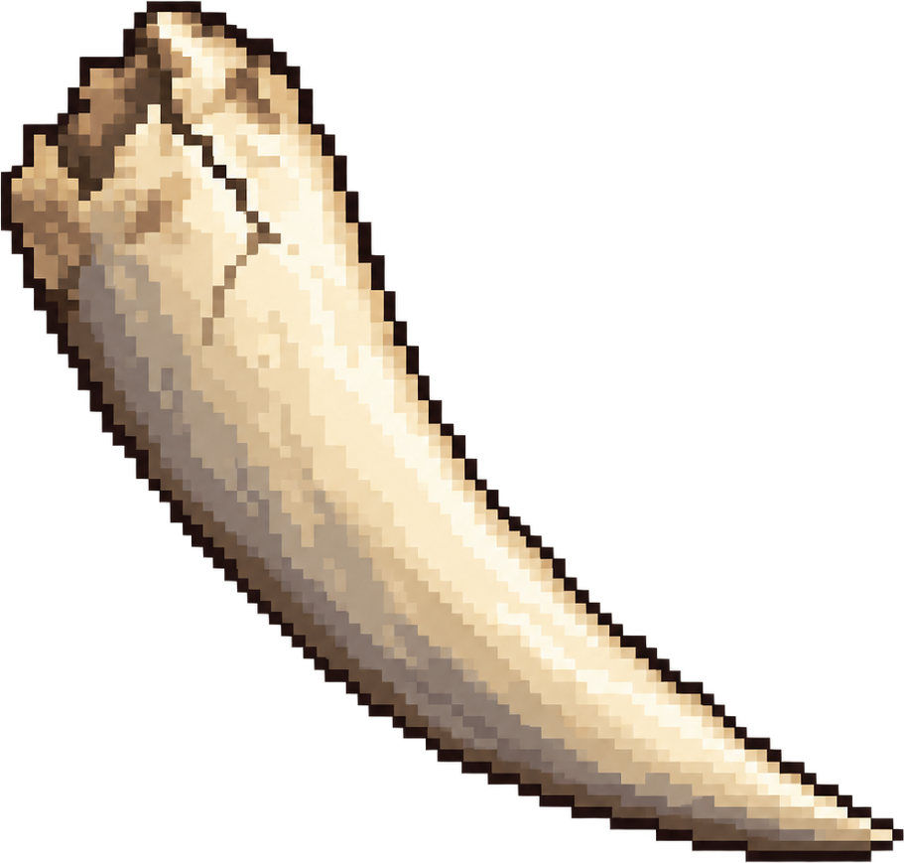
TOXICBARRIER / PERSONAL PORTFOLIO
05 / 06
Development & visual integration
Solo project. Game design and development, level design, balancing, art integration and UI.
DEC 2025 – PRESENT
WINDOWS PC
TOWER PROGRESSION
DEVELOPMENT PROCESS
01 Prototype
Movement, resources, tower upgrades and authored enemy waves.
02 Integrate
Import transparent sprites. Align tower pivots and keep pixel filtering consistent.
LEVEL 0
LEVEL 1
LEVEL 2
LEVEL 3
03 Refine
RESOURCE READABILITY
Tune navigation, warning effects, bilingual UI and the full game loop.
Wood
Stone
Gel
Teeth
Notes:
This page shows the sprites currently used by the project, including the level-zero tower and all three upgrades. The work presented here is art direction and integration: coherent materials, readable silhouettes, real alpha, point filtering and consistent base pivots. Resource types remain distinct at pickup size. The production process moves from the core loop to visual integration and then to navigation, interface and balance refinement. Existing character and building asset packs are part of the project’s visual asset integration; this page does not claim all source art was hand-drawn.
Sources: User confirmed solo project and game development responsibility. Git initial commit 9111d0f is dated 2025-12-27, matching Unity project creation. Assets/Sprites/Sprites_tower0.png, Sprites_tower.png, Sprites_tower2.png, Sprites_tower3.png, Sprites_stone.png, Sprites_gel.png, Sprites_teeth.png. Wood: Assets/PeterRadiant/Tiny Swords/UI Elements/Icons/Icon_02.png, referenced by Assets/Resources/Presentation/WoodPickup.asset (texture GUID 859e44a7cf53f4e889017843532b11d2). output/ArtIntegration/README.md; output/ArtDirection/ArtOnlyBrief.md; output/Review/2026-09-20/ExpandedRoutes.md.

Slide 6
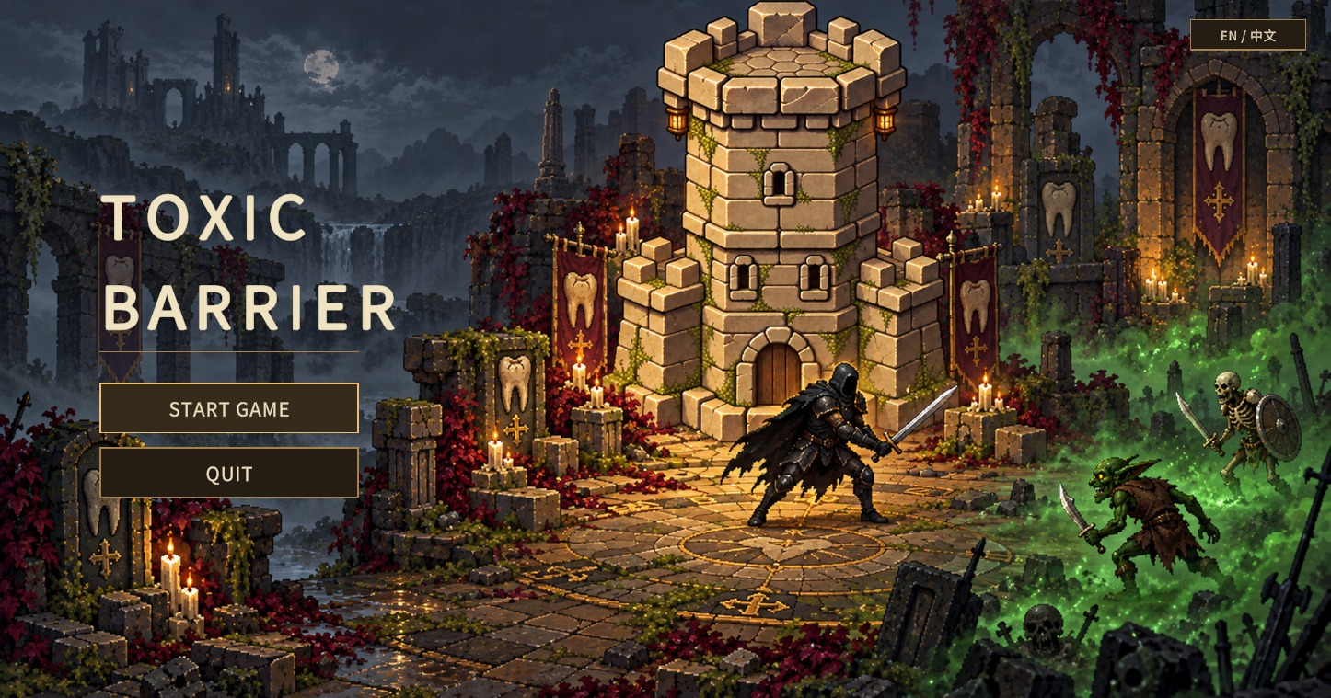
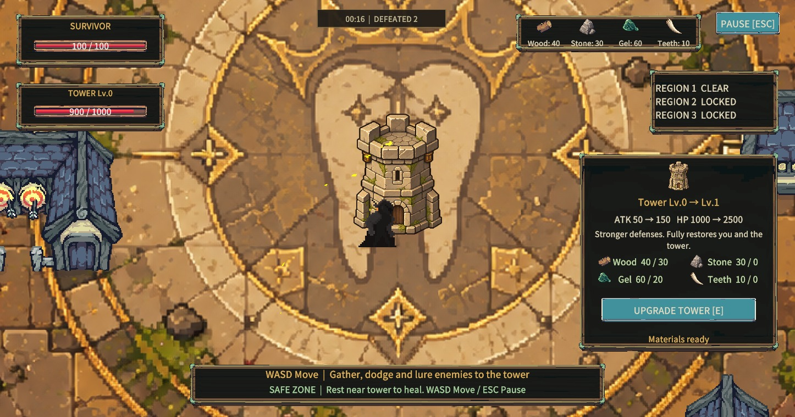
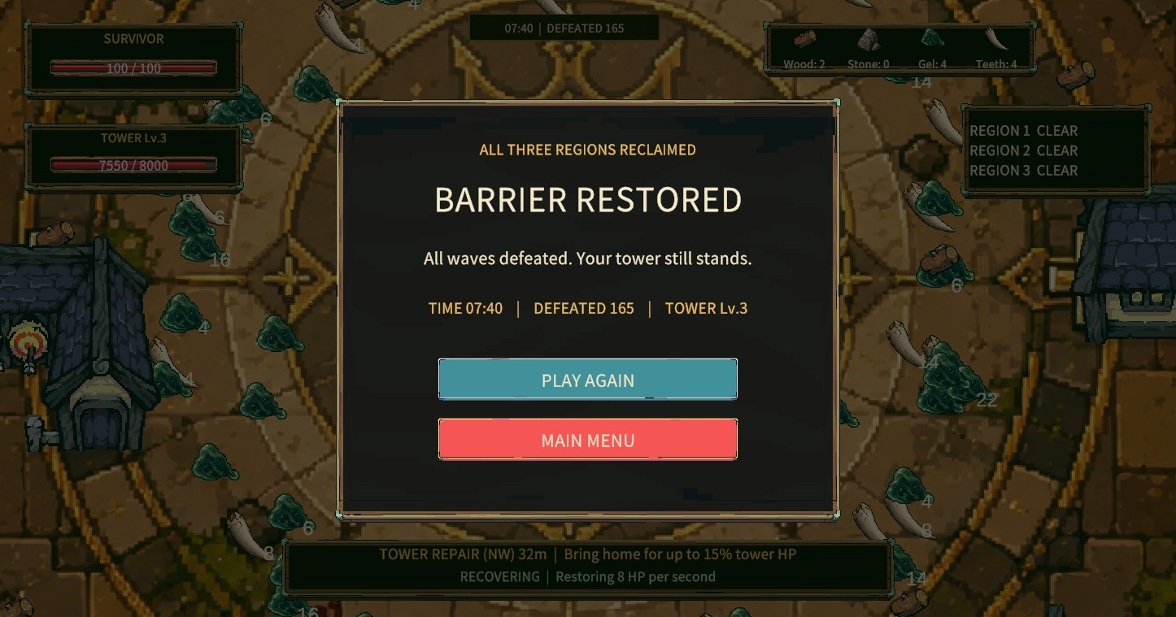
TOXICBARRIER / PERSONAL PORTFOLIO
06 / 06
Game gallery & presentation
From the first menu to the final defense. English and Chinese interface settings remain available.
Main menu
Upgrade feedback
All three regions reclaimed
PROMOTIONAL VIDEO / 1–2 MIN
PLAYER PLAYTEST
Video slot
THE ROOKIES
Project page pending
Notes:
The gallery shows the actual menu, upgrade feedback and victory screen. The space under Player Playtest is intentionally empty for future player photos, observations and feedback. The 16:9 promotional-video area is reserved for a recording and contains no video yet. The Rookies page has not been created. A shorter one-minute video can still be inserted if a timed presentation is needed later.
Sources: .utmp/ui-checks/01-main-menu.png and 04-upgrade.png. output/Review/2026-09-20/ExpandedRoutesVictory.png is a completed automated full-flow run, not a human playtest. User explicitly requested leaving playtesting blank and confirmed The Rookies is not set up.

