Slide 1

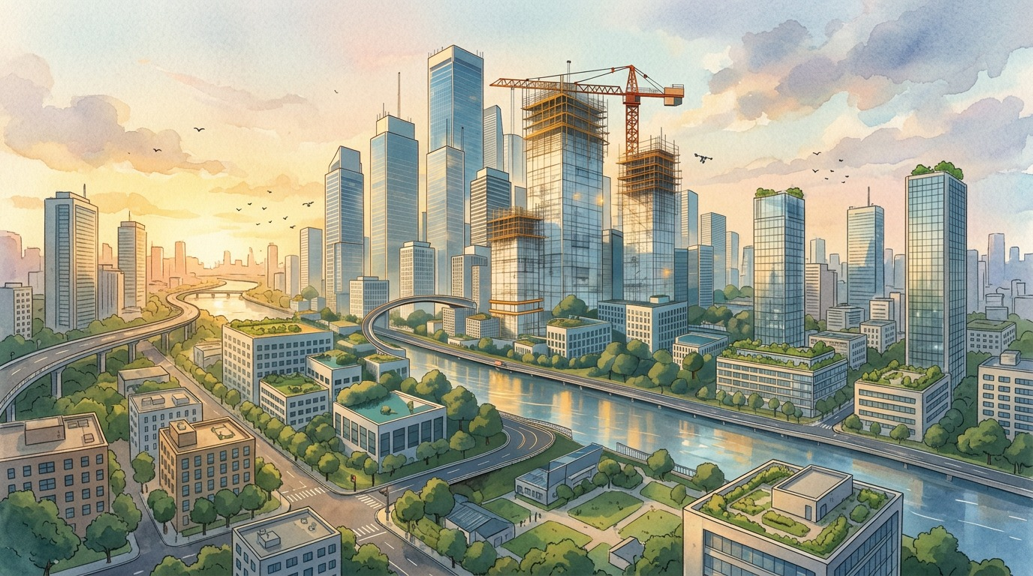
ToxicBarrier & Vision Zero
Game design portfolio
ToxicBarrier
Vision Zero
A Unity survival game
A competitive city-planning board game
Notes:
TARGET: 20 seconds
Today I’m presenting two of my game projects. ToxicBarrier is a digital survival game about protecting a tower. Vision Zero is a competitive board game about planning safer streets. I’ll explain the main decisions in each game, with a short gameplay video for ToxicBarrier.
PROJECT SOURCES
ToxicBarrier: output/Promo/2026-09-19/ToxicBarrier_Background_1920x1080.png, promotional illustration, not gameplay. Vision Zero: C:/GameProjects/CityBoardGame/核心美术背景图.png, project artwork.

Slide 2

ToxicBarrier
Survive while protecting the tower
Explore for resources
Gather materials and bring them back to upgrade your tower.
Return to defend
Lure enemies into its attacks and decide when to leave safety.
Win: reach tower level 3 and clear all three regions.
Notes:
TARGET: 50 seconds
In ToxicBarrier, the player and the central tower are on the same side. The tower attacks automatically, while the player moves around the map, collects materials and draws enemies into its range. The tower starts at level zero and can reach level three. Upgrades improve it and open access to more of the map. The main decision is when to explore and when to return. Staying close is safer, but collecting resources requires leaving that protection. To win, the player must fully upgrade the tower and clear the waves and remaining enemies in all three regions.
PROJECT SOURCES
Assets/Scripts/Loot/Enemies/Tower.cs: InitialLevel=0, MaxLevel=3. .utmp/ui-checks/02-game-hud.png. output/Review/2026-09-19/GameplayPolish.md. output/Review/2026-09-20/ExpandedRoutes.md.

Slide 3
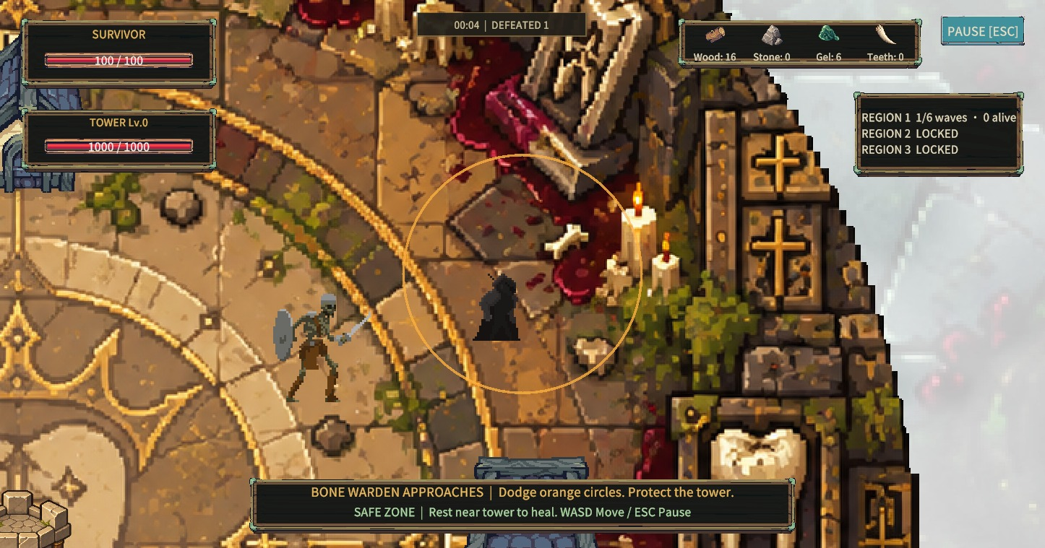
Movement creates tactical choices
Break enemy sight
Buildings create alternate routes and places to escape pursuit.
Read the danger
The boss marks its strike area before the attack lands.
Exploration also offers limited supplies to repair the tower.
Notes:
TARGET: 40 seconds
I’ve been refining the decisions around movement. Buildings now give players routes around enemies. If a building blocks an enemy’s view, it searches the last place it saw the player before returning to the tower. This lets positioning change a fight. The orange circle shown here warns the player before a boss attack lands. There are also limited repair supplies in the outer region. Bringing one back can save the tower, but the trip means spending time away from it. The next video shows these decisions in action.
PROJECT SOURCES
.utmp/ui-checks/12-boss-telegraph.png is a staged Play Mode feature check, not a complete natural playthrough. EnemyAttackBehavior.cs; FinalSiegeBoss.cs; TowerRepairCargo.cs. output/Review/2026-09-20/ExpandedRoutes.md.

Slide 4
ToxicBarrier gameplay
01:00
Explore. Upgrade. Defend the tower.
Notes:
TARGET: 60 seconds
[Play the 60-second gameplay recording. Let the game audio carry this section. No live narration is required.]
PROJECT SOURCES
Poster artwork: output/Promo/2026-09-19/ToxicBarrier_Background_1920x1080.png. A video file has not yet been supplied. The deck currently contains a poster image, not an embedded video.

Slide 5
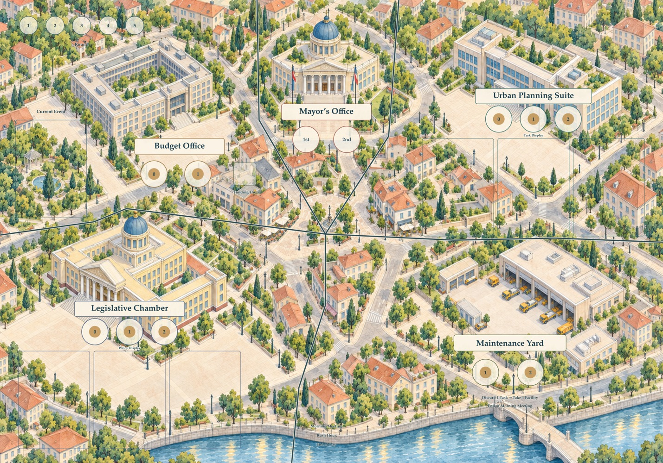
Vision Zero
The Safe City Project
2–4 players, 5 rounds
Each player leads a city-planning team.
Assign employees to departments. Draft safety dice to complete transport projects.
Most Safety Points wins.
Notes:
TARGET: 55 seconds
Vision Zero moves from real-time action to planning around a table. It is a competitive game for two to four players, played over five rounds. Each player leads a city-planning team with three employees. Players send them to departments on this shared board to obtain funding, choose projects, gain policies or invest in infrastructure. Then they draft safety dice and place them on projects. A limited supply means a useful die may disappear before your next turn. Projects earn Safety Points when their requirements are complete. The player with the highest final score wins. The board and component designs are prepared for a physical prototype.
PROJECT SOURCES
C:/GameProjects/CityBoardGame/Vision Zero - The Safe City Project Rulebook.docx, sections 1, 3, 7, 8 and 14. Latest department rules take precedence in Production/制作与缺项清单.md, updated 2026-09-19. Image: Structures/Vision_Zero_Main_Board_Open_City_Board_Final.png. Production is in prototype preparation, not claimed manufactured.

Slide 6
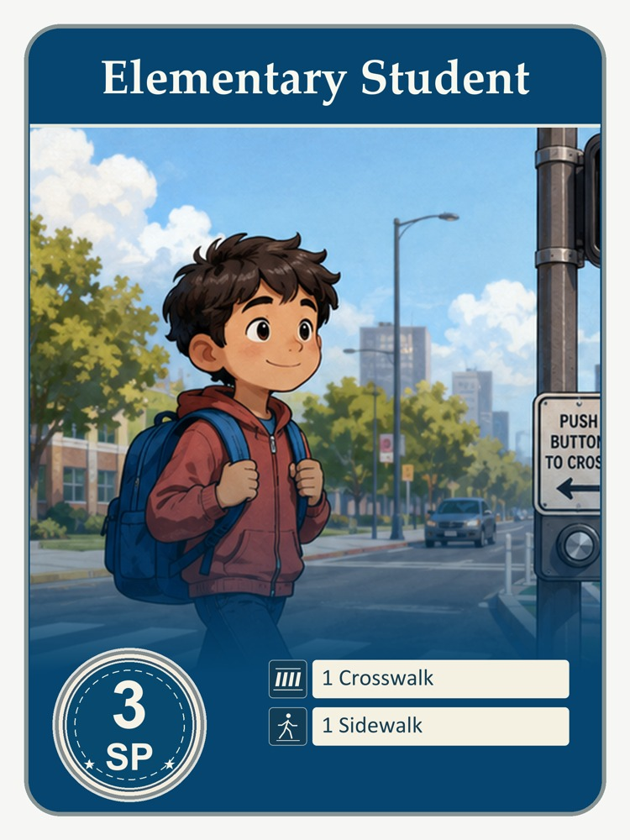
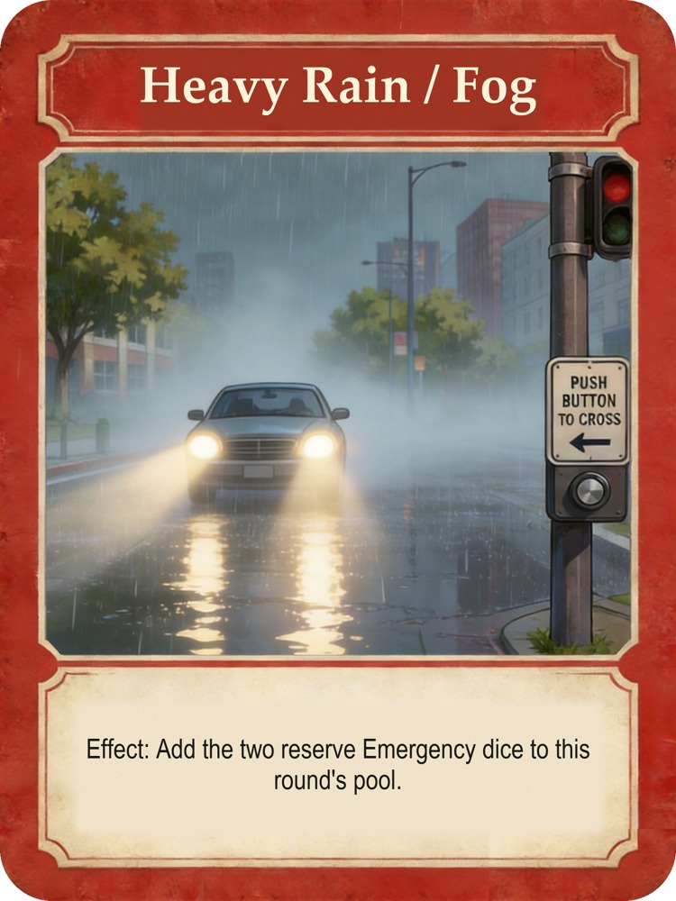
A small project, a real trade-off
Complete a safe route
The Student project needs a crosswalk and a sidewalk. It earns 3 Safety Points.
Keep money for risk
Heavy rain adds emergency dice. Funding can help mitigate their penalties.
Notes:
TARGET: 60 seconds
Here is a simple example. The Elementary Student project needs one crosswalk and one sidewalk, and it is worth three Safety Points. A player drafts matching symbols to complete it. But the choice sits inside a larger plan. Do I take the die that finishes this project now, or build toward another project? How much funding should I keep for emergencies? The Heavy Rain and Fog event on the right adds two emergency dice to the pool. That makes saving money more useful, because many emergency penalties can be mitigated with Coins. Permanent infrastructure offers another option: a reusable safety symbol for future projects. I want the transport theme to affect decisions through the rules, so different travelers and changing conditions matter during play.
PROJECT SOURCES
Vision Zero rulebook sections 5, 8, 10 and 12. Original files: CommuterCards/ElementaryStudent.png and TrafficCards/HeavyRain_Fog.png. Not every emergency can be mitigated: Critical Error cannot. Permanent infrastructure maximum three per player.

Slide 7
Design focus
ToxicBarrier
Vision Zero
Immediate decisions
Planning across rounds
Where to move, when to explore,
and when to return to the tower.
Which projects to pursue,
and how much risk to accept.
Clear choices. Visible consequences.
Notes:
TARGET: 25 seconds
These projects explore decisions at different speeds. ToxicBarrier asks players to react through movement and choose when to leave the tower. Vision Zero asks them to plan across rounds with limited resources. My focus across both is to give players clear choices and visible consequences. Thank you.
PROJECT SOURCES
Closing is a design reflection based on the project mechanics described on slides 2–6, not a claim about measured player outcomes.

