Slide 1

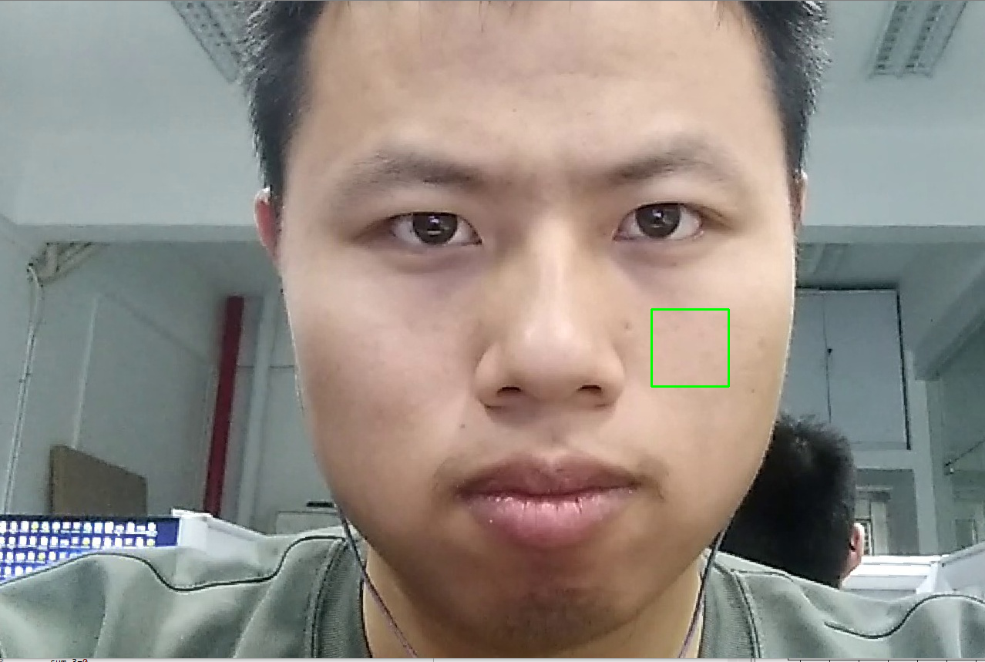
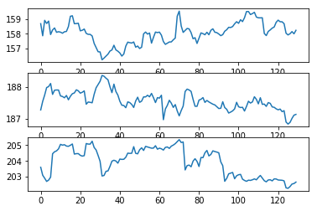
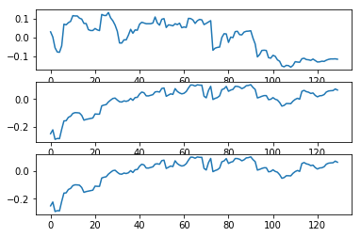

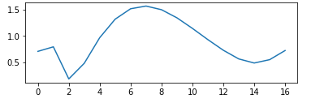
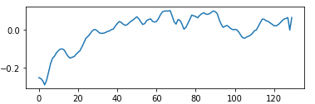
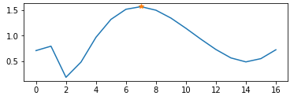
Heart rate detection using Facial Image Sequences
Capture a video including faces
Face detection and Face alignment
Select an area of face
Split the BGR channels
Do fastICA of B G R sequences
select one of fastICA sequences by computing correlation
Pass a sliding filter
Do FFT
Find the highest multitude
Heart rate=axis_x of highest multitude*Fs/N*60

