Slide 1

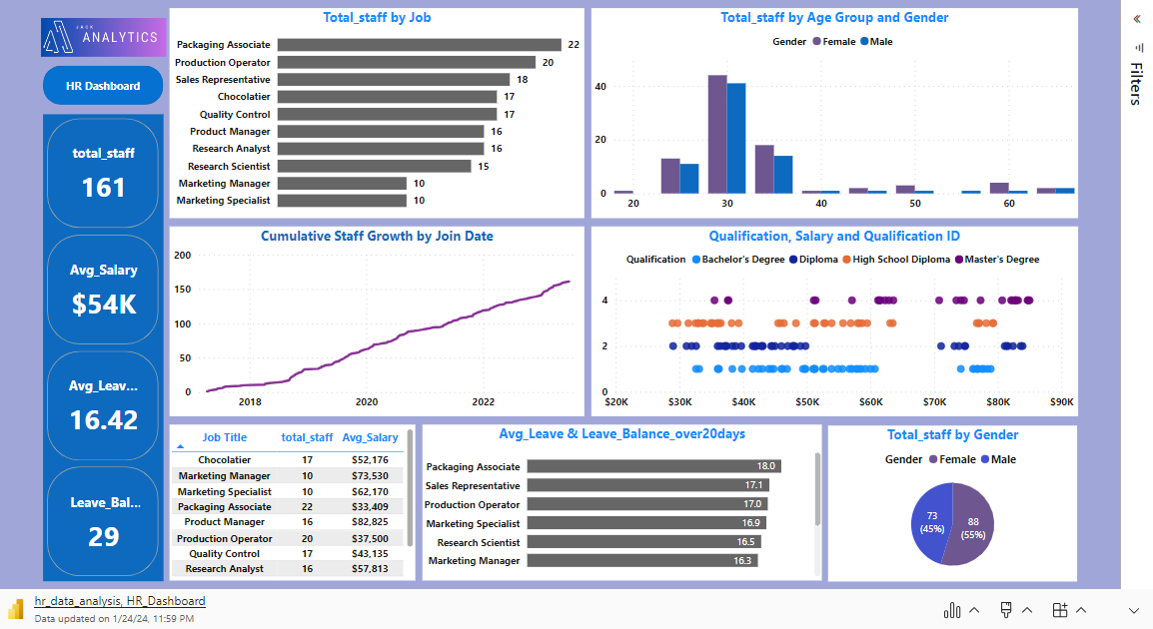
Microsoft Power BI

Slide 2
Questions raised for this HR Data Analysis:
Microsoft Power BI
Total employees in each job role
Staff Gender breakdown
Staff Gender breakdown
Salary for Qualification
Staff growth over time
Staff leave balance analysis
Complete HR Dashboard

