Slide 1
Locally Hosted RAG pipeline with Language Model
Junaid Yeasir Fahim

Slide 2
Introduction
Project Overview
Project Objectives

Slide 3
Project Overview
Main Goal: Develop a system that can answer questions based on the content of a given PDF document.

Slide 4
Objectives
Develop a RAG system for question answering # Enable efficient retrieval of relevant context # Generate accurate and coherent answers # Provide a user-friendly interface # Optimize system performance # Ensure scalability and extensibility # Document and share the RAG system
✅
✅
✅
❗
❗
✅
✅

Slide 5
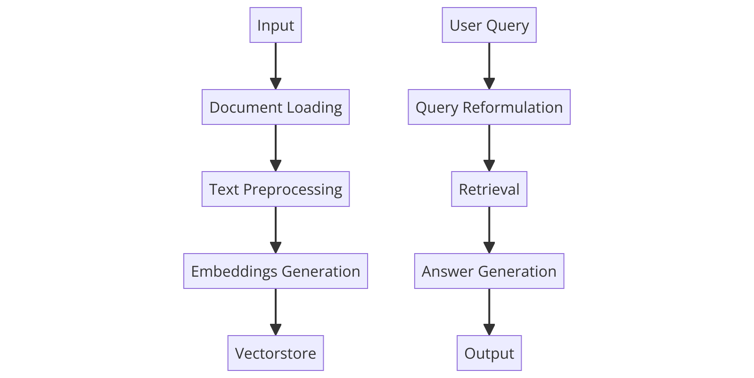
Final Software System Architecture
Fig. 1 : Information Flow Diagram of the RAG system

Slide 6
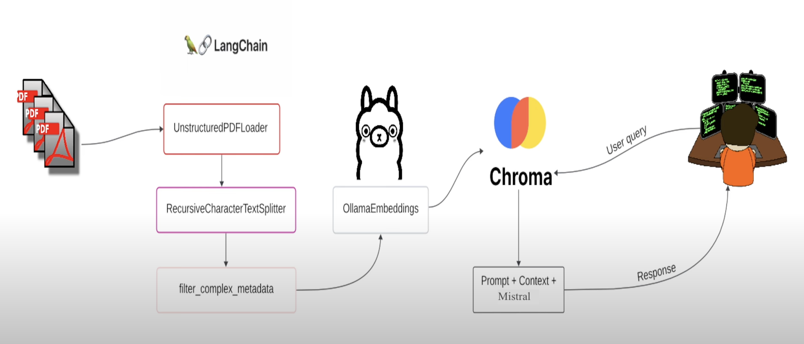
Final Software System Architecture
Fig. 2 : Data Flow Pipeline between modules of the RAG system

Slide 7
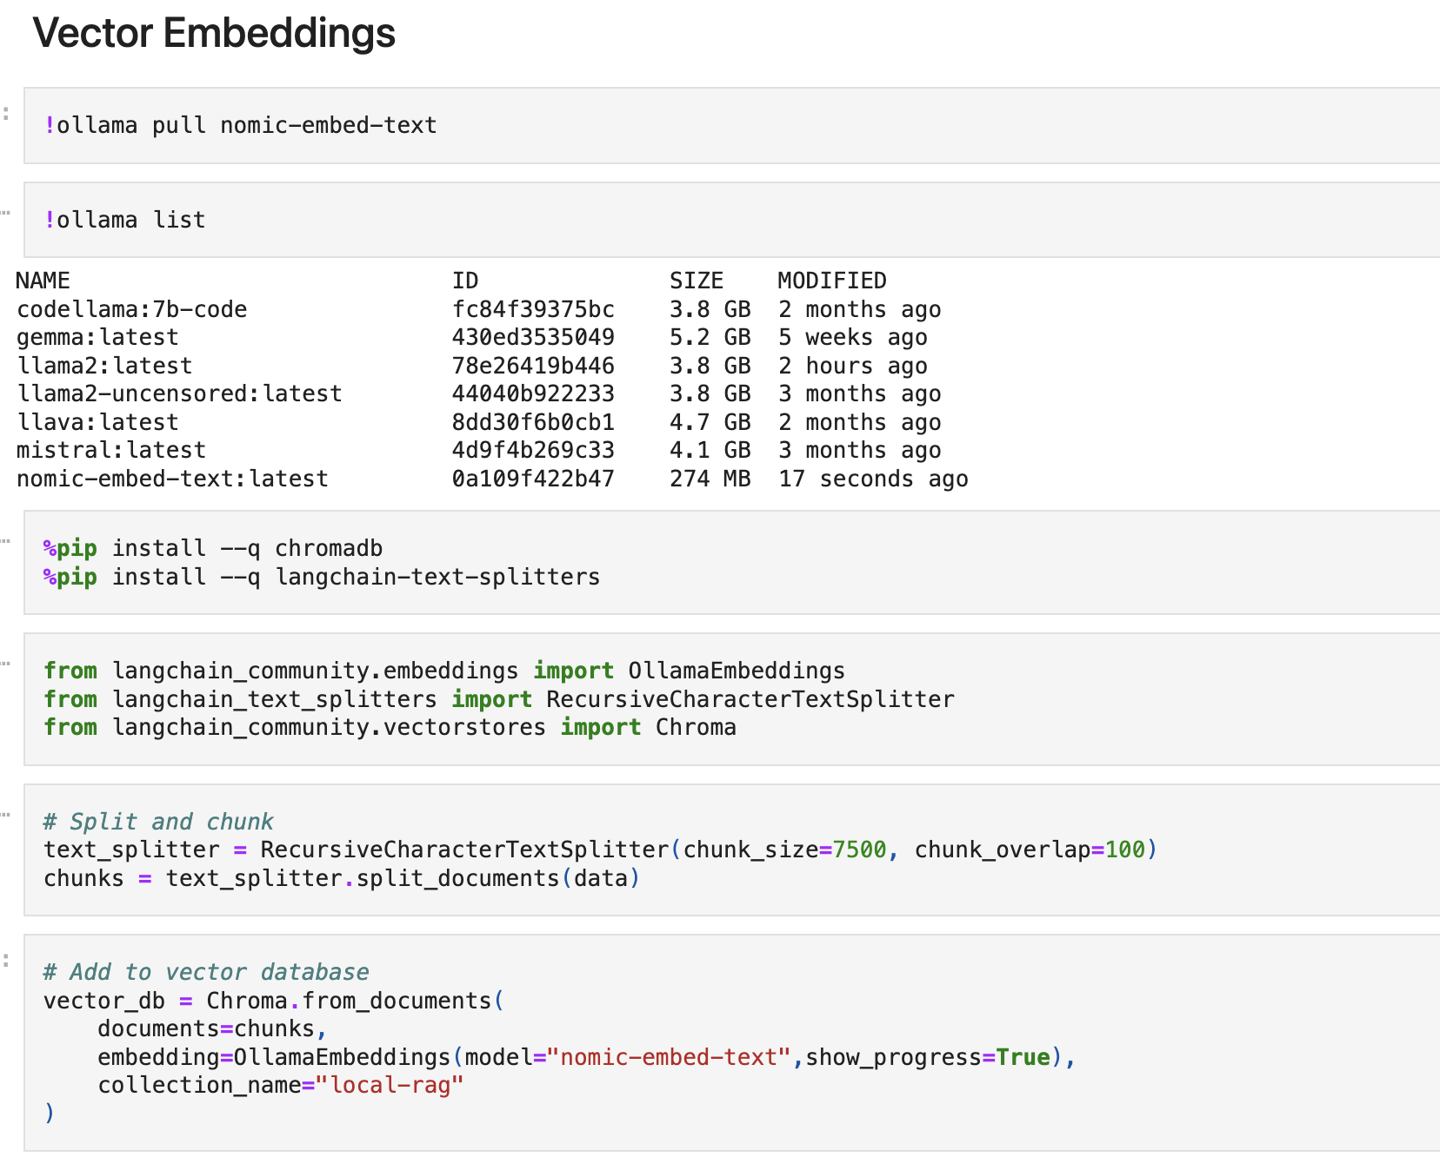
Final Software System Architecture
Code-Chunk. 1 : Text splitting & Vector Embeddings

Slide 8
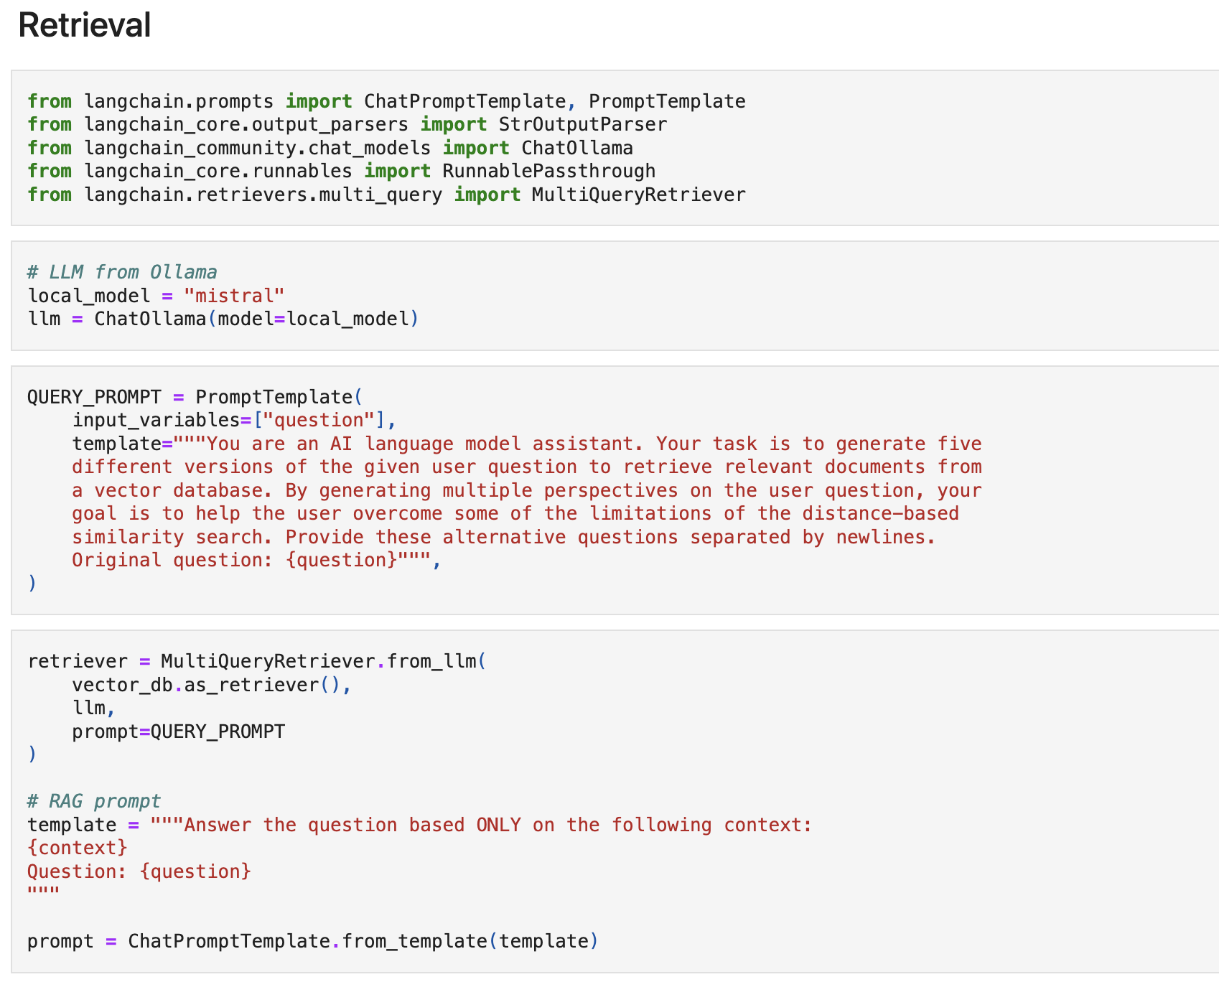
Final Software System Architecture
Code-chunk. 2 : Retrieval module

Slide 9
Outcomes
The RAG system successfully demonstrates the ability to answer questions based on the content of PDF documents.
The retrieval component efficiently finds relevant context
The answer generation module produces coherent and accurate responses
Aligns well with the project goals of enabling knowledge extraction from unstructured data
The user interface provides a seamless interaction for users to input queries and receive answers.

Slide 10
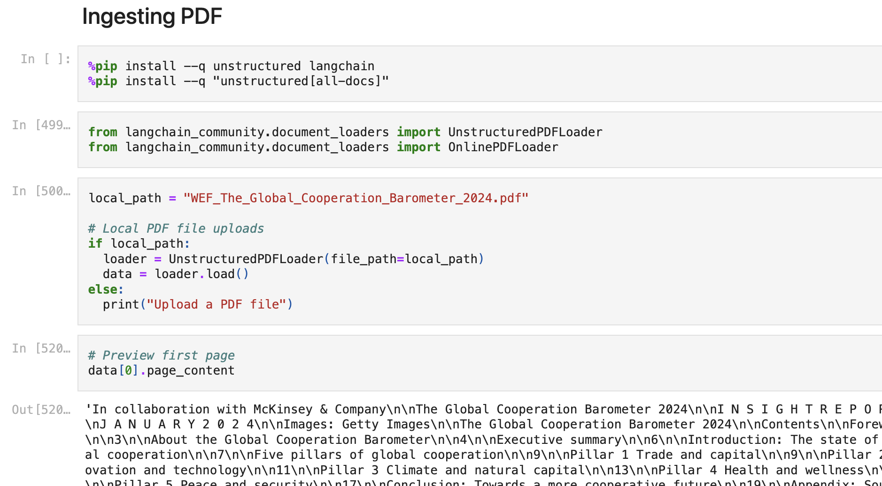
Demonstration/ Results
Fig. 3 : Uploading the PDF locally/ online

Slide 11
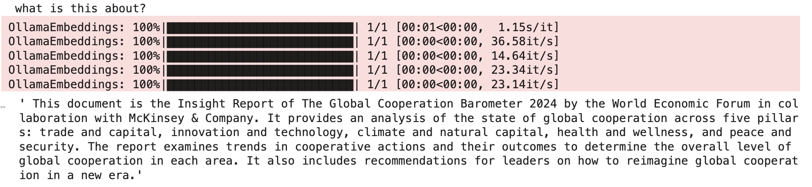
Demonstration/ Results (contd.)
Fig. 4 : Summarization test

Slide 12
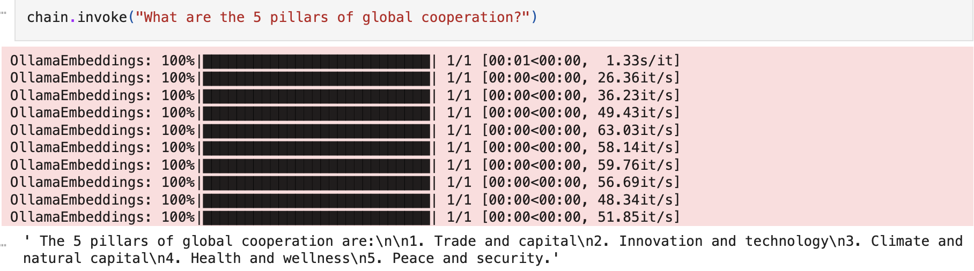
Demonstration/ Results (contd.)
Fig. 5 : Efficient Question-Answering test

Slide 13
Project Reflection
Key Learnings:
Langchain framework
Ollama index & the libraries
Ideas always take more time to implement
Help was always found in the communities of Stackoverlow/ langchain/ youtube etc.

Slide 14
Project Reflection
Software Design and Planning:
Having a well-defined goal is essential
Clear architectural planning
Step-by-step component integration

Slide 15
Project Reflection
Development and Validation:
Insights into iterative testing and validation (agile method)
Refinement of query handling and retrieval accuracy.

Slide 16
Project Reflection
Mistakes and Improvements:
Time-management & keeping short-reachable mini-goals is important
Challenges faced in vector database management and query optimization
future improvements aimed at enhancing scalability and response times.

Slide 17
Racial & Gender Equity Statement
The RAG system is designed to be easily deployable in various environments, including areas with limited internet or server access capabilities.
By enabling local hosting of the RAG system, we aim to bridge the digital divide and provide access to information retrieval and question-answering capabilities to underserved communities.
This local hosting feature is particularly beneficial for users in rural or remote areas, where internet connectivity may be limited or unreliable

Slide 18

THE END
Questions?

