Slide 1
SC4052 CLOUD PROJECT
Lee Jun Yang
U2220336C
Topic 2: Personal Assistant-as-a-Service

Slide 2

VIDEO DEMO

Slide 3
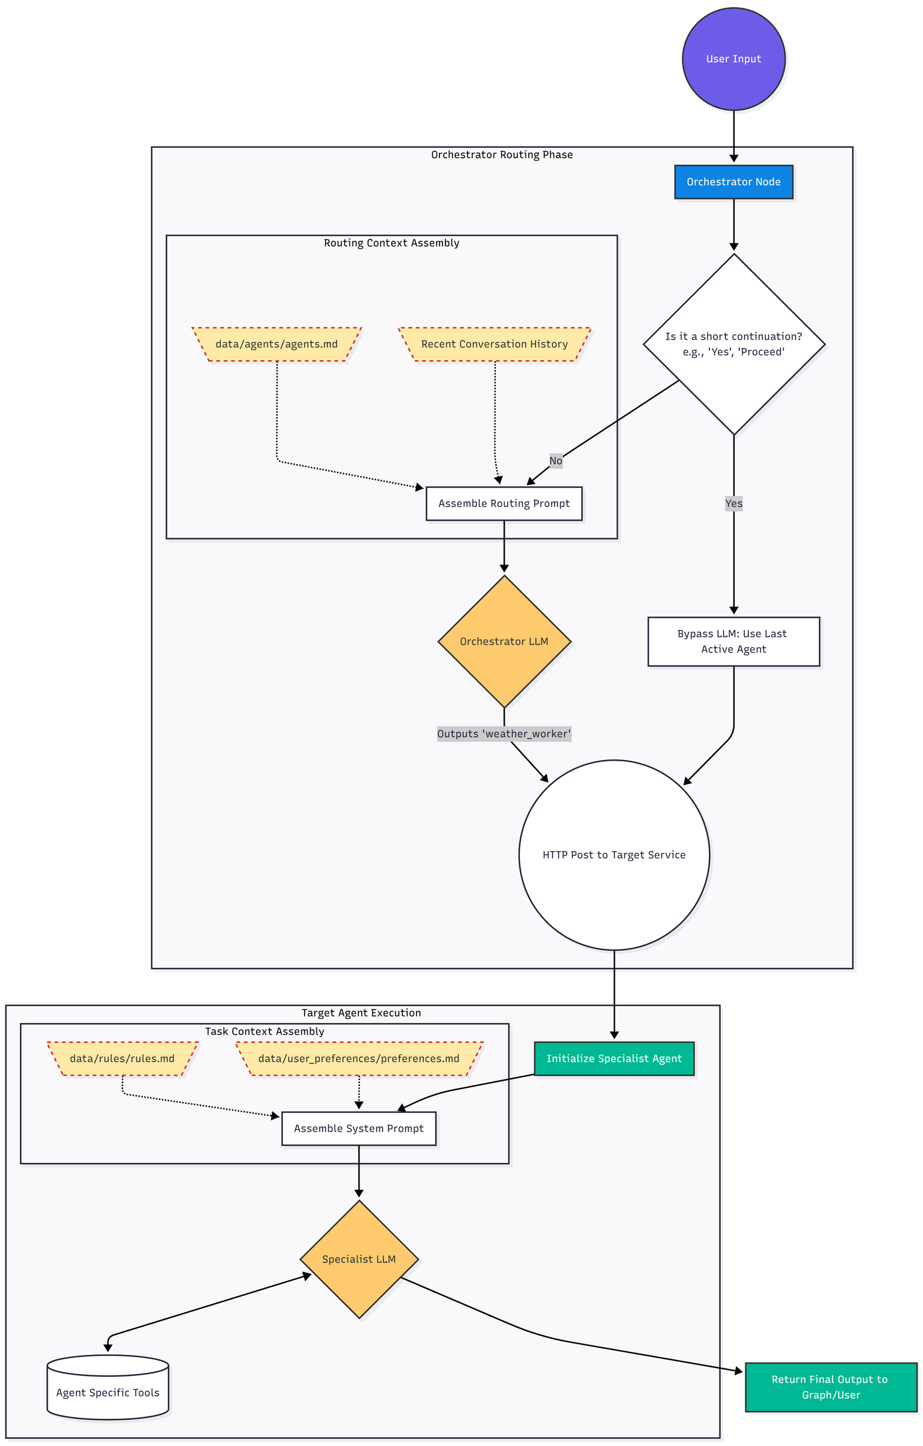
OVERALL WORKFLOW
How Orchestrator routes to specified agent
After receiving user input, the system assembles a system prompt at the orchestrator level before invoking the LLM.
This prompt combines agent definitions and conversation history to provide full context.
The orchestrator LLM uses this context to interpret the request and route it to the most appropriate agent.
This approach enables flexible and dynamic behaviour without modifying the underlying model.

Slide 4
OVERALL WORKFLOW
How agent completes its task
After the task is routed to a specific agent, the system performs prompt assembly again.
This prompt combines rules.md, preferences.md, and the agent-specific tools to provide full context.
The assembled prompt is then passed to the LLM, enabling the agent to execute the task and generate the final response.

Slide 5
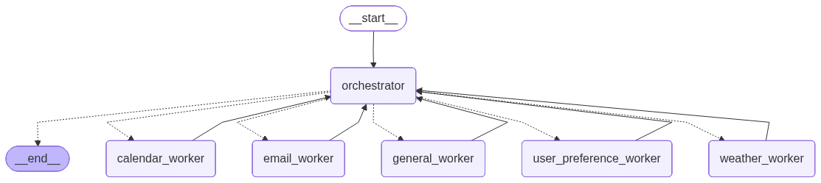
AGENTIC LOOP WORKFLOW
Overall Orchestrator - Worker Workflow
Our Personal Assistant-as-a-Service application will follow this flow which involves 5 different agents.
The orchestrator agent with user’s input and assembled system prompts will decided which agent to route to.

Slide 6
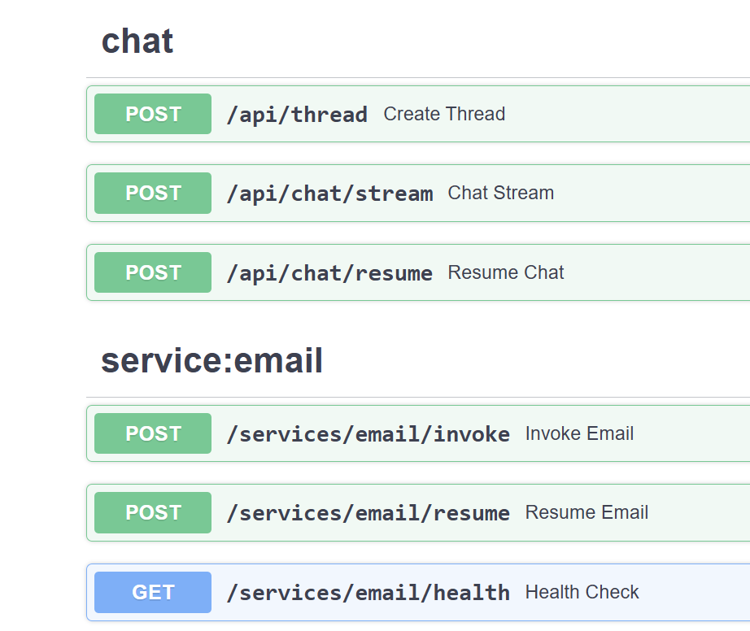
RESTFUL API
Use of RESTful API
Our PAaaS platform uses RESTful APIs to enable communication between the frontend, orchestrator, and backend services.
Endpoints such as “/api/chat/stream” and “api/thread” handle user interactions,
Service endpoints (e.g., the email service) support modular and scalable operations, where specific functions can be invoked independently and resumed as needed through HTTP requests.
This design ensures loose coupling, scalability, and easier integration of independent services.

Slide 7
OVERVIEW OF AGENTS
Weather Agent
Email Agent
Calender Agent
User Preference Agent
General Agent
Provides real-time weather information
Supports forecasts (hourly and multi-day)
Retrieves metrics such as temperature, humidity, wind speed, rainfall, UV index, and PSI
Can return both local and global weather data
Reads and summarises emails
Searches for specific messages in the inbox
Composes new emails
Sends replies to existing email threads
Manages calendar events (create, read, update, delete)
Checks for scheduling conflicts before creating events
Supports searching and retrieving events
Handles event modifications and deletions
Stores and updates user-specific settings
Manages preferences such as timezone, email tone, and measurement units
Ensures personalised responses across sessions
Persists preferences for consistent behaviour
Handles general queries not requiring specialised tools
Provides natural language responses
Acts as a fallback agent when no specific domain agent is required

Slide 8

LIMITATIONS
Due to resource constraints, smaller-sized LLMs were used in this application as the models were required to run locally on available GPUs.
As a result, the token throughput is relatively lower, which impacts the overall responsiveness and efficiency of the system.

