Slide 1

EMPLOYEE MANAGEMENT SYSTEM
Project Supervisor: Dr. N. Srinivasan
Name of the Student: P. JYOSHMITHA REDDY
Register Number: 39110419

Slide 2
Presentation Outline
Course Certificate
Introduction
Objectives
System Architecture / Ideation Map
Project Implementation
Methodology
Conclusion
References

Slide 3
Course Certificate

Slide 4
Introduction
Employees are the backbone of any company therefore their management plays a major role in deciding the success of an organization.
Employees Management Software makes it easy for the employer to keep track of all records
This software allows the administrator to edit employees, add new employees and update employee.
This system brings about an easy way of maintaining the details of employees working in any organization.

Slide 5
Objectives
In this world of growing technologies everything has been computerized. With large number of work opportunities the Human workforce has increased.
Thus there is a need of a system which can handle the data of such a large number of Employees.
This project simplifies the task of maintaining records because of its user friendly nature.
A user friendly front-end for the user to interact with the system.

Slide 6
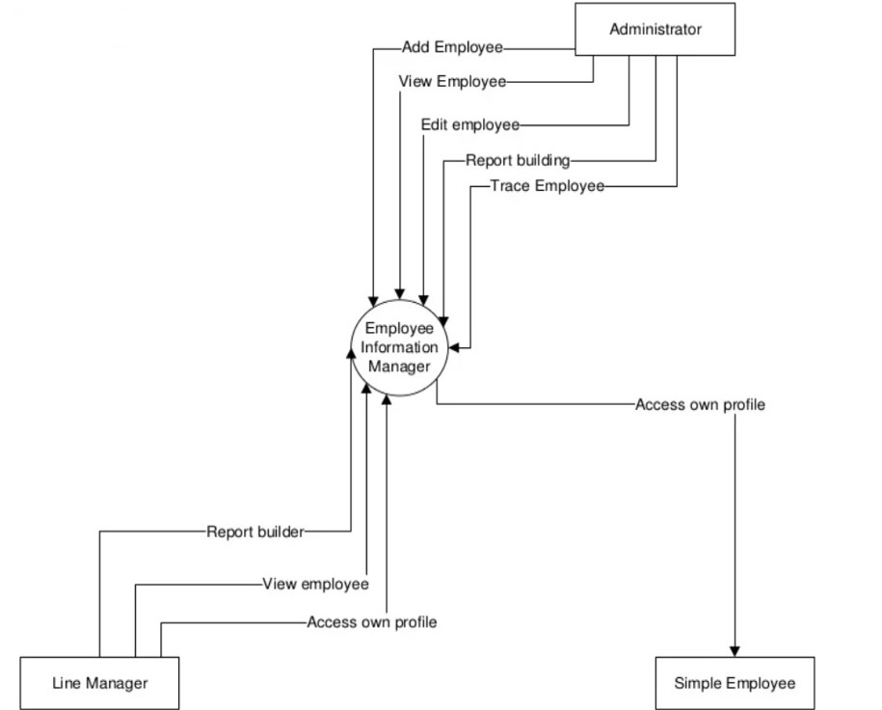
Flow Diagram

Slide 7
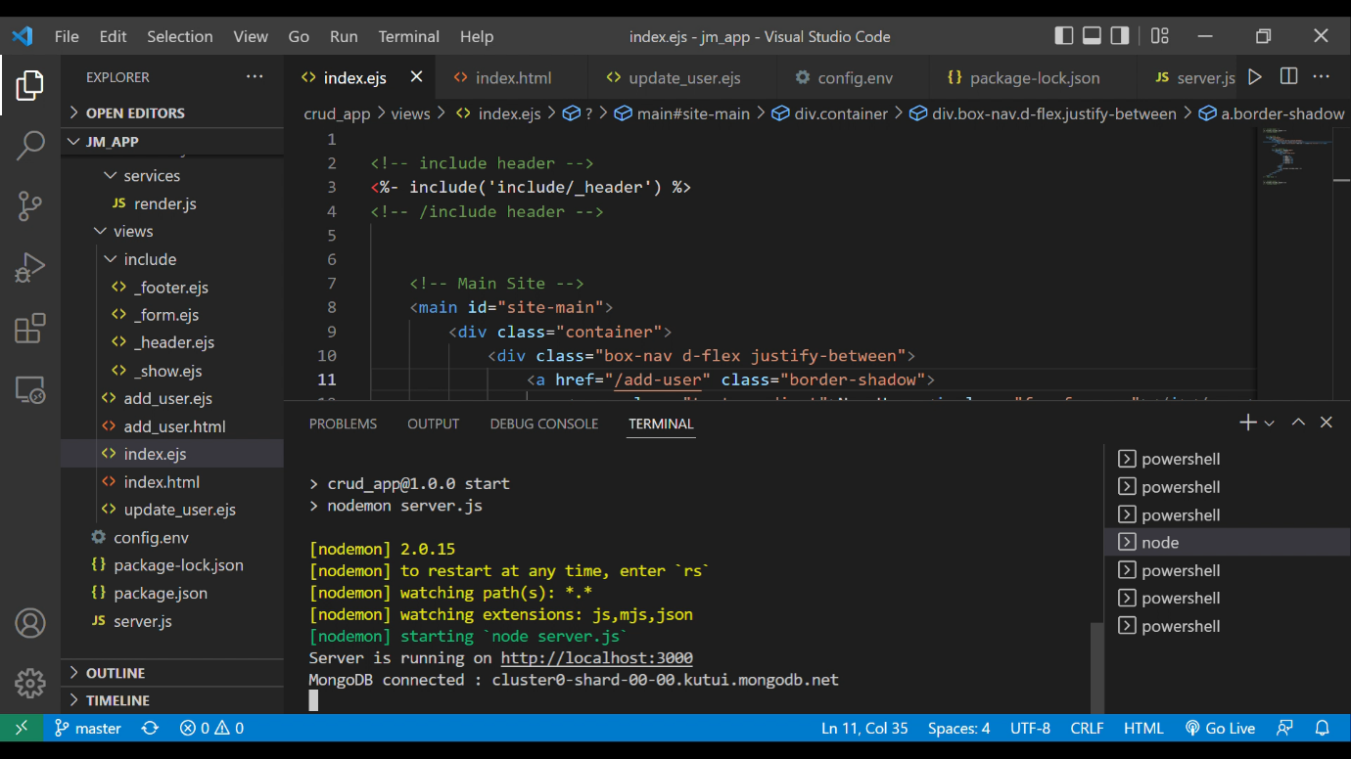
Employee Management System
1) Run npm start. The server is running on localhost:3000

Slide 8
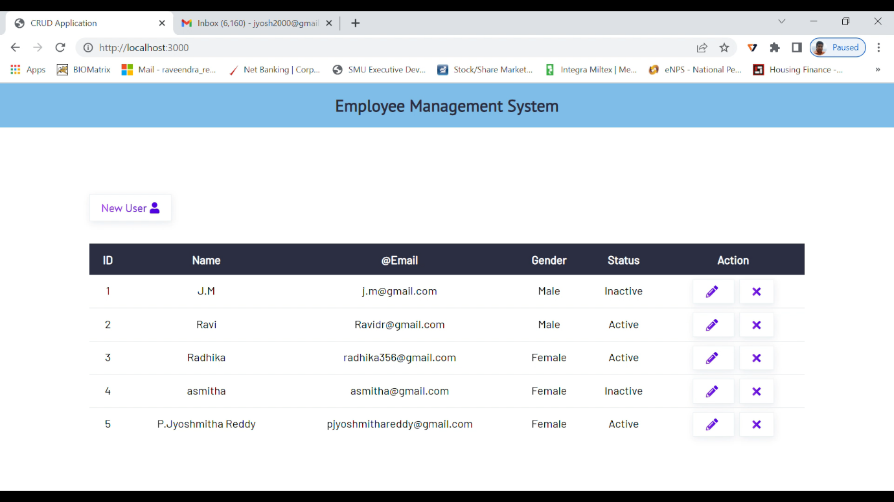
Employee Management System
2) Web application is now running on localhost:3000

Slide 9
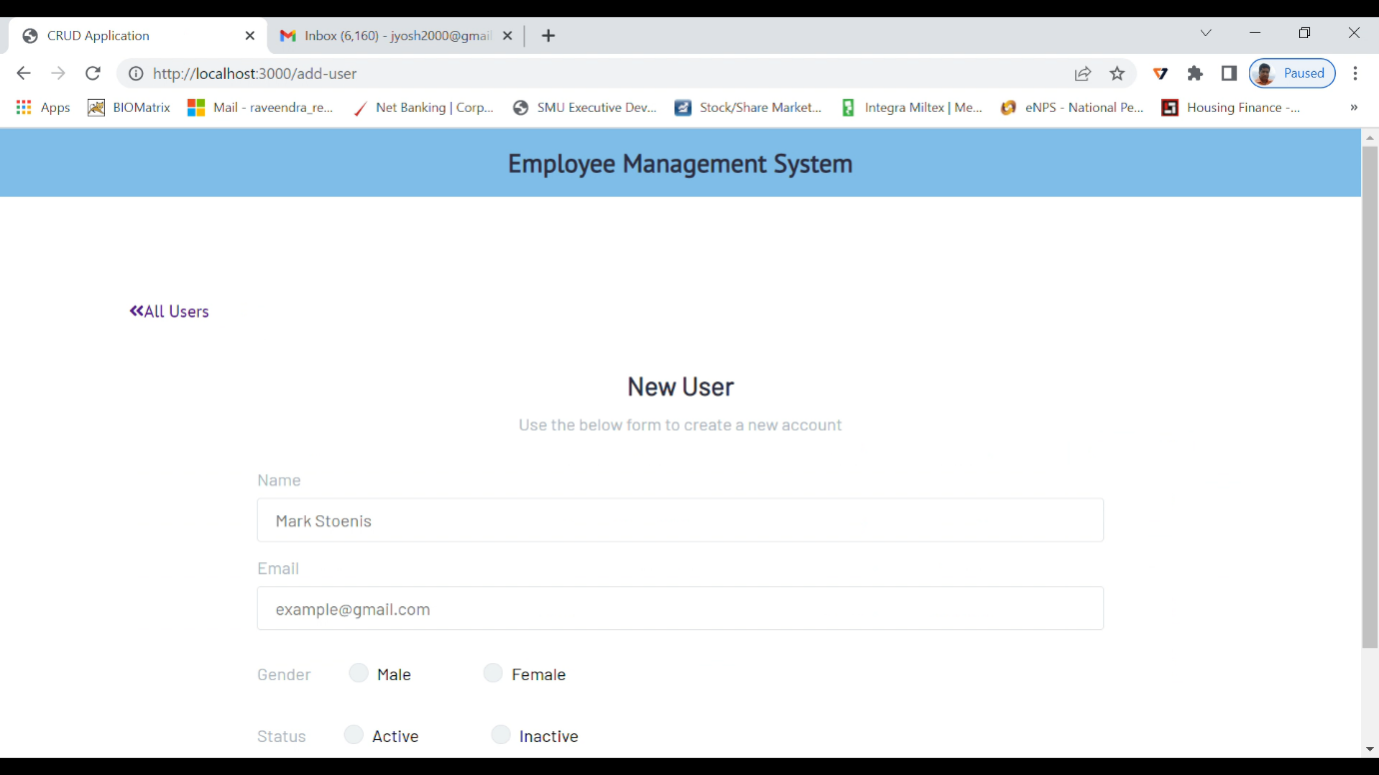
Employee Management System
3) Click on add users to add a new employee

Slide 10
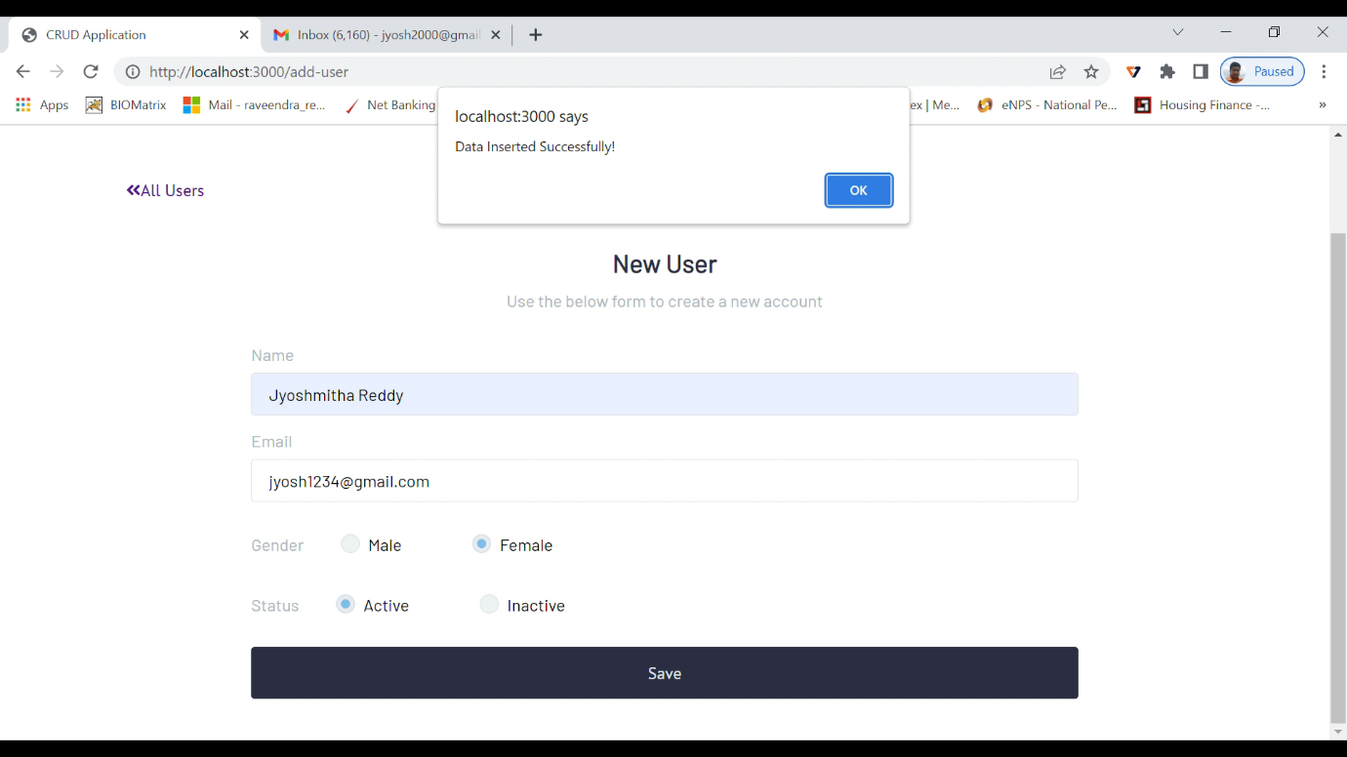
Employee Management System
4) Save it

Slide 11
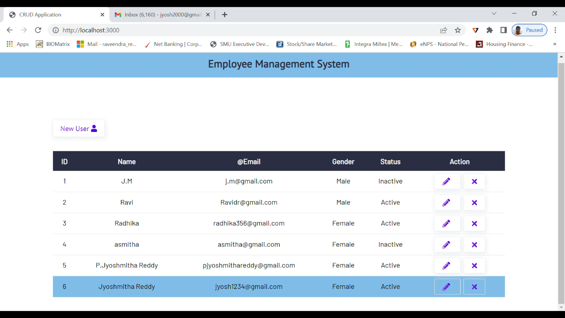
Employee Management System
5) The employee is now added to the list

Slide 12
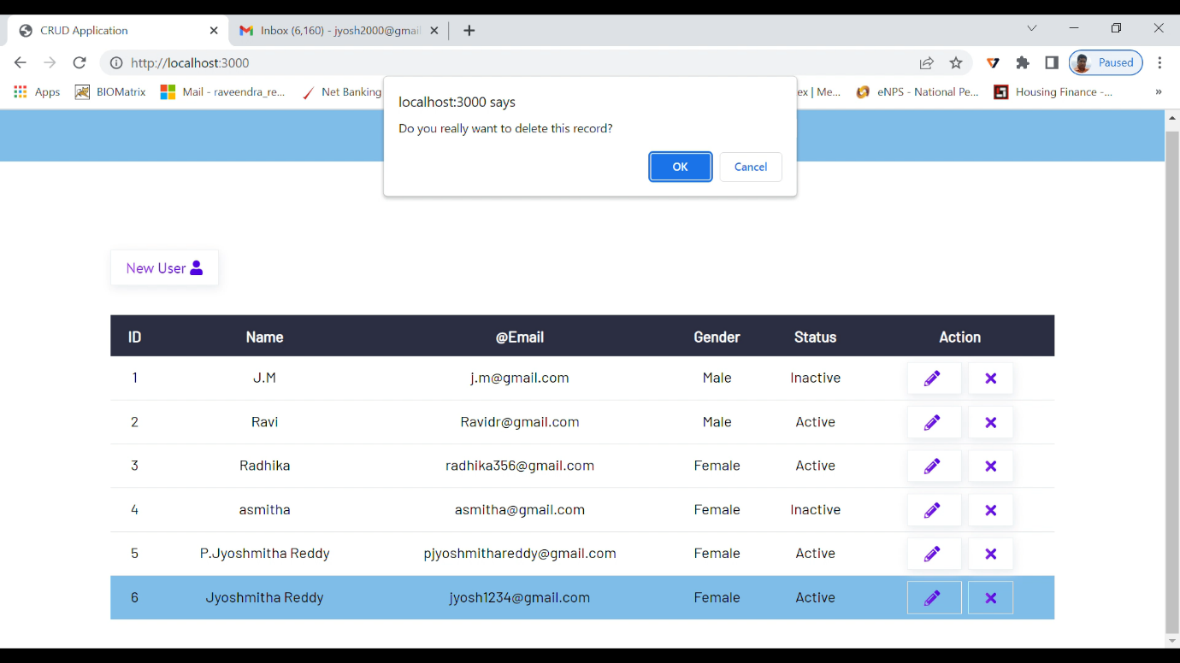
Employee Management System
6) Click on the delete icon to delete the employee

Slide 13
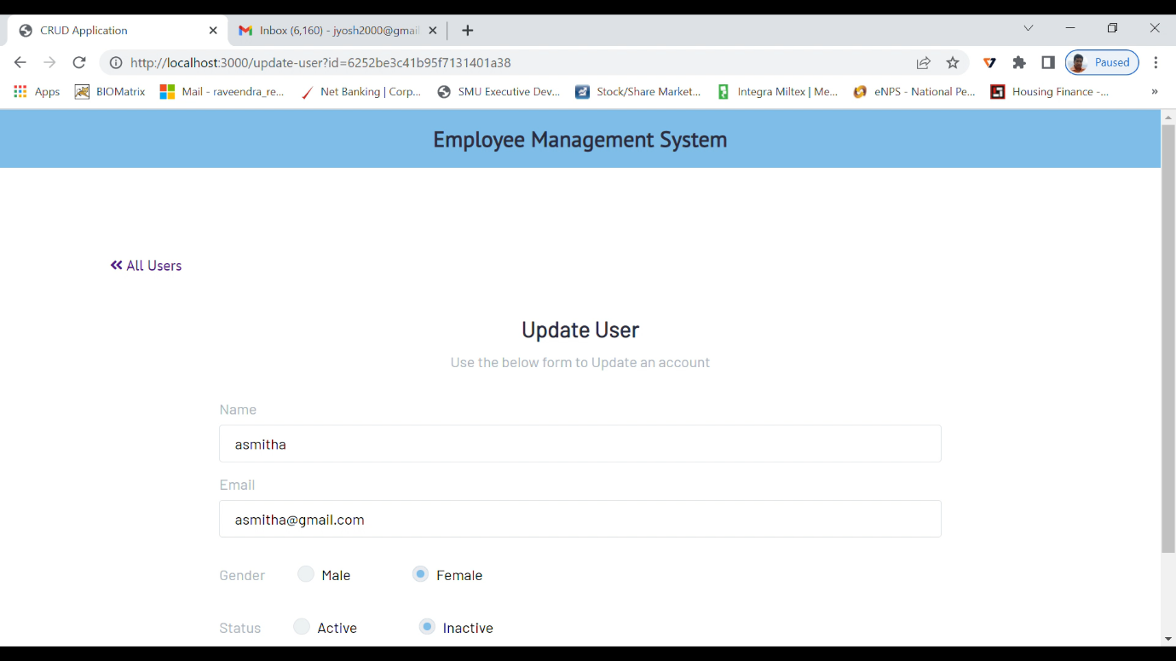
Employee Management System
7) Click on the edit icon to update the employee info

Slide 14
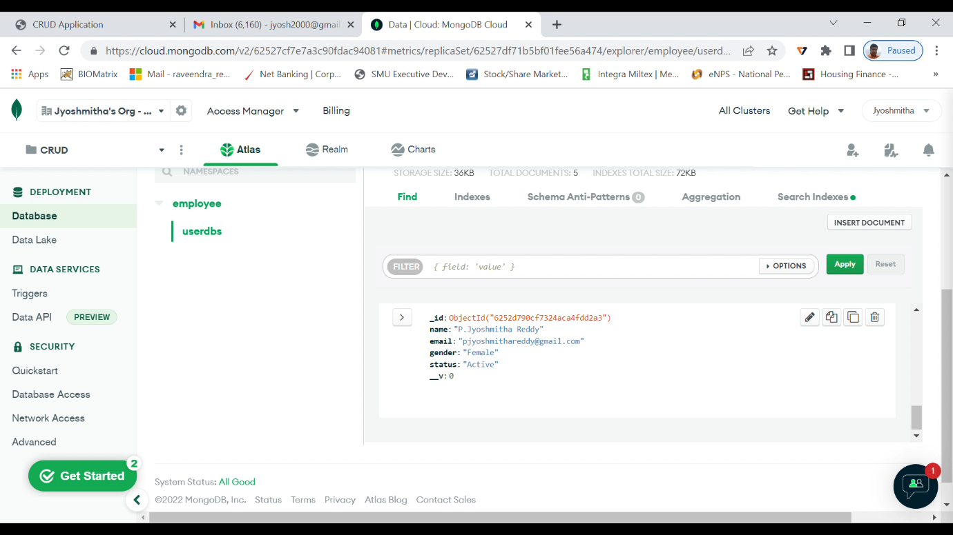
Employee Management System
8) All the data is stored in the Mongo DB database

Slide 15
Methodology
Mongo DB is used as database to store and maintain records.
HTML, CSS, EJS, JS is used as frontend application
Admin can create and modify the employee details.
This web application is a MERN Stack webapp
It uses CRUD Operations

Slide 16
Conclusion
The objective of this project was to build a web based program for EMS in order to manage employees safely and securely. The system developed is able to meet all the basic requirements.
The software product produced was fairly good
The user interface is good and is very easy to navigate
The EMS will be also benefited by the proposed system, as it will automate the whole procedure, which will reduce the workload.

Slide 17
References
 | www.google.com www.wikipedia.com https://www.mongodb.com/

