Slide 1
Cardzo – Document Tools App
Document Tools
&
EBookReader
Team
Sidharth CS
Praveen Kumar
Jyothis KS
Krishnendu Suresh
Jabirhusain KP

Slide 2
Contents
Introduction
Project Objectives
Modules Introduction – DocScanner, DocTools, Ereader
Software Requirements
Context Diagrams

Slide 3
Introduction
The Cardzo app will give the user pretty much every features regarding managing documents like converting, creating, viewing documents along with an epub reader to make it easy to read books from our smartphone device.

Slide 4
Project Objective
To create an interactive android app which provides :
A Document Scanner to create pdfs from images
Document tools like Convertor, Compressor, etc..
Ebook Reader

Slide 5
What We Are Using?
Front-end
  Flutter
    Mobile UI Development Framework by Google
    Primary language : Dart
Back-end
  Python Django
    Web Development Framework
    Primary Language : Python
Model
  Incremental Model

Slide 6
Incremental Model
Requirements divided into multiple standalone modules
Every subsequent release of the module adds function to the previous release
Errors are easy to be recognized.
Simple to manage risk because it handled during its iteration
Used in a project has a lengthy development schedule.

Slide 7
Flutter
Flutter is an open source Google mobile UI framework
Flutter is free
Cross – platform development
Better looking UI
Uses Dart as Primary language

Slide 8
Dart
Developed by Google
C style syntax
Used for developing apps for mobile,web, etc..
Can be compiled to native code or javascript

Slide 9
Python Django
Django is a free and open-source web framework
Based on Python language
Uses Model-Template-View architecture
Based on DRY (Don’t Repeat Yourself) concept

Slide 10
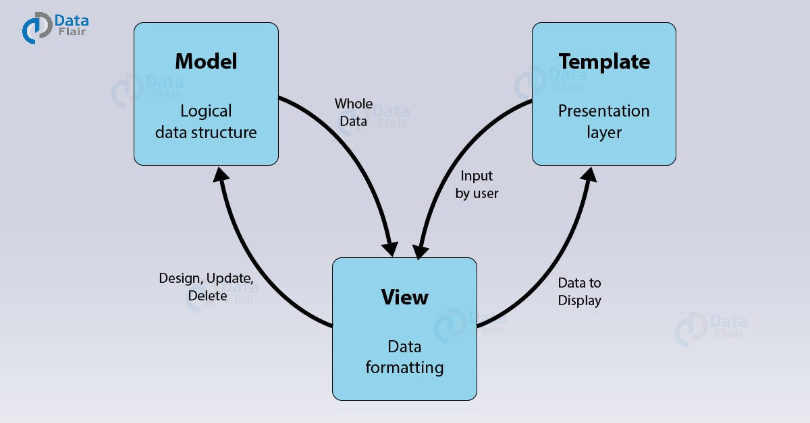
Model-Template-View

Slide 11
Python
Open Source and Community Development
Extensive Support Libraries
Learning Ease and Support Available

Slide 12
DocScanner
Functionalities :
Creating a document from given image
Displaying PDF Documents
Allow User to share the created documents

Slide 13
DocTools
Functionalities :
Compress Documents
Convert Documents to Another Format
PDF Splitter and Joiner

Slide 14
EPUB
EPUB is an e-book file format
Uses .epub extension
EPUB is supported by many e-readers
Archive file consisting of XHTML files carrying the content, along with images and other supporting files.

Slide 15
EReader
Functionalities :
Display Epub formatted Ebooks
Provides Night mode
Other functions like adjusting scroll and font size

Slide 16
Translator Module
Functionalities :
Getting Text from Typed Images using OCR
Translation of the text to other languages

Slide 17
Software Requirements
• Platform :
◦ Android
• Operating System :
◦ Android – Version 6.0 above ( API 23 above )
• Hardware :
◦ Smartphone should have camera
◦ at least 2GB RAM

Slide 18
Software Requirements
Developer Side
Android SDK 27 ( Android 8.1 )
Android Studio / VS Code
Flutter SDK
Hardware Permissions Needed
    Camera Access
    Network Access

Slide 19
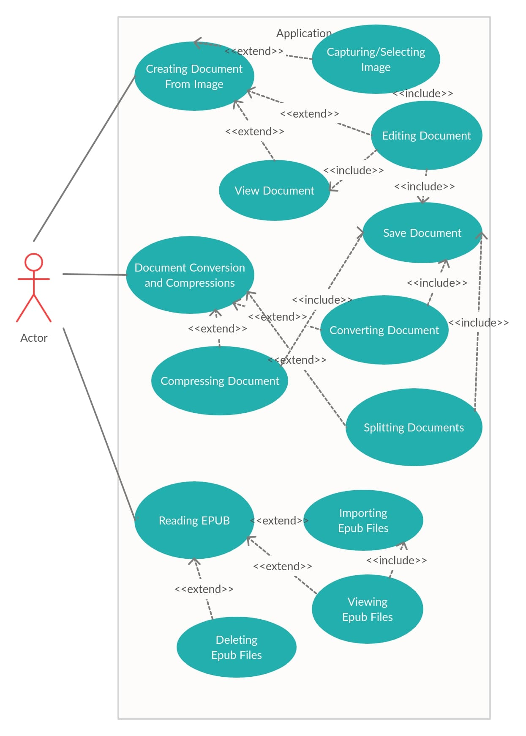
UseCase Diagram

Slide 20
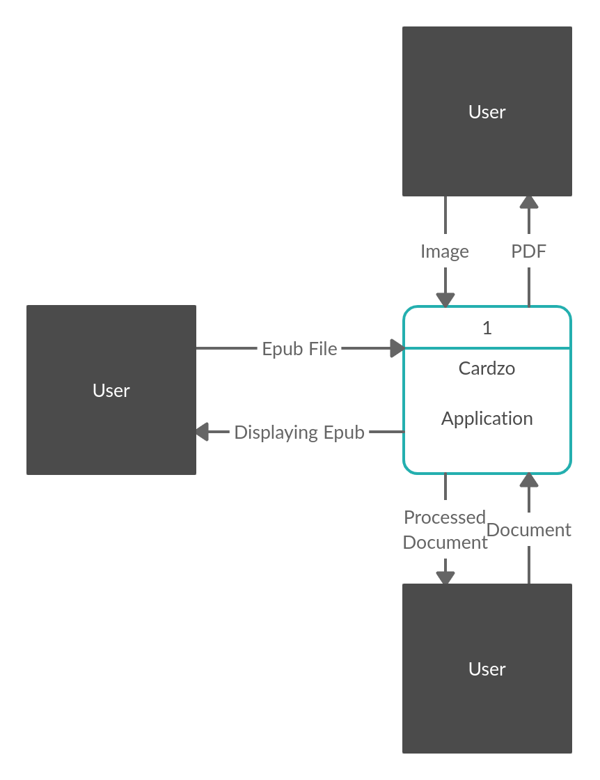
Context Diagram

Slide 21
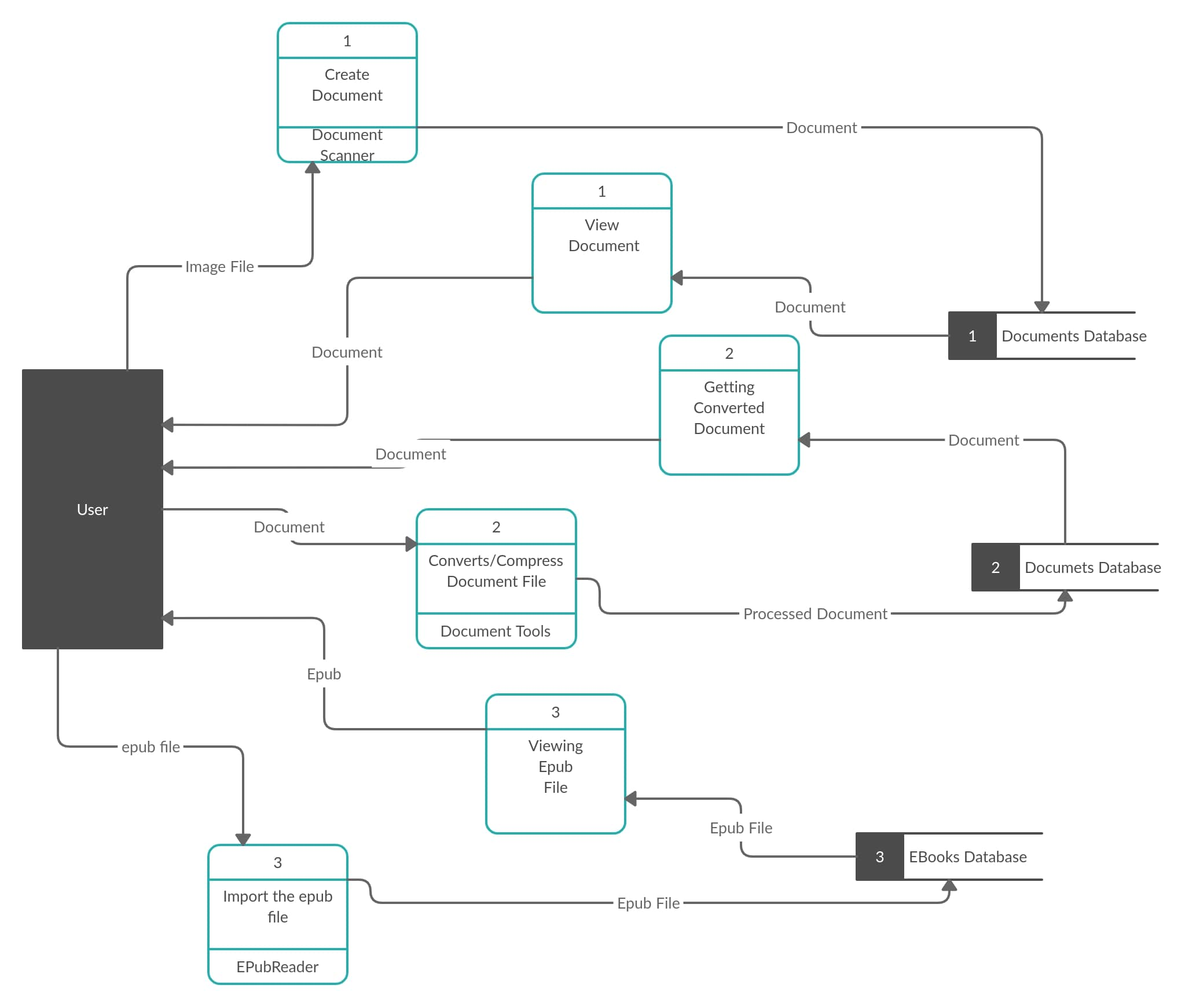
Level 1 Diagram

Slide 22
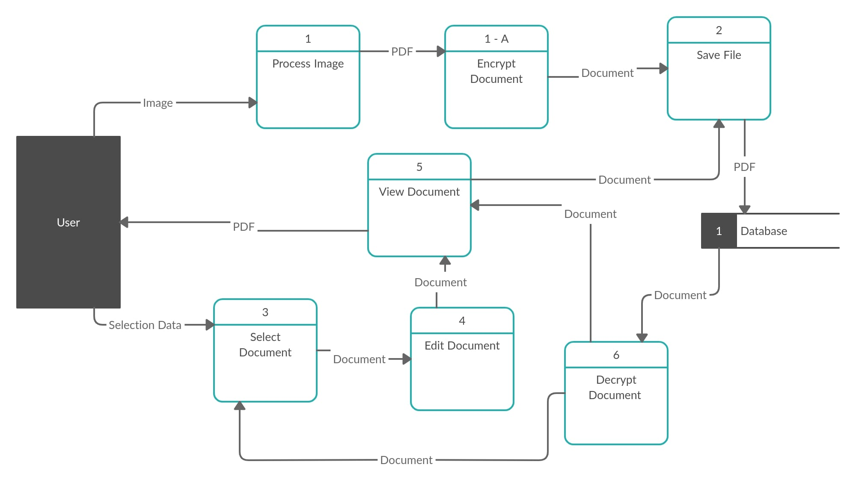
DocScanner

Slide 23
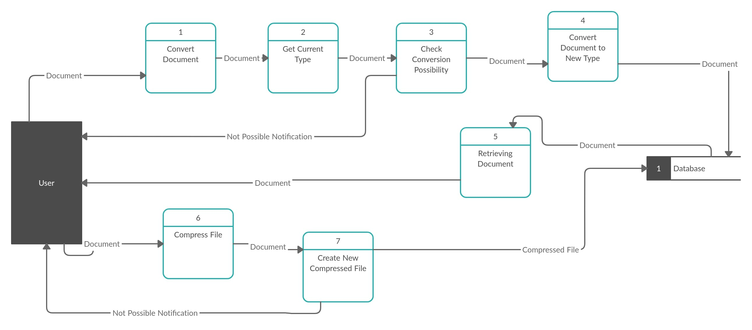
DocTools

Slide 24
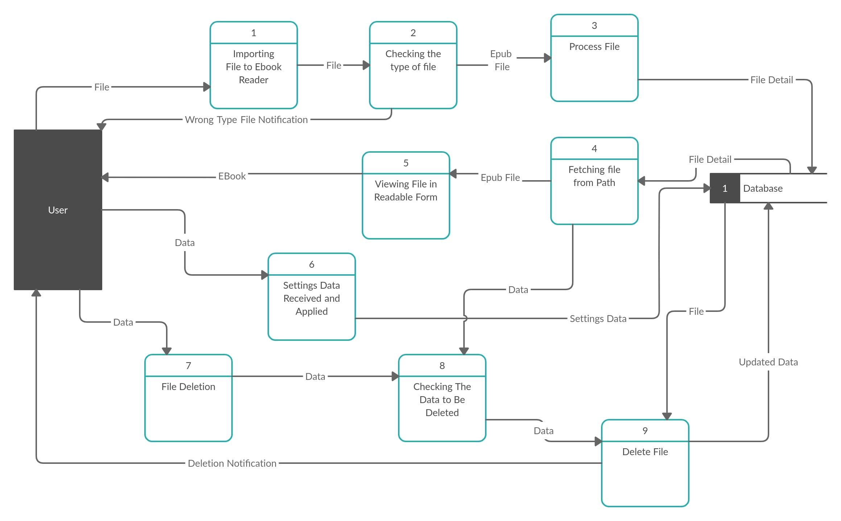
EReader

Slide 25
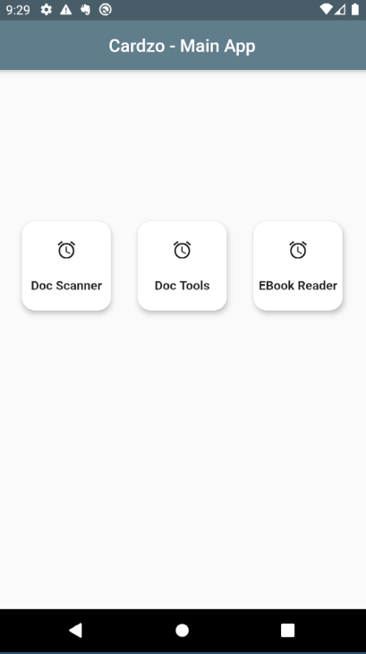
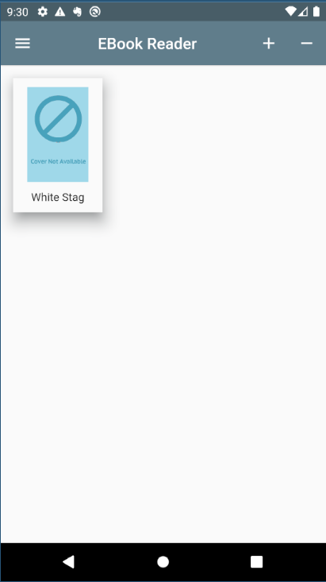
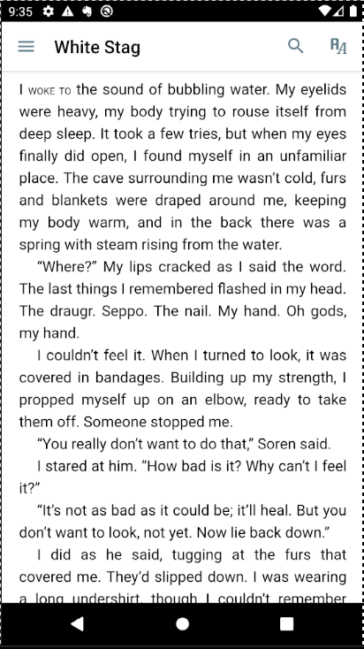
GUI Models

Slide 26
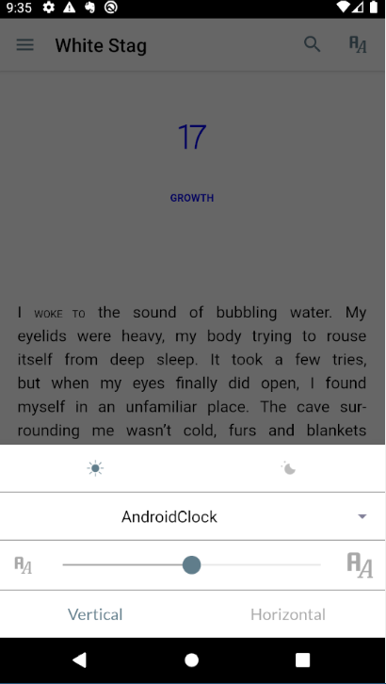
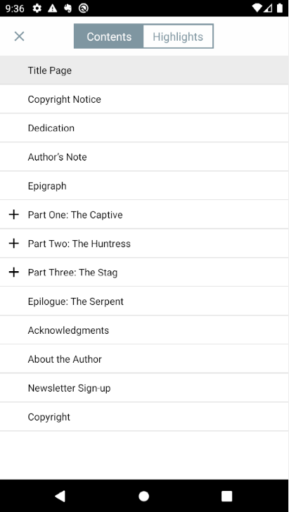
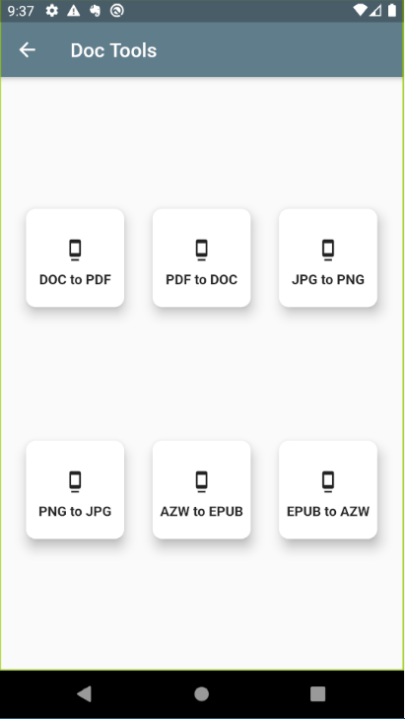
Continue..

Slide 27
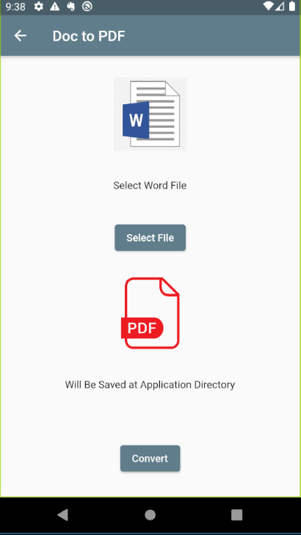
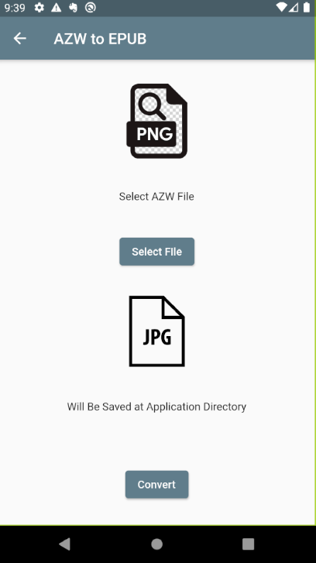
Continue..

Slide 28
Future Enhancements
Changing DocTools Modules API to our own API
Completing Missing Features in each module
Adding Translator Module
Add object detection feature using Deep Learning

Slide 29
THANK YOU

