Slide 1
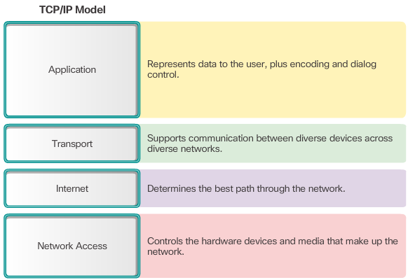
The TCP/IP Protocol Model
Notes:
3.2.4.3 The TCP/IP Protocol Model

Slide 2
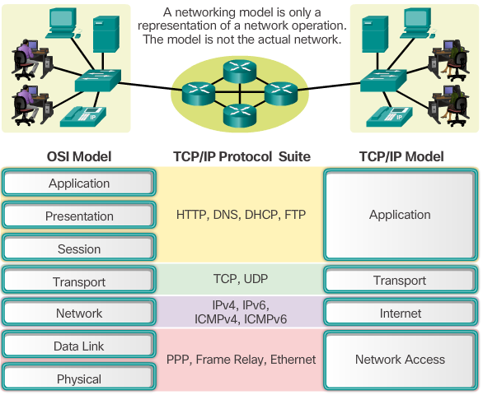
The Benefits of Using a Layered Model
Notes:
3.2.4.1 The Benefits of Using a Layered Model

Slide 3
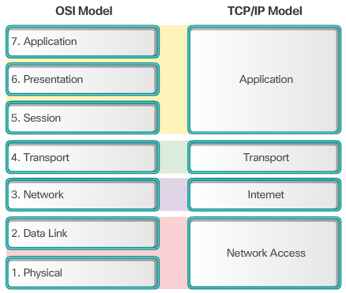
OSI Model and TCP/IP Model Comparison
Notes:
3.2.4.4 OSI Model and TCP/IP Model Comparison
3.2.4.5 Activity – Identify Layers and Functions
3.2.4.6 Packet Tracer – Investigating the TCP/IP and OSI Models in Action

Slide 4
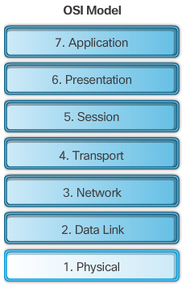
The OSI Reference Model
Notes:
3.2.4.2 The OSI Reference Model

Slide 5
Protocol Data Units
Data
Data
Data
Segment
Packet
Frame
Bits or bit stream
Notes:
3.3.1.2 Protocol Data Units

Slide 6
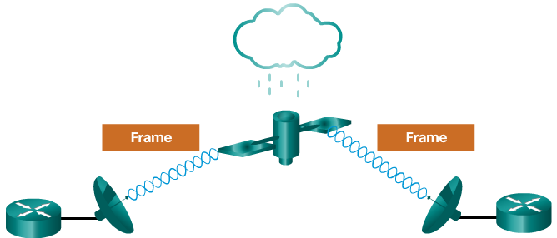
The Frame
Frames have three basic parts:
Header
Data
Trailer

Slide 7
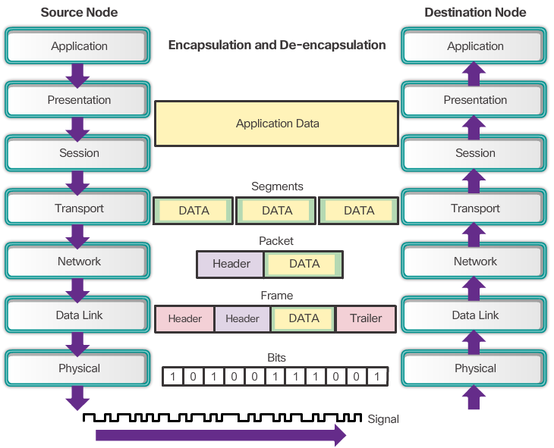

Slide 8
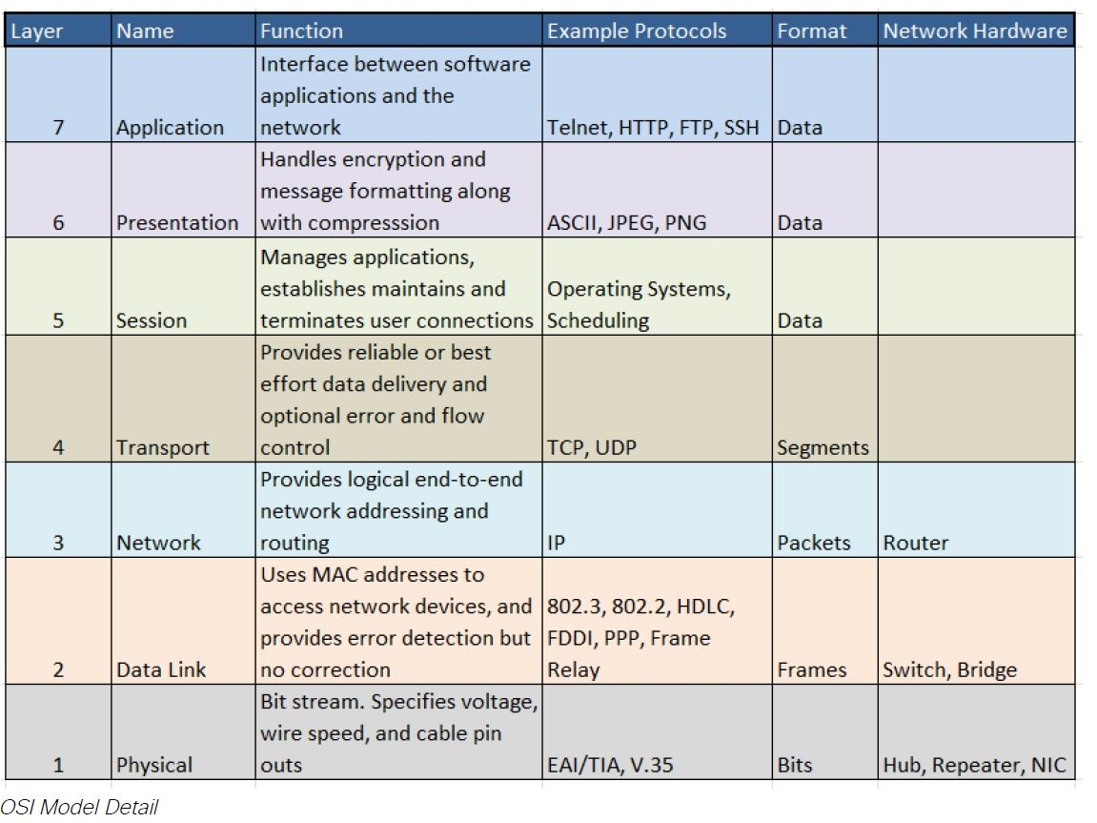

Slide 9
