Slide 1

Review-1
SkillNect – Smart Career Guidance and Development App
Submitted by Mr. D.VENKATA RAVI KUMAR, M.TECH.,(Ph.D) ASSISTANT PROFESSOR
22MH1A05B5 KUDIPUDI JYOTHI
22MH1A0589 BIKASH PRASAD YADAV
22MH1A05E3 SHIVANAND PRASAD KUSHWAHA
22MH1A0597 DASI KARTHEEK

Slide 2
INDEX:
CONTENT
Abstract
Introduction
Objective
Existed System
Purposed System
Comparative Table: Existing vs Proposed System
Findings from Reference Papers
Application of the Project
Novelty and Innovation
Implementation details & RoadMap/Blueprint
References

Slide 3
2. ABSTRACT:
SkillNect is a web and mobile application that helps students and professionals plan, build, and track their career growth. The platform includes various career development tools like resume evaluation, career roadmap creation, skill-building, and interview preparation, all in one system. Users can upload resumes for professional feedback, find personalized learning paths, and track their skill progress through interactive dashboards.
In addition to technical skills, SkillNect focuses on personal and communication skills. It offers exercises to boost confidence, clarity, and presentation. The application features a mock interview tool that mimics real interview situations and provides performance feedback. Built with modern web, mobile, and cloud technologies, SkillNect delivers a smooth and scalable experience, acting as a complete digital career companion that guides users toward their professional goals.

Slide 4
3. INTRODUCTION:
SkillNect is a smart career guidance and development platform designed for students and professionals.
It offers both web and mobile access, making career planning simple and easily accessible.
The platform helps users analyze their strengths and build a personalized career growth roadmap.
It includes AI-assisted resume evaluation to enhance job readiness and profile quality.
Users can improve technical and communication skills through structured learning modules.
Mock interview simulations are provided to boost confidence and prepare for real-world interviews.
The system allows users to track progress, skill milestones, and job applications in one place.
The backend is built with Spring Boot, ensuring robust, secure, and efficient operations.
The frontend is developed using React (web) and React Native (mobile) for a seamless user experience.
The platform is hosted on AWS Cloud, ensuring scalability, high performance, and real-time access.

Slide 5
4. OBJECTIVES :
AI-Assisted Resume Evaluation: To develop a module that provides personalized suggestions and improves job-readiness.
Structured Career Roadmap: To overcome limitations in traditional career guidance by offering a structured roadmap, skill tracking, and course recommendations.
Unified Web & Mobile Interface: To design an intuitive platform that allows users to access all career tools in a single application.
Interactive Personality & Interview Features: To implement exercises like personality development tasks and AI mock interviews for overall professional growth.

Slide 6
5. EXISTED SYSTEM
Description of Existing System: The existing career guidance solutions are fragmented across multiple platforms. Users rely on separate tools for resume evaluation, online courses, mock interviews, and job tracking. This leads to a lack of structured guidance, no unified progress tracking, and limited feedback on personal and communication skills. Traditional methods like offline career counseling or workshops are time-consuming, not personalized, and less interactive.
Technologies / Tools Used:
Basic web applications for resume parsing and keyword matching
Video conferencing platforms (Zoom, Google Meet) for mock interviews
Learning management systems (LMS) like Coursera, Udemy, and edX for skill development
Spreadsheets or offline methods for tracking job applications and progress
No AI integration or cloud services for analytics, storage, or automation

Slide 7
6. PROPOSED SYSTEM :
Description of Proposed System: SkillNect is a unified web and mobile application that provides end-to-end career guidance for students and professionals. The system integrates multiple modules in a single platform:
Resume Analyzer & ATS Score → Users upload resumes, the system analyzes keywords, formatting, and generates an ATS compatibility score with improvement suggestions.
Career Roadmap & Course Recommendations → Users select career goals; AI generates a learning roadmap with skill, course, and project recommendations.
Personality & Communication Development → Users take quizzes or record interactions; system evaluates confidence, clarity, and body language, suggesting exercises.
AI-Powered Mock Interviews → Users attempt video or text interviews; AI evaluates performance and provides feedback and scores.
Job & Skill Tracker → Users track applied companies, skill progress, and milestones, with reminders for tasks.
All modules are connected through a central dashboard, which summarizes progress, scores, and recommendations. The system ensures real-time updates and a personalized learning experience.

Slide 8
Technologies / Tools Used:
Frontend: React (Web), React Native (Mobile)
Backend: Spring Boot (REST APIs)
Database: MySQL / MongoDB
Cloud Services: AWS (EC2 for hosting, S3 for file storage, RDS for database)
AI/ML Tools: Python libraries or custom AI modules for resume analysis, personality evaluation, and mock interview feedback
Version Control: Git & GitHub

Slide 9
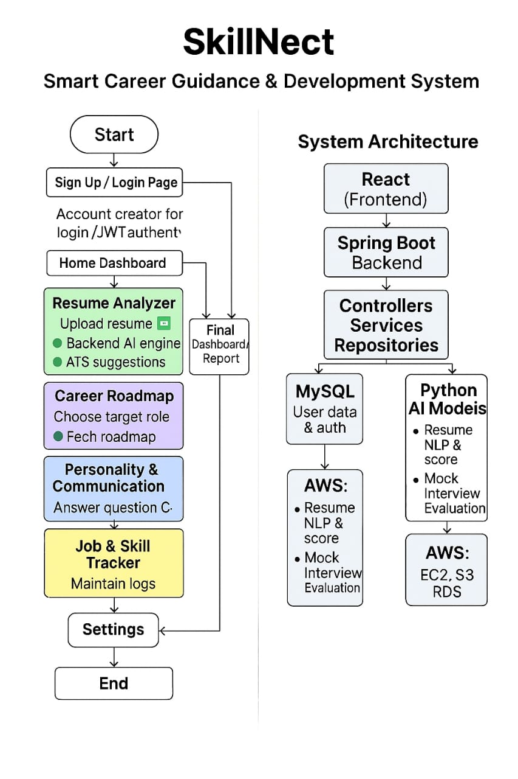
FLOWGRAPH:

Slide 10
7. COMPARATIVE TABLE: EXISTING VS PROPOSED SYSTEMS:
Feature | Existing System | Proposed System (SkillNect)
Resume Evaluation | Basic keyword matching; limited feedback | AI-assisted resume analysis with personalized suggestions
Career Guidance / Roadmap | Fragmented guidance across multiple platforms | Unified career roadmap with courses, projects, and skill tracking
Personality & Communication | Rarely addressed; offline workshops only | Integrated personality quizzes, communication exercises, and progress tracking
Mock Interviews | Manual video calls; limited feedback | AI-powered mock interviews with detailed scoring and improvement suggestions
Job & Skill Tracking | Manual tracking using spreadsheets | Automated job and skill tracker with reminders and dashboards
Tools / Technologies | Basic web apps, LMS (Coursera, Udemy), Zoom/Meet, spreadsheets | React (Web), React Native (Mobile), Spring Boot, MySQL/MongoDB, AWS, AI modules
Advantages | Easy to access individual tools | All-in-one platform, personalized guidance, progress tracking, AI feedback
Limitations | No integration, limited feedback, time-consuming | Requires initial setup, learning curve for AI features

Slide 11
8. FINDINGS FROM REFERENCE PAPERS:
Reference Paper | Key Insights / Findings
AI-Driven Real-Time Interview Simulation App with Voice Recognition and Facial Analysis | AI can evaluate user performance in interviews, analyzing speech, tone, and facial expressions to provide personalized feedback.
Placement Predictor and Course Recommender System | Predictive analytics and recommendation engines can guide students toward suitable courses and improve placement outcomes.
Inferring Students’ Personality from Their Communication Behavior in Web-Based Learning Systems | Communication patterns and behavior in online learning can be analyzed to infer personality traits, helping in soft skill development.
Revolutionizing Resume Building with Intelligent ATS Optimization to Boost Career Development and Employability | Intelligent ATS-aware resume builders enhance employability by optimizing formatting, keywords, and content to match job requirements.

Slide 12
9. APPLICATIONS OF THE PROJECT:
REAL-WORLD USE CASES AND BENEFITS:
Career Planning for Students
  Helps students identify suitable career paths based on their skills and interests.
  Provides a structured roadmap with courses, projects, and milestones.
Resume Optimization for Job Seekers
  Offers AI-assisted resume evaluation to improve formatting, keywords, and ATS compatibility.
  Increases chances of selection in campus and off-campus recruitment.
Skill Development and Tracking
  Tracks progress on technical and soft skills.
  Suggests personalized courses and projects for skill enhancement.
Communication and Personality Improvement
  Provides exercises to enhance confidence, clarity, and body language.
  Infers personality traits and suggests improvement strategies.
Interview Preparation
  AI-powered mock interviews simulate real-world scenarios.
  Gives detailed feedback

Slide 13
10. NOVELTY AND INNOVATION:
Originality and Improvements:
Combines multiple career guidance tools into a single unified platform (resume evaluation, roadmap, skill tracking, mock interviews, personality development).
Uses AI-powered modules for resume analysis, interview evaluation, and personalized recommendations.
Integrates technical and soft skill development, which is rarely addressed together in existing systems.
Provides a mobile and web interface, ensuring accessibility and real-time progress tracking.
Add-ons and New Aspects Introduced:
Personalized Career Roadmaps: Tailored to the user’s chosen job role or field.
AI Mock Interviews: Analyzes speech, confidence, and body language with actionable feedback.
Skill & Job Tracker: Monitors skill milestones and job applications in one place.
Personality & Communication Exercises: Improves confidence, clarity, and presentation skills systematically.

Slide 14
11. IMPLEMENTATION DETAILS & ROADMAP/BLUEPRINT:
Current Implementation (PHASE 1 – Initialization Phase):
The project “SkillNect – Smart Career Guidance and Development App” is currently in the initial planning and setup stage. In this phase, we have:
Defined the core objectives, modules, and scope of the project.
Finalized the tech stack for both web and mobile applications (Spring Boot for backend, React for frontend, Firebase/MongoDB for database).
Collected initial datasets and reference materials for AI-assisted features like resume analysis and career recommendations.
Designed the basic system architecture and flow diagrams representing how different components interact.
Started building the prototype UI for user registration and authentication pages.

Slide 15
FUTURE IMPLEMENTATION
PHASE 2 – Core Development Phase:
Develop backend APIs for user profiles, career tracking, and roadmap generation.
Integrate the database to store user data securely and efficiently.
Establish the AI-based resume analysis engine to evaluate resumes based on ATS standards.
PHASE 3 – AI and Recommendation Integration Phase:
Implement machine learning models to provide personalized career suggestions and skill improvement paths.
Integrate APIs for career roadmap visualization and performance tracking.
Begin testing AI accuracy and model tuning for better user adaptability.
PHASE 4 – Frontend and Mobile Interface Development Phase:
Develop a responsive web and mobile interface for easy access.
Add interactive dashboards, mock interview modules, and progress tracking systems.
Ensure synchronization between the web and mobile versions for a seamless user experience.
PHASE 5 – Testing and Optimization Phase:
Conduct unit testing, integration testing, and system testing for all modules.
Optimize performance, fix bugs, and ensure data security and user authentication compliance.
Validate AI recommendations with sample user data for reliability.
PHASE 6 – Deployment and Future Expansion Phase:
Deploy the complete system on AWS Cloud with continuous integration and deployment (CI/CD) setup.

Slide 16
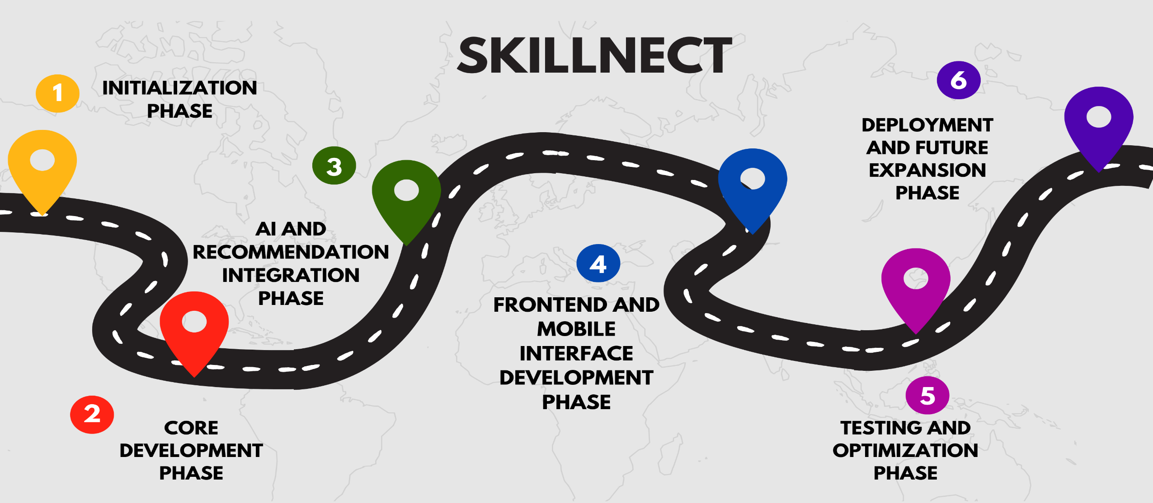
PROJECT ROADMAP

Slide 17
12. REFERENCES :
S. R. Jagtap, V. Kulkarni, Y. Pachorkar, O. Taur, S. Gupta, and U. Pujeri, “AI-Driven Real-Time Interview Simulation App with Voice Recognition and Facial Analysis,” Indian Journal of Science and Technology, vol. 18, no. 25, pp. 2058–2066, Jul. 2025.
https://doi.org/10.17485/IJST/v18i25.760
P. P. Wadekar, Y. P. Pillai, M. U. Roy, and N. Phadnis, “Placement Predictor and Course Recommender System,” International Research Journal of Engineering and Technology (IRJET), vol. 5, no. 3, pp. 3960, Mar. 2018.
W. Wu, L. Chen, Q. Yang, and Y. Li, “Inferring Students’ Personality from Their Communication Behavior in Web-based Learning Systems,” International Journal of Artificial Intelligence in Education, vol. 29, pp. 189–216, Jan. 2019.
https://doi.org/10.1007/s40593-018-00173-9
S. S. Shravan Kumar, K. B. Bhimsingh, T. K. Kaushlendra, A. P. Chitnis, V. H. Salvi, A. S. Patil, M. Parate, and S. Sharma, “Revolutionizing Resume Building with Intelligent ATS Optimization to Boost Career Development and Employability,” International Journal on Advanced Computer Theory and Engineering, vol. 14, no. 1, 2025.
https://journals.mriindia.com

