Slide 1

Review-2
SkillNect – Smart Career Guidance and Development App
Submitted by Mr. D.VENKATA RAVI KUMAR, M.TECH.,(Ph.D) ASSISTANT PROFESSOR
22MH1A05B5 KUDIPUDI JYOTHI
22MH1A0589 BIKASH PRASAD YADAV
22MH1A05E3 SHIVANAND PRASAD KUSHWAHA
22MH1A0597 DASI KARTHEEK

Slide 2
2. ABSTRACT:
SkillNect is a web and mobile application that helps students and professionals plan, build, and track their career growth. The platform includes various career development tools like resume evaluation, career roadmap creation, skill-building, and interview preparation, all in one system. Users can upload resumes for professional feedback, find personalized learning paths, and track their skill progress through interactive dashboards.
In addition to technical skills, SkillNect focuses on personal and communication skills. It offers exercises to boost confidence, clarity, and presentation. The application features a mock interview tool that mimics real interview situations and provides performance feedback. Built with modern web, mobile, and cloud technologies, SkillNect delivers a smooth and scalable experience, acting as a complete digital career companion that guides users toward their professional goals.

Slide 3
3. INTRODUCTION:
SkillNect is a smart career guidance and development platform designed for students and professionals.
It offers both web and mobile access, making career planning simple and easily accessible. The platform helps users analyze their strengths and build a personalized career growth roadmap. It includes AI-assisted Resume evaluation to enhance job readiness and profile quality. Users can improve technical and communication skills through structured learning modules. Mock interview simulations are provided to boost confidence and prepare for real-world interviews.
The system enables users to track progress, skill milestones, and job applications in one convenient location. The backend is built with Spring Boot, ensuring robust, secure, and efficient operation. The frontend is developed using React (web) and React Native (mobile) for a seamless user experience. The platform is hosted on AWS Cloud, ensuring scalability, high performance, and real-time access.

Slide 4
4. OBJECTIVES :
AI-Assisted Resume Evaluation: To develop a module that provides personalized suggestions and improves job-readiness.
Structured Career Roadmap: To overcome limitations in traditional career guidance by offering a structured roadmap, skill tracking, and course recommendations.
Unified Web & Mobile Interface: To design an intuitive platform that allows users to access all career tools in a single application.
Interactive Personality & Interview Features: To implement exercises like personality development tasks and AI mock interviews for overall professional growth.

Slide 5
Modules Used in the Project
1. User Module
Allows users (students/learners) to log in and access the system.
People can upload their resumes and other information that has to do with their careers. Users can also add career-related data to the system. The career-related data that users can upload includes resumes.
People can make scores for the Application Tracking System. Get ideas on how to make the Application Tracking System better. The Application Tracking System scores can be generated by users. They can get suggestions, on how to optimize the Application Tracking System.
People can do things to help them talk to others and work on their personality. They can practice talking to people and try to be a better person. Users can do communication exercises and personality exercises to help them.
People can do practice interviews that use intelligence and they will get feedback on how they did. They will get to see how they performed in the AI-powered interviews and what they can do to improve. The feedback, from the AI-powered interviews will help them.
The dashboard shows us the results. It also has progress charts and analytics. We can see the results on the dashboard and the progress charts are there too. The analytics are also available, on the dashboard.
2. Admin Module
The admin person can look at all the information that belongs to the users, including their resumes and the records of what they do, on the system. The admin can see all the user data, the user. The user activity logs.
The admin person can keep an eye on how the AI system is working and they can look at what the modules are putting out. The admin person is able to monitor the AI system performance and analyze the module outputs.
Responsible for validating content and maintaining system integrity.
Monitors analytics, user progress, and overall system usage.
Controls user access and role-based permissions.

Slide 6
3. Resume Analyzer Module
The system looks at the resumes that people upload. It gives them scores based on what the applicant tracking system thinks. It handles all the resumes that are uploaded. Then it generates scores for each one of them which are called ATS scores. The ATS scores are like a grade, for the resumes.
This thing looks at resumes and job descriptions. Then tells you how to make the resume better for the job. It helps you make your resume match what the job is looking for. The thing gives you ideas to make your resume more suitable, for the job description.
Uses AI models to identify skills, gaps, and recommendations.
Supports exporting analysis results and reports.
4. Career Roadmap Module
Generates personalized career paths based on user interests and skills.
Recommends courses, learning resources, and progression plans.
The system keeps an eye on how skills are developing and it changes the roadmap as it goes along. The roadmap gets updated dynamically to show what is happening with the skills development. This means the skills development and the roadmap are always connected and changing together.
5. Communication & Personality Module
Provides AI-driven speaking practice and personality assessment.
This thing checks what people say. Gives them ideas on how to do it better. It looks at the responses. Tells people what they can do to improve the feedback from the responses. The feedback, from the responses is very important. That is why this thing evaluates the responses and provides feedback on the responses.
The system keeps an eye on how the user's doing over time and it tells them what topics they need to practice more. It helps the user to see where they need to improve and what they should focus on to get better. The user can then use this information to work on the topics that the system says they need to practice. This way the user can see their progress and the system can help them to keep getting better at the topics they are learning.

Slide 7
6. Mock Interview Module
Simulates real-world interviews for selected job roles or topics.
Records user responses and evaluates them using AI algorithms.
Provides performance reports and recommendations for improvement.
7. Skill Tracker Module
Tracks user activity and progress across all modules.
Displays analytics, achievements, and milestones.
Sends notifications and recommendations for improvement.
8. Dashboard Module
Centralized interface displaying all module results, notifications, and insights.
Visualizes data using charts and progress indicators.
Integrates all module outputs for easy access and monitoring.

Slide 8
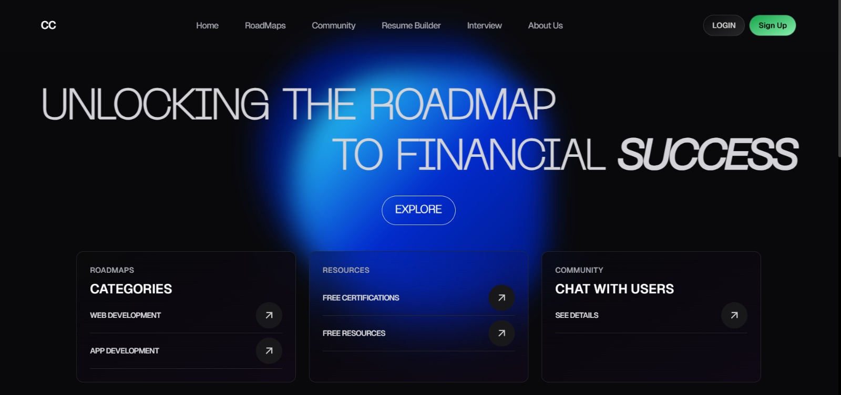
FRONTEND DESIGN

Slide 9
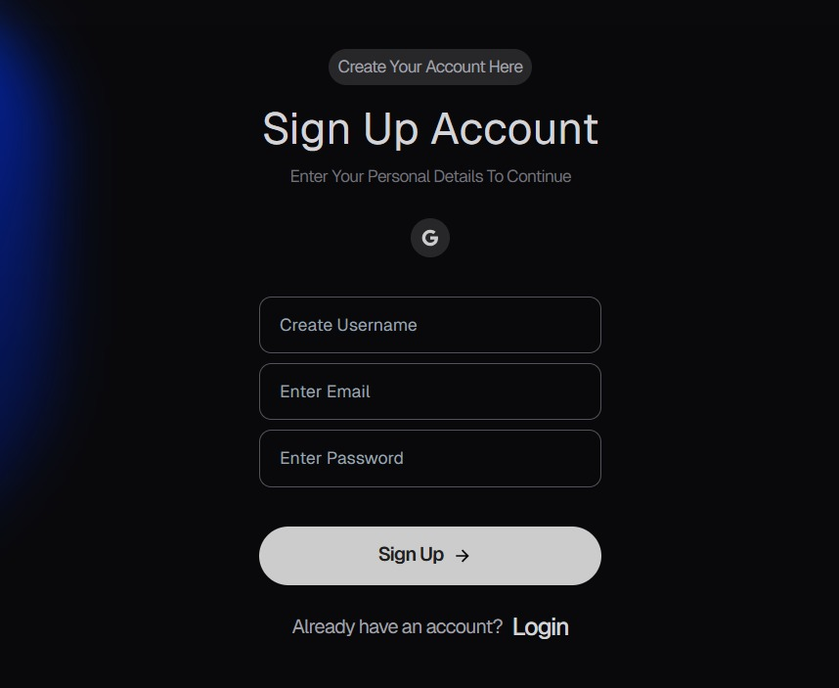
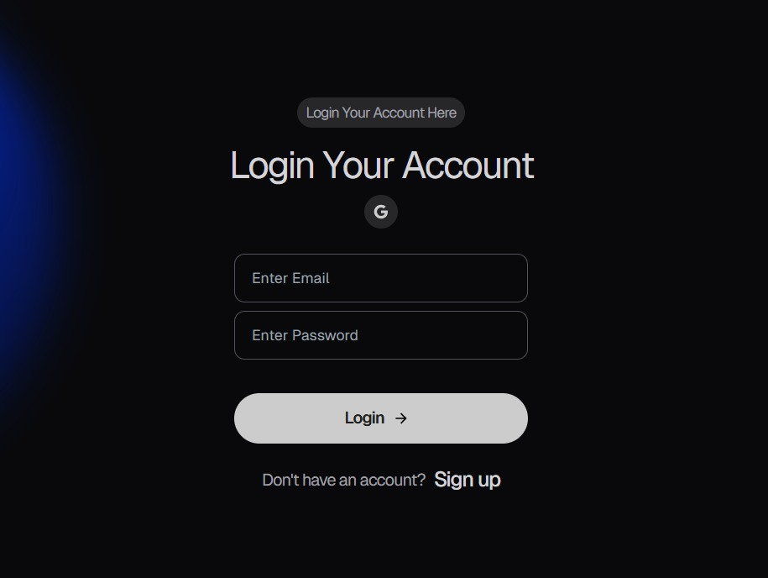
Login and Signup Page

Slide 10
FRONTEND COMPLETED FUNCTIONALITY – SkillNect
• We made the user interface using ReactJS.
• The user and admin login screens are done.
• We have navigation for the user and admin so they see different things when they log in.
• The user can see their profile. Change their settings.
• There is a page where the user can upload their resume and we check to make sure it is the kind of file.
• The user can see a list of all the resumes they have uploaded.
• We show the user their ATS score.
• We have parts of the website that show the user what skills they are missing and what they should learn.
• The user can see a plan for their career, which's, like a map.
• We have charts and graphs that the user can interact with. Admin dashboard UI to view users and resume entries
• Responsive design for desktop and mobile screens
• Frontend routing and component structure completed

Slide 11
FUTURE WORK – SKILLNECT
• Implement AI-based resume parsing and skill extraction using NLP techniques
• Develop a real ATS scoring engine to evaluate resumes against job descriptions
• Add personalized career roadmap generation based on user skills and goals
• Enable real-time skill gap analysis and job role recommendations
Integrate backend services to enable real user authentication and data persistence
• Implement secure resume storage with encryption and access control
• Introduce an admin analytics dashboard to track user progress and platform usage
• Deploy the application on cloud infrastructure for scalability and availability
• Integrate third-party job portals and learning platforms for recommendations
• Enhance the system with continuous AI model improvement using user feedback

Slide 12
12. REFERENCES :
S. R. Jagtap, V. Kulkarni, Y. Pachorkar, O. Taur, S. Gupta, and U. Pujeri, “AI-Driven Real-Time Interview Simulation App with Voice Recognition and Facial Analysis,” Indian Journal of Science and Technology, vol. 18, no. 25, pp. 2058–2066, Jul. 2025.
https://doi.org/10.17485/IJST/v18i25.760
P. P. Wadekar, Y. P. Pillai, M. U. Roy, and N. Phadnis, “Placement Predictor and Course Recommender System,” International Research Journal of Engineering and Technology (IRJET), vol. 5, no. 3, pp. 3960, Mar. 2018.
W. Wu, L. Chen, Q. Yang, and Y. Li, “Inferring Students’ Personality from Their Communication Behavior in Web-based Learning Systems,” International Journal of Artificial Intelligence in Education, vol. 29, pp. 189–216, Jan. 2019.
https://doi.org/10.1007/s40593-018-00173-9
S. S. Shravan Kumar, K. B. Bhimsingh, T. K. Kaushlendra, A. P. Chitnis, V. H. Salvi, A. S. Patil, M. Parate, and S. Sharma, “Revolutionizing Resume Building with Intelligent ATS Optimization to Boost Career Development and Employability,” International Journal on Advanced Computer Theory and Engineering, vol. 14, no. 1, 2025.
https://journals.mriindia.com

Slide 13
Thankyou

