Slide 1
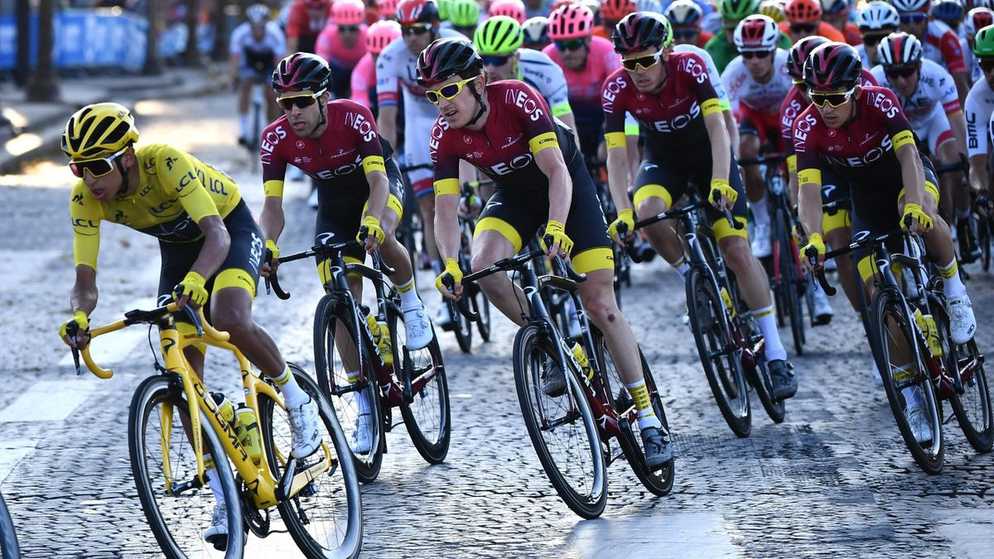
Tour de France
Jyothy Das

Slide 2
Tour de France
Annual men's multiple-stage bicycle race held primarily in France.
Oldest and most prestigious of the three Grand Tours.
Held in July.
The route changes each year.
21 individual stages over a 23- or 24-day period.
Cover approximately 3,500 kilometres.
Winner : Rider with the lowest cumulative time wins the ‘Yellow Jersey’.
Not held in the years 1915-1918 and 1940-1946 due to the two World Wars.
To know more Ctrl+ Click here.

Slide 3
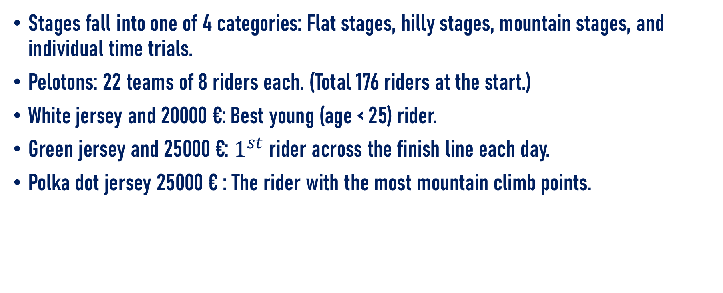
Tour de France
Stages fall into one of 4 categories: Flat stages, hilly stages, mountain stages, and individual time trials.
Pelotons: 22 teams of 8 riders each. (Total 176 riders at the start.)
White jersey and 20000 €: Best young (age < 25) rider.
Green jersey and 25000 €: $1^{st}$ rider across the finish line each day.
Polka dot jersey 25000 € : The rider with the most mountain climb points.

Slide 4
Tour de France
Participant countries: Ctrl+ Click here

