Slide 1
Vector / Reference / Function
금융공학 프로그래밍

Slide 2


std::vector

Slide 3
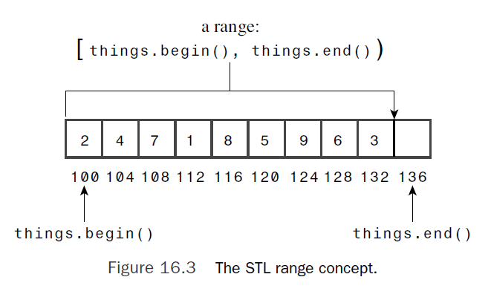

std::vector

Slide 4
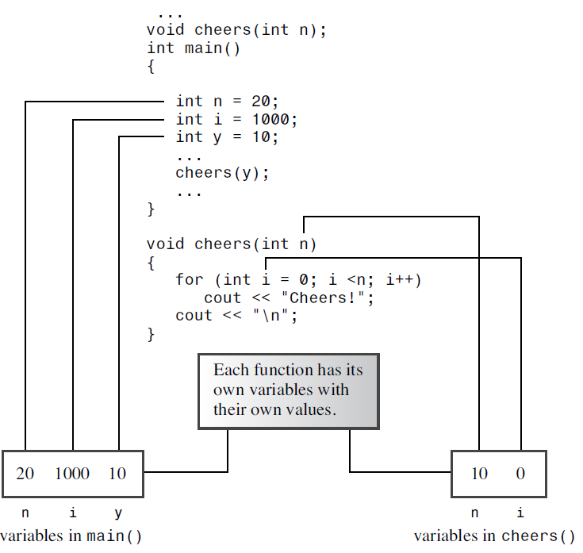
Local variables

Slide 5
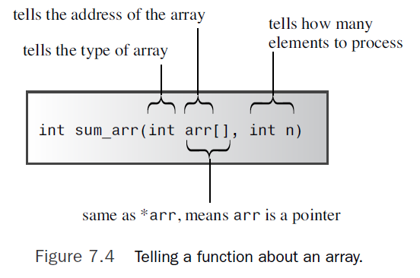
Array as Arguments

Slide 6

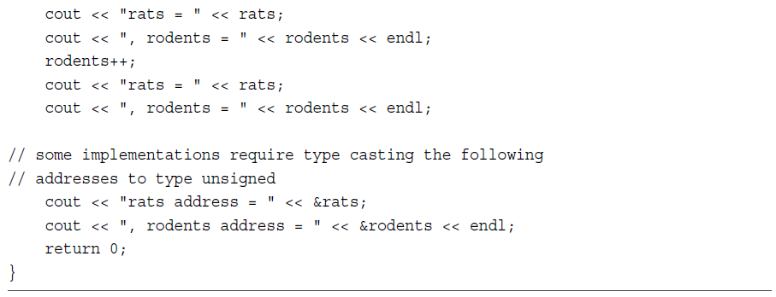
Reference variable

Slide 7
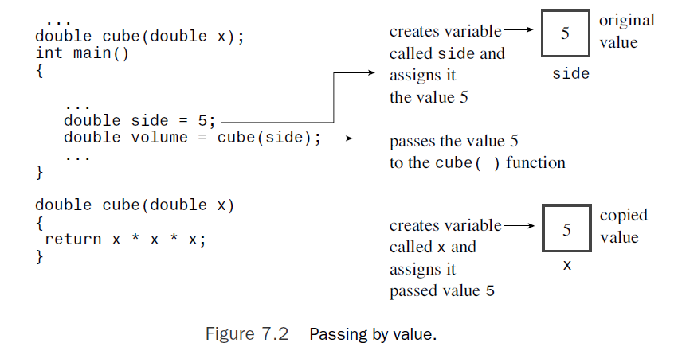
Passing by value

Slide 8
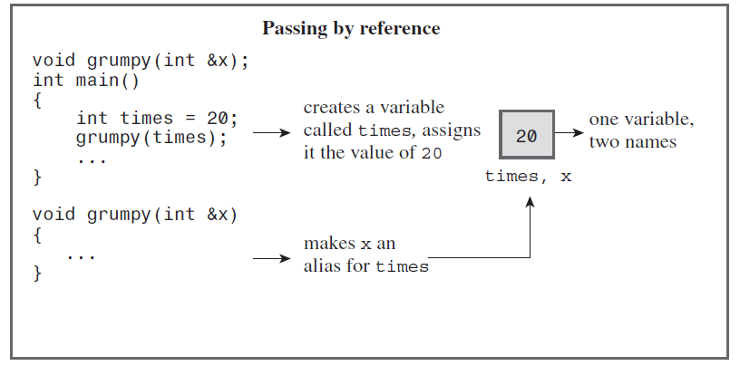
Passing by reference

Slide 9
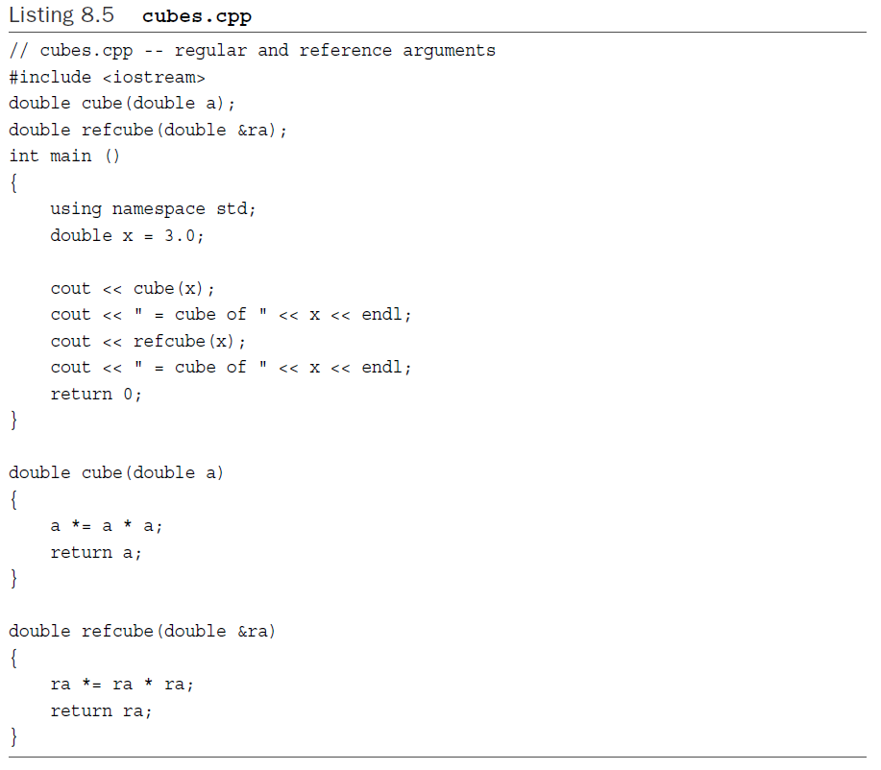

Slide 10

Default arguments

Slide 11

Function overloading

Slide 12
Q & A

