Slide 1
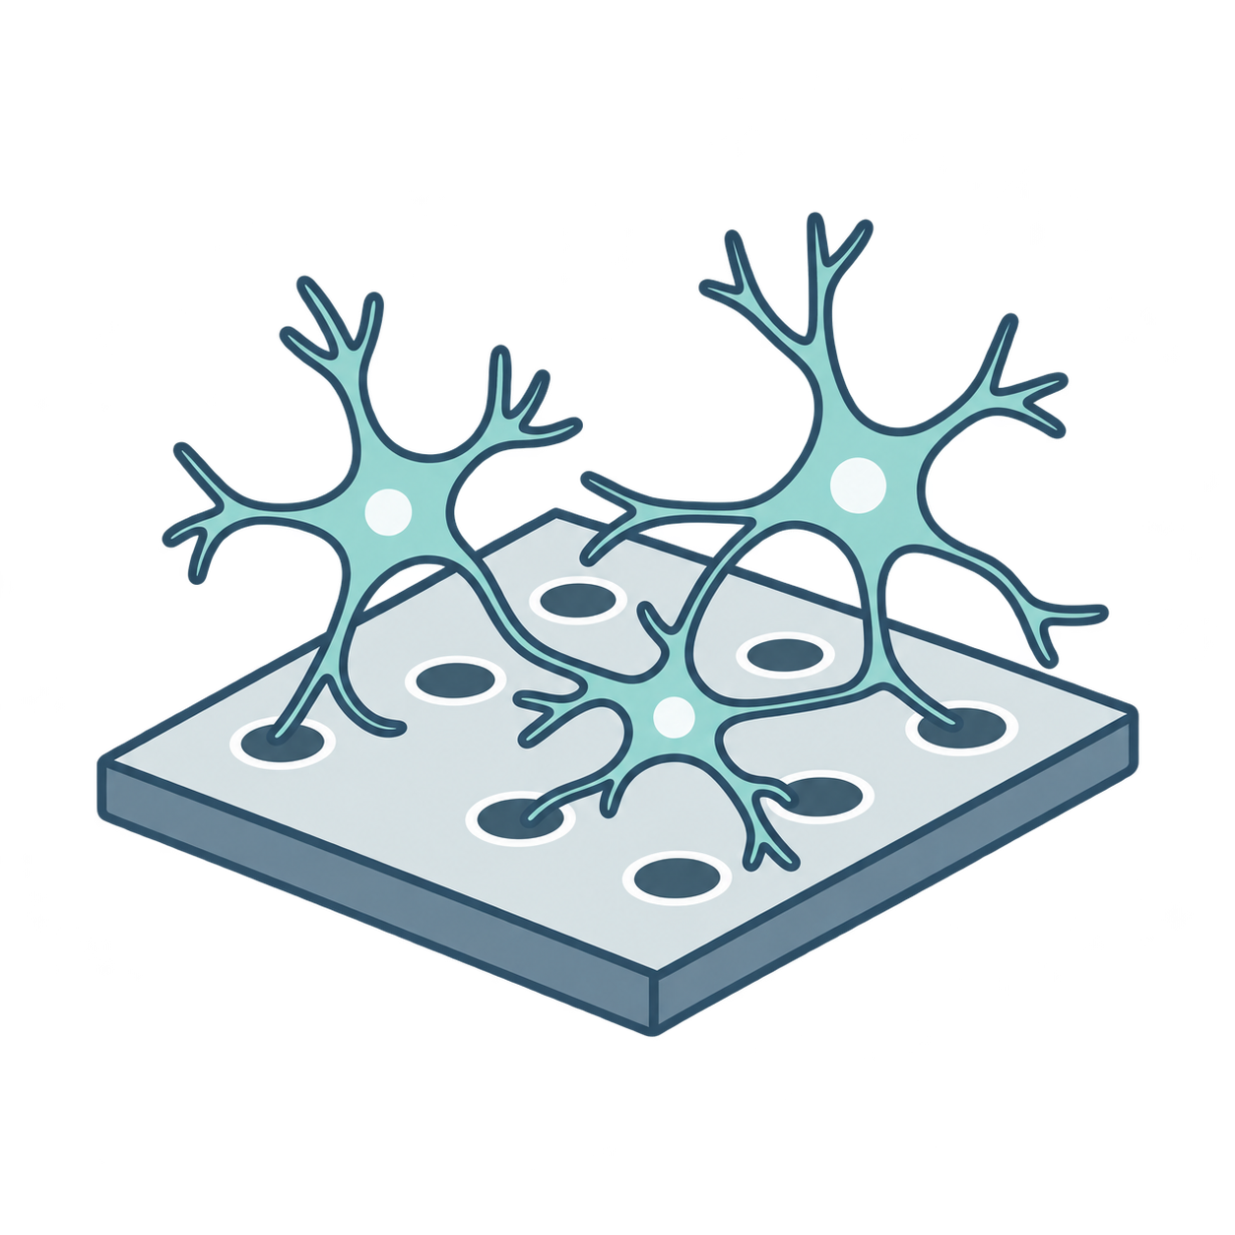
(a) Spike-to-spike compression
Shared encoder
Shared decoder
Input
6 × Linear + LIF
6 × Linear + LIF
Reconstruction
X
Binary latent
^
X
Z
Input
adapter
+ mask
1024
768
512
256
128
32
128
256
512
768
1024
1024
Neural
recording
Input only
32 channels
1024 channels
1024 channels
Encoder: 1024 → 1024 → 768 → 512 → 256 → 128 → 32
Decoder: 32 → 128 → 256 → 512 → 768 → 1024 → 1024
Time runs left to right and is preserved through the shared stages.
(b) Delay-tolerant training
Original target
X
Learned causal delay
Exponential filtering
p
(
c
d
)
Before adaptation
0–30 bins, per channel
Mean squared
difference
Reconstruction
^
Same kernel, full convolution
X
Exponential filtering
L
VR
Illustrative causal delay
0.2
0.5
0.3
3 nonzero
taps shown
One event spreads to later bins
t
d
=
0
d
=
1
d
=
2
t
t
+
1
t
+
2
Schematic spikes and widths. Training input and target include 30 zero-tail bins.
Notes:
BSAE: spike-to-spike compression with delay-tolerant training
Technical replay of an existing design; no new image generation performed. Based on local BSAE config.yaml, models/autoencoder.py, models/layers.py, models/delay.py, losses/van_rossum.py and train.py; source hashes recorded separately. Expanded shared architecture, six Linear+LIF stages per side, binary 32-channel bottleneck. Adapter and validity mask only before shared encoder. Original target receives the learned causal per-channel delay; reconstruction bypasses delay. Both branches use the same 20-bin exponential kernel with full convolution. Current training pads 30 zero-tail bins; no measured performance or model-generated raster is shown. Raster patterns, filtered curves and the three-tap impulse response are explicitly schematic. Native editable explanation, independent generated neural-recording pictogram. Whole image draft is excluded. Draft inspected and transfer plan saved before native authoring. U-Net original architecture inspected only for dimension and contraction/expansion representation: https://lmbweb.informatik.uni-freiburg.de/people/ronneber/u-net/u-net-architecture.png . Simple mathematical labels are native grouped text, not OMML. Intended width 177.8 mm.

