Slide 1
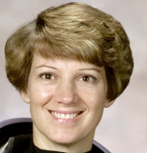
Local detail and global context
fine detail
Input
Local encoder
Prediction
Fuse
scene context
complementary
representations
Global encoder
Illustrative features. Photo: NASA / scikit-image, public domain.
Notes:
Local detail and global context
Design study: MAE https://arxiv.org/abs/2111.06377; CLIP https://arxiv.org/abs/2103.00020; U-Net https://arxiv.org/abs/1505.04597; Transformer https://arxiv.org/abs/1706.03762. Original examples, not reproductions.
Original schematic demonstration. Values, signals and patterns are illustrative, not measured results. Publication width 177.8 mm. NASA astronaut photo via scikit-image, public domain: https://scikit-image.org/docs/stable/api/skimage.data#skimage.data.astronaut

