Slide 1
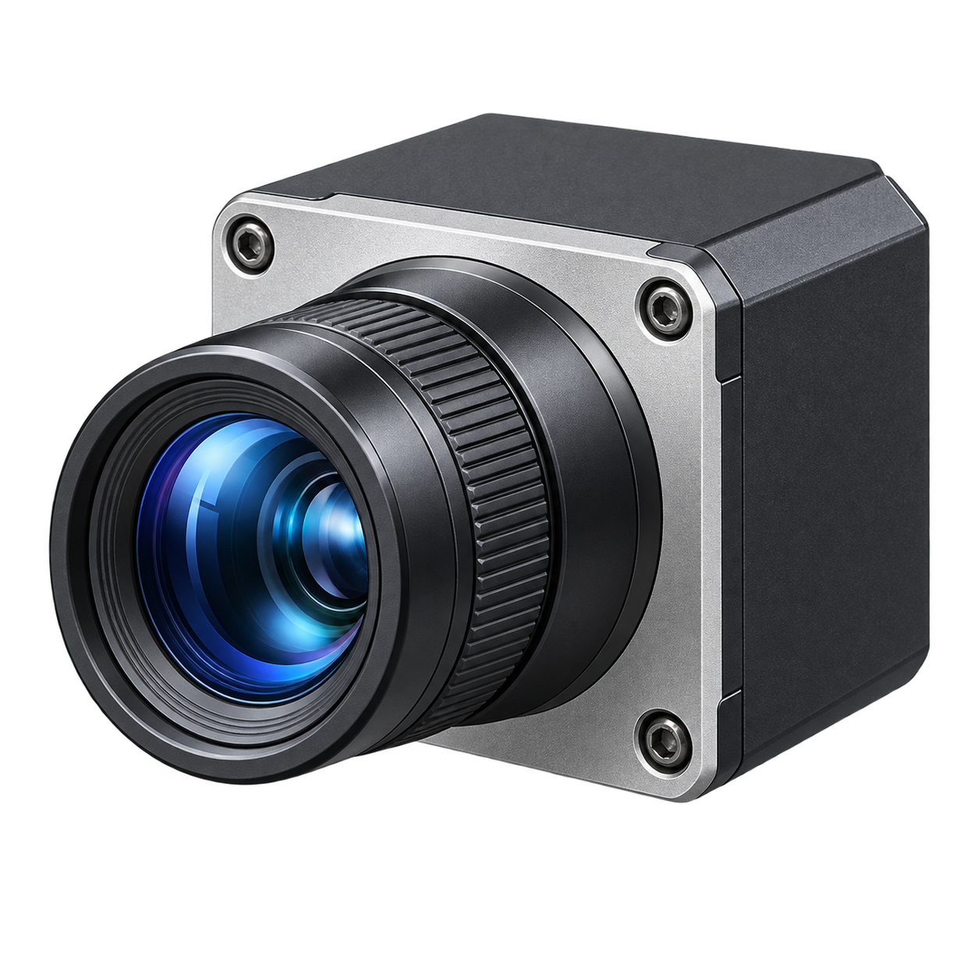
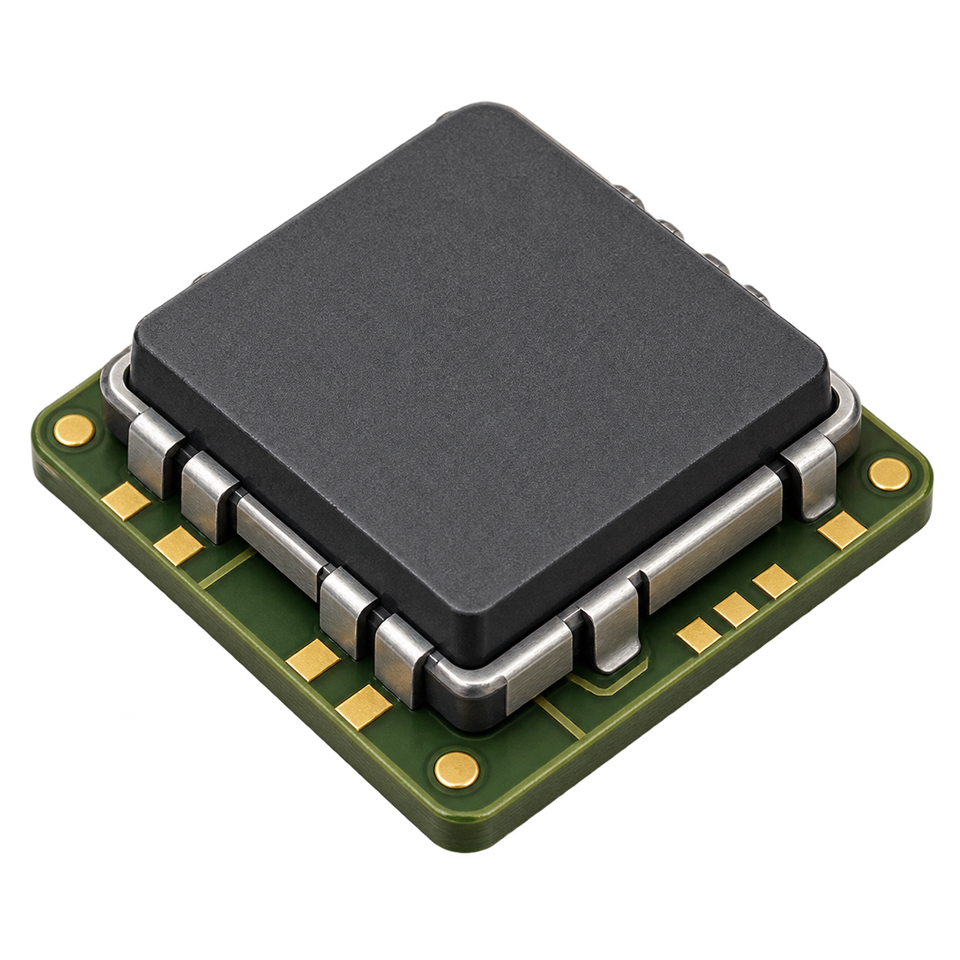
Timestamped visual–inertial state correction
Moving platform
Visual obs.
at tₖ
Visual estimator
Processing finishes
after tₖ
Pose correction
for tₖ
Inertial stream
advances to t_{now}
Inertial propagation
faster sampling
Update the stored state at tₖ
State and measurement buffer
Stored
states
s(tₖ)
s(tₖ₊₁)
…
s(t_{now})
Retained IMU samples in (tₖ, t_{now}]
Buffered
inertial samples
Update
Future
propagation
from tₖ to t_{now}
After correction
and replay
s⁺(tₖ)
Replay
s⁺(t_{now})
Next
state
s(t): propagated pose s⁺(t): corrected pose
Corrected current pose
Symbolic timing and samples; illustrative sensor icons. Time intervals are not to scale.
Notes:
Timestamped visual–inertial state correction
Hypothetical method supplied by the user. The state buffer and sample ticks are schematic. No measurements, latency or frame rates are asserted. Publication width: 177.8 mm. Existing editable diagram revised with two generated representative pictorial assets. All explanatory labels, temporal marks and connectors remain native. Asset prompts and source PNGs are saved separately. Design reference inspected: MAE original architecture, https://arxiv.org/html/2111.06377v3/arch.png, for recurring item identity only. Olive-copper book guides color allocation. No source artwork is embedded.

