Slide 1

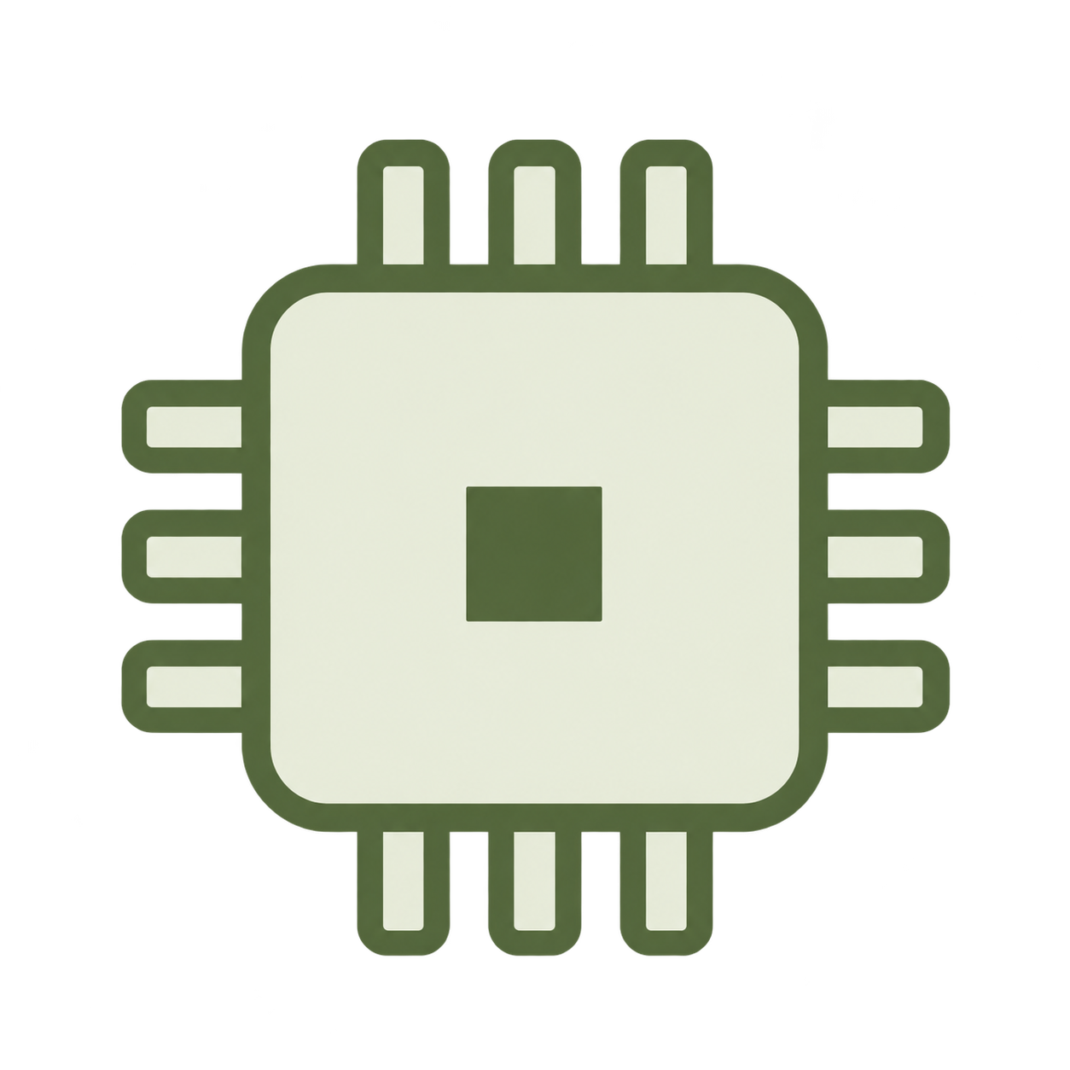
(a) Sensing and delayed estimation
Visual input
Visual estimator
Processing delay
Delayed correction
t
t
k
k
IMU stream
Inertial propagation
Live estimate
fast sampling
(b) Correct and replay
State and measurement buffer
Stored states
…
s
(
t
)
s
(
t
)
s
(
t
)
k
k
+1
now
Retained IMU
samples
(
t
,
t
]
k
now
Update
Continue
Corrected states
+
Replay
+
Next
state
s
(
t
)
s
(
t
)
k
now
s
(
t
+
Current pose
)
: propagated
s
(
t
)
: corrected
Illustrative sensors and samples; symbolic timing, not to scale.
Notes:
Timestamped visual–inertial correction
Illustrative method and schematic timing, not measured data. Flat sensor pictograms generated with the built-in image generator. All mathematical notation, diagram shapes and connectors are editable native objects. Math uses individually positioned Times New Roman text components grouped by expression, not OMML. Reference: CLIP, https://arxiv.org/html/2103.00020v1/main-diagrams.png, inspected for prose/math distinction and consistent indexed identity. Olive-copper color book. Intended width 177.8 mm.

