Slide 1
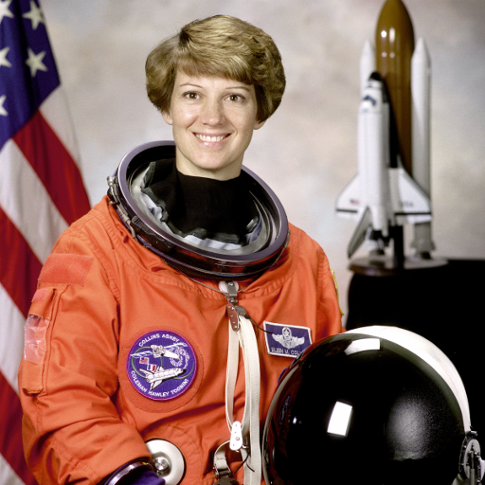
(a) Select informative patches
Input patches
Importance sᵢ
Retained patches
6
0
1
0
0
top 3
Patch
scorer
1
5
1
0
10
1
3
0
1
sᵢ ≥ 0
0
1
0
2
6
10
16
16
same spatial order
S = {6, 10, 16}
4 × 4 grid, row-major IDs
retained set, expanded below
(b) Pool the retained embeddings
hᵢ = E(xᵢ)
α = (5, 3, 2) / 10
z
h₆
h₁₀
h₁₆
Σ
α₆ = 0.50
α₁₀ = 0.30
α₁₆ = 0.20
z = 0.50h₆ + 0.30h₁₀ + 0.20h₁₆
Illustrative scores and embeddings. Photo: NASA / scikit-image.
Notes:
Content-aware patch pooling
New illustrative test of the paper-figure skill. This is a hypothetical method, not a claimed implementation or empirical result. Scores and six-component vectors are illustrative. One shared E encodes the selected patches. Main arrows carry a collection; dashed guide only links two views of the same retained set. Source photograph: NASA, Eileen Collins, public domain via scikit-image: https://scikit-image.org/docs/stable/api/skimage.data#skimage.data.astronaut . Design references inspected: MAE https://arxiv.org/abs/2111.06377 and CLIP https://arxiv.org/abs/2103.00020 . Target width 177.8 mm; all annotations, bars, cells, frames and connectors are editable native shapes. Photograph and exact crops are separate pictures.

