Slide 1
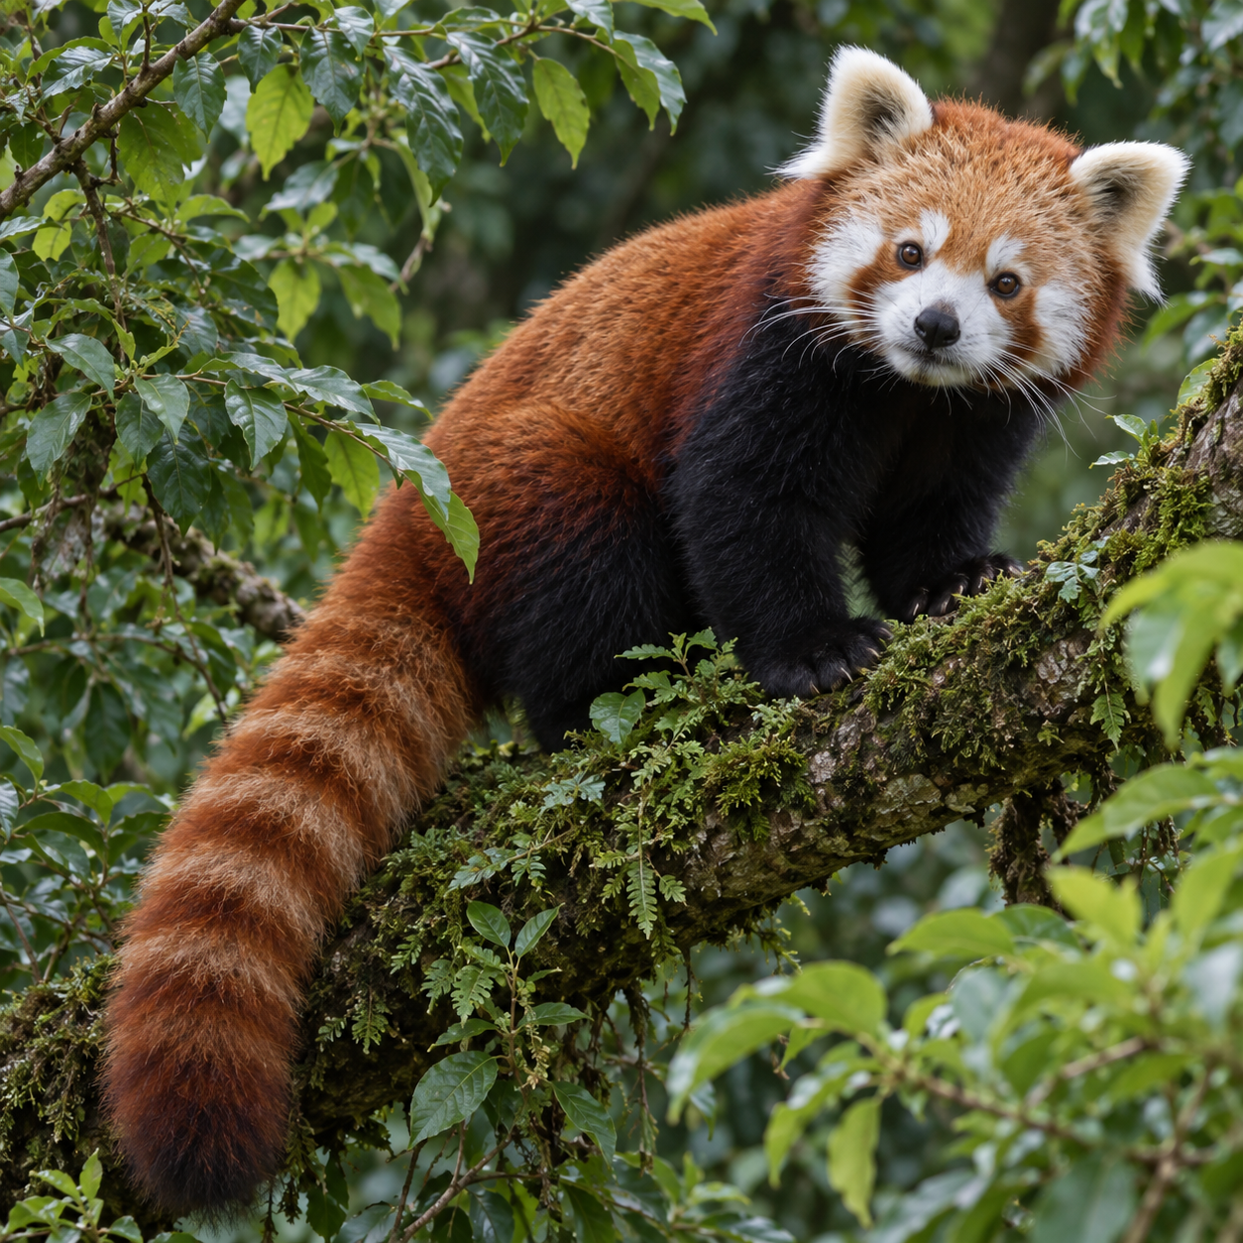
Learning from missing image patches
Masked image
Visible
patches
Restore order
Predicted patches
4 × 4 patches
Latents
+ mask tokens
symbolic
Encoder
M
M
M
2
2
2
Decoder
1
2
3
4
M
2
M
M
M
M
M
5
5
6
7
8
5
5
5
M
M
M
M
M
M
10
M
10
M
M
9
10
11
12
10
10
M
M
15
M
M
M
M
13
14
15
16
15
15
15
4 of 16 visible
Masked
positions
Original target
Compare only the 12 masked positions
Masked-patch loss
Illustrative training schematic · predictions shown symbolically
Notes:
Learning from missing image patches
Original illustrative MAE-inspired training schematic. The separately generated red-panda source is not experimental data. Predictions are symbolic native cells, not a reconstruction. Four of sixteen patches are visible. The twelve masked positions contribute to the loss. Full generated composition draft is not embedded. All explanatory text, masks, tokens, borders and arrows are native. Cropped pictures are independently replaceable. Intended width 177.8 mm.

