Slide 1

05/2026
Canadian Natural Gas Production Trends &
Upstream Capacity
Kimberly Lin & Ryan A. Mardani

Slide 2
05/2026
Business Problem
Exploratory Data Analysis
Forecast Approach
Strategic Implications
Dashboard Demo
Future Work
Tech Stack
Agenda

Slide 3

05/2026
Business Problem

Slide 4
05/2026
1. How has Canadian natural gas production evolved over the past 20+ years?
2. What structural regime shifts in production can be linked to major global events?
3. Is current production growth sufficient to support LNG Canada Phase 1 demand?
4. Will future production (2026–2030) create surplus or a risk of shortage?

Slide 5
05/2026
Exploratory Data Analysis

Slide 6
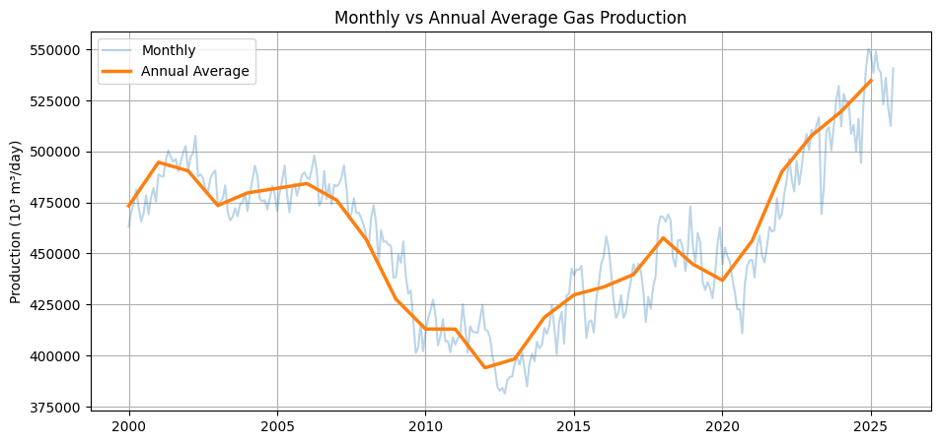
05/2026
Compare monthly data with annual averages to capture both short-term volatility and long-term direction.

Slide 7
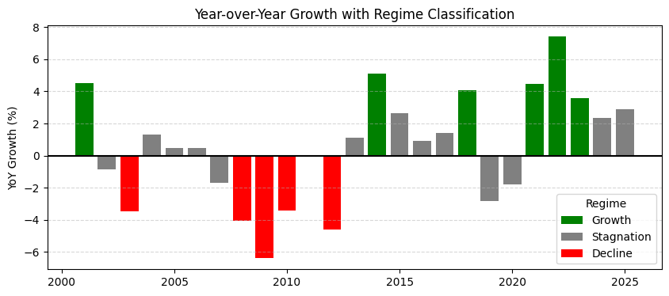
05/2026
Analyze year-over-year growth and classify each year into three regimes using a ±3% threshold.

Slide 8
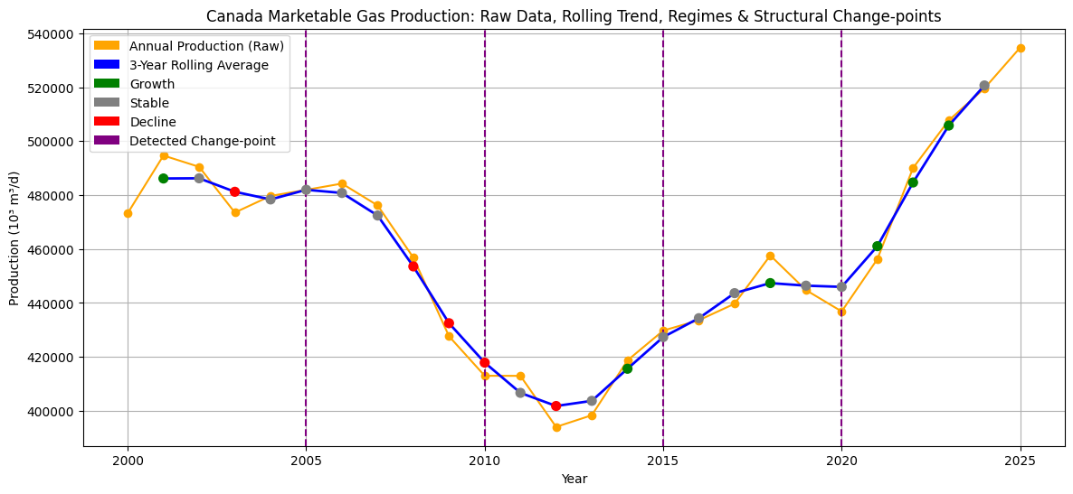
05/2026
Identify structural shifts and change-points, and align them with major global events such as the 2008 Global Financial Crisis, the COVID-19 pandemic, etc.

Slide 9
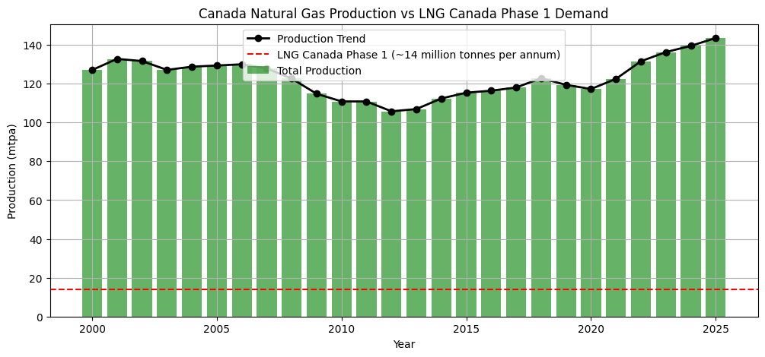
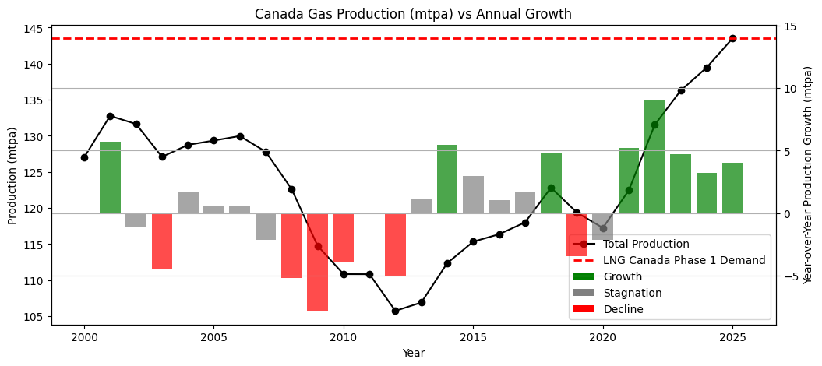
05/2026
LNG demand appears small relative to total production.
| Production = Domestic Consumption + Exports + Storage Adjustment
| ΔAvailable ≈ ΔProduction − Δ(Domestic + Exports)
Incremental LNG feedgas supply is primarily dependent on sustained production growth.

Slide 10
05/2026
Forecast Approach

Slide 11
05/2026
Modeling Framework
Forecasting Objectives
Training period: 2000–2022
Validation period: 2023–2025
Refitting period: 2000–2025
Forecast horizon: 2026–2030
Seasonality
(Winter peaks vs Summer troughs)
Forecast uncertainty
(95% Confidence Intervals)

Slide 12
05/2026
Prophet
Seasonal statistical forecasting
Stable monthly production modeling
Strong baseline interpretability
SARIMA
Flexible trend forecasting
Handles long-term seasonal behavior
Supports uncertainty analysis
Model Selection Rationale
Persistent seasonal production patterns
Medium-term supply adequacy focus
Interpretable forecasting methods
Dual-model robustness comparison

Slide 13
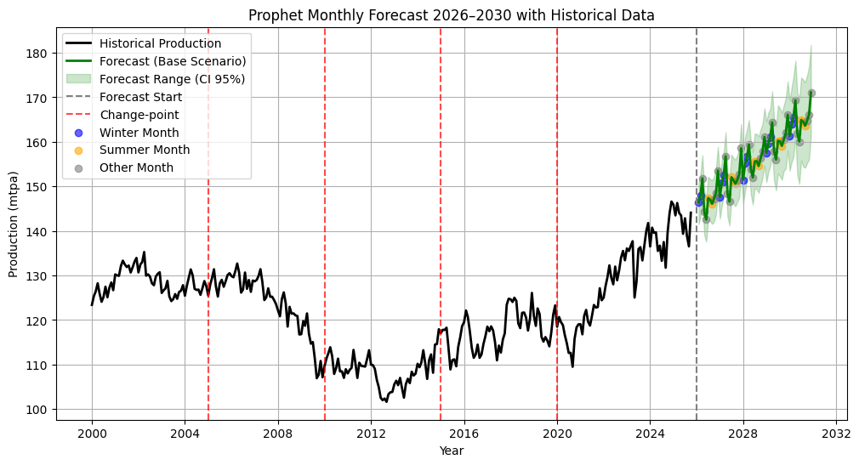
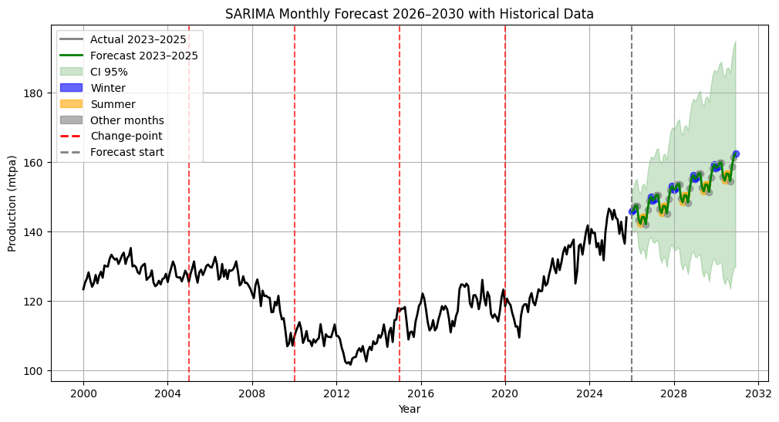
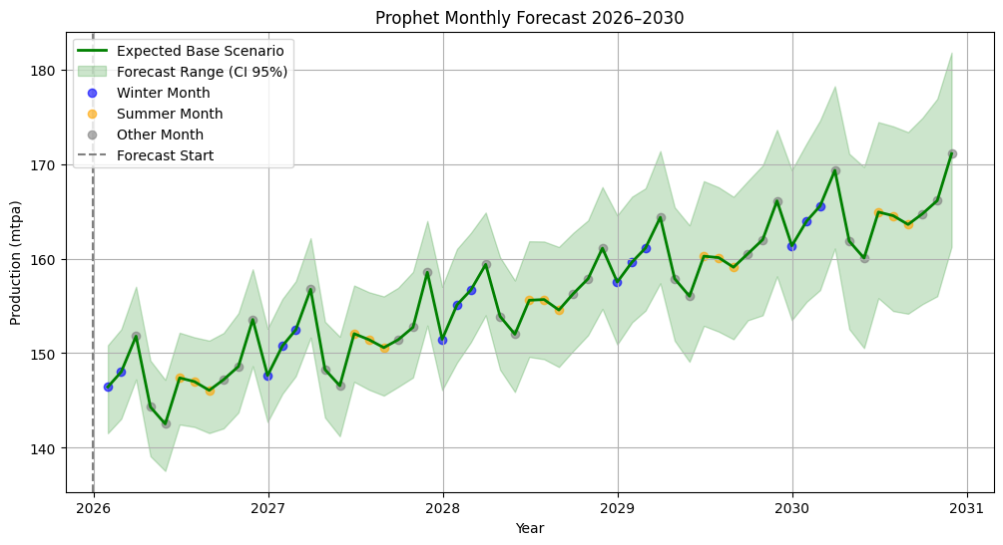
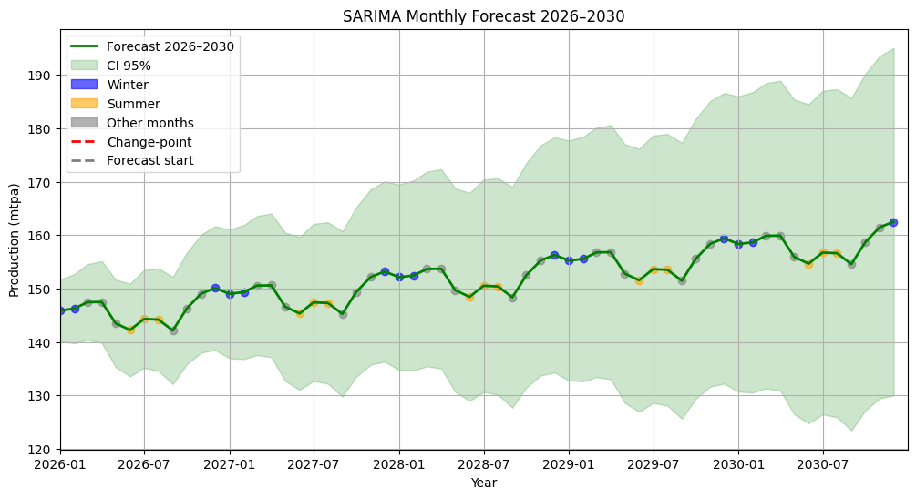
05/2026
Prophet
SARIMA

Slide 14
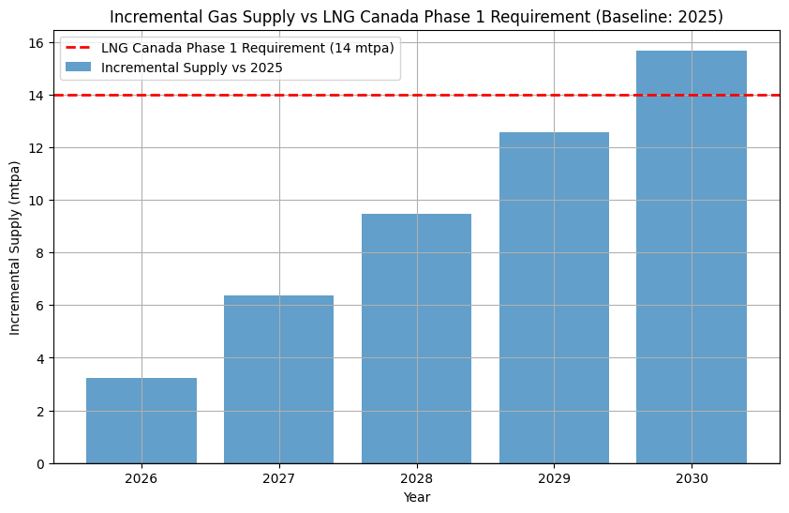
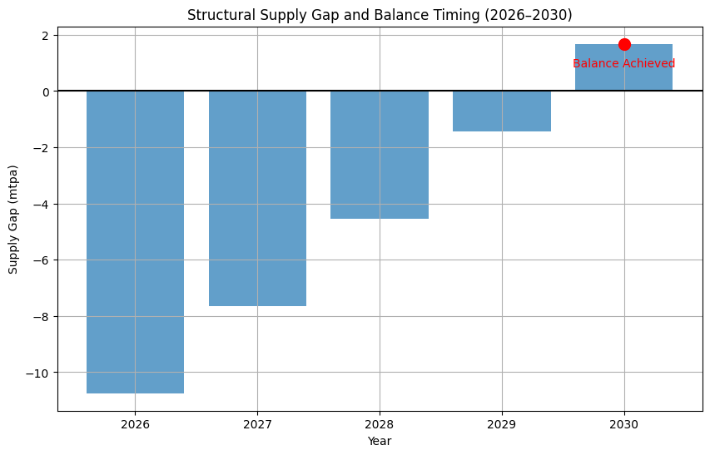
05/2026
Incremental Supply Projection
Supply Gap & Structural Tightness

Slide 15
05/2026
Canada’s upstream gas supply appears sufficient to support LNG Canada Phase 1 in the medium term
Strategic Implications
Near-term supply tightness is expected before market balance improves around 2030
Findings are based on unconstrained upstream production potential and exclude infrastructure and market constraints, e.g. Western Canadian Sedimentary Basin (WCSB)

Slide 16
05/2026
Dashboard Demo
Canadian Marketable Natural Gas Supply Trends - a Hugging Face Space by jyunyilin

Slide 17
05/2026
Automated data pipeline (dataset updates)
Enhanced feature engineering (lags, rolling, seasonality)
Scenario-based & business metrics evaluation
API deployment (FastAPI / model serving)
Data drift monitoring & retraining logic
Expanded infrastructure-constrained scenarios
Future Work

Slide 18













Tech Stack
05/2026
Tools & Deployment
Programming Language
Version Control
statsmodels
Prophet
ruptures
Repository
Development Environment
SARIMA
SARIMAX
PELT algorithm

Slide 19
05/2026
Q & A

