Slide 1
Mastering Git, Github and Markdown
Mobility Technical Group
Patrick Zhong

Slide 2

Git

Slide 3
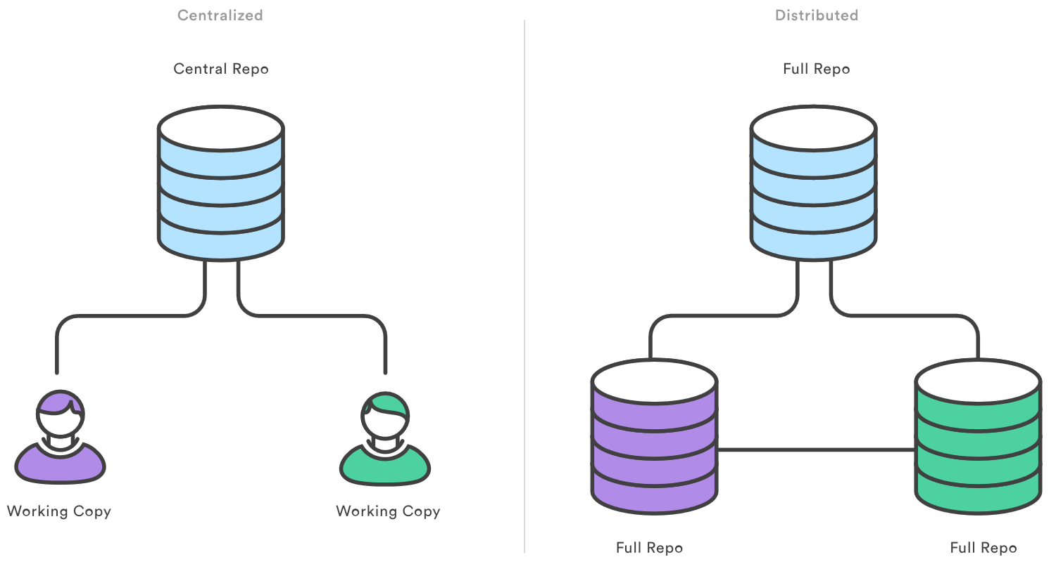
A distributed version control system
Instead of a working copy, each developer gets their own local repository, complete with a full history of commits.

Slide 4
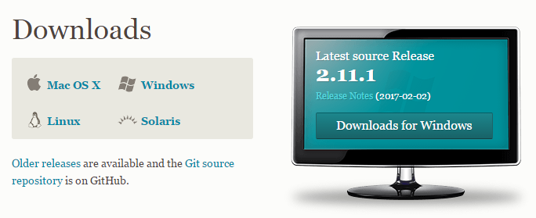
Download & Install Git
Select a proper installation package for your system. Download link: https://git-scm.com/downloads.
Install git with default settings.

Slide 5
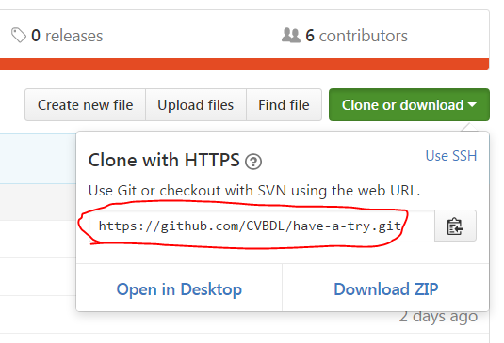
Download code repo to local machine
Download code base “have-a-try” from Github to local machine.
From Github, you could find the URL to repo:

Slide 6
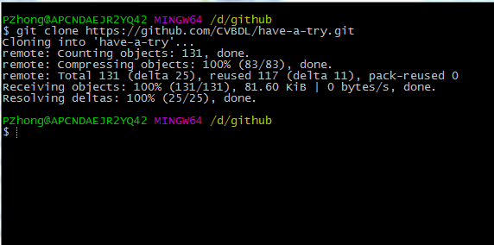
Download code repo to local machine
Command:
SYNOPSIS: git clone <repo> <directory>
git clone https://github.com/CVBDL/have-a-try.git

Slide 7
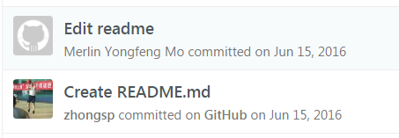
Git config
You must config username and email, so that Github is able to recognize your commit. Commands:
git config --global user.name <name>
git config --global user.email <email>
Show the current configuration
git config –global -l

Slide 8
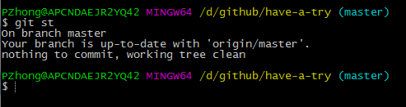
Git command alias
You could define some shortcuts for frequently used commands.
Recommend settings:
git config --global alias.st status
git config --global alias.co checkout
git config --global alias.br branch
git config --global alias.ci commit

Slide 9
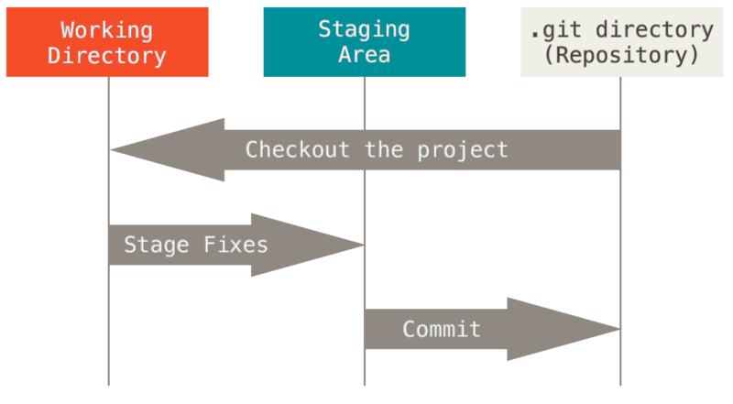
The 3 states

Slide 10
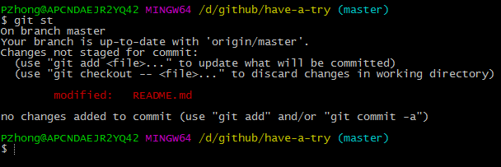
Inspecting a repository
You could use this command to check repo status at any time.
git status

Slide 11
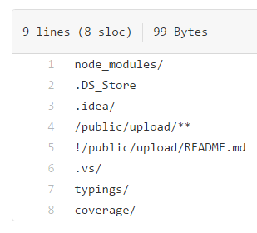
Saving changes
First, state a file or directory
git add README.md (a single file)
git add patrick/ (a directory)
Second, commit changes
git commit –m ‘Update readme file’
The special ‘.gitignore’ file
Exclude the files/directories from version control.

Slide 12
Undoing changes
Command: git checkout
Checking out files, checking out commits, and checking out branches.

Slide 13
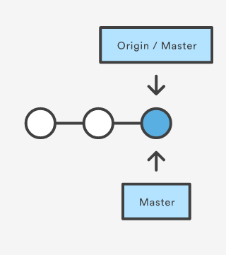
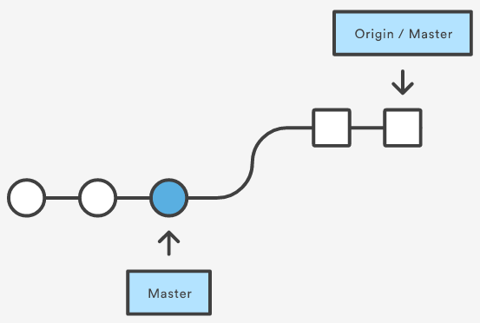
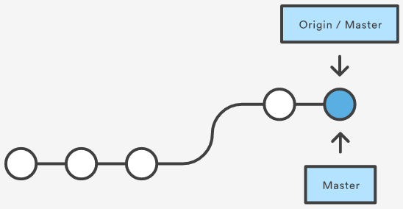
Update local code with upstream
Command: git pull

Slide 14
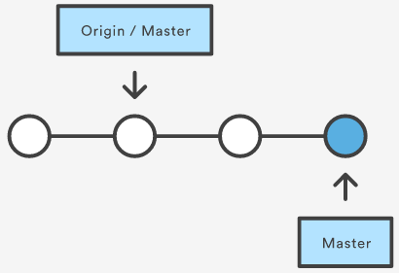
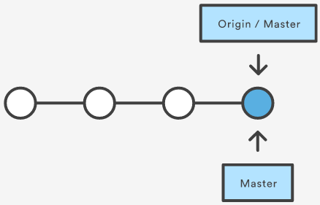
Publich local changes to upstream
Command: git push

Slide 15
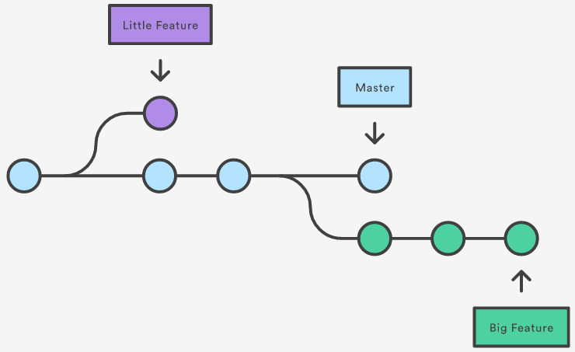
Advance: Using branches
Command: git branch <branch_name>

Slide 16
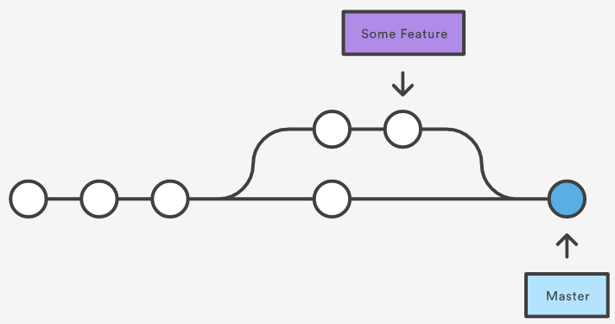
Advance: Merge
Command: git merge <branch_name>

Slide 17
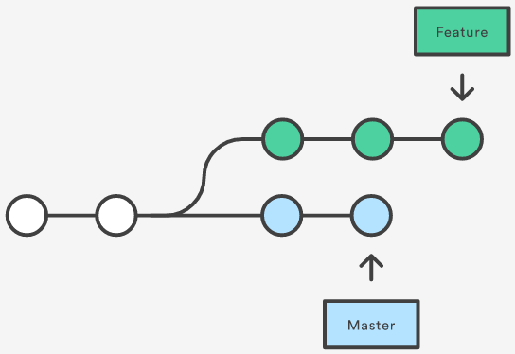
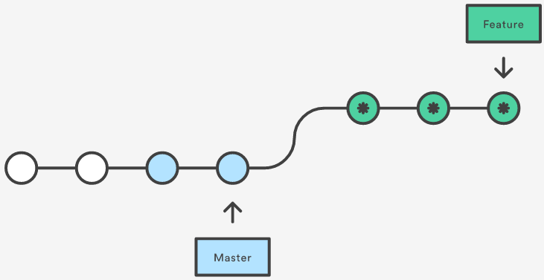
Advance: Rebase

Slide 18
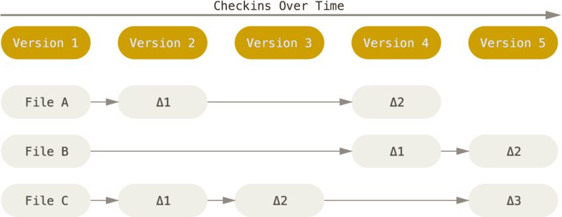
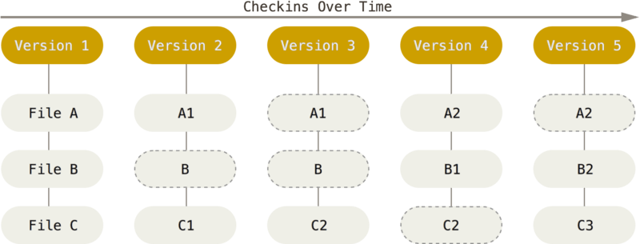
Deep: Snapshots, Not Differences

Slide 19
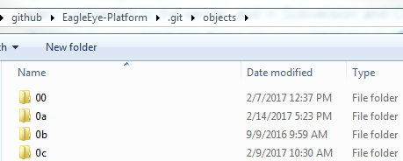
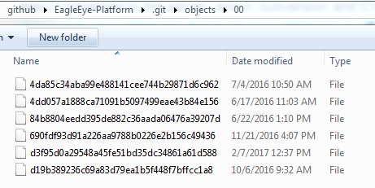
Deep: check-summed
Git uses for this checksumming is called a SHA-1 hash. This is a 40-character string composed of hexadecimal characters (0–9 and a–f) and calculated based on the contents of a file or directory structure in Git.
For example: 24b9da6552252987aa493b52f8696cd6d3b00373

Slide 20

Github
Based on the Git software version control system by Torvalds, GitHub launched in 2008.
The largest open source community in the world.
Companies at Github:
Google, Microsoft, Facebook, etc.
Famous open source projects at Github:
Linux (https://github.com/torvalds/linux)
Git (https://github.com/git/git)
Node.js, Bootstrap, Jquery, Angular.js, React
.Net, Python

Slide 21
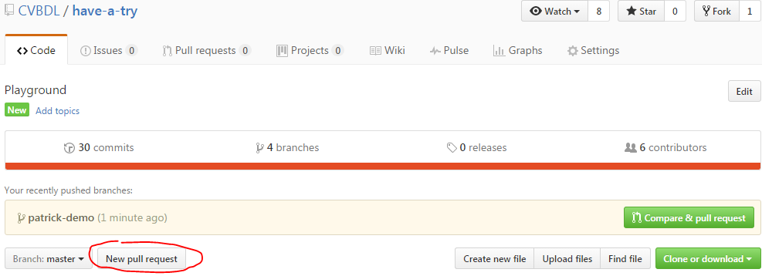
Pull Request

Slide 22
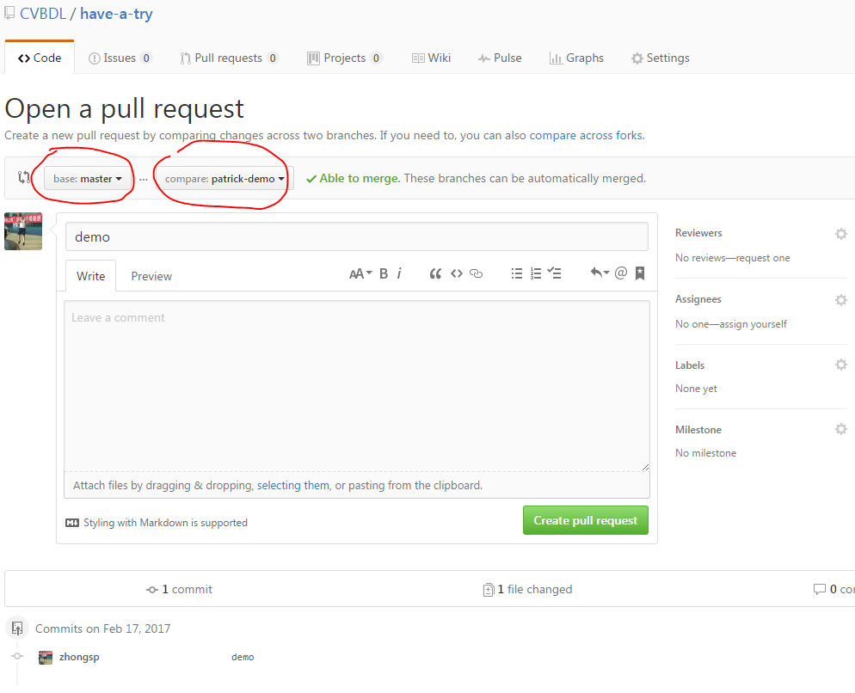
Pull Request

Slide 23
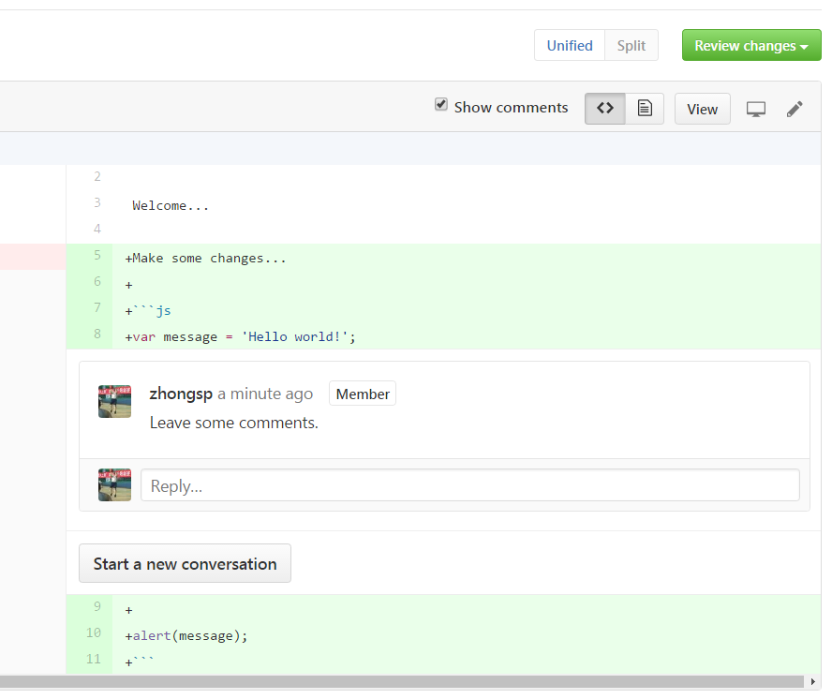
Code Review

Slide 24
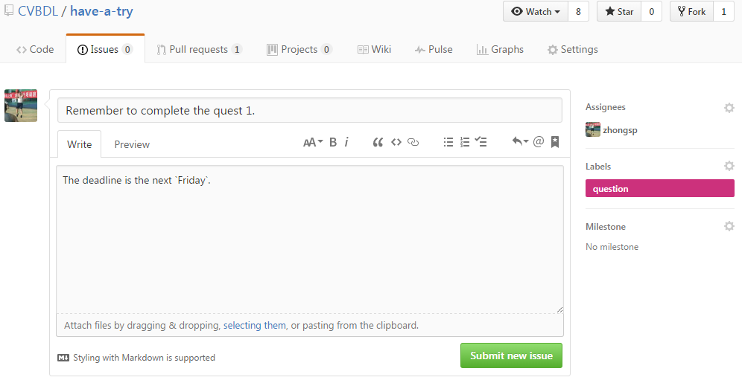
Issues
Log a bug
Write a to-do item

Slide 25

Markdown
Markdown is a lightweight markup language with plain text formatting syntax designed so that it can be converted to HTML and many other formats using a tool by the same name.
Filename extensions: .md, .markdown
References:
Mastering Markdown (https://guides.github.com/features/mastering-markdown/)

Slide 26
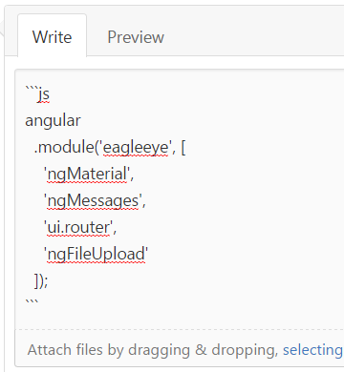
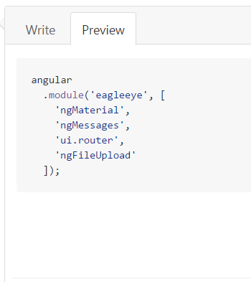
Syntax highlighting
Supported language: https://github.com/github/linguist/blob/master/lib/linguist/languages.yml
E.g., js, css, html, text, sh, chart, java …

Slide 27
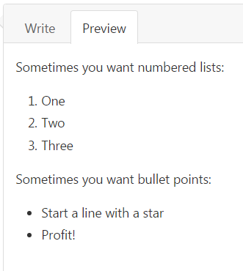
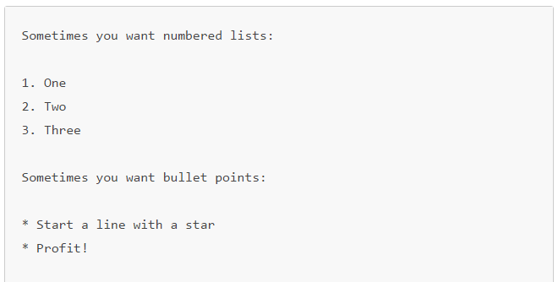
Ordered/Unordered List

Slide 28
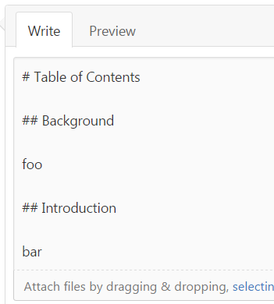
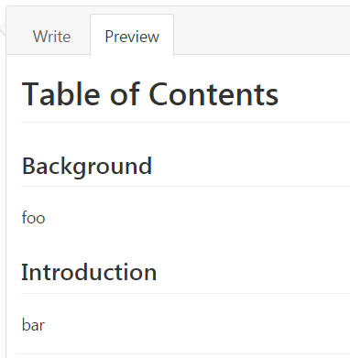
Headers
Symbol: #
H1 header: #
H2 header: ##
…

Slide 29
Thank you

