Slide 1
漏洞库
OSVDB: OpenSource Vulnerability Database, (http://www.osvdb.org)
NVD: National Vulnerability Database (http://nvd.nist.gov)
中国的：
CNCERT 漏洞库 http://www.cert.org.cn/publish/main/9/index.html
CNCERT
中国国家信息安全漏洞库 http://www.cnnvd.org.cn
“China National Vulnerability Database of Information Security ”，简称“CNNVD”，中国信息安全测评中心
Notes:
ENHANCING CYBERSECURITY FOR FUTURE NETWORKS.pdf 有各种库，语言标准
Attack tree analysis，Attack graph ‘An Annotated Review of Past Papers on Attack Graphs“
3. NESSUS扫描，OVAL
vulnerability information
The entire NVD database can be downloaded from this web page for public use.
CVSS impact scores of vulnerability. CVSS scores could be get from NVD[22] or CVE[23] database.
The CVSS score reﬂects several factors, including the ease of exploitation of the vulnerability, the estimated number of affected systems, and the impact of the vulnerability. In particular, the availability of an exploit tool or exploit code, the ability to exploit the vulnerability remotely, the number and importance of systems affected by the vulnerability, and the level of control gained by a successful exploit all imply a higher severity metric.

Slide 2
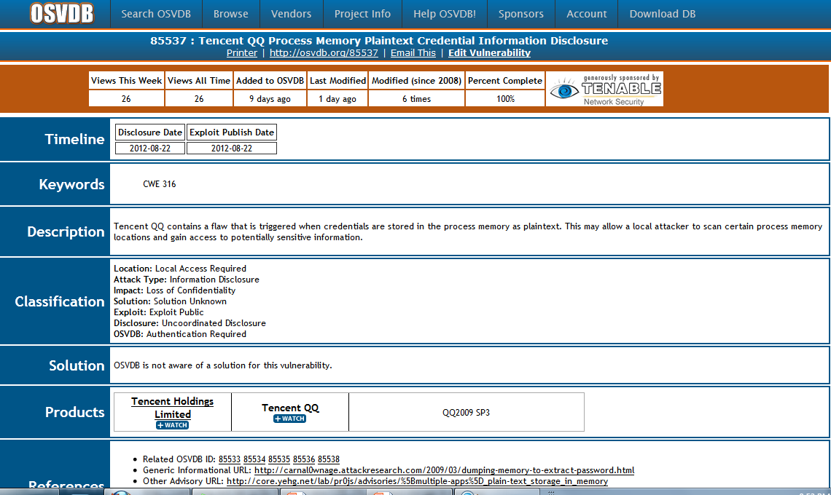

Slide 3
CVSS （Common Vulnerability Scoring System）
score and severity of the vulnerability :
June 20, 2007: CVSSv2 was announced by the Forum of Incident Response and Security Teams (FIRST) and the Common Vulnerability Scoring System-Special Interest Group (CVSS-SIG).
CVSS2 calculator: http://nvd.nist.gov/cvss.cfm?calculator&version=2
Base, temporal, environmental metrics
http://www.first.org/cvss/cvss-guide
Severity Level | Low | Medium | High
Scores | 0.0-3.9 | 4.0-6.9 | 7.0-10.0
Notes:
CVSS can also be described by what it is not. That is, it is none of the following:
A threat rating system such as those used by the US Department of Homeland Security, and the Sans Internet Storm Center.[1] These services provide an advisory warning system for threats to critical US and global IT networks, respectively.
A vulnerability database such as the National Vulnerability Database (NVD), Open Source Vulnerability Database (OSVDB) or Bugtraq. These databases provide a rich catalogue of known vulnerabilities and vulnerability details.
A vulnerability identification system such as the industry-standard Common Vulnerabilities and Exposures (CVE) or a weakness dictionary such as the Common Weakness Enumeration (CWE). These frameworks are meant to uniquely identify and classify vulnerabilities according to the causes "as they are manifested in code, design, or architecture." [2]

Slide 4
These metric groups are described as follows:
Base: represents the intrinsic and fundamental characteristics of a vulnerability that are constant over time and user environments
Temporal: represents the characteristics of a vulnerability that change over time but not among user environments.
Environmental: represents the characteristics of a vulnerability that are relevant and unique to a particular user's environment.
Notes:
http://www.first.org/cvss/cvss-guide
base and temporal metrics are specified by vulnerability bulletin analysts, security product vendors, or application vendors
The environmental metrics, however, are specified by users because they are best able to assess the potential impact of a vulnerability within their own environments.

Slide 5
CVE-Common Vulnerability and Exposures
Mitre(http://cve.mitre.org)
CVE is a list of information security vulnerabilities and exposures that aims to provide common names for publicly known problems.
The goal of CVE is to make it easier to share data across separate vulnerability capabilities (tools, repositories, and services) with this "common enumeration.“
Notes:
MITRE Corporation, who edits Common Vulnerabilities and Exposures (CVE).
An information security exposure is a mistake in software that allows access to information or capabilities that can be used by a hacker as a stepping-stone into a system or network. See the Terminology page for a complete explanation of how this term is used on the CVE Web site.
Using a common identifier makes it easier to share data across separate databases, tools, and services, which until the creation of CVE in 1999, were not easily integrated. If a report from a security capability incorporates CVE Identifiers, you may then quickly and accurately access fix information in one or more separate CVE-compatible tools, services, and repositories to remediate the problem. With CVE, your tools and services can "speak" (i.e., exchange data) with each other. You'll know exactly what each covers because CVE provides you with a baseline for evaluating the coverage of your tools. This means you can determine which tools are most effective and appropriate for your organization's needs. In short, CVE-compatible tools, services, and databases will give you better coverage, easier interoperability, and enhanced security.
CVE is industry endorsed by the CVE Editorial Board and the numerous organizations that have declared their products CVE-compatible or include CVE Identifiers in their vendor alerts and security advisories. CVE content is approved by the CVE Editorial Board, which is comprised of leading representatives from the information security communit

Slide 6
Security automation
The Security Content Automation Protocol (SCAP) http://scap.nist.gov/
NVD Primary Resources
Vulnerability Search Engine (CVE software flaws and CCE misconfigurations)
National Checklist Program (automatable security configuration guidance in XCCDF and OVAL)
SCAP (program and protocol that NVD supports)
SCAP Compatible Tools
SCAP Data Feeds (CVE, CCE, CPE, CVSS, XCCDF, OVAL)
Product Dictionary (CPE)
Impact Metrics (CVSS)
Common Weakness Enumeration (CWE)

Slide 7
XCCDF
eXensible Configuration Checklist Description Format
OVAL
Open Vulnerability and Assessment Language
CVSS
Common Vulnerability Scoring System
CCE
Common Weakness Scoring System
SCAP
Security Automation Rools
CPE
Common Platform Enumeration
CCE
Common Configuration Enumeration
ARF
Assessment Result Format
CVE
Common Vulnerabilities and Exposures
CWE
Common Weakness Enumeration
CYBEX
Draft Rec. ITU-T X.cybex, “Cybersecurity information exchange framework,” ITU-T Study Group 17, Q4/17 e-meeting, Doc. 010R2, July 2010.

Slide 8
XCCDF
eXensible Configuration
Checklist Description Format
OVAL
Open Vulnerability and Assessment Language
CVSS
Common Vulnerability Scoring System
CCE
Common Weakness Scoring System
CPE
Common Platform Enumeration
CCE
Common Configuration Enumeration
ARF
Assessment Result Format
CVE
Common Vulnerabilities and Exposures
CWE
Common Weakness Enumeration
IODEF
Incident
Object
Exchange
Format
CAPEC
Common
Attack Pattern
Enumeration
And
Classification
CEE
Common
Event
Expression
Application
Specific
Extensions
Notes:
Common Event Expression (CEE). CEE standardizes the
way computer events are described, logged, and exchanged.
By using CEE’s common language and syntax, enterprise-
wide log management, correlation, aggregation, auditing,
and incident handling can be performed more efficiently
and produce better results.
Incident Object Description Exchange Format
(IODEF). IODEF defines a data representation that
provides a framework for the exchange of information
commonly exchanged by Computer Incident Response
Teams (CIRTs) about computer security incidents.
Common Attack Pattern Enumeration and Classifica-
tion (CAPEC). CAPEC is a sophisticated specification for
the identification, description, and enumeration of attack
patterns. In significantly improves on IODEF.
Phishing, Fraud, and Misuse Format. The Phishing,
Fraud, and Misuse Exchange Format extends IODEF to
support the reporting of phishing, fraud, other types of
electronic crime.

Slide 9
漏洞预防：安全意识，安全审记
漏洞检测：渗透测试，风险评估
漏洞修复：补丁(patch)管理
Notes:
信息安全漏洞分析基础
Exploit
Fuzz testing is often employed as a black-box testing methodology in large software projects where a budget exists to develop test tools.
Zero-day

Slide 10
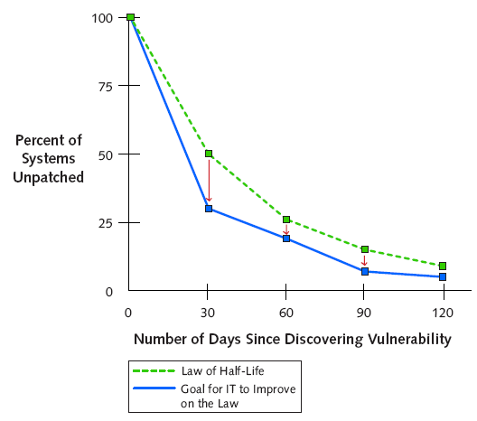
漏洞管理中的动力学和数字
补丁失败
漏洞被利用
对于一般的企业组织，平均每30天修补关键漏洞数量的50％
漏洞关键级别降低，则半衰期加倍
最流行和最关键的漏洞每年只有50％改变，即有50％的关键漏洞会存在一年以上
80％的漏洞利用出现在漏洞发表后的60天内
风 险 损 失
较佳时机
Data Source: Qualys, 2004
时 间 延 迟
有18％的新补丁出现“补丁的补丁”现象，而发布两周后的补丁则只有不到10%
漏洞被利用的时间曲线则与站点的知名度、漏洞类型等有关
Data Source: LISA 2002
Notes:
You can’t patch them all at once. There always will be systems not connected to the network, or new assets added to the network that do not reflect the latest patch or upgrade. These systems will be more vulnerable to exploit code.
Mitigate more than the remaining half of the vulnerabilities over the next month. Half of the network resources are protected in the first 30 days of a critical vulnerability, so the patch and distribution procedures are known to work. More than 50 percent of the remaining resources should be treated in the subsequent months.
Improve reduction of risk in the enterprise by shrinking the half-life to less than 30 days. Security teams should strive to make improvements that reduce the current half-life of vulnerabilities. In other words, since the current half-life is 30 days, security teams should work to reduce vulnerability half-lives in their organization.
New critical vulnerabilities occur throughout the year. Left undetected and unpatched, new vulnerabilities can undo all of the security team’s hard work. Keep vigilant and adjust assessment cycles according to the value of the network resources to be protected. Again, what is safe today may be vulnerable tomorrow.
Half of the vulnerabilities still exist in the network a year later. Be sure management processes completely remove a vulnerability. This includes updating configurations for new devices placed on the network as well as implementing management metrics to drive the vulnerability risk to zero. Effective security teams will drive down the persistence of vulnerabilities.
• Vulnerability management is a never-ending process. Implement management metrics to refine the best practices for vulnerability management. It is very difficult to manage what you cannot measure, which is one of the problems of total reliance on hit-or-miss, exploit-oriented signature-based products.

Slide 11
漏洞研究与挖掘
源代码审核（白盒），逆向工程（灰盒），FUZZing(黑盒）
动态调试分析（调试工具WinDBG，ollydbg）, …
反汇编静态分析（二进制代码分析和比较）（IDA pro ：Windows, Linux or Mac OS X hosted multi-processor disassembler and debugger ）
黑盒测试
Fuzzer：基于缺陷注入的自动软件测试技术
dumb fuzzing 无需了解测试对象，提供完全随机的输入或简单改变某些字节。简单，容易快速触发错误，但完全随机性会导致产生大量无效的输入或格式。
Intelligent fuzzing 研究目标应用程序的协议或文件格式、功能配置，了解各类漏洞的成因，有目的地编写fuzzer。能够对某些感兴趣 的部分集中测试，因此更有效
Notes:
Fuzzing是一种。通过编写fuzzer工具向目标程序提供某种形式的输入并观察其响应来发现问题，这种输入可以是完全随机的或精心构造的。Fuzzing测试通常以大小相关的部分、字符串、标志字符串开始或结束的二进制块等为重点，使用边界值附近的值对目标进行测试。
主要有两种类型的fuzzing技术 ：dumb fuzzing 这种测试无需了解协议或文件本身格式，通过提供完全随机的输入或简单改变某些字节去发现问题。这种方法实现起来较简单，容易快速触发错误，但它的完全随机 性会导致产生大量无效的输入或格式。Intelligent fuzzing 研究目标应用程序的协议或文件格式、功能配置，了解各类漏洞的成因，有目的地编写fuzzer。编写有效的fuzzer需要花费时间，但能够对某些感兴趣 的部分集中测试，因此更有效。
所谓“静态分析”，是相对于上面所提到的“动态分析”而言的。在“动态分析”过程中，调试器加载程序，并以调试模式运行起来，分析者可以在程序的执行过程 中观察程序的执行流程和计算结果。但是，在实际分析中，很多场合不方便运行目标，比如软件的某一模块（无法单独运行）、病毒程序、设备环境不兼容导致无法 运行……那么，在这个时候，需要直接把程序的二进制代码翻译成汇编语言，方便程序员阅读。
在二进制代码分析中，必须要用到逆向分析的工具，这些软件工具一般可分为 2.1系统监控工具， 2.2反汇编器， 2.3调试器 2.4和反编译器。
系统监控工具用来监控，研究以及剖析 待逆向的程序，这是由于程序与外部世界的通信都要经过操作系统，系统监控工具可 以监控网络活动，文件访问，注册表访问等等一系列的软件运行活动。反汇编器足以 程序的可执行二进制代码为输入，生成包含整个或部分程序的汇编代码文本文件的程 序。

Slide 12
工具
Ollydbg （自由软件，功能强大，结合静态反汇编与动态调试的分析器） Win32Dasml （自由软件，静态分析工具）
IDA pro （商业软件， Windows, Linux or Mac OS X hosted multi-processor disassembler and debugger ）
Windbg （免费软件，Microsoft公司的内核级调试工具）
Fuzzer:
Fuzzer API’s and Frameworks：SPIKE ，Scatch,Peach
Web 应用、操作系统、协议、正则表达式等的Fuzzer
Notes:
SPIKE - SPIKE is an attempt to write an easy to use generic protocol API that helps reverse engineer new and unknown network protocols. It features several working examples. Includes a web server NTLM Authentication brute forcer and example code that parses web applications and DCE-RPC (MSRPC).
Scratch - Scratch is an advanced protocol destroyer (”fuzzer”) which can routinely find a wide variety of vulnerabilities from a simple packet. scratch does complex parsing of binary files to determine what to fuzz with what data. scratch also comes with a framework for fuzzing binary protocols such as SSL and SMB.
PEACH - Peach Fuzzer Framework - Peach is a cross-platform fuzzing framework written in Python. Peaches main goals include: short development time, code reuse, ease of use, and flexability. Peach can fuzz just about anything from .NET, COM/ActiveX, SQL, shared libraries/DLL’s, network applications, web, you name it!
微软发布了一个免费工具，帮助程序员测试正则表达式，堵上拒绝服务攻击（DoS）的漏洞。 SDL Regex Fuzzer支持Windows XP以上系统

