Slide 1
Mini Introduction to Social Network Analysis
By Jennifer Yu,
Epidemiologist at Institut Armand-Frappier, INRS, Université du Québec
Montreal R-Ladies meetup – November 15, 2018

Slide 2
Plan
Introduction to SNA and some vocabulary
Some R codes (use survey data from R-Ladies)

Slide 3
Fields of study
Epidemiology
Ecology
Sociology
Political science
Organizational behavior
Archeology
Many more…
Notes:
Social network analysis is used in many fields

Slide 4
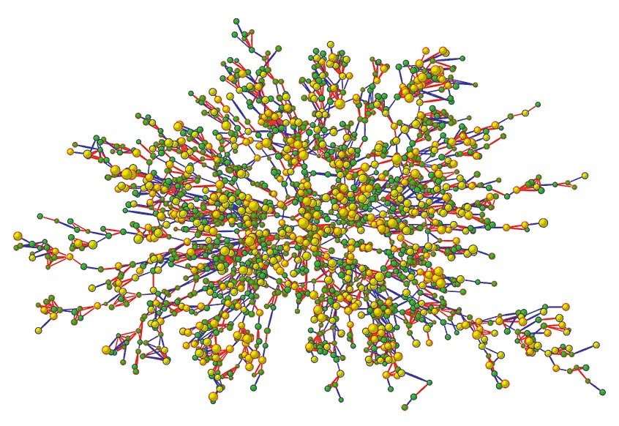
Real Network Example
Christakis NA and Fowler JH. The spread of obesity in a large social network over 32 years. New England Journal of Medicine. 2007;357:370-379
Notes:
Epidemiology – Network from the Framingham study about obesity

Slide 5
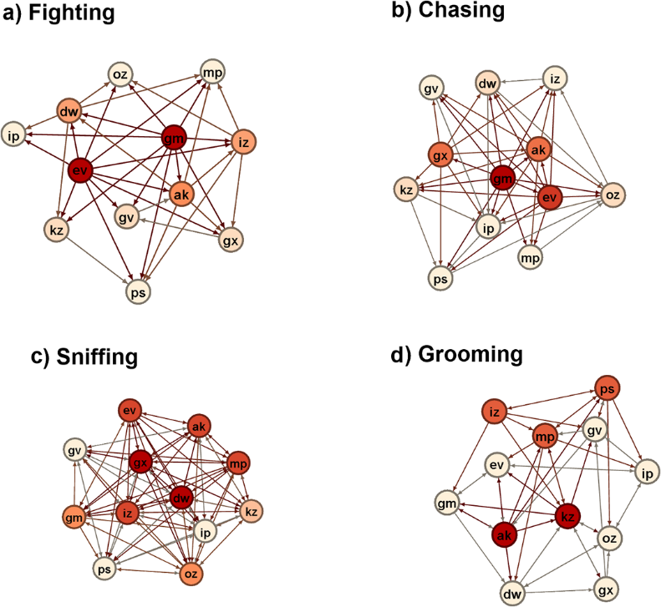
Real Network Example
So N, Franks B, Lim S, Curley, JP. A Social Network Approach Reveals Associations between Mouse Social Dominance and Brain Gene Expression. PLOS One 2015;10
Notes:
Network of mice interacting with each other

Slide 6
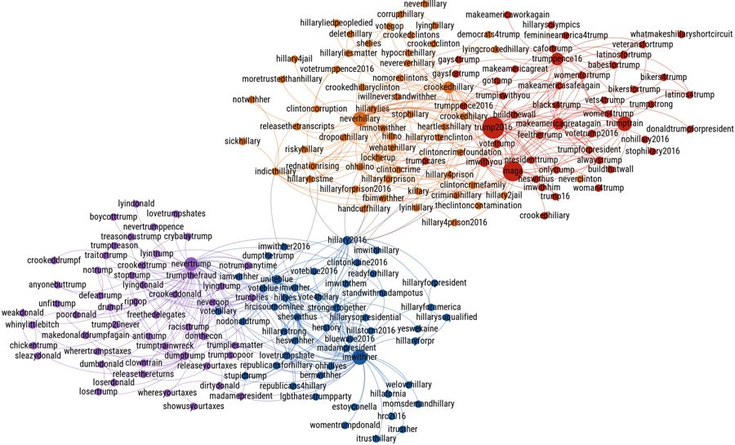
Real Network Example
Bovet A, Morone F, Makse HA. Validation of Twitter opinion trends with national polling aggregates: Hillary Clinton vs Donald Trump. Sci Rep. 2018 Jun 6;8(1):8673.
Notes:
“Hashtag classification via network of co-occurrence. Network of hashtags obtained by our algorithm from June 1st to September 1st. Nodes of the network represent hashtags and an edge is drawn between two hashtags when their co-occurrence in tweets is significant (see Methods). The size of the node is proportional to the total number of occurrence of the hashtag. Two main clusters are visible, corresponding to the Pro-Trump/Anti-Clinton and Pro-Clinton/Anti-Trump hashtags. Inside of these two clusters, the separation between Pro-Trump (red) and Anti-Clinton (orange), or Pro-Clinton (blue) and Anti-Trump (purple), is also visible. The coloring corresponds to clusters found by community detection”

Slide 7
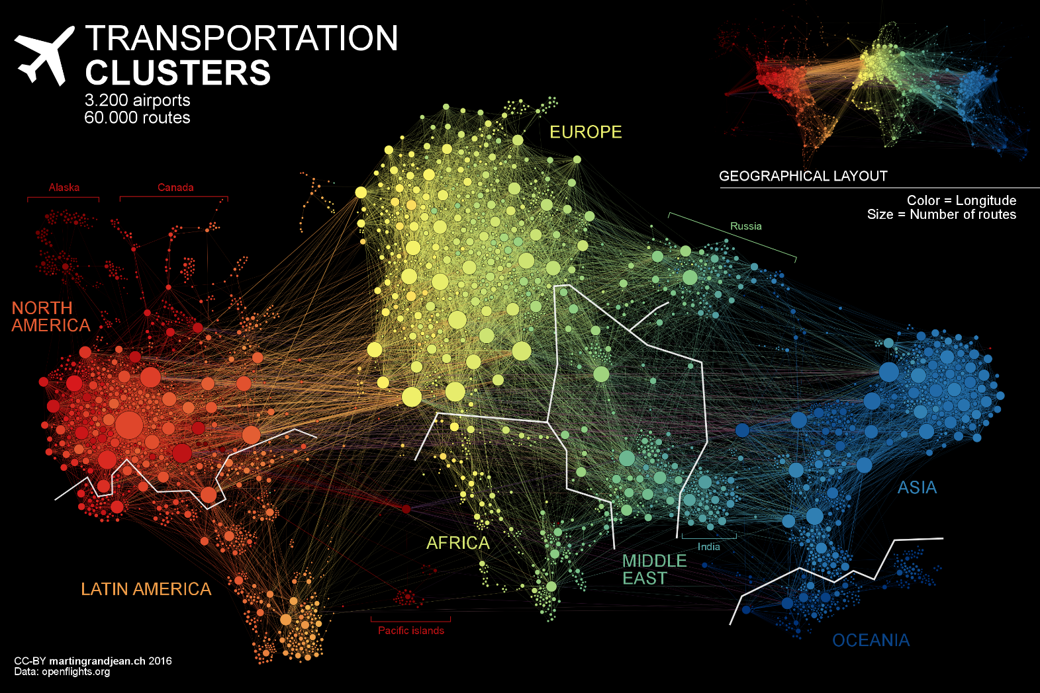
Real Network Example
http://www.martingrandjean.ch/connected-world-air-traffic-network/
Notes:
Airport networks

Slide 8
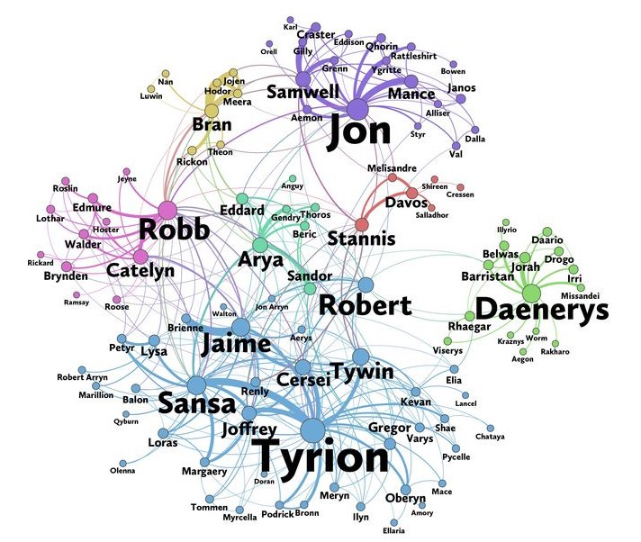
Real Network Example
https://medium.com/@himanshubeniwal/a-network-analysis-of-game-of-thrones-73360505e541
Notes:
Network of fictional characters

Slide 9
A definition of SNA
Network: collection of nodes connected by edges
Social Network Analysis:
Methodology for analyzing the network
Formulation of network theory
Notes:
Social network analysis can be seen as a tool to analyze network data. Or it can be used to formulate theory, such as looking at the individual in the network with the most decision power in a company and we see that this person is connected to a lot of people in the said company. We then infer that a person with a high centrality has more power.

Slide 10
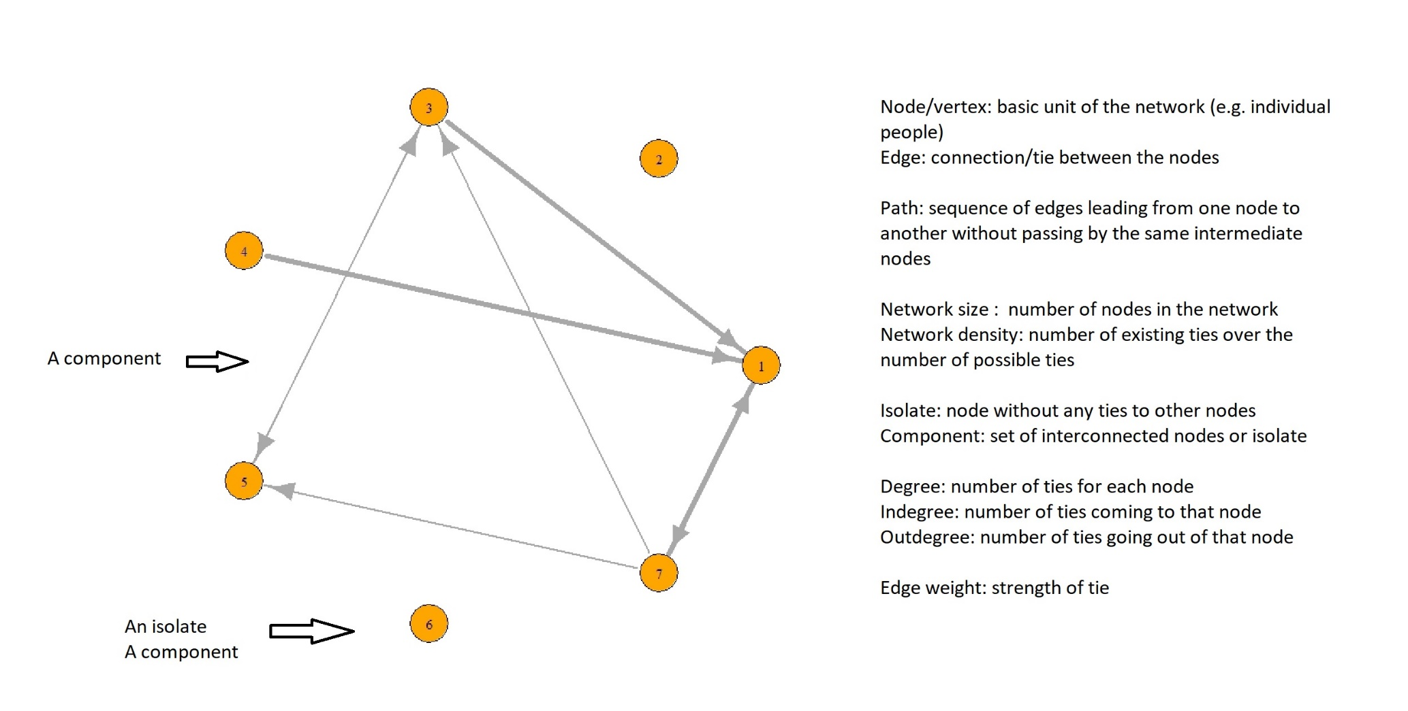
SNA Vocabulary
Notes:
Some vocabulary for social network analysis. There are many more.

Slide 11
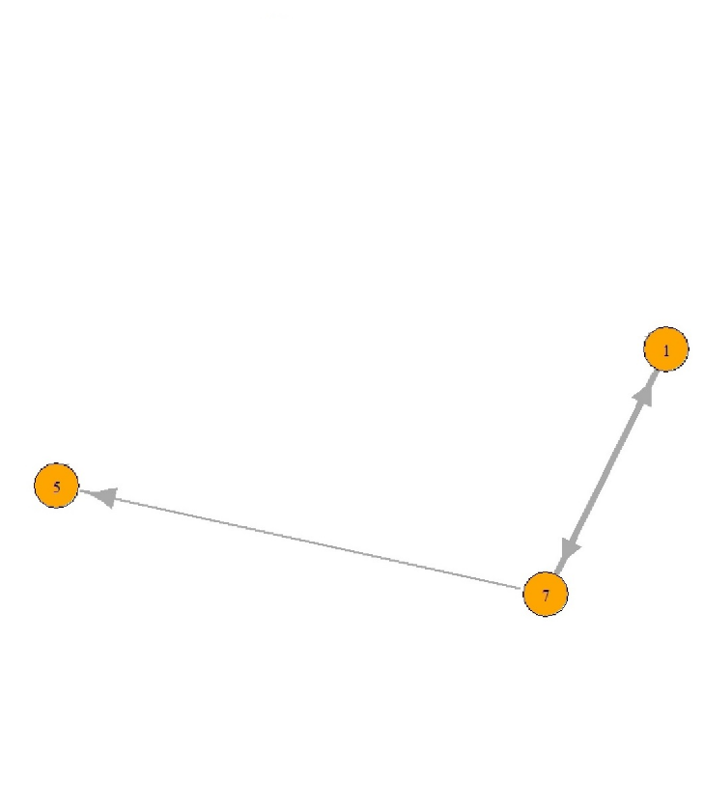
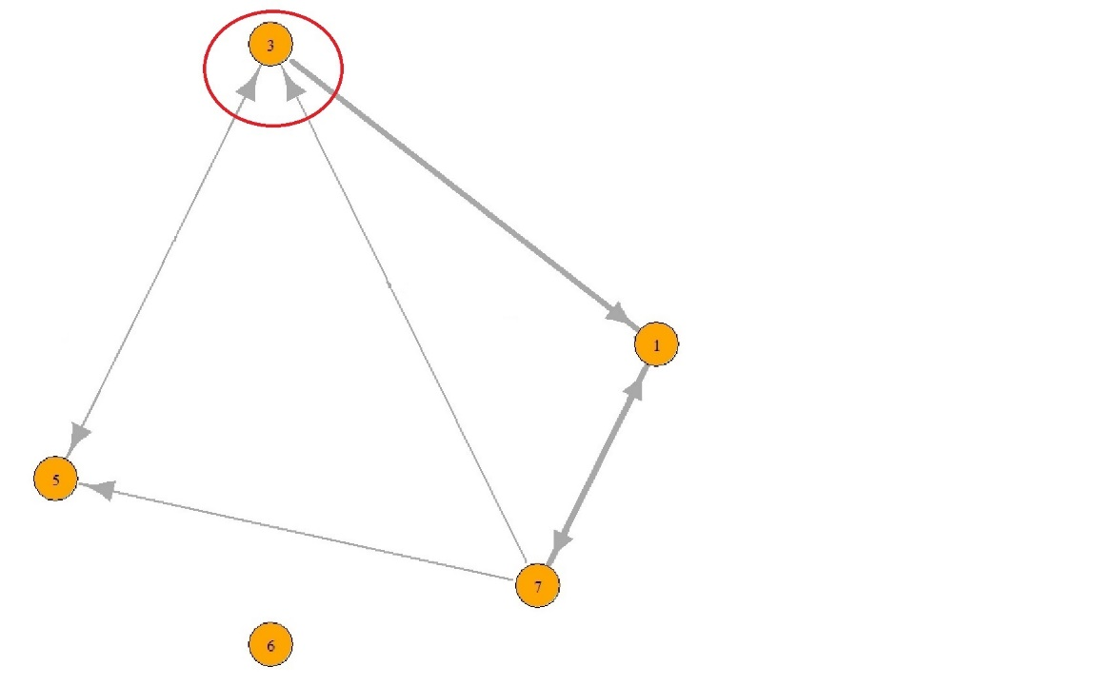
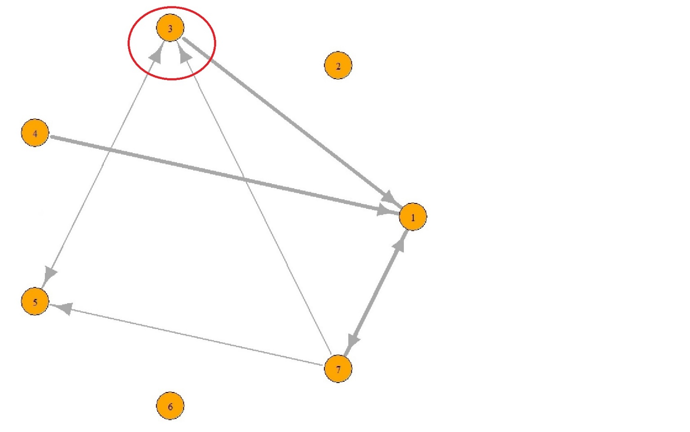
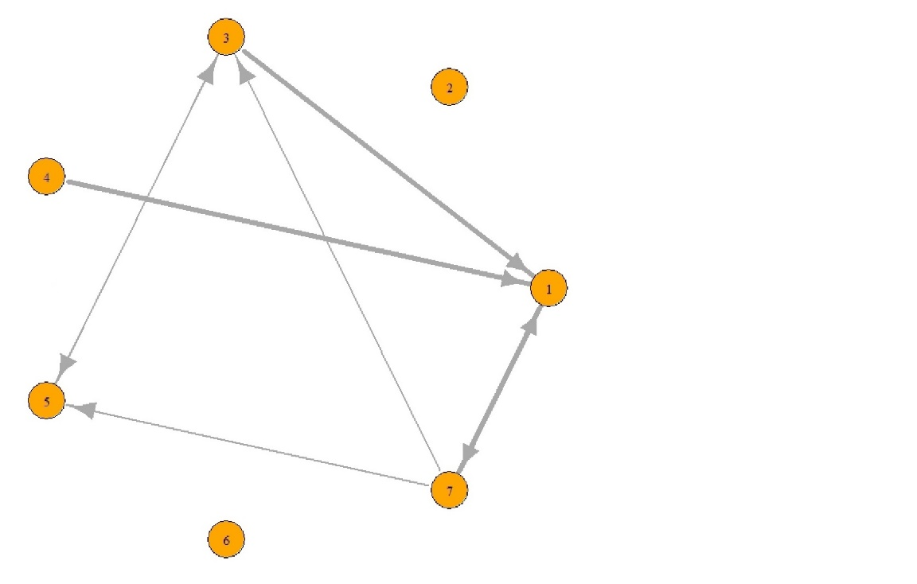
Describing the Nodes
Socio-metric vs ego-centric networks
Who are included in the network
Measures:
Number of nodes with a certain attribute (e.g. number of male)
Proportion of nodes with a certain attribute (e.g. proportion of male)
Centrality measures
Many more…
Notes:
I’m taking the last network. It was a socio-metric network where everyone in a community is included, for example a school or a class. But then I want to focus on that person in particular, and so I remove all the people not connected to him. And I want to study the network of that person in particular, I would remove him since he’s connected to everyone. And we get an ego-centric network.

Slide 12
Describing the Edges
Predefined definition of a tie
E.g. friendship ties, someone talked to in the last month
Direction of edges
Edge weight
Measures:
Number of ties (weak/strong)
Proportion of weak/strong ties
Adjacency matrix
 | P01 | P02 | P03 | P04
P01 | 1 | 1 | 1 | 1
P02 | 0 | 2 | 0 | 0
P03 | 0 | 1 | 2 | 2
P04 | 1 | 1 | 2 | 1
Notes:
For the adjacency matrix, depending on the research question, we may get different values. Here, let’s take an example of a network where the ties were defined as how much do you think of each person. A same person can think about themselves and therefore we can have loops. 0 is for not thinking about that person, 1 for sometimes thinking about that person, and 2 for often thinking about that person. The rows are the respondents.
The measures we can do are the number of weak or strong ties. Again we have to define what a weak or strong tie mean.

Slide 13
Describing the network structure
Describing the network as a whole
Network size
Network density
Number of components
Number of isolates
Many more…

Slide 14
SNA in R – Graph creation
2 main packages used for SNA: igraph and network/sna
R objects: igraph and network
Database to import
Node characteristics
Adjacency matrix
Create an igraph object containing both the nodes’ attributes and the ties between the nodes
Notes:
In the example I will show in R, I will use igraph. We can use both igraph and sna, but they use different R objects and we need to convert. I won’t go over the details.
Go to Rstudio for the mini tutorial on SNA in R

Slide 15
SNA in R - Plotting
Add plotting characteristics to different node attributes
Favorite season: colour
Times dining out: size
Extroversion/introversion: shape
Add plotting characteristics to edge attributes
Don’t know that person = no tie
Just met that person = thin line
Knew that person before = thick line
Plotting with different layouts
Default
Circle
Notes:
Season color: Spring = pink, summer = green, fall = orange, winter = sky blue, missing = grey
Dining size, missing = 10
Extrovert = rectangle, ambivert = circle, introvert = square, missing = circle

Slide 16
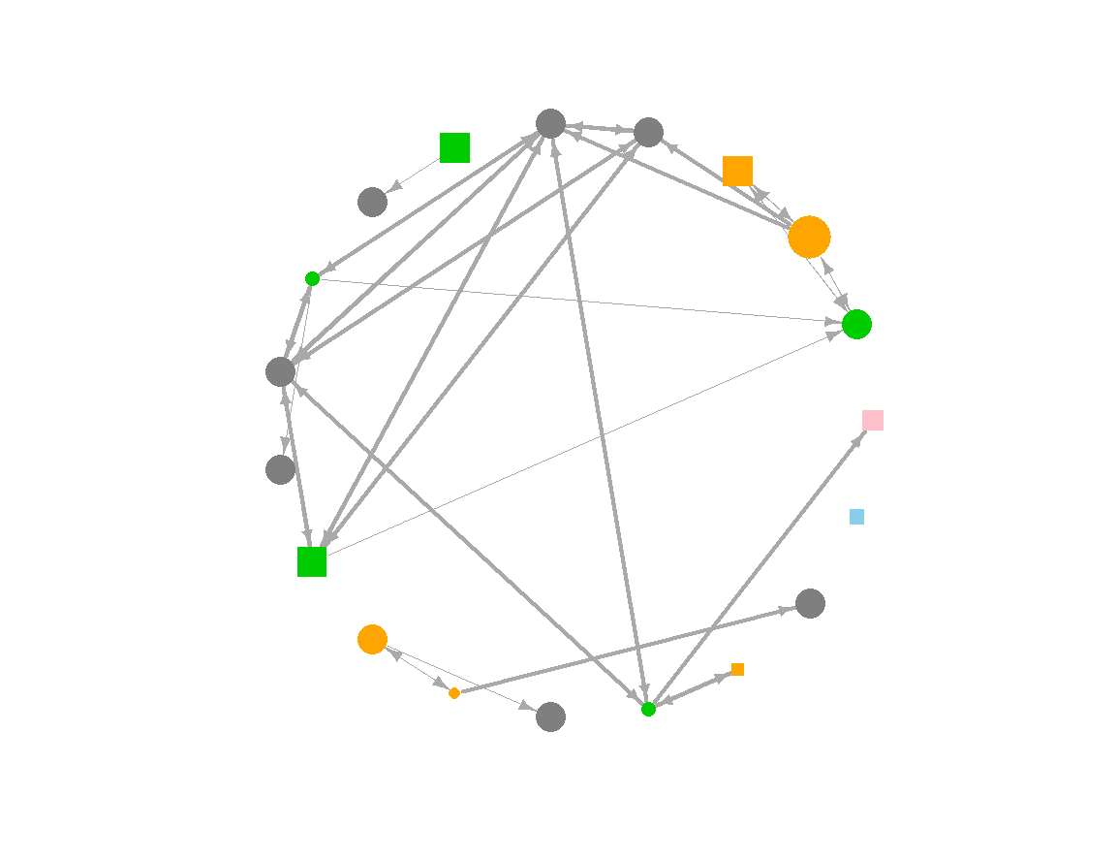
SNA in R – Resulting Plot

Slide 17
SNA in R – Calculate SNA measures
Whole network structure measures
Network size
Network density
Degree centrality

Slide 18
Other Analyses
ERGM
Longitudinal analyses
SIENA
Many more…
Notes:
We have seen an overview of social network and we have done a few simple analyses. There are many more that we can do. We had a cross-sectional set of data, but we could have a longitudinal or panel study where we have a network that changes over time and we want to know let’s say how the network density changes.

Slide 19
Questions?

Slide 20
Thank you!

