Slide 1
M3N10/M4N10/M5N10: 2020-2021 Computational Partial Differential Equations (CPDEs : 2020-2021) Lecture 13-14-15-18 : Hyperbolic PDEs (part b) (Dispersion & Dissipation)

Slide 2
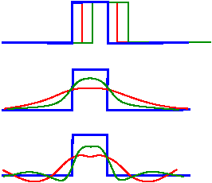
Numerical solutions exhibit:
+c
Advection
Advection
Dissipation
Dispersion
Phase Differences
Dissipation
Dispersion
The three mechanisms of advection, diffusion, and dispersion are central to the behaviour of partial differential equations and their discrete models, and together account for most linear phenomena. The study of numerical methods for these equations reveals many of the issues that come up repeatedly in more difficult problems.
The derivative terms in the advection , diffusion and dispersion
operators play a crucial role, both in terms of accuracy and in terms of the stability of the discretized scheme.

Slide 3
Summary of findings through numerical experiments:
CFL > 1: all methods examined tend to blow up (A,B,C & F) (i.e. unstable numerically).
CFL=1: A, B unstable, C & F give exact result.
CFL < 1: C & F display dispersive, dissipative behaviour and out of phase with exact solution result. Results exasperated at regions where sudden changes, or large gradients in the u-field arise.
CFL < 1: Greater resolution in grid, reduces the dispersive, dissipative behaviour of C & F. Dissipation effects of F less than C. Dispersive behaviour in C not evident; F displays relatively weaker Dissipation but significant Dispersive behaviour.
Modified equations, schemes C & F

Slide 4
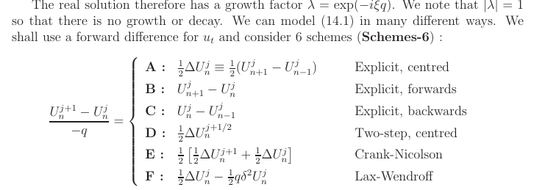
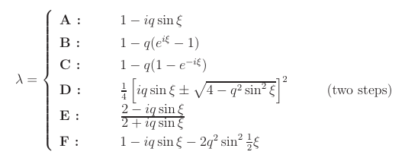
Von-Neumann Fourier Stability analysis:

Slide 5
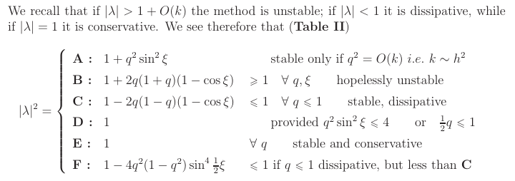
Von-Neumann Fourier Stability analysis:

Slide 6
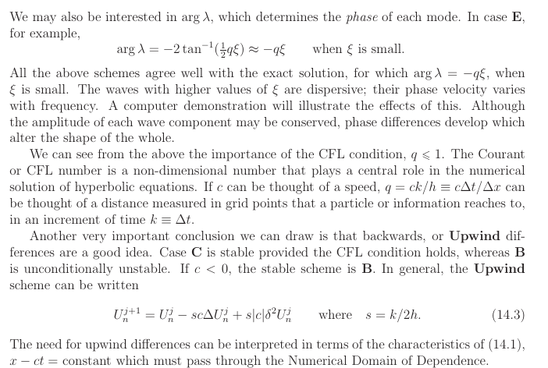

Slide 8
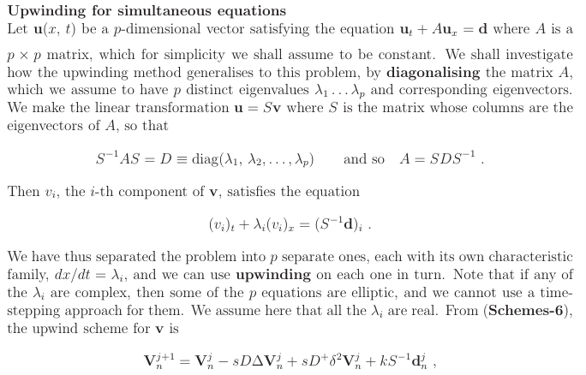
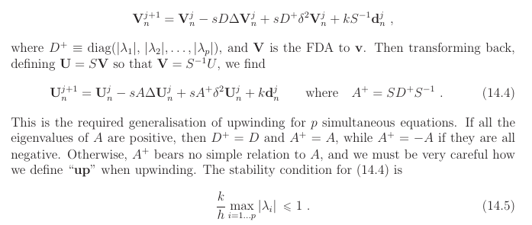

Slide 9
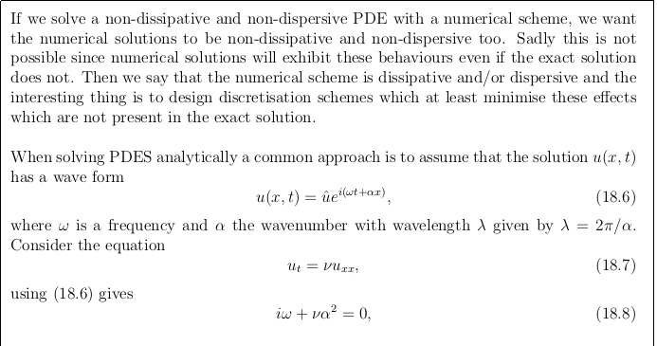
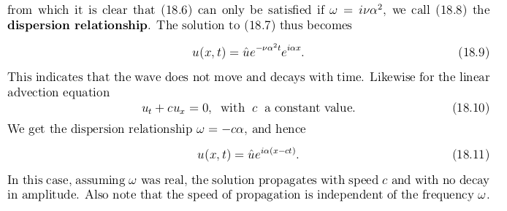
More on Dissipation & Dispersion

Slide 10
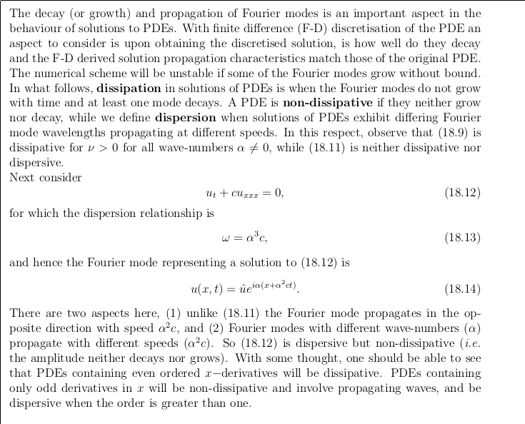

Slide 11
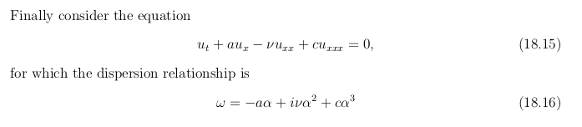
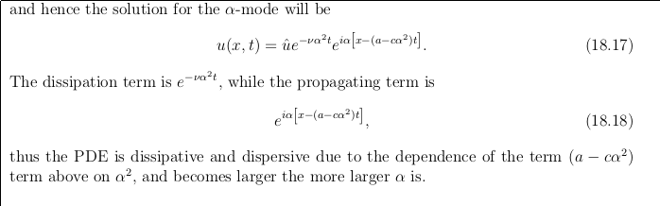

Slide 12
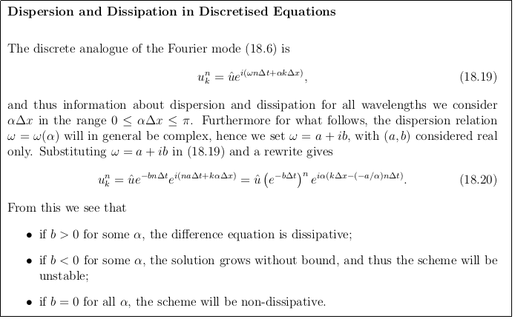
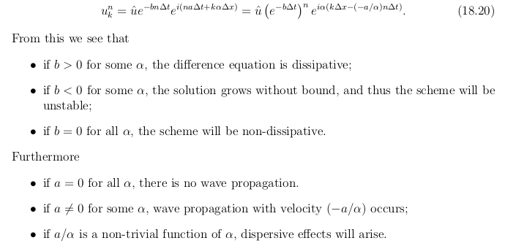

Slide 13
