Slide 1

ENSF 692 -Interprovincial Migration in Canada
John Zhou & Jack Shenfield

Slide 2
Data
Monthly data, by province, from 2005-01 to 2025-01:
Consumer price index
Housing index
Employment
Wage/Salary
Population
In/Out migration

Slide 3
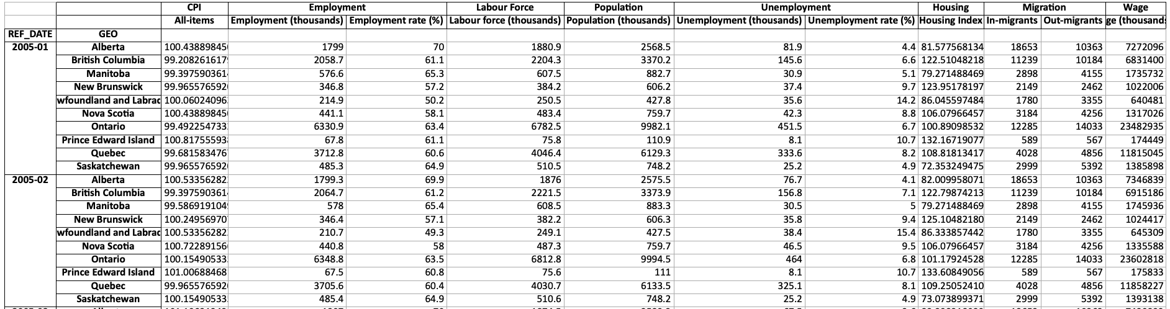
Data Analysis
Data was cleaned and combined into a Pandas Dataframe for analysis, i.e.,

Slide 4
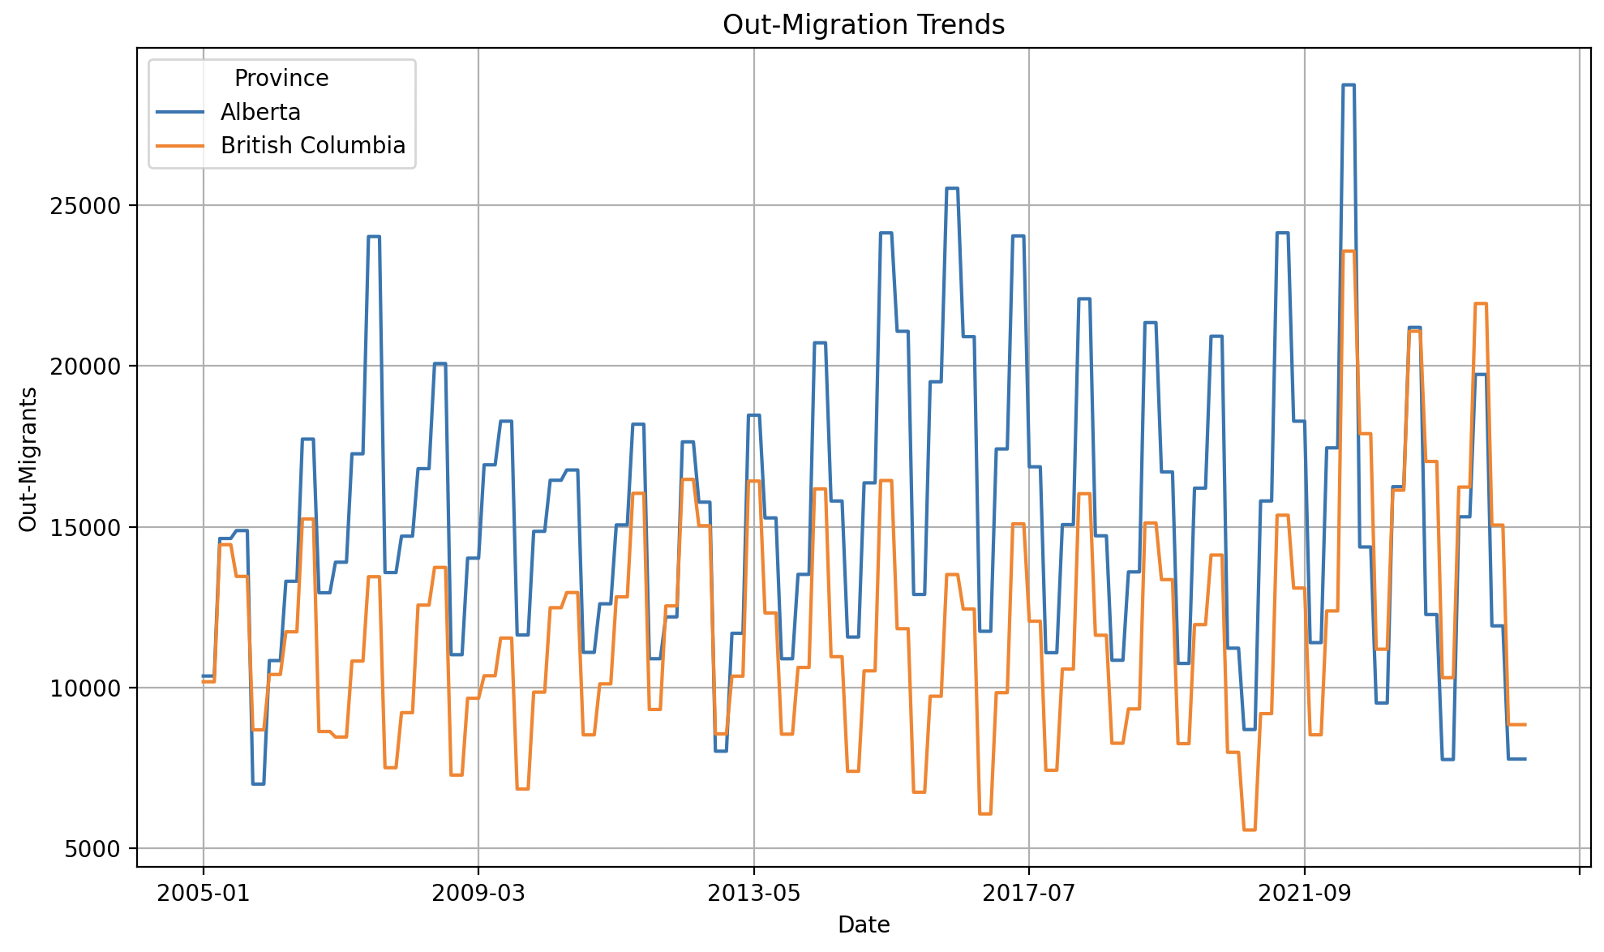
Input and Output
To fulfill assignment requirements, we will require input of 2 provinces from the user, e.g., "Alberta Ontario", as well as the data they would like to demonstrate against migration, e.g., "Wages".
The output will be a dual y-axis plot to overlay migration statistics with the chosen statistic.

Slide 5

Thank you for listening! Any questions

Slide 6
Datasets
[1] Statistics Canada, “Table 34-10-0139-01 – Interprovincial migration by mode of transportation and selected characteristics, annual,” *Statistique Canada*, accessed Jun. 16, 2025. [Online]. Available: https://www150.statcan.gc.ca/t1/tbl1/en/tv.action?pid=3410013901
[2] Statistics Canada, “Table 17-10-0040-01 – Estimates of the components of international migration, quarterly,” *Statistique Canada*, released Mar. 19, 2025; accessed Jun. 16, 2025. [Online]. Available: https://www150.statcan.gc.ca/t1/tbl1/en/tv.action?pid=1710004001
[3] Statistics Canada, “Table 14-10-0287-03 – Labour force characteristics by province, monthly, seasonally adjusted,” *Statistique Canada*, released Jun. 6, 2025; accessed Jun. 16, 2025. [Online]. Available: https://www150.statcan.gc.ca/t1/tbl1/en/tv.action?pid=1410028703
[4] Statistics Canada, “Table 36-10-0205-01 – Wages, salaries and employers’ social contributions (x 1,000), monthly,” *Statistique Canada*, released May 30, 2025; accessed Jun. 16, 2025. [Online]. Available: https://www150.statcan.gc.ca/t1/tbl1/en/tv.action?pid=3610020501
[5] Statistics Canada, “Table 18-10-0004-01 – Consumer Price Index, monthly, not seasonally adjusted,” *Statistique Canada*, released May 20, 2025; accessed Jun. 16, 2025. [Online]. Available: https://www150.statcan.gc.ca/t1/tbl1/en/tv.action?pid=1810000401
[6] Statistics Canada, “Table 18-10-0205-01 – New housing price index, monthly,” *Statistique Canada*, released May 21, 2025; accessed Jun. 16, 2025. [Online]. Available: https://www150.statcan.gc.ca/t1/tbl1/en/tv.action?pid=1810020501

