Slide 1

ENSF 692 -Interprovincial Migration in Canada
John Zhou & Jack Shenfield

Slide 2
Data
Monthly data, by province, from 2005-01 to 2025-01:
Consumer price index
Housing index
Employment
Wage/Salary
Population
In/Out migration

Slide 3
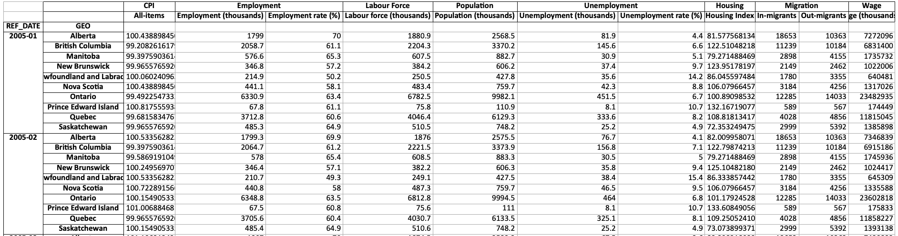
Data Analysis
Data was cleaned and combined into a Pandas Dataframe for analysis, i.e.,

Slide 4
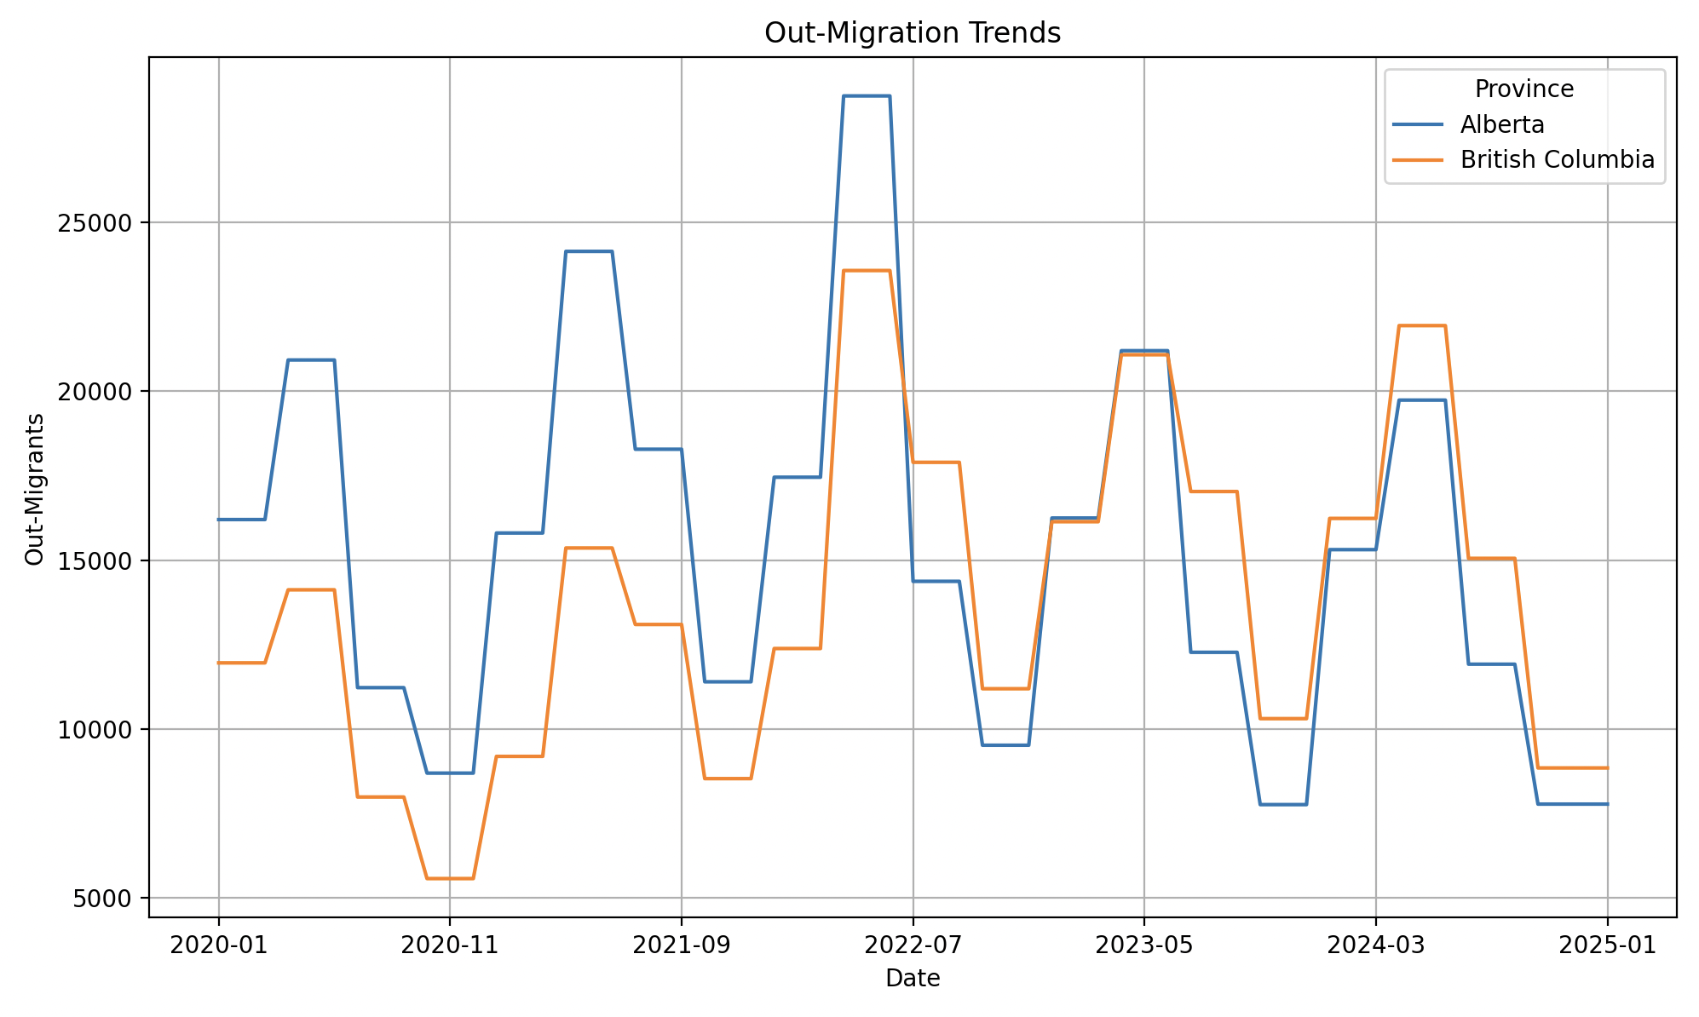
Input and Output
To fulfill assignment requirements, we will require input of 2 provinces from the user, e.g., "Alberta Ontario", as well as the data they would like to demonstrate against migration, e.g., "Wages".
The output will be a dual y-axis graph to overlay migration statistics with the chosen statistic.

Slide 5

Thank you for listening! Any questions

