Slide 1
Churn Prediction

Slide 2

Data insights
Lot of missing data
High cardinality categoric variables
No visible separability between classes
Imbalanced data set which is common to anomaly and churn prediction problems

Slide 3
Handling Missing data
Used impute by a constant value for all numeric columns
Mean imputation and median imputation were also tried but did not achieve better results

Slide 4
High cardinality
Feature selection was done using K-Best selection using mutual information
Most High cardinality categoric variables are dropped
Empty columns and single variable categorical variables have been turned to ordinal wherever required

Slide 5
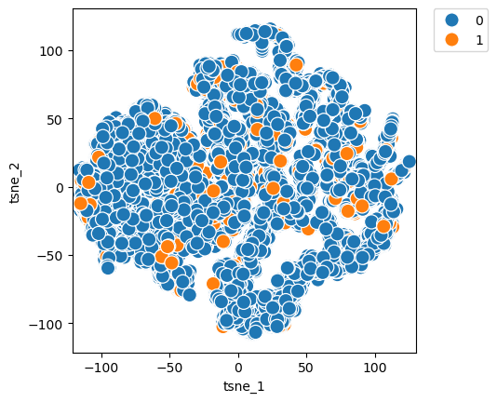
Separability of concept classes
Multiple variants at different perplexity levels has been tried out with similar results.
Parametric modelling seems like a difficult option here

Slide 6
Confirmation
One class SVM was used to confirm the T-sne plots at higher dimension. Inherently there is no difference that could be found at a distribution level
Anomalies had to be churned at feature level using tree based or KNN like non-parametric techniques

Slide 7
Models tried
Catboost
Knn
LogistiRregression
One class SVM

Slide 8
Catboost
Used target Class 1's (Churn) F1 score as evaluation metric .
Precision ratio at 90% recall is another good evaluation metric.
Number of data points to evaluate for a single churn prediction
Baseline imbalanced data has a Precision ration 1 in 10 for 90% ile
Catboost achieves 1 in 4 at 90% recall.

Slide 9
Pipeline
Experiments Done through MLFlow trackin system.
MLFlow server setup through Dockerfile
Actual model serving with preprocessing (SKLearn pipeline) are both served through MLFlow catboost serving

Slide 10
Net steps
Compression ratio of 1:4 is still very low, 1:2 is more sellable.
Need more features ,currently separability of two classes is very poor according both T-sne and Mutual-informaiton analysis.
Features that actually cause churn are missing from dataset .This requires some good domain expertise and Business analysis to collect this information.
Bayesian modelling might also be helpful , but with a better of understanding of features we might look for areas where explaining away is going wrong. Which should help in achieving better seperability.

