Slide 1

Customer Insights
By Jonah Zembower

Slide 2

Objective
To understand customer demographics, behaviors, and preferences to inform targeted marketing strategies and improve customer satisfaction.

Slide 3

Customer Dataset Overview
Dataset comprises 1000 customer records with details on demographics, purchasing behavior, and preferences.
Variables include Customer ID, Age, Annual Income, Spending Score, Gender, Total Purchases, Category Most Purchased, and Recent Purchases.

Slide 4
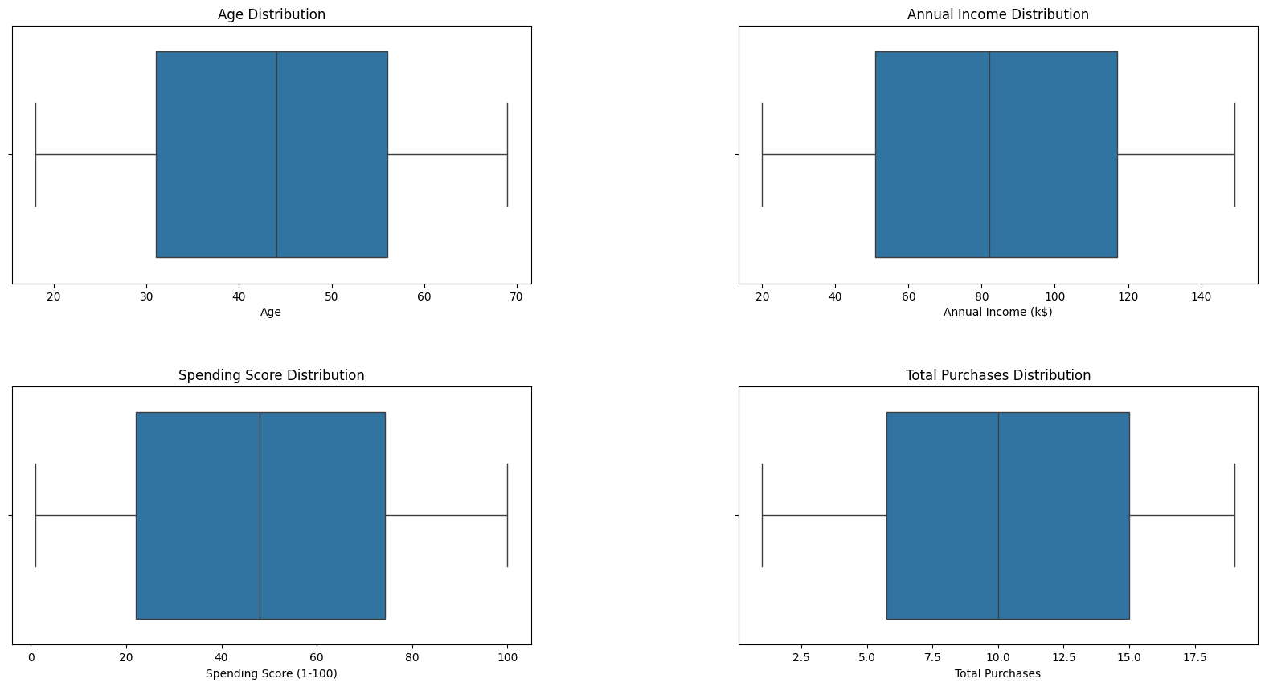
Analyzing Dataset

Slide 5
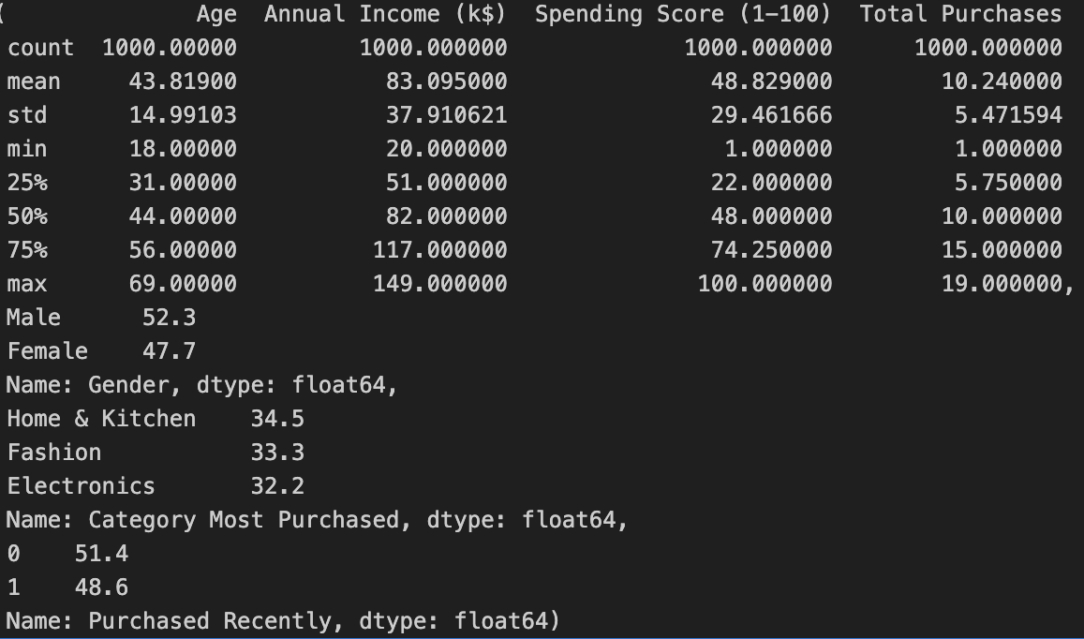
Analyzing Dataset
-Overall, there is a lot of diversity in the values that creates an even spread within most of the variables such as age, annual income, spending score, and total purchases.
-There appears to be more males than females. This will affect our future clustering
methods. Realistically, we will have more clusters that represent males due to this.
-The category most purchased is relatively similar in values but shows some slight favor
to Home and Kitchen. This will be reflected in the clusters.
-Recent purchase activity shows that about 50% have recently purchased something.
That is relatively high and will affect the customer persona groupings.

Slide 6
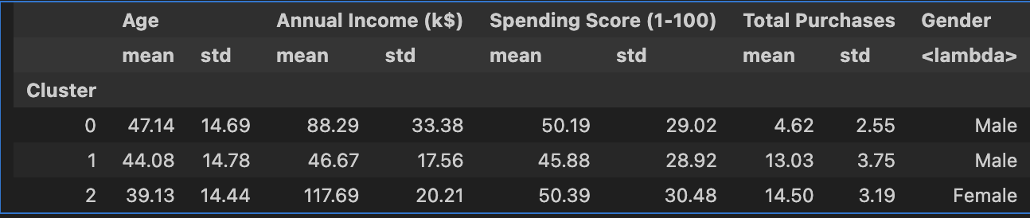
Customer Personas
Applied K-means clustering to segment customers into distinct personas
1. The first cluster has an average age at 47 and an average income that is about middle class. The spending score is interestingly high as well but the total purchases is lower. The gender is male.
2. The second cluster has an average age of 44 and an average income that is lower class. The spending score is lower and the total purchases are surprisingly elevated. The gender is male.
3. The third cluster has an average age at 39 and an average income that is upper class. The spending score is the highest and the total purchases are also the highest. The gender is female.

Slide 7
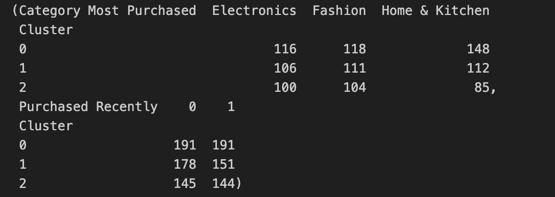
Customer Personas Shopping Habits
Balanced Buyer: Middle-aged, middle-class males with a moderate spending score and preference for Home & Kitchen.
Selective Shopper: Middle-aged, lower-income males, cautious in spending with a balanced category interest, excluding Electronics.
Versatile Shopper: Younger, upper-income females, high spenders across all categories, indicating diverse interests.

Slide 8
Strategic Implications
The analysis successfully identified distinct customer personas, providing a foundation for personalized marketing strategies.
Future efforts will focus on refining predictive models and continuously adapting marketing strategies based on evolving customer insights.
The detailed report consists of ideas for future marketing strategies.

