Slide 1

01
Task C2
How task C2 is processed?
02
Remove Fetch
How can we avoid fetch operations using shared storage?
03
RDMA
RDMA solution
04

Slide 2
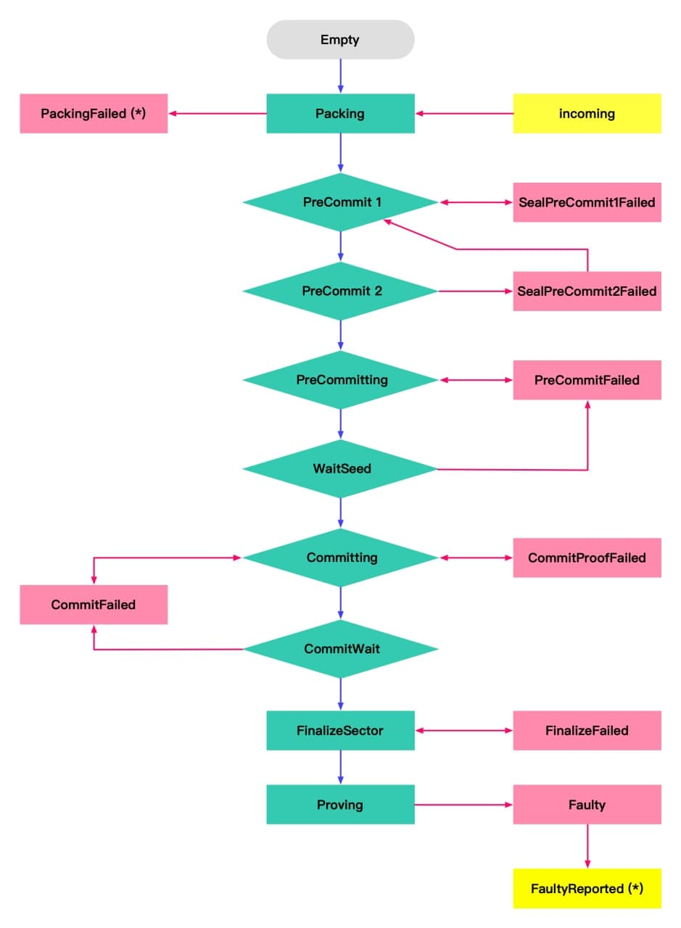
Sealing Job tasks

Slide 3
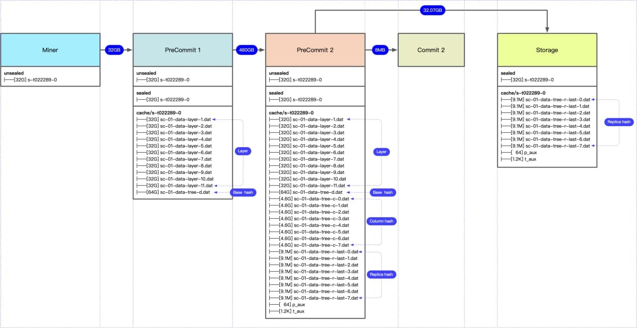
Sealing Jobs storage usage

Slide 4

How task C2 is processed?
During the previous meeting, there were doubts about the way C2 Task was handled. Our guess is that, since the C2 Worker does not require storage, it can directly access the PC2 Worker's storage and completed tasks.
On the same worker that completed PC2, there is a small task called C1 that continues the process. After the C1 job has finished, a 20MB file is created and sent to the C2 worker using JSONRPC.
The data has to be fetched, but compared to PC1 and PC2, the data transfer is very small.

Slide 5
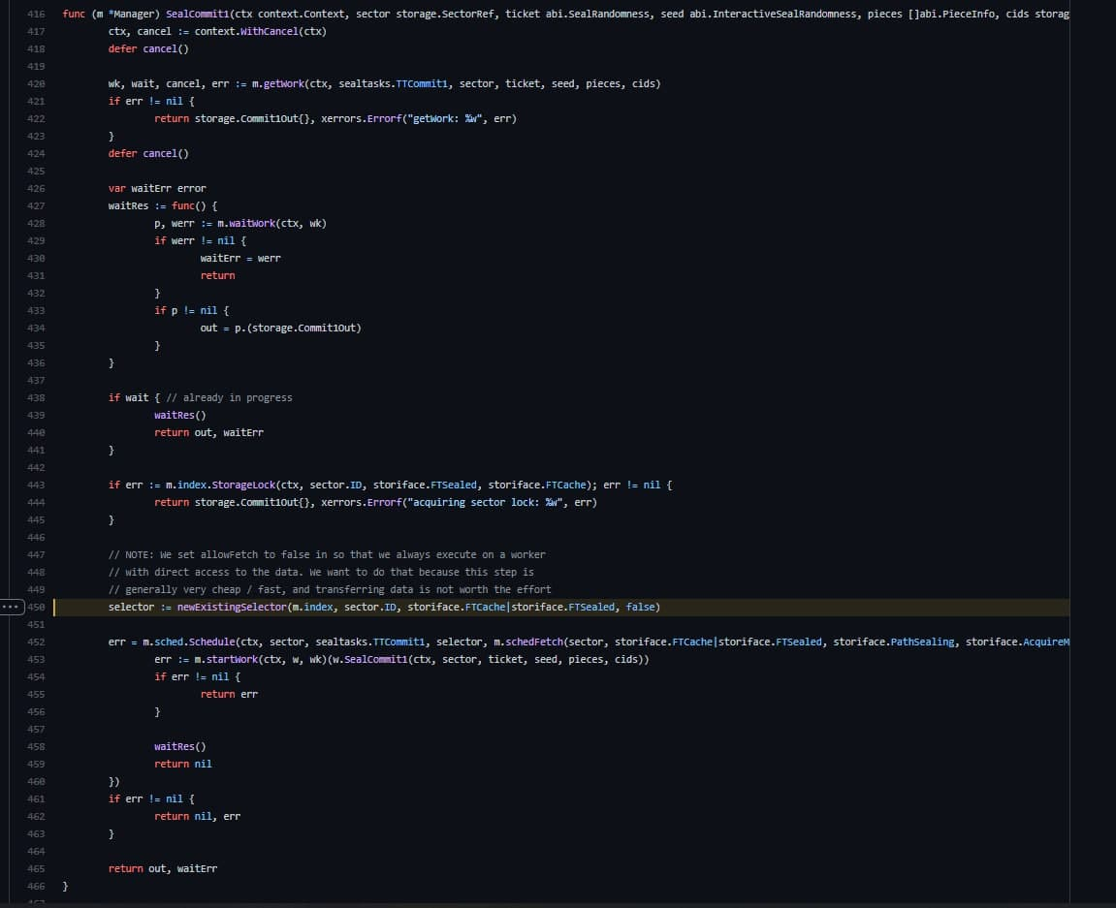
C1 → C2 Data Transfer

Slide 6
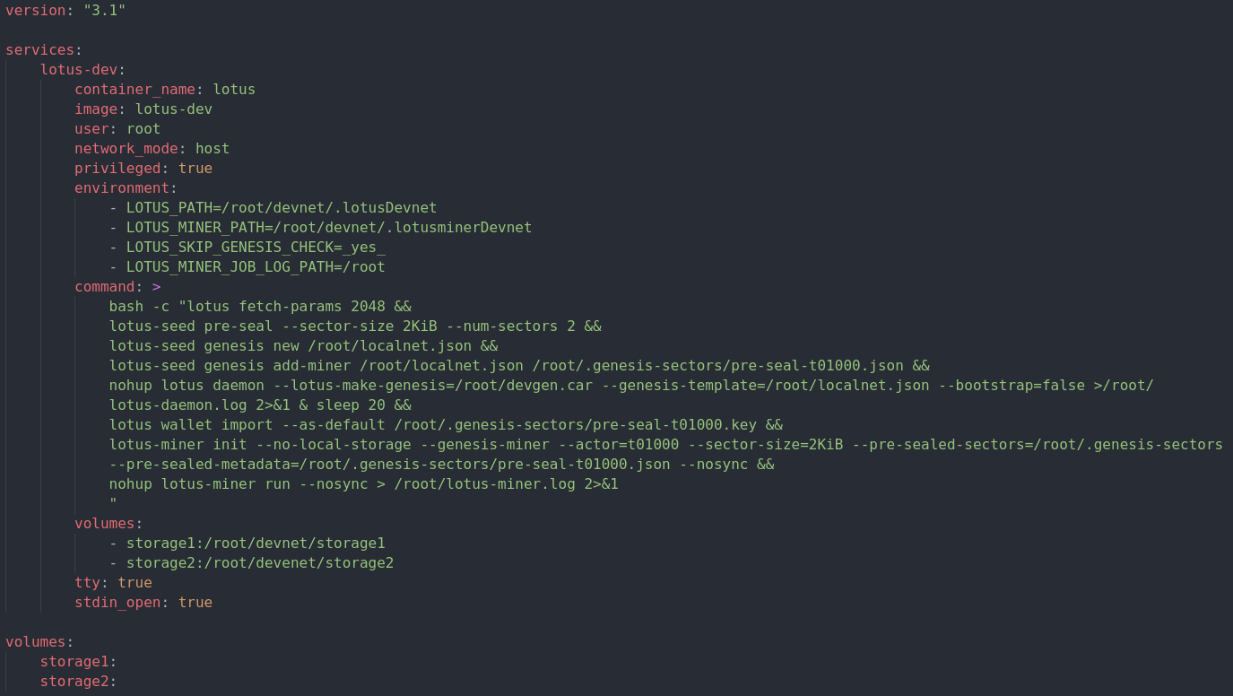
Simulating DevNet environment with Docker
Docker-compose for run lotus-daemon , lotus-miner

Slide 7
Simulating DevNet environment with Docker
Simulating DevNet Steps
Docker Image file
Config Miner Layout
3
1
In the Docker image file, we have created an automated script that retrieves the code from the specified repository. The script fetches the source from the repository, compiles and exports it, allowing a developer to test the latest changes.
Simulating a large set-up requires running multiple workers in docker containers on separate physical and virtually based servers. they are all part of the same miner.
Lotus Devnet Sector Config
Create deals and task
2
4
As soon as the Docker image can be used, we start lotus daemon and miner with 2k sectors that allow us to use smaller sectors for testing.
Scheduler can be used to assign tasks to workers after the environment is ready. Our tool creates multiple deals and makes the miner accept them in order to provide tasks to workers.

Slide 8
Solution for Eliminating the "Fetch" method
To gain a better understanding of how Lotus handles shared storage, we modified some parts of the Lotus project, added some additional logs to the source code, and ran tests in two scenarios :
Creating an environment with separated storage which is the default configuration for the FileCoin, the result ended with GET operation.
This setup uses a Docker volume to simulate a shared storage environment with several workers and different task support, with each worker doing a specific task and sending the process on to the next worker to complete. As they have shared storage, there wasn't a GET operation.

Slide 9
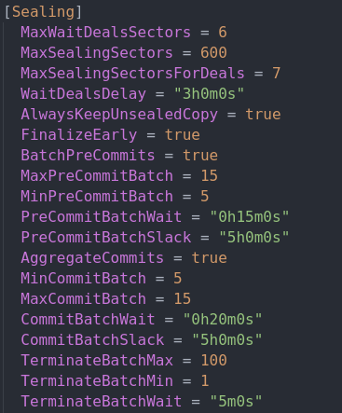
Tools & Configuration
Scenario 1: Separate Storage
Tools :
Docker
Sector 2 Kb
Configuration :
Miner (AP, PC1 tasks)
Worker (PC2, C2 tasks)

Slide 10
Commands
Scenario 1: Separate Storage
Initialize miner :
lotus-miner init --genesis-miner --actor=t01000 --sector-size=2KiB --pre-sealed-sectors=/root/.genesis-sectors --pre-sealed-metadata=/root/.genesis-sectors/pre-seal-t01000.json –nosync
Initialize worker:
lotus-worker run --listen "0.0.0.0:3455"

Slide 11
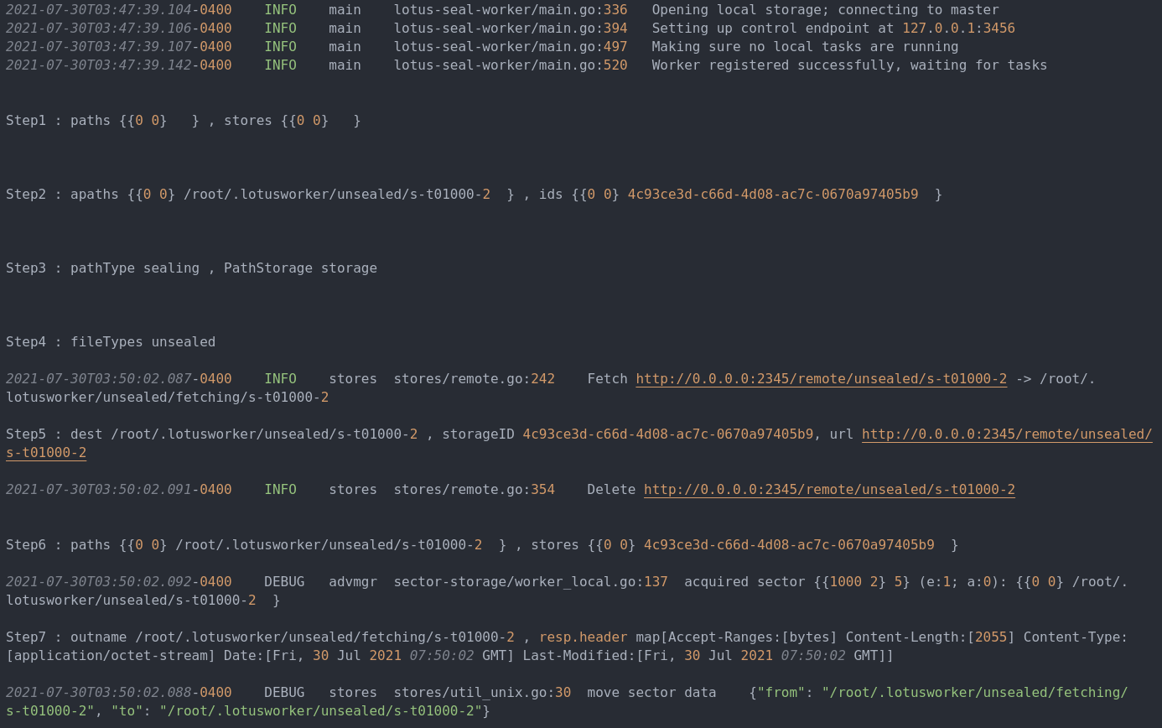
Worker Result
Scenario 1: Separate Storage

Slide 12
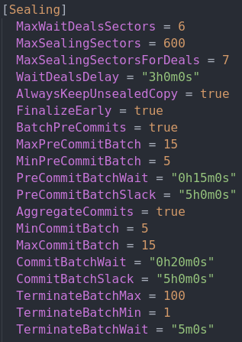
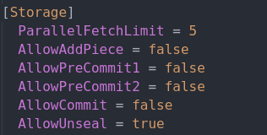
Tools & Configuration
Scenario 2:
Shared
Storage
Tools :
Docker
Sector 2 Kb
Share storage with docker volume
Configuration :
Miner
Worker 77a69335 (C2, PC2 tasks)
Worker 81346a03 (PC1 task)

Slide 13
Commands
Scenario 2:
Shared
Storage
Initialize miner without local storage :
lotus-miner init --no-local-storage --genesis-miner --actor=t01000 --sector-size=2KiB --pre-sealed-sectors=/root/.genesis-sectors --pre-sealed-metadata=/root/.genesis-sectors/pre-seal-t01000.json –nosync
Initialize workers without local storage :
lotus-worker run --no-local-storage --precommit1=false --precommit2=true --commit=true --listen "0.0.0.0:3457"
Attach and Init mounted storage for miner :
lotus-miner storage attach --seal --init /root/devnet/storage1
lotus-miner storage attach --seal --init /root/devnet/storage2
Attach mounted storage for workers :
lotus-worker storage attach --seal /root/devnet/storage1
lotus-worker storage attach --seal /root/devnet/storage2

Slide 14
Workers Info
Scenario 2:
Shared
Storage
Session: 77a69335-5a26-4059-8b75-2131318ba7e3
Enabled: true
Hostname: ip-172-31-36-231
CPUs: 8; GPUs: []
RAM: 15.46 GiB; Swap: 0 B
Reserved memory: 2.223 GiB
Task types: FIN GET UNS C1 C2 PC2 AP
bb56783f-faec-427a-9848-1bfb4059f0a4:
Weight: 10; Use: Seal
Local: /root/devnet/storage1
fac05ecc-8b6b-424f-a33c-e3eb6eb694a8:
Weight: 10; Use: Seal
Local: /root/devnet/storage2
Session: 81346a03-8370-4f98-a259-c5781e0f0901
Enabled: true
Hostname: ip-172-31-36-231
CPUs: 8; GPUs: []
RAM: 15.46 GiB; Swap: 0 B
Reserved memory: 2.548 GiB
Task types: FIN GET UNS C1 PC1 AP
bb56783f-faec-427a-9848-1bfb4059f0a4:
Weight: 10; Use: Seal
Local: /root/devnet/storage1
fac05ecc-8b6b-424f-a33c-e3eb6eb694a8:
Weight: 10; Use: Seal
Local: /root/devnet/storage2

Slide 15
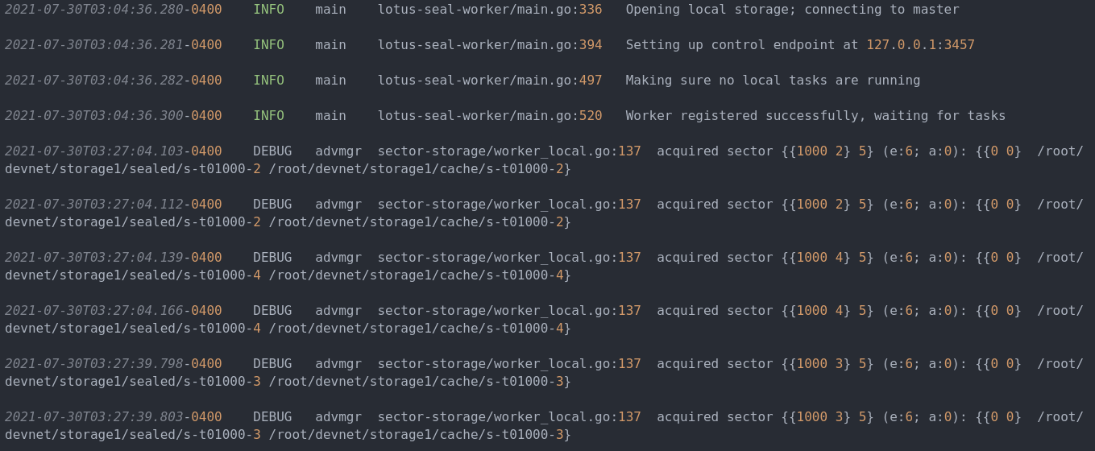
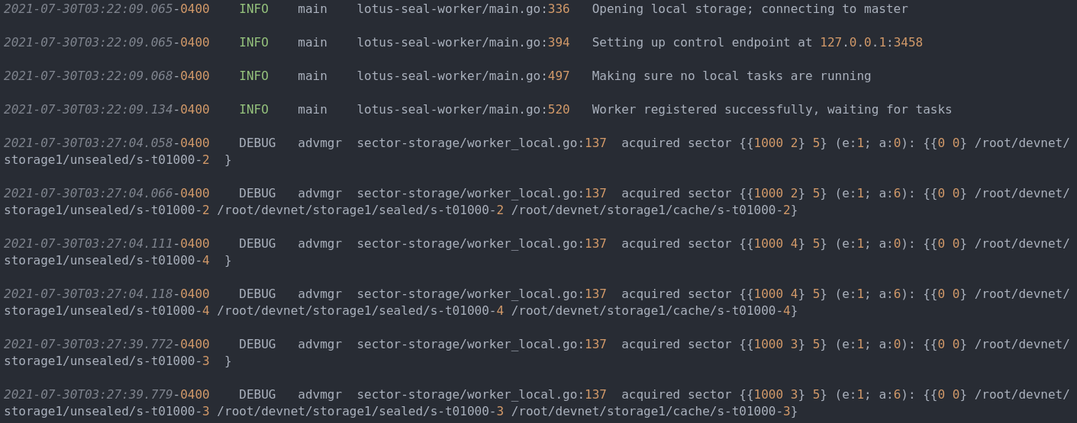
Worker 77a69335 Result
Scenario 2:
Shared
Storage
Worker 81346a03 Result

Slide 16




Implementing scenario two using RDMA
In computing, remote direct memory access (RDMA) is a direct memory access from the memory of one computer into that of another without involving either one's operating system. This permits high-throughput, low-latency networking, which is especially useful in massively parallel computer clusters.
Bandwidth
Latency
CPU
High rate Bandwidth 10 ~ 400 GbE/s
1000 Nano Second latency
Reduces CPU utilization

Slide 17









RDMA Advantages
Data transfer between servers and between server and storage without the involvement of the host CPU in the data path
Reduces memory bandwidth bottlenecks and provides high bandwidth utilization
Bandwidth 10 ~ 400 GbE/s
Optimized server utilization with high speed networking and CPU offload
RDMA provides low latency through stack bypass and copy avoidance
High availability and high reliability for compute, storage, and network
Reduces CPU utilization
Increases total SSD utilization to over 90%

Slide 18
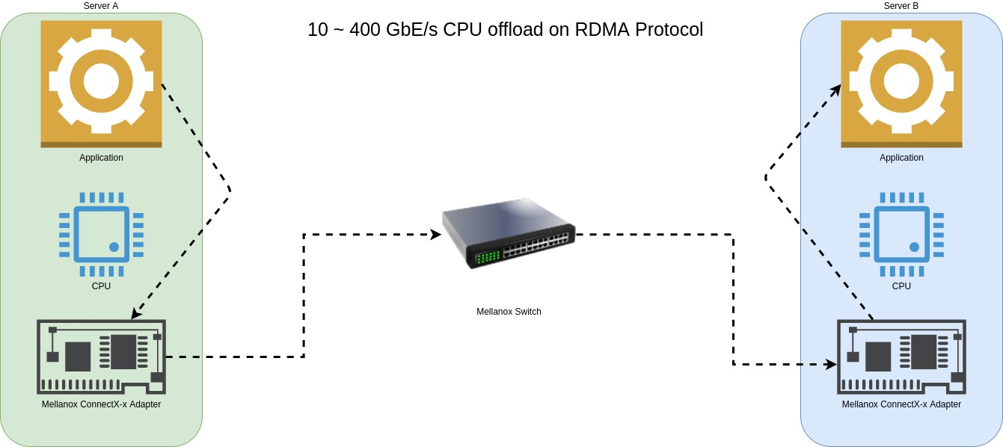
RMDA Protocol
CPU Offload
RDMA allows direct memory access from the memory of one node into that of another without involving either one’s CPU.

Slide 19
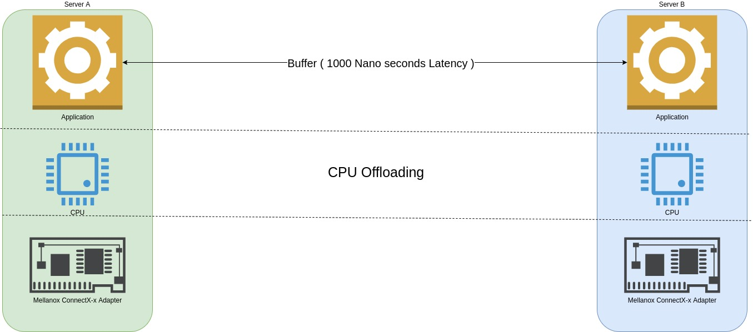
RMDA Protocol
Low Latency
Extreme low latency is achieved by a combination of hardware offloading and accelerating mechanisms. As a result, end-to-end latency of RDMA sessions can be as low as 1000 nano-seconds or 1 micro-second.

Slide 20
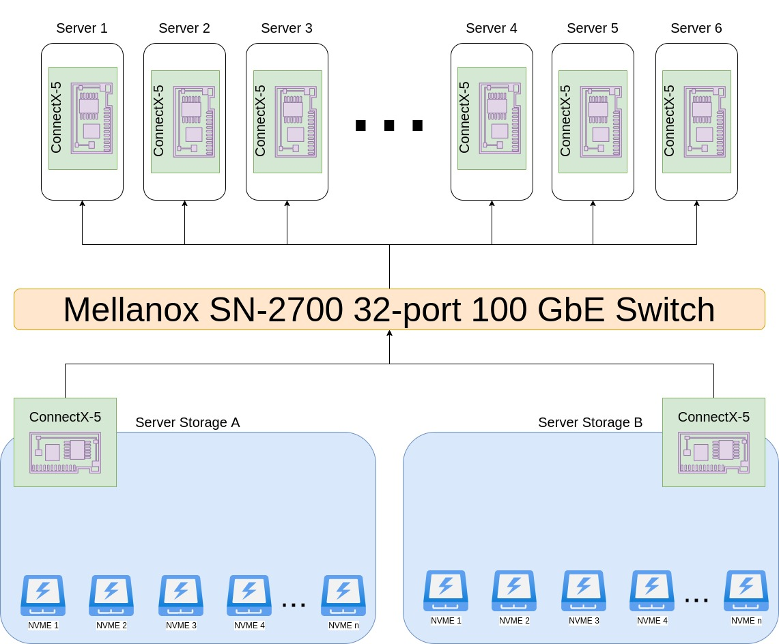
RMDA Protocol
Suggestions for hardware and software
Hardware
Switch SN-2700 32-port 100 GbE/s
NIC MCX516A-CCAT ConnectX-5
CableMCP1600-C003E26N DAC (1to1)
Software
nfs over RDMA
RDMA roce solutions
Ethernet Drivers
Firmware
RDMA over converged Ethernet (RoCE)

Slide 21

Job Tracker
Real-time tracking of your sealing jobs
Track the duration of tasks completed by workers
Job tracking logs were saved to a log file
Check the mining log for task completion duration
Reference JobTracker to lotus code easily

Slide 22
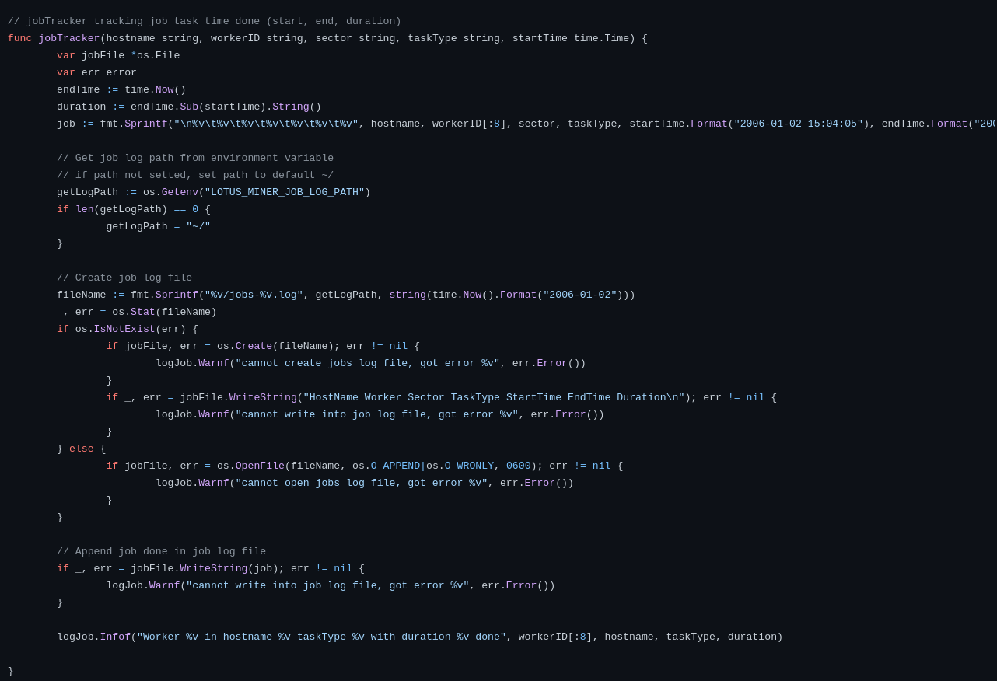
Job Tracker
code

Slide 23
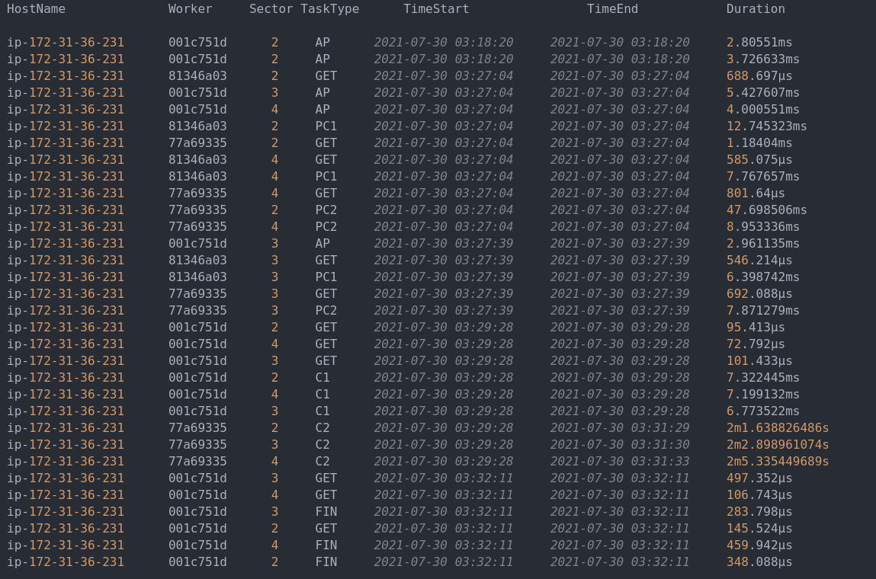
Job Tracker
Result

Slide 24
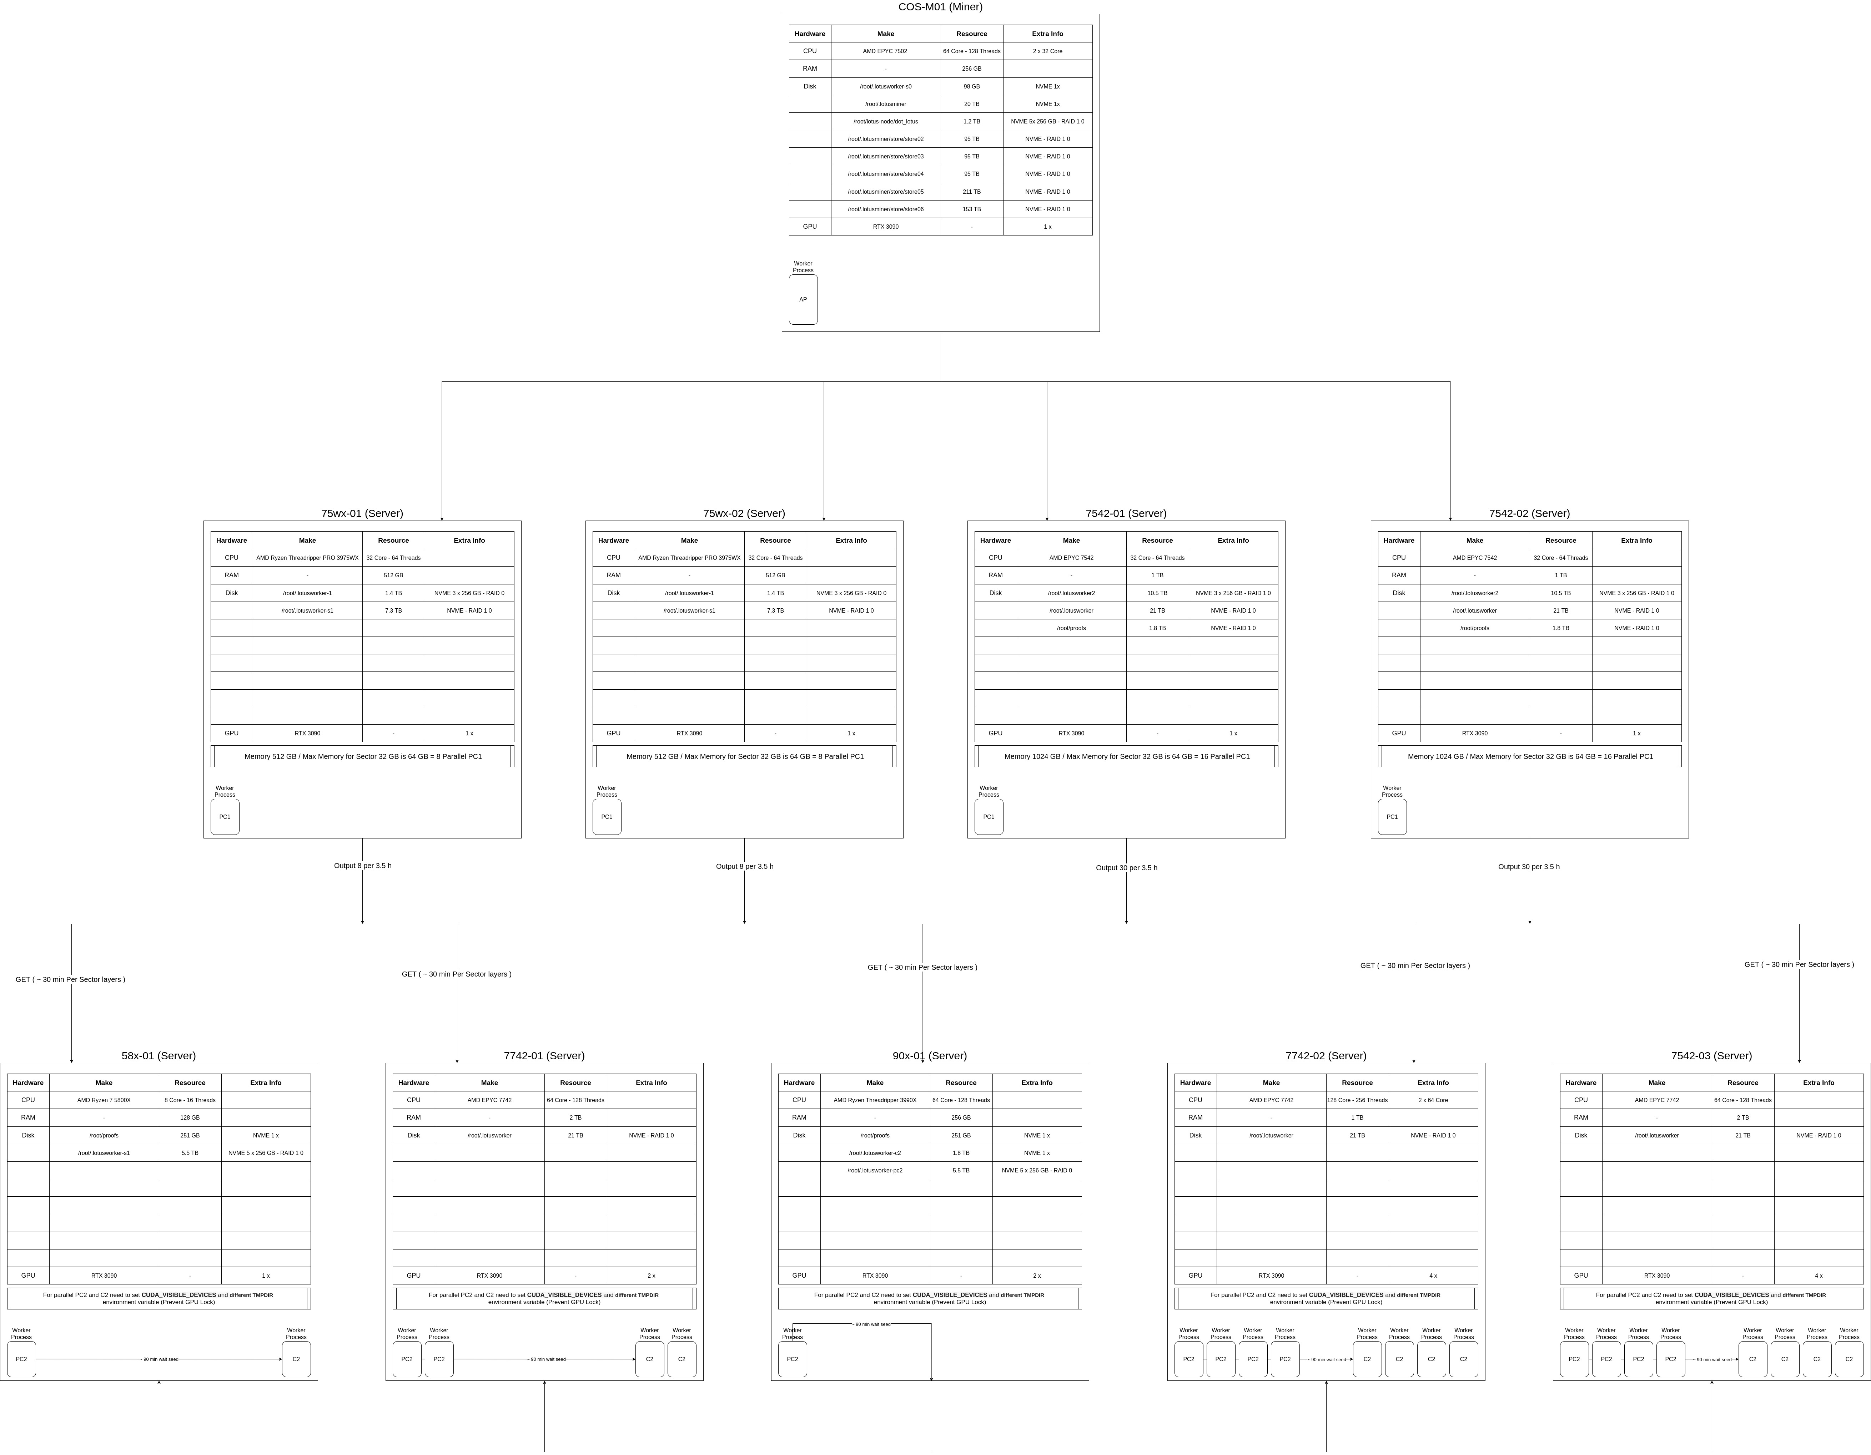
Lab servers

