Slide 1

ANALYSIS BY JOELLE RAJARISON
(TABLEAU)

Slide 2

D A T A S E T S
Two datasets were used for the analysis. One that looks at the popularity of songs by country and another by year.
The purpose of this analysis is to gain insights on the popular songs on Spotify (based on Billboard) and better understand the market. More specifically, from the perspective of a new artist thinking of entering the industry, what type of songs would be more likely to succeed and in which market?
The first dataset was obtained from https://www.kaggle.com/leonardopena/top-50-spotify-songs-by-each-country and looks at the top 50 songs on Spotify by country or region. It was extracted at Christmas (2019); it is therefore expected that the most popular songs are about Christmas. This dataset was used to analyze the similarity of the markets and the genres that are the most relevant despite the period being during Christmas.
The second dataset was obtained from https://www.kaggle.com/leonardopena/top-spotify-songs-from-20102019-by-year . It includes the top songs in the world from 2010 to 2019 and looks at the overall trend. This dataset is particularly important to recognize patterns and spot the artists that generally create popular songs instead of one single hit in their career.
ANALYSIS BY JOELLE RAJARISON
(TABLEAU)

Slide 3

F I R S T D A T A S E T

Slide 4
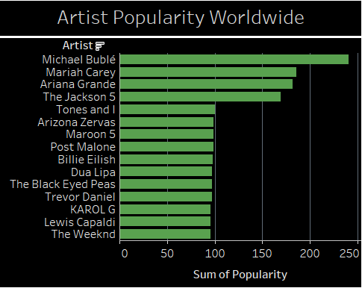
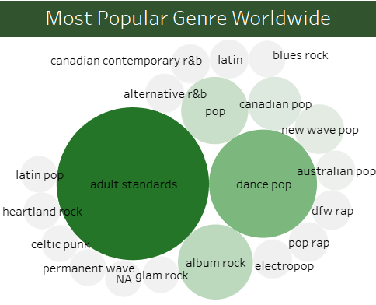
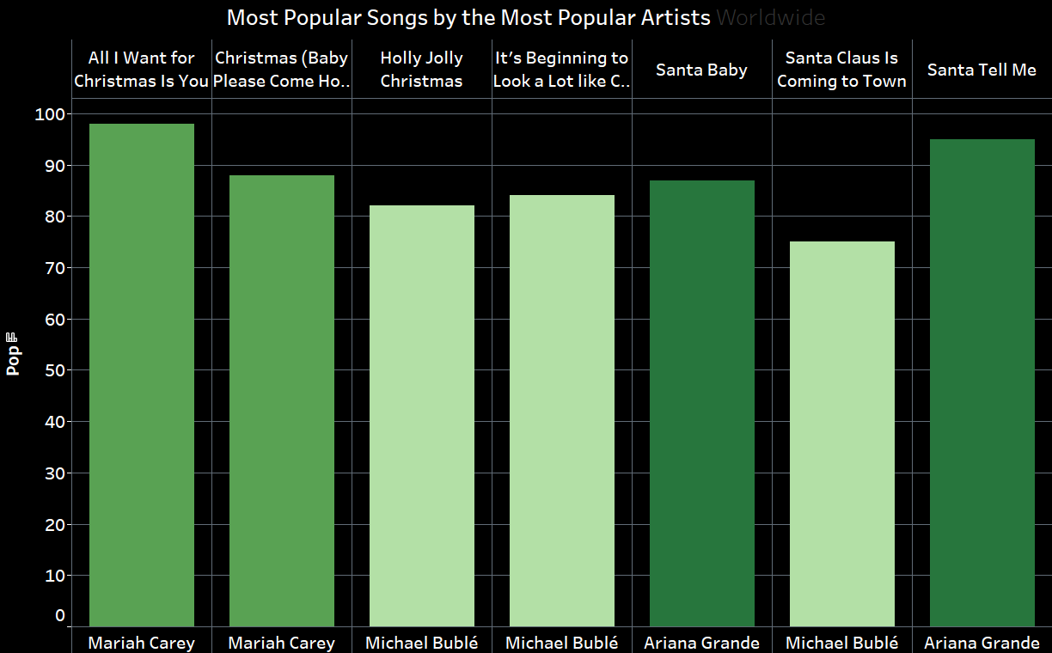
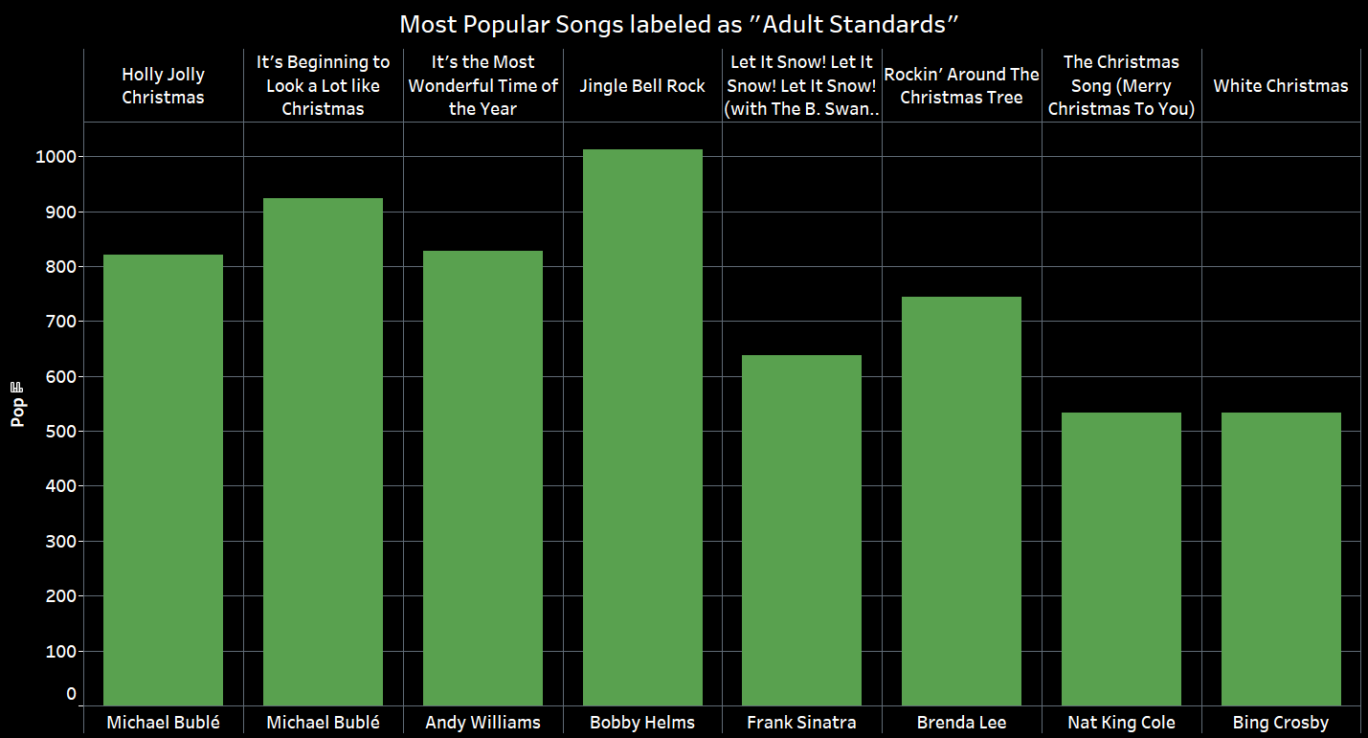
As expected, the most popular songs from the most poplar artists are related to Christmas.
Regarding the most popular genres, the one that stands out the most is “Adult Standards” and if we look at the most popular songs in the category, they are all related to Christmas.
Notes:
-Top 3 artists: Michael Buble, Mariah Carey, Ariana Grande
-Mostly American Artists
-Top genres: Adult standards, dance pop, pop, album rock
-Adult standards: def
USA:
-Most popular: Bing Crosby by far : old artist: which songs

Slide 5
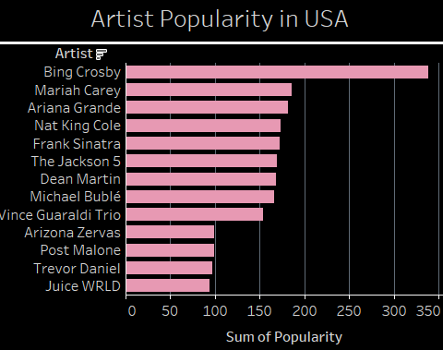
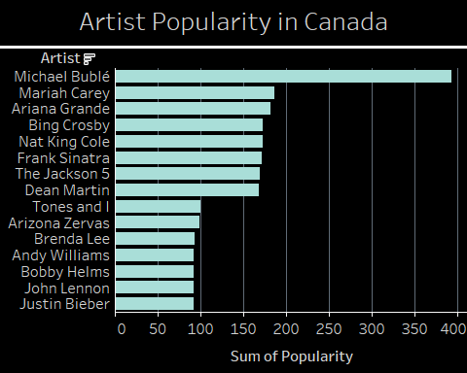
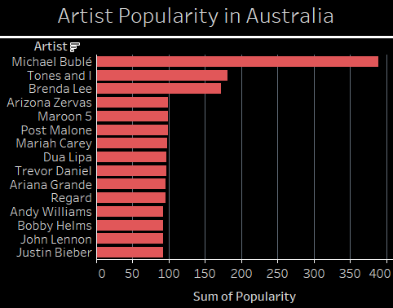
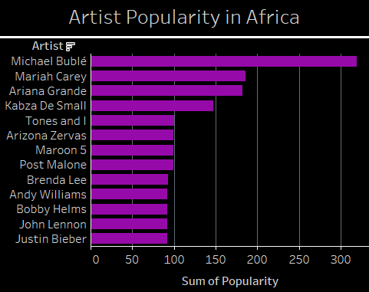
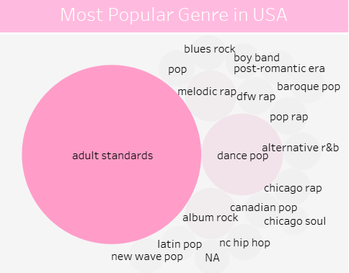
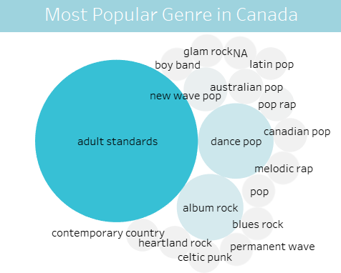
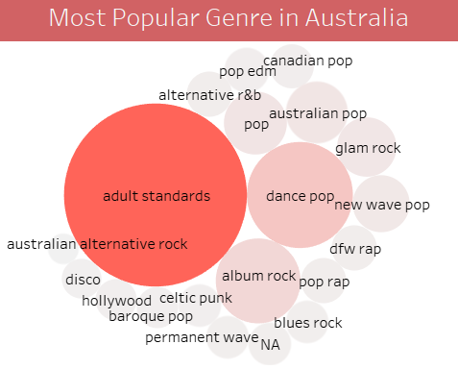
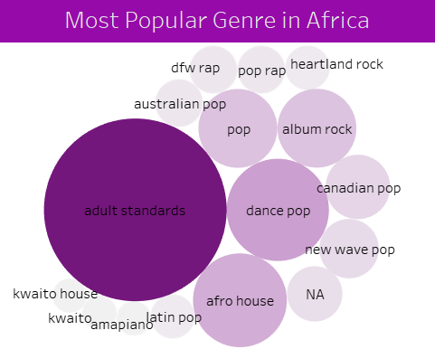
The North American, Australian and African markets are the most similar to each other as well as to the global market. “Adult Standards” and “Dance Pop” are the most popular genres.
The Canadian singer Michael Bublé holds the first place, except in the US where the American Bing Crosby is more popular. Both are, however, known for their Christmas songs.
ANALYSIS BY JOELLE RAJARISON
(TABLEAU)

Slide 6
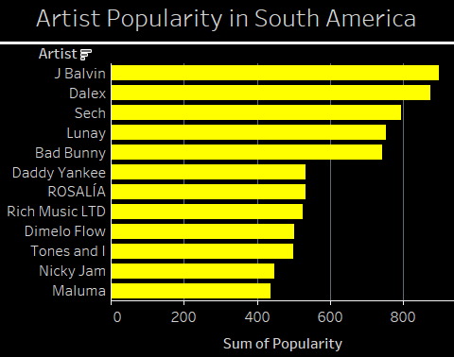
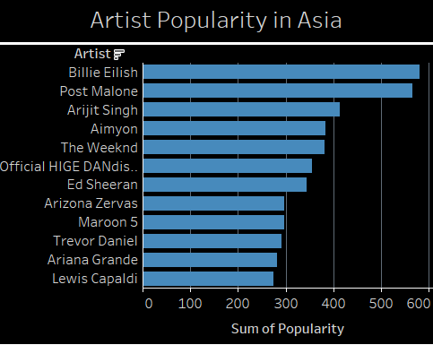
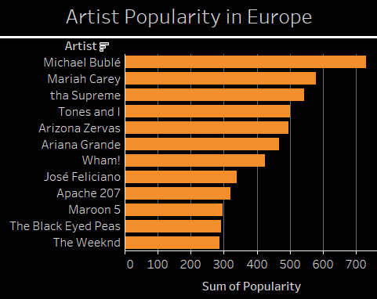
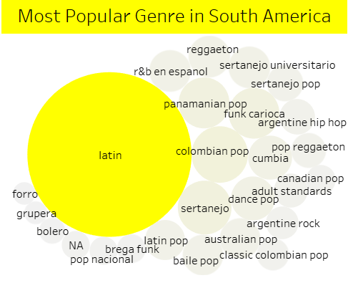
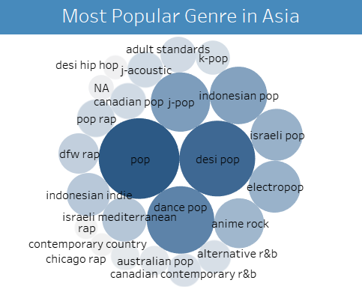
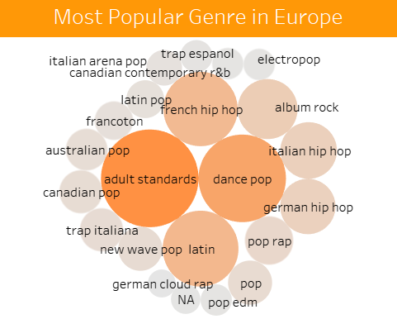

Slide 7
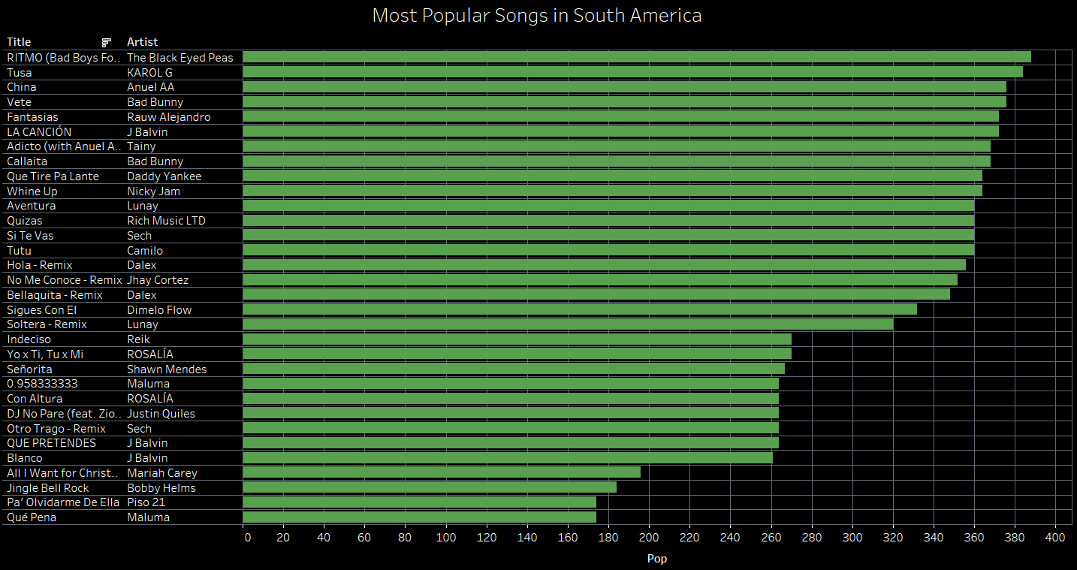
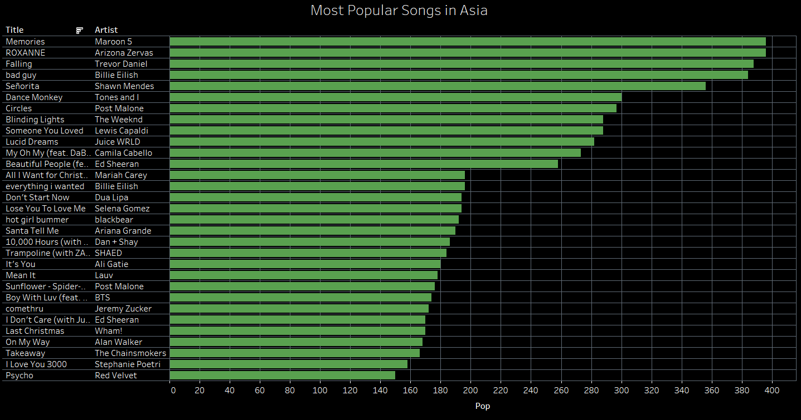
The European market is a bit similar to the global one as the Adult Standards category is the most popular one, but the degree to which it is popular is much less in Europe (previous slide).
Interestingly, in the South American and Asian markets, the genre “Adult Standards” is not popular at all. In fact, the former market is dominated by Latin songs and the latter by different types of pop songs. Looking at the most popular songs, little to none is related to Christmas (See graphs to the right).
In South America, it might be due to the strong cultural influence of the local music. To them, fiesta is most likely related to dancing bachata or salsa or any other Latin dances, regardless of the occasion (Christmas, birthday party, wedding, etc.).
In the Asian market, however, it is most likely due to the fact that a lot of them do not celebrate Christmas and so it is just a normal day for them.

Slide 8
C O N C L U S I O N – FIRST DATASET
From the perspective of a new artist thinking of entering the industry, assuming the goal is to gain international recognition as well as the biggest portion of the global market share possible, it is best to study the North American artists as they seem to be the ones with the most influence globally, at least for now. Indeed, if we look at the top artists across the world, even in Asia, most of them are American or Canadian. In terms of genres, after “Adult Standards”, “Dance Pop” seems to be the most popular; however, a lot of them are related to Christmas as well and so coming up with a conclusion regarding the genres is limited with this dataset.
Regarding the advertising, it would be best to target the North American, Australian, Asian and maybe the African and European markets, but avoid focusing too much on the niche Latino market.
ANALYSIS BY JOELLE RAJARISON
(TABLEAU)

Slide 9
S E C O N D D A T A S E T

Slide 10
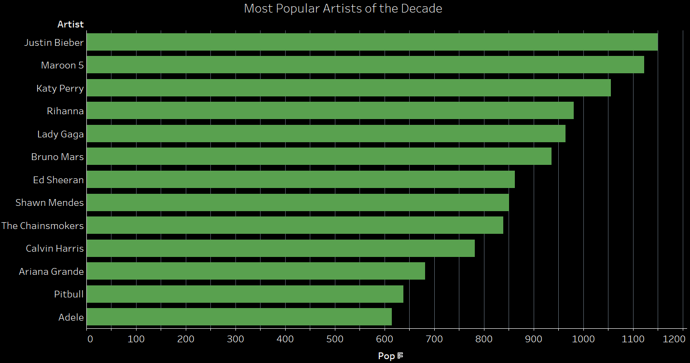
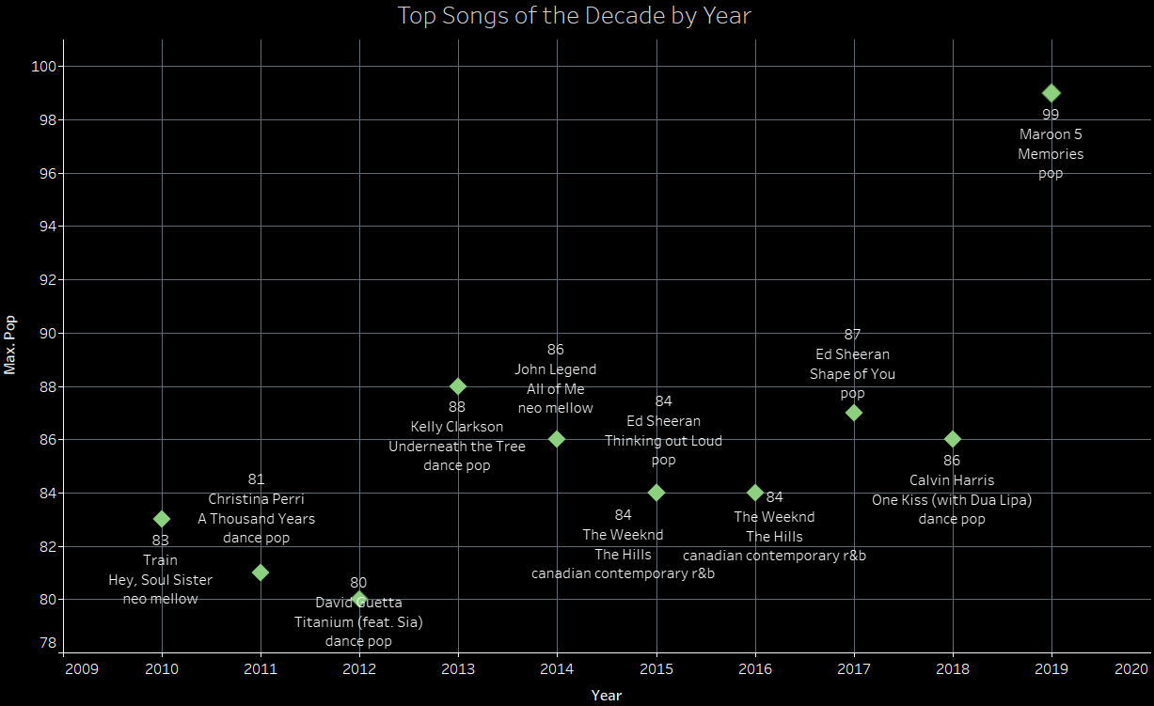
This dataset confirms that the most popular artists from 2010 to 2019 are mostly either American or Canadian.
The Canadian Justin Bieber was the most popular, closely followed by Maroon 5 and then Rihanna.
The two artists that are not from North America in the top 13 are the British Calvin Harris and Adele.
Looking at the top songs by year, the artists are often not among the top artists of the decade. Yet, some of the top artists of the decade do not have any song as the most popular of the year.

Slide 11
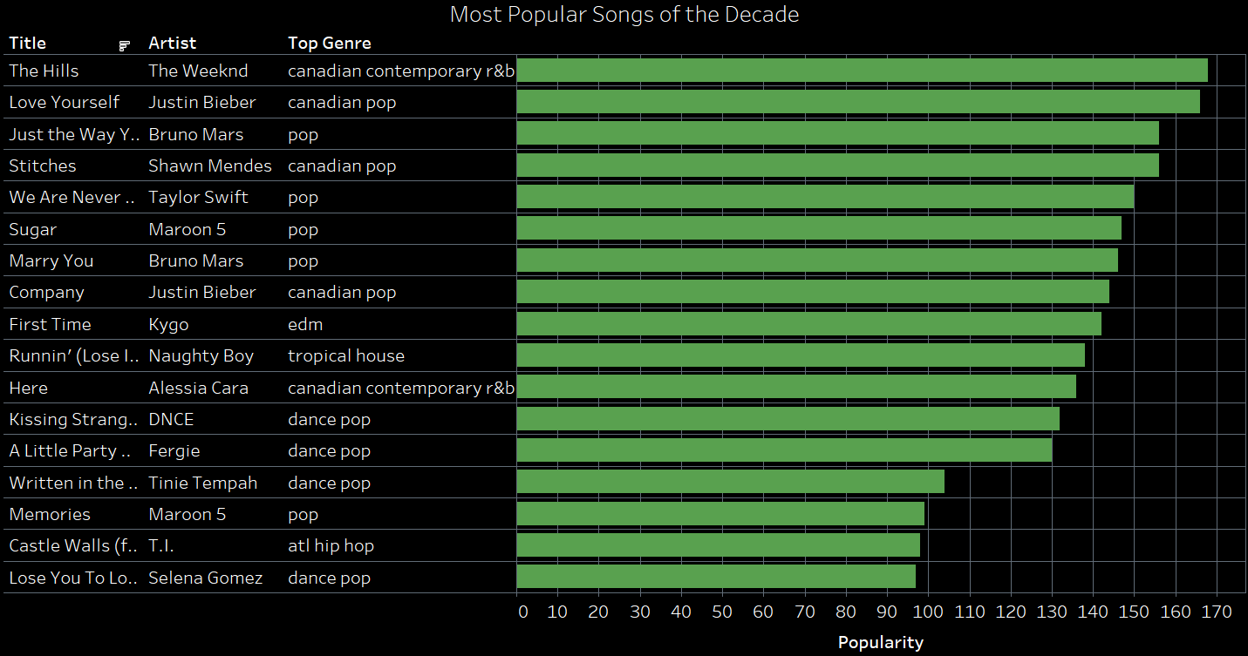
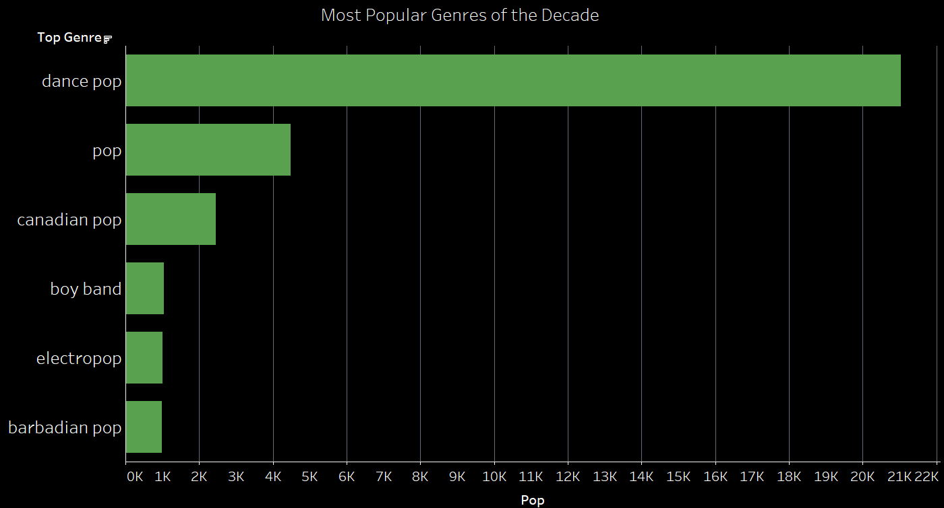
Not surprisingly, the most popular songs are mostly pop songs.
The only non-pop songs are in the “Canadian Contemporary R&B”, “EDM”, “Tropical House” and “Atl Hip Hop” categories.
The most popular genre is “Dance Pop” and beats the other genres by far. This agrees with the results of the previous dataset.
The other most popular genres are pop-related. It is thus safe to say that (good) pop type songs are the most likely to succeed in the industry.
ANALYSIS BY JOELLE RAJARISON
(TABLEAU)

Slide 12
C O N C L U S I O N – SECOND DATASET
From the perspective of a new artist thinking of entering the industry, assuming the goal is to gain international recognition as well as the biggest portion of the global market share possible, the results suggest that creating songs in the pop category would likely be more popular than in any other genre. Of course, some artists already have their own style and it would be better for them to be true to themselves but from a business point of view, there is strong evidence that catchy pop songs are more popular as they dominate the market.
An interesting observation is that the most popular artists do not necessarily have the most popular songs of the year, which suggests that they don’t focus on making really big, single hits with the rest of the songs on the album being mere filler tracks. They focus on making as many hits as possible. It is rather logical but it shows that having fillers might have more negative effects than we think.
Another point to mention is that not every artist wants to be the most popular. Some might simply want to gain enough recognition to live off their music. In that case, it might be possible for them to focus on a more niche market (specific genre or country). Further analysis would then be needed.
ANALYSIS BY JOELLE RAJARISON
(TABLEAU)

Slide 13
L I M I T A T I O N S
The limitations of the analysis include:
The dataset: It is unclear how the data was collected and from which playlist it was taken. We know the songs are Billboard top hits but it’s unknown from which Billboard playlists they were taken.
Missing information: Some countries were not included. For example, not all countries in Europe or Asia were in the first dataset, which makes it difficult to grasp the full picture.
The changes in the industry: More and more, there are different genres that are gaining fame, such as K-pop. While it remains a subgenre of pop music, it is fundamentally different from the typical American pop genre. It’s unknown whether K-pop will grow even more in popularity or not in the future.
ANALYSIS BY JOELLE RAJARISON
(TABLEAU)

Slide 14
THANK YOU FOR YOUR TIME.
JOELLE RAJARISON

