Slide 1
WifiRC-First execution wizard
Wizard storyboard
Dept: Software

Slide 2
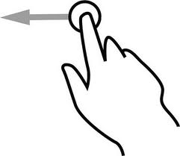
1st screen…
Head area
Swipe right. Go
To 2nd screen
Personalize head and
bottom areas with your
favorite buttons
Bottom area
Page control
Show again later
Don’t show again

Slide 3

… and 2nd screen
Head area
Swipe left. Go
to 1st screen.
Swipe Head and Bottom
Areas for adding more
buttons
Swipe right. Start
Executing WifiRC
Bottom area
Page control
Show again later
Don’t show again

