Slide 1

Cloud Computing & DevOps
Image Gallery
Group Members
3Cs-02: Jangmaw Sunday Awng
3Cs-03: Labang Myu Ring Awng
3Cs-05: Lahtaw Bawk Li
3Cs-11: Mwihpu Nan Lung
3Cs-16: Ngadawng Ja Seng Htoi
3Cs-17: Sham Sut Ring Naw
3Cs-19: Wabaw Zau Ing
3Cs-21: Zunwa Zau Ring

Slide 2
Contents
Abstract
Objective
Architecture Diagram
Data Flow Diagram
Use case Diagram & User Interface
Design Justification
Step-by-step Product Selection Documentation
Scalability Design
Implementation Roadmap

Slide 3
Abstract
G1N8CSF Gallery Pro is a photo management web application designed to allow users to easily upload, organize, and view their photos. This application is built with a modern UI/UX design and allows photos to be displayed in either a Masonry (wall-style layout) or Grid view. It utilizes ImgBB cloud services.Users can filter photos by Date, Name, or Size, and can also check information such as the total number of photos, usage duration, and total data storage size.

Slide 4
Objective
Cloud storage – To be stored in the cloud without requiring dedicated memory.
Storage saving – To save hard drive / Memory space.
Backup – Automatically backup to prevent data loss.
Recovery – To be recovery using another device, if the devices breaks.
Security – Encrypted and securely stored on a cloud server.
Collaboration – Users can see and work on the same file at the same time for better teamwork

Slide 5
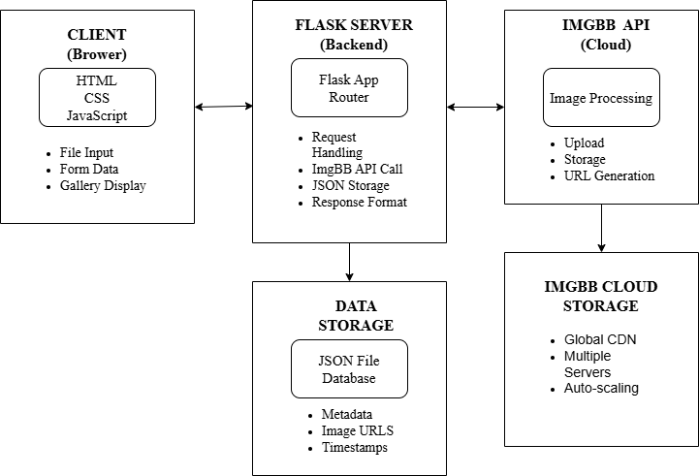
System Architecture Diagram

Slide 6
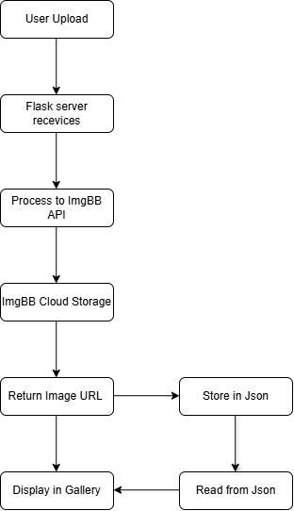
Data Flow Diagram

Slide 7
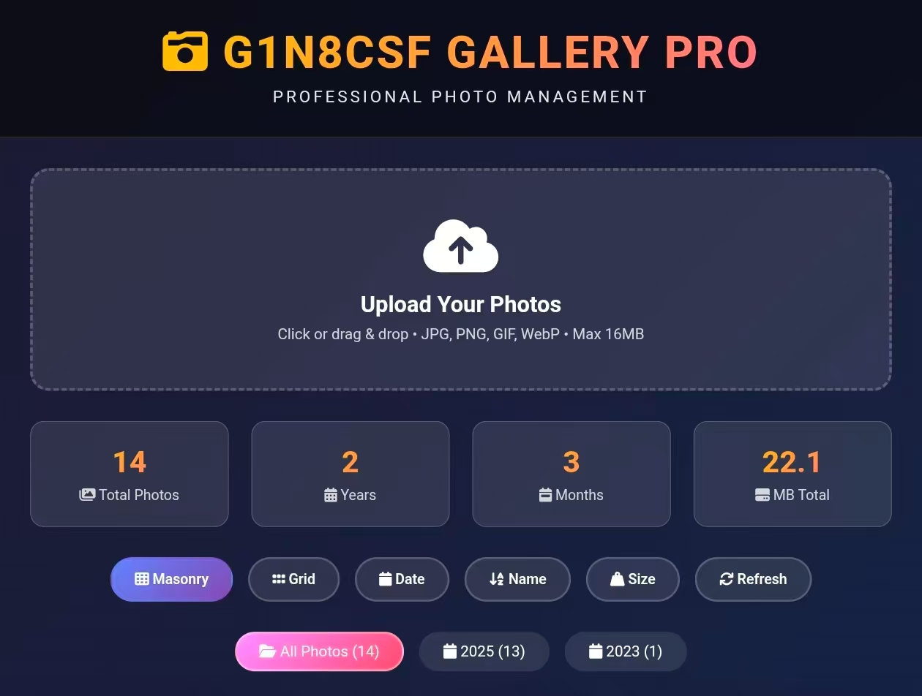
User Interface & Use case Diagram

Slide 8
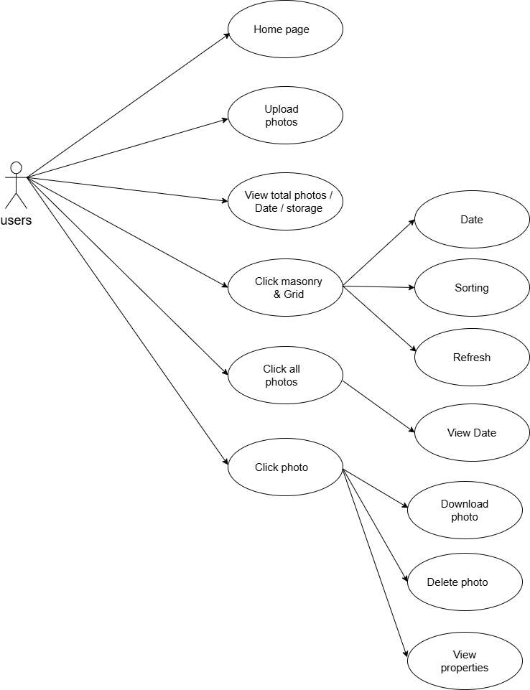

Slide 9
Design Justification
1. Why imgBB Cloud for Image Storage?
No Server Hassle
Focus on Features
Saves Time and Money
2. Why Python Flask as the Main Framework?
Simple and Lightweight
Quick Development
3. Why These Specific Python Libraries?
Requests
Pillow (PIL)
python-dotenv

Slide 10
Step-by-step Product Selection Documentation
1. Main Factors for Choosing Cloud Service
  Cost: Low cost is important for students/projects.
  Performance: Fast image loading even with high traffic.
  Security: Encryption, access control, compliance.
  Scalability: Can handle growing user traffic smoothly.
  Regional availability: Data stored near users improves speed.

Slide 11
2.Comparison of Cloud Providers
  AWS S3: Reliable, scalable, but requires credit card.
  Google Cloud Storage: Good for AI/analytics, more complex/expensive.
  Azure Blob: Integrates with MS products, higher cost.
  ImgBB: Simple, built-in CDN, free tier available-practical for small projects.
3. Decision
Chose ImgBB as the cloud service for the student image gallery project.

Slide 12
4. Reasons for Choosing ImgBB
  Cost-effective: Free plan sufficient for students.
  Simple architecture: No backend server required; store image path in DB.
  Built-in CDN: Faster image loading.
  Easy integration: REST API, direct frontend upload.
  Scalable: Can upgrade if app grows.
5. Conclusion
ImgBB = best balance of simplicity, speed, and affordability for small- scale projects. Bigger projects may use AWS, Google Cloud, or Azure.

Slide 13
Scalability Design
Enhancing Performance & Scalability
Data Security & Recovery
Ensuring High Availability & Uptime

Slide 14
Implementation Roadmap
Project over view
A simple, scalable, resilient web application for uploading and viewing images, built using modern cloud native technologies
5-Day Implementation Roadmap: Images Gallery Web App
Technology Stack:
· Backend: Python Flask
· Frontend: HTML, CSS, JavaScript, JSON
· Database/Storage: imgBB API (for image storage and metadata)
· Cloud Service: imgBB Cloud Services

Slide 15
Daily Time Allocation (Approximate):
· Day 1: 6-8 hours (Setup and foundation)
· Day 2: 6-7 hours (Core upload functionality)
· Day 3: 5-6 hours (Gallery and display)
· Day 4: 6-7 hours (Advanced features)
· Day 5: 6-8 hours (Testing and deployment)

