Slide 1

Department of Computer Science
LAN Base Chat and File Sharing System

Slide 2
Group - I
Supervisor - Sr. Maran Gam Awng
Co-Supervisor - Sr. Labya Naw Naw
Group Members
3Cs-02: Jangmaw Sunday Awng
3Cs-03: Labang Myu Ring Awng
3Cs-05: Lahtaw Bawk Li
3Cs-11: Mwihpu Nan Lung
3Cs-16: Ngadawng Ja Seng Htoi
3Cs-17: Sham Sut Ring Naw
3Cs-19: Wabaw Zau Ing
3Cs-21: Zunwa Zau Ring

Slide 3
Contents :
Introduction
Abstract
Objectives
User Interface & Use-case Diagram
Flowchart
Conclusion

Slide 4
Introduction
People, who on the same local network easily and quickly share messages and files.
The system uses a technology called socket API to provide real-time chat and file sharing.
It is built as a web application, making it perfect for teachers and students need to share lessons, messages, files, and videos easily.
It focuses on group communication, discussions, user privacy, and fast performance (low latency).

Slide 5
Abstract
This project is designed to provide chat and file sharing within a Local Area Network (LAN).
It can operate without an internet connection, ensuring independent local communication.
The system is developed using socket API, supporting both client-server and peer-to-peer communication.
It enables real-time messaging and fast file transfer with minimal delay.
A user-friendly interface is implemented to make the system easy to use.

Slide 6
Objectives
To provide fast and efficient real-time communication for users on the LAN.
To make the sharing files simple and quick.
To submit activities such as assignments.
To support one-to-one (peer-to-peer).
To have an easy-to-use and user-friendly interface.

Slide 7
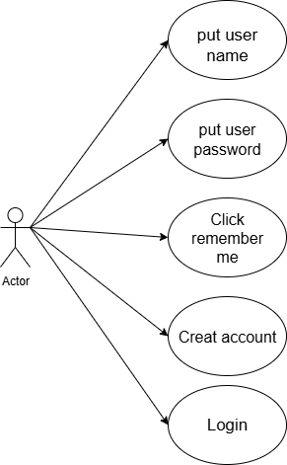
User Interface & Usecase Diagram
Speed Transfer
User name:
Enter user name
User password:
Enter user password
Login Form
Login
Remember me
Create account

Slide 8
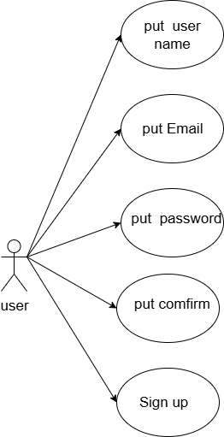
Username:
Enter user name
Email:
Enter user email
Password:
Sing up Form
Enter user new password
Password confirmation:
Enter user confirmation password
Sign Up
Have you account? login

Slide 9
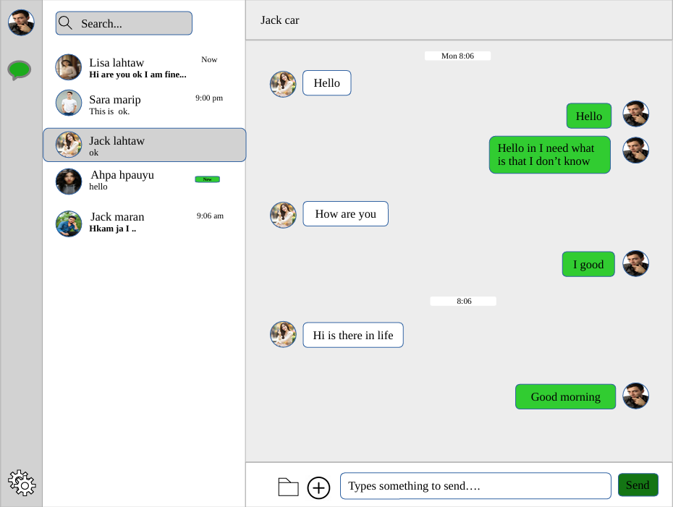
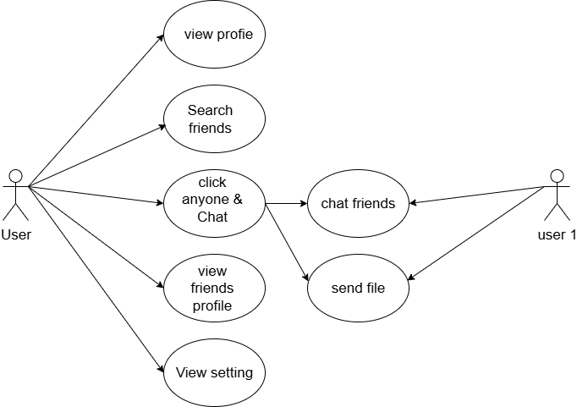
Main Screen& Chat Page

Slide 10
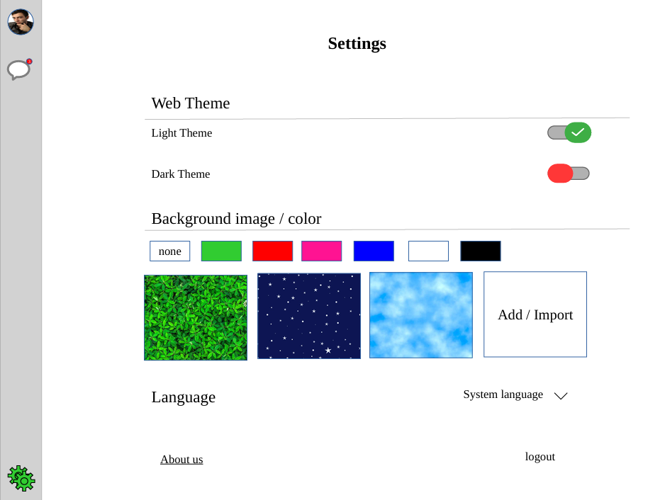
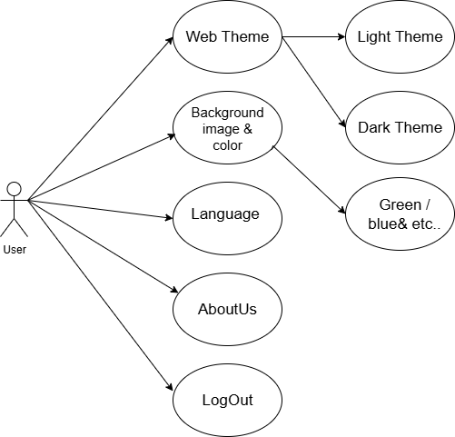
Setting

Slide 11
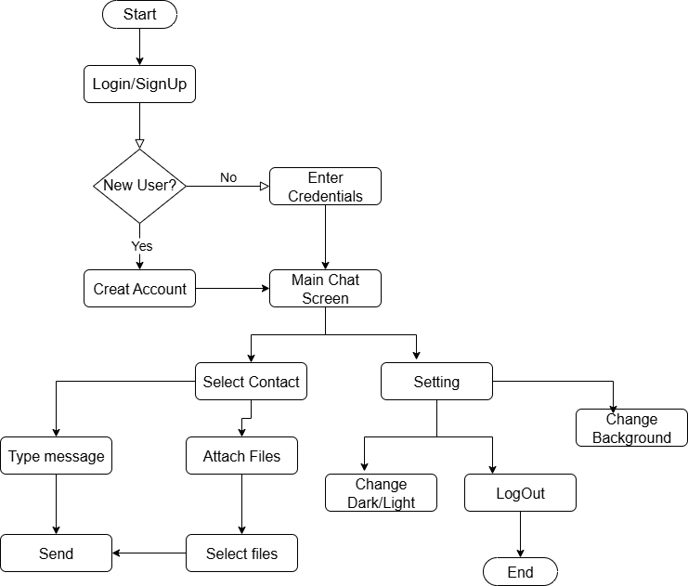
Flowchart

Slide 12
Conclusion
Building this system required the use of important computer networking principles.
The final application is easy to use and successfully allows for real-time messaging and fast file sharing.
Because it runs on a LAN without needing the internet, it offers users strong privacy.
In the future, new features could be added, like encryption for better security, video sharing, offline messaging, and support for Wi-Fi and different devices (cross-platform).
Overall, this is a very useful system and serves as an excellent tool for learning about Networking, Software Development, and System Design.

