Slide 1
Covid-19 ML Project, BIU DS18
Shlomi Jakubowicz 30 Mar 2025
MSc in Bio-Tech & CS. Currently at BTG Ferring QC Data

Slide 2
Project Motivation
COVID-19, a highly contagious respiratory disease caused by the SARS-CoV-2 virus, triggered a global pandemic in 2020, profoundly affecting health and societies worldwide.
Predicting new COVID-19 cases with machine learning (ML) can provide crucial insights for public health, enabling proactive interventions and resource optimization.
Predict “new_cases_smoothed_per_million”, New confirmed cases of COVID-19 (7-day smoothed) per 1,000,000 people.

Slide 3

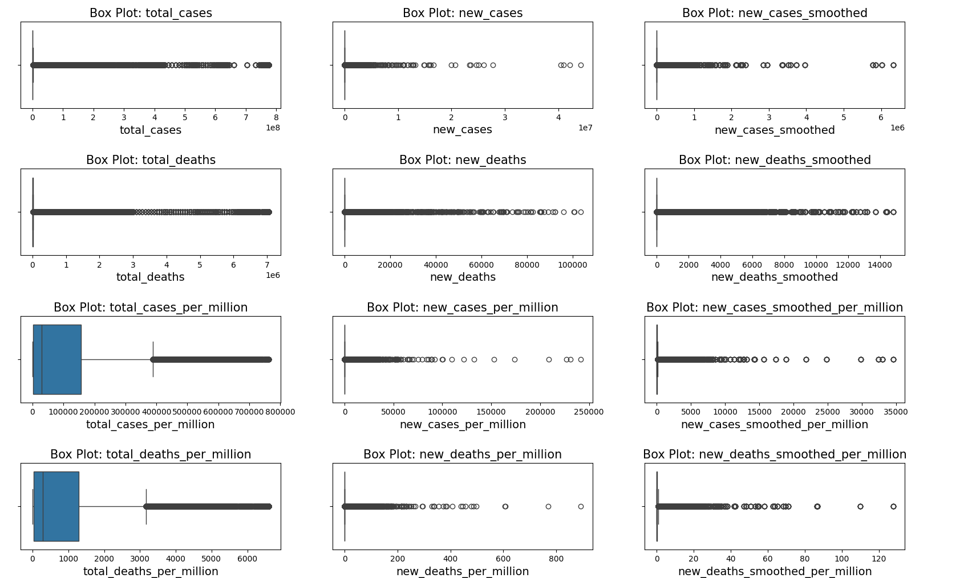
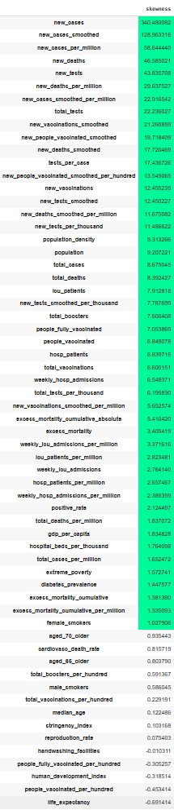
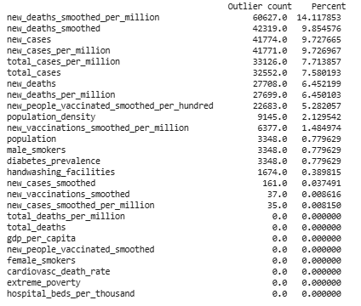
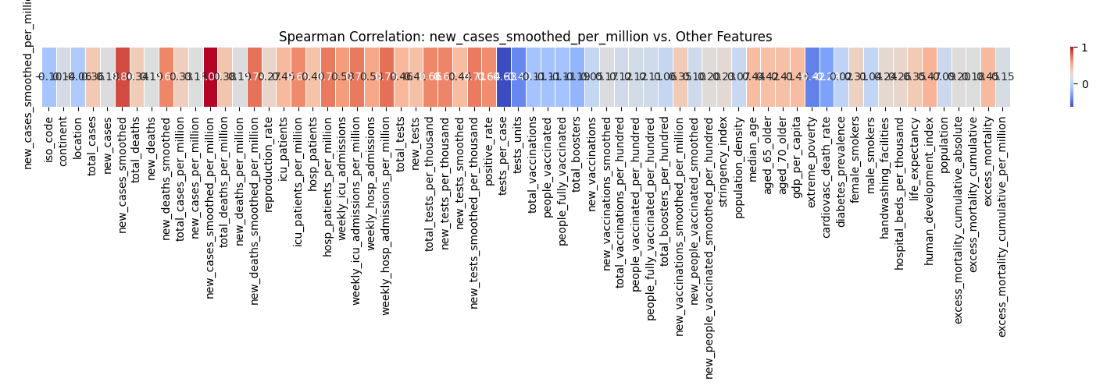
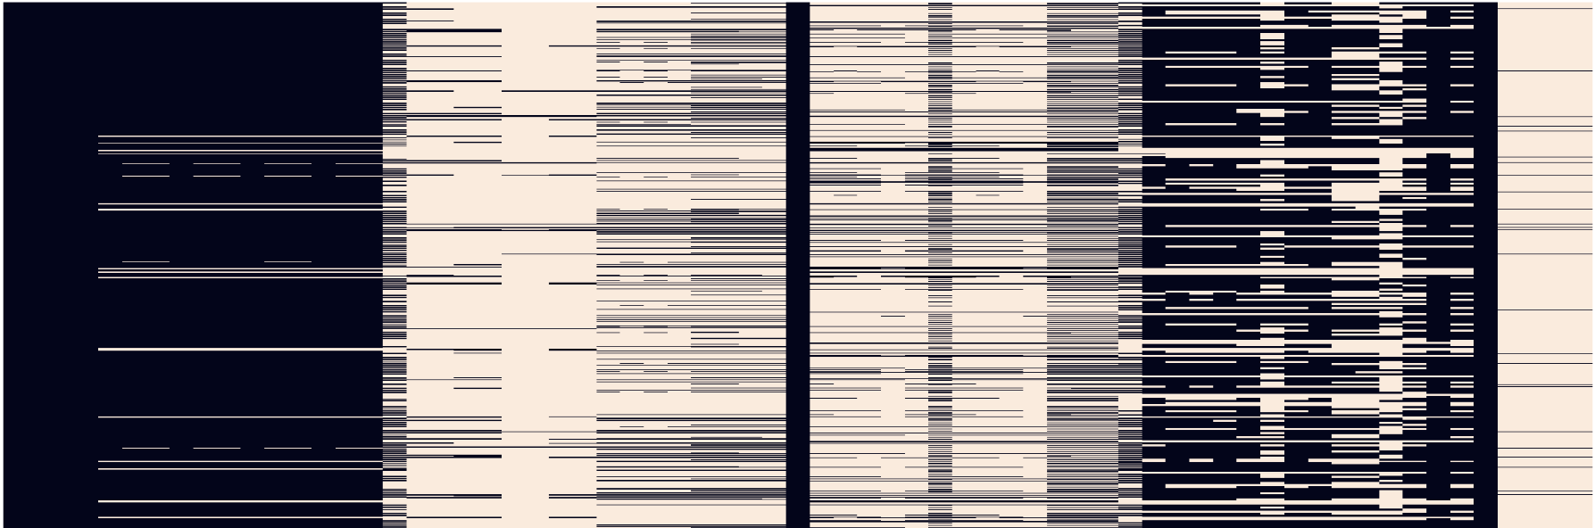
The Data Set (owid covid data ~400K)
https://docs.owid.io/projects/covid/en/latest/dataset.html
Mathieu, E., Ritchie, H., Ortiz-Ospina, E. et al. A global database of COVID-19 vaccinations. Nat Hum Behav (2021). https://doi.org/10.1038/s41562-021-01122-8
Hasell, J., Mathieu, E., Beltekian, D. et al. A cross-country database of COVID-19 testing. Sci Data 7, 345 (2020). https://doi.org/10.1038/s41597-020-00688-8

Slide 4
Project Challenges
Data leakage
Features for case include the target value.
Created a lag series for the shift in new cases last 7 days.
Data processing
400K was to much to handle.
Evntully focused on omicron outbreak Nov 2021 – April 2022
Splitting the data
Split based on country iso code as a whole. sampled different iso code for train val tets. Made sure etch contintet is present in all 3.
Cross validation
Used randomly iso code as before to better evaluate the models.
Time series…

Slide 5
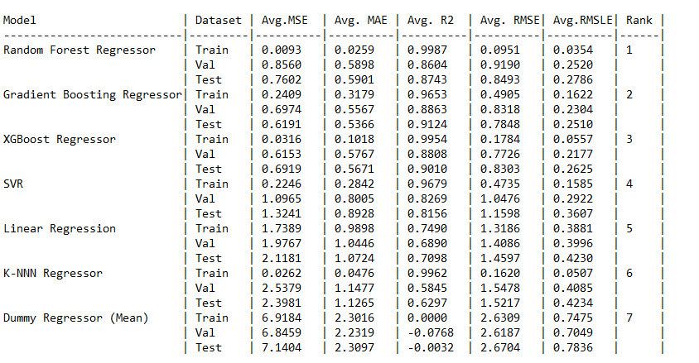
Model Results (5-Fold Cross Validation)

Slide 6
Thanks!
Any questions?
You can find me at
jshlomi@yahoo.com (yes. Yahoo!!!)
jshlomi81@gamil.com

