Slide 1
Rare Disease RAG Chatbot
A Retrieval-Augmented Generation System for Evidence-Based Answers on Rare Diseases
Shlomi Jakubowicz – June 2025 (BIU DS18)

Slide 2
Why This Project
Rare diseases affect millions, yet expert knowledge is limited and scattered across sources.
Clinicians struggle to find reliable, evidence-based answers quickly; traditional LLMs often hallucinate or lack biomedical grounding.
Goal: Build a trustworthy AI assistant for 20^{A} rare diseases using structured (ORDO, mim2gene) and unstructured (PubMed) data.
Demo:
https://rare-disease-rag-app-etaz9a8nphysbuuhxlyj85.streamlit.app/
Cystic Fibrosis (CF):"What are two significant CFTR gene mutations, their associated clinical symptoms, and novel therapeutic approaches in clinical trials for these mutations?“
Huntington's Disease:"Detail the genetic anomaly, typical progression of motor and cognitive symptoms, and two advanced gene-targeting or neuroprotective strategies for Huntington's Disease.“
Duchenne Muscular Dystrophy (DMD):"What is the primary gene affected, earliest clinical signs, and latest advancements in exon-skipping or gene replacement therapies for Duchenne Muscular Dystrophy?
^{A} Diseases list: Cystic Fibrosis, Huntington's Disease, Duchenne Muscular Dystrophy, Spinal Muscular Atrophy, Hemophilia A, Hemophilia B, Gaucher Disease, Pompe Disease, Neurofibromatosis Type 1, Prader-Willi Syndrome, Angelman Syndrome, Rett Syndrome, Fragile X Syndrome, Phenylketonuria, Alpha-1 Antitrypsin Deficiency, Marfan Syndrome, Ehlers-Danlos Syndrome (Hypermobile Type), Sickle Cell Anemia, Thalassemia Major, Crigler-Najjar Syndrome Type 1

Slide 3
Data Sources and Tools
Data
PubMed Abstracts: ~20,000 abstracts covering 20 rare diseases.
ORDO via Blazegraph: Structured rare disease data from the Orphanet Rare Disease Ontology, queried locally using SPARQL.
mim2gene.txt: Gene-disease mappings from OMIM for gene-level context.
Tools
BioBERT + FAISS: Embedding model and vector search engine for semantic retrieval.
GPT-4: Generative models for answer synthesis.
Streamlit : Frameworks for building the user interface.

Slide 4
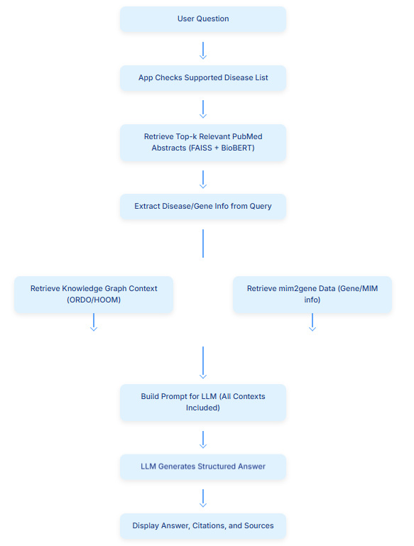

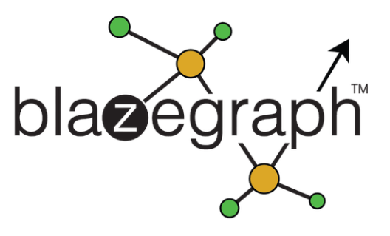



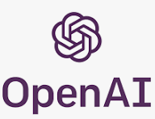

System Architecture
RAG System Pipeline for Rare Disease Q&A

Slide 5
Example Use Cases LLM vs RAG Comparison
Question: What are the common genetic mutations associated with Cystic Fibrosis, what are their clinical manifestations, and what are the latest gene-editing therapies under investigation for CF?"
Feature/Aspect | Copilot's Response (General LLM) | Your RAG System's Response | Advantage
Overall Scope | Comprehensive general overview | Direct, concise, and focused on "latest" and specifics | Both
Mutation Details | Mentions key mutations, categorizes by class | Clearly identifies CFTR, highlights F508del, mentions others | RAG
Gene-Editing Therapies | Lists types (CRISPR, Base/Prime, mRNA, Gene Replacement) | Specific mentions (CRISPR, Prime, In Utero), explicit challenges | RAG
Source/Evidence | General, numbered citations (e.g., 1, 2, 3) | Crucially, Direct PMIDs with titles | RAG
Verifiability | Less directly verifiable | Highly verifiable, allows direct lookup of sources | RAG
Factual Accuracy | Generally accurate, but potential for generality/hallucination for niche details | High accuracy, grounded in retrieved evidence | RAG
Freshness of Info | Stated "as of 2025," but less explicit verification of latest research | Reflects "latest investigations" via recent PMIDs | Both
Actionability | Provides good information for understanding | Actionable for researchers/clinicians to explore primary literature | RAG
LLM: excels at generating fluent, broad-ranging text from its vast training data, including diverse news and public information.
RAG: system's strength is providing highly accurate, verifiable, and up-to-date answers by grounding its responses in specific, evidence-based retrieved data.

Slide 6
Challenges, Summary & Next Steps
Challenges:
Dependency hell ☺ – Tackled.
Original idea was to connect online to Orpahnet endpoint and query (not done due API availability & restrictions.
Result hallucinations (e.g. PMID : 123456) – Tackled.
Achievements:
Built a RAG system for rare disease Q&A
Integrated structured (ORDO, mim2gene) and unstructured (PubMed) biomedical data
Demonstrated use cases with improved evidence-backed answers
Next Steps:
Expand coverage to more rare diseases
Enhance retrieval accuracy and relevance
Pursue additional data (e.g., clinical trials data, drugs DB)
Improve retrieval accuracy
Clinical validation and deployment

Slide 7
Thank you!
I appreciate your time.

